Slide 1
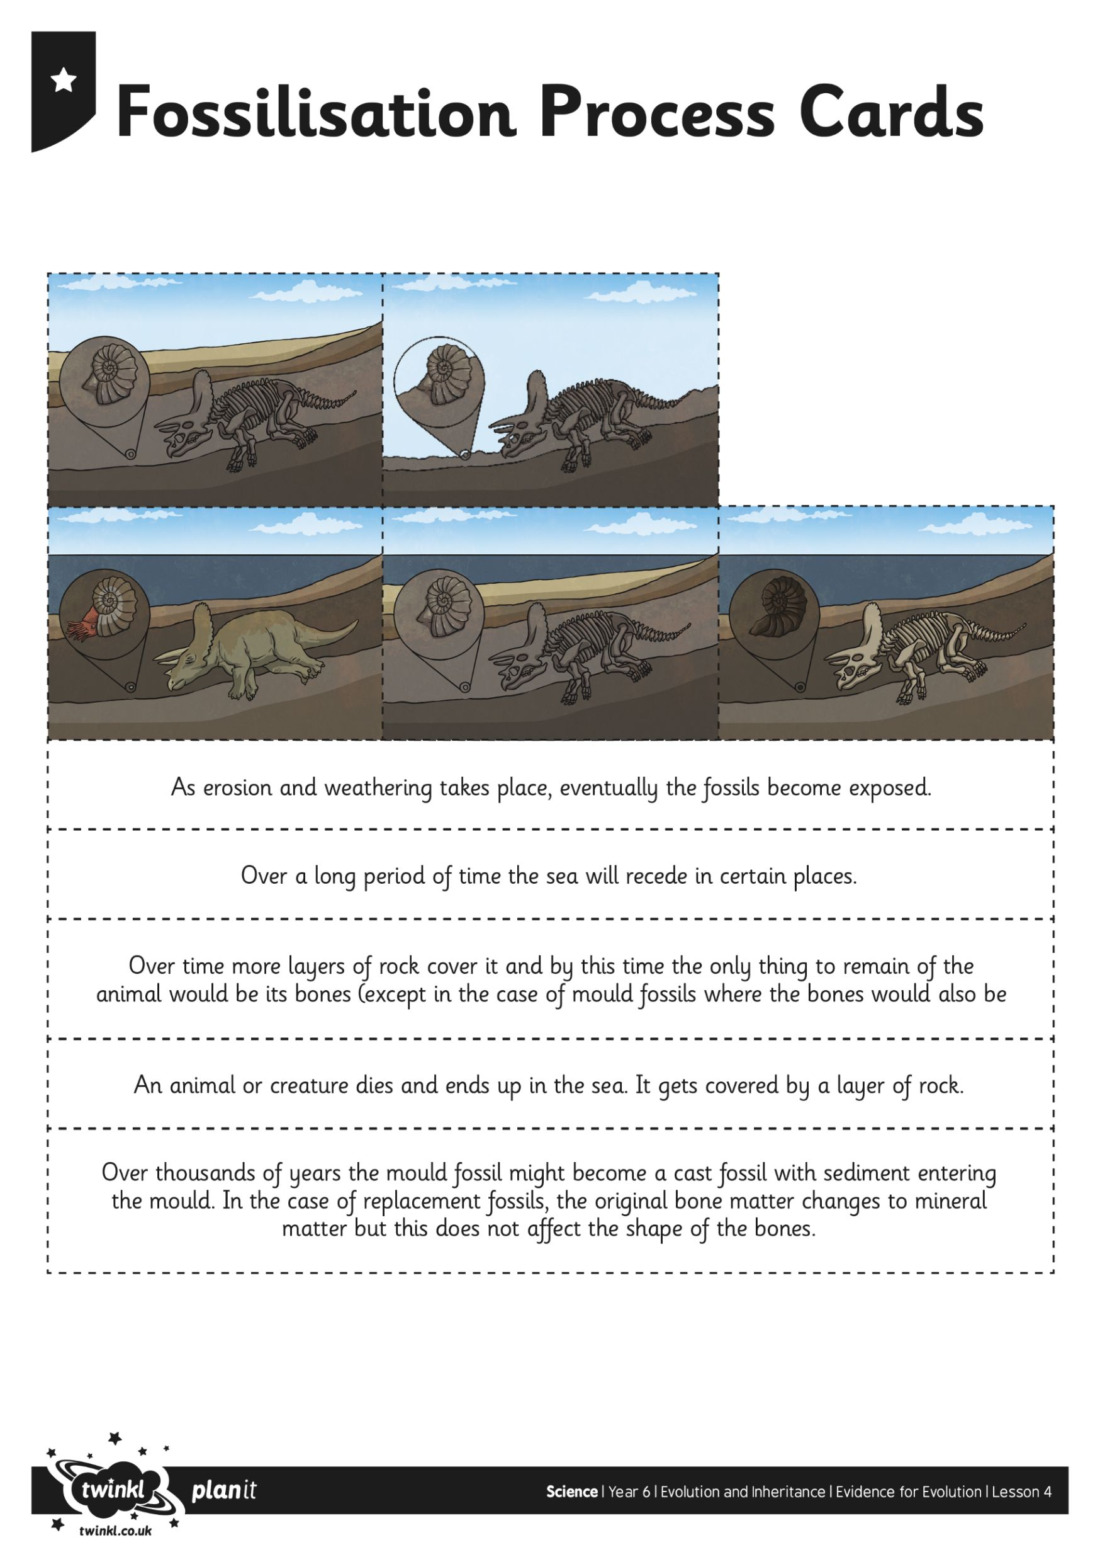
Can you remember the fossilisation process?
Do you remember what a fossil is? TTYP!
https://www.stem.org.uk/resources/elibrary/resource/36611/fossils
Watch me!
Up to 4.32

Slide 2
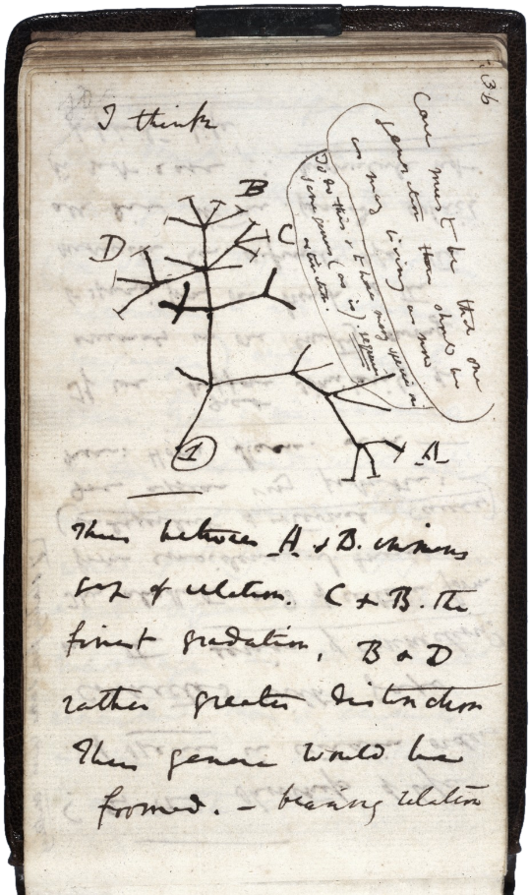
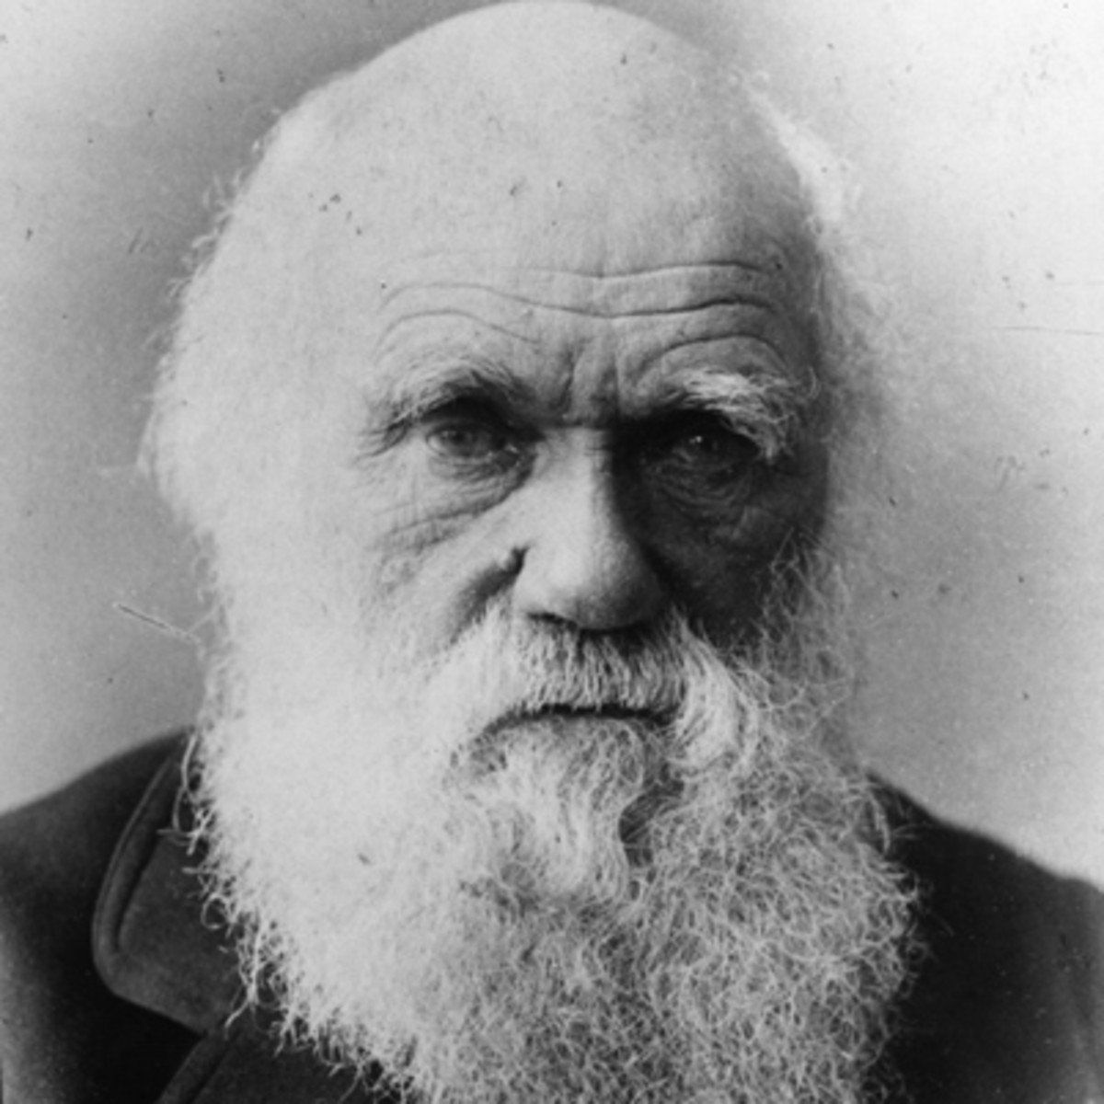
Darwin believed that there was a single point of origin for all living things and that we then evolved into the living things that we are today through a process of adaptation.
This was the original diagram by Darwin that shows how all living things were related – his ‘Tree of Life’.

Slide 3
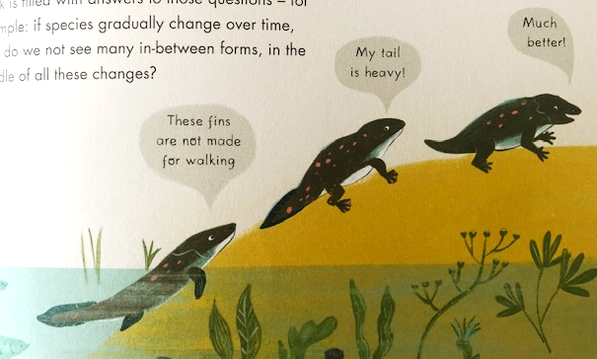

Darwin used fossils as evidence for his theory to show changes in different species, but fossils are evidence of extinct species (e.g. woolly mammoths, dinosaurs, dodo birds).
There weren’t many fossils to show species AS they were evolving (the in-between stages).

Slide 4
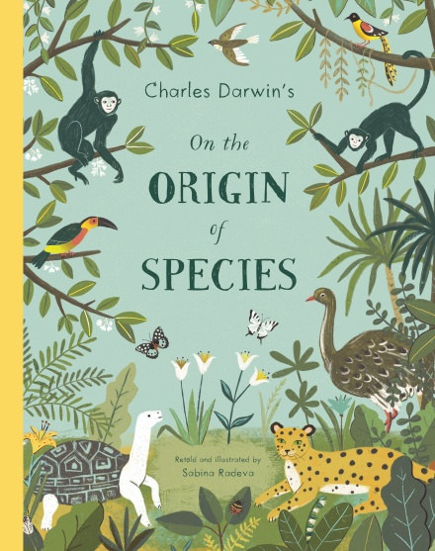
Darwin explained that this was because NATURAL SELECTION makes living things better adapted to where they live. Once animals with more USEFUL traits appear, they will compete and replace those that are less adapted.
There weren’t many fossils that showed this because perfect conditions are needed for fossils to form, and those conditions are really rare.
Let’s look at the diagram from ‘On the Origin of Species’…
(Imperfections of the Geological Record and Organs of Extreme Perfection pages.)

Slide 5
What factors do you think cause living things to need to adapt and evolve over time? TTYP!
- Temperature: e.g. fur for cold habitats
- Body shape: longer legs to escape predators
longer necks to reach food
- Habitat: move from land to sea or sea to land
- Protection: need to camouflage, run away
- Food sources

Slide 6
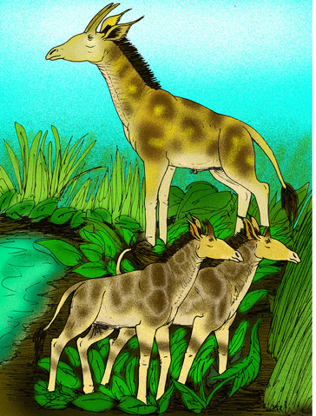
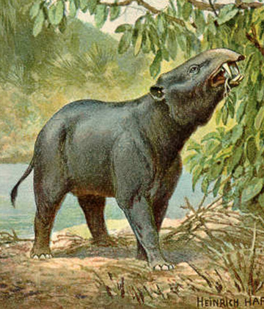
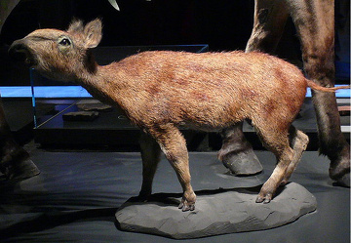
We’re going to show how certain species have evolved over time.
Which animals do you think these early creatures evolved into?

Slide 7
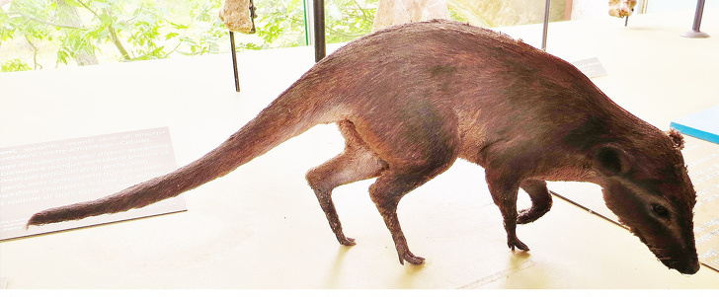
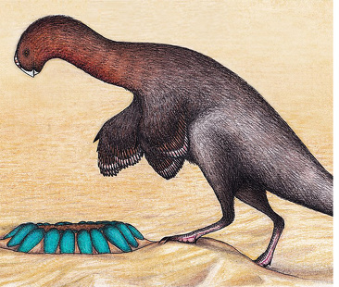
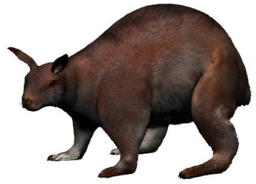
Which animals do you think these early creatures evolved into?

