Slide 1
Lesson 1
L.O.: to understand beliefs and teachings.
C.: prior learning recap and the Big Story.
Eq: WAS JESUS REALLY THE MESSIAH?

Slide 2
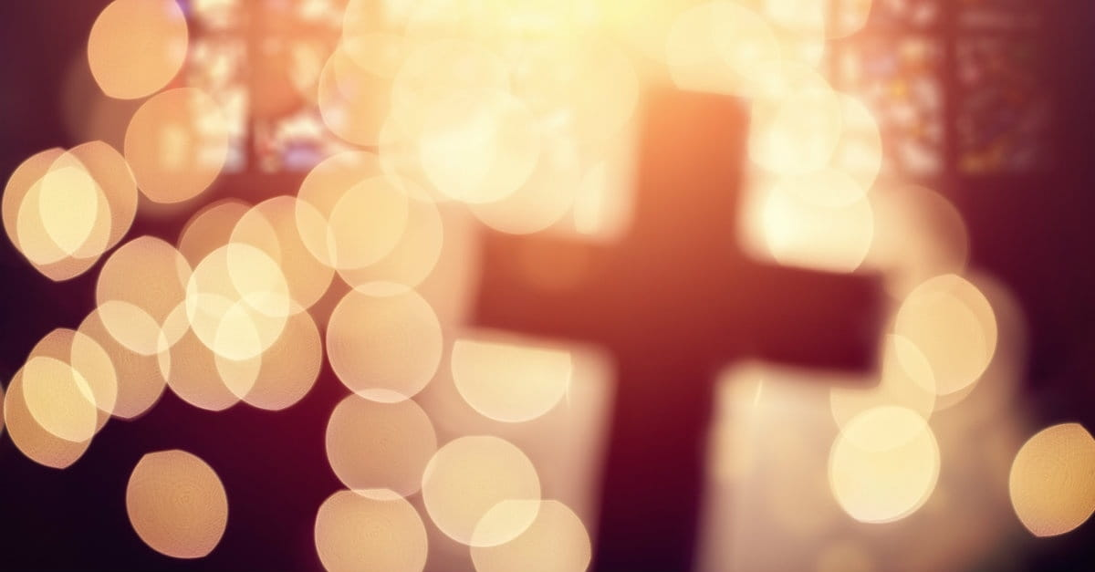
Prior Learning: Today is NOT a test…
We want you to show us all you know so we can plan how to
teach you our next topic on Christianity.

Slide 3



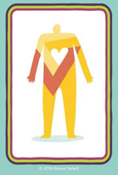
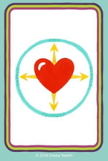

The Big Story of the Bible
Can you make links and suggest what any of these symbols represent?

Slide 4



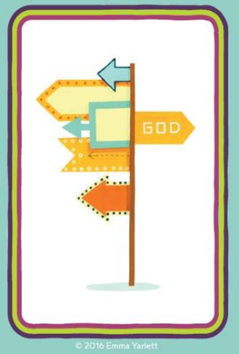





The Big Story of the Bible
God
Creation
The Fall
People of God
Incarnation
Gospel
Salvation
Kingdom of God
God was here before anything else.
God made the world including people.
God gave people choice and they let him down. They ‘fell’ from grace.
People trying to re-gain God’s trust through many ups and downs e.g. Noah. This is the Old Testament.
Jesus is born. He is God in human form. Some people believe that he is the Messiah.
The New Testament. Jesus spreading positive messages and performing his miracles. Gospel means ‘good news’.
Jesus’ death and resurrection was to fully save us from our sins.
God’s ‘Kingdom’ having begun in human hearts through Jesus. God sends the Holy Spirit to empower people to bring the ‘good news’ and be the best person you can possibly.

Slide 5

Your task: The Big Story of the Bible

Slide 6
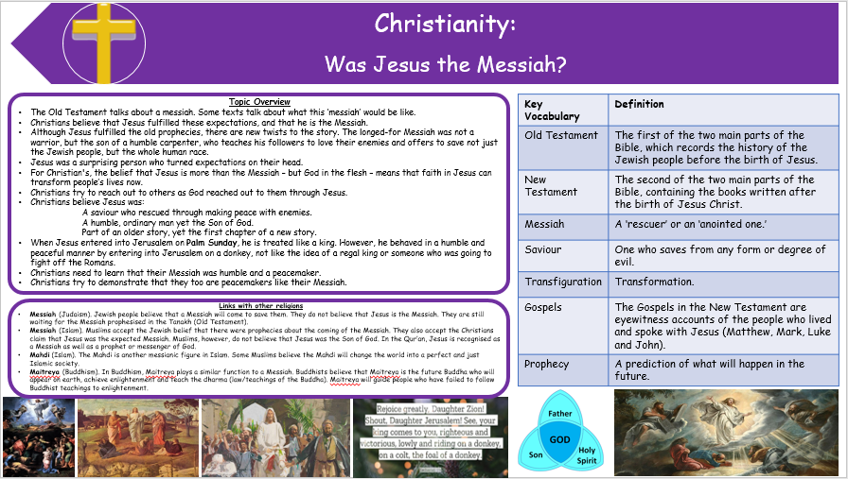
Stick your Knowledge organiser into your book

