Slide 1
olympics
Monday

Slide 2
What are the Olympics?
Today, you’re going to research the Olympics. You could find out about:
Where and when they started
Why they started
The events that took place in the ancient Olympics
The events that take place in modern day Olympics
Any Olympic games that are remembered for specific reasons
Any famous athletes

Slide 3
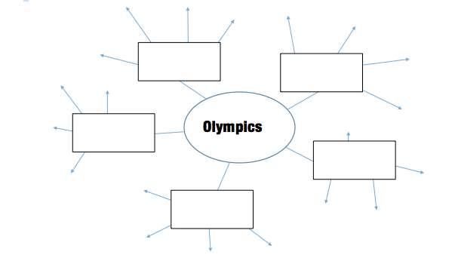
You can use this template to help record your research

Slide 4
olympics
Tuesday

Slide 5
Choose what type of writing you want to do
You could:
Write a non-chronological report explaining the Olympic games
Write a biography of an athlete
Write a newspaper report detailing a day at the Olympic games

Slide 6
How to choose the type of text
Go through previous weeks and look at the PowerPoints to remind yourself of the different text types and the features of each type.

Slide 7

Newspaper report
There is a PowerPoint to help you write a newspaper report, if you choose this text type.

Slide 8
olympics
Wednesday

Slide 9
Plan your writing
You can use this planning template again to record your research into paragraphs for your specific text type.
Or you can use today to plan
sentences and vocabulary you’d like
to use.

Slide 10
olympics
Thursday - Write!

Slide 11
olympics
Friday - edit your writing

