Slide 1
The tempest
By William Shakespeare
Monday- get to know the text

Slide 2
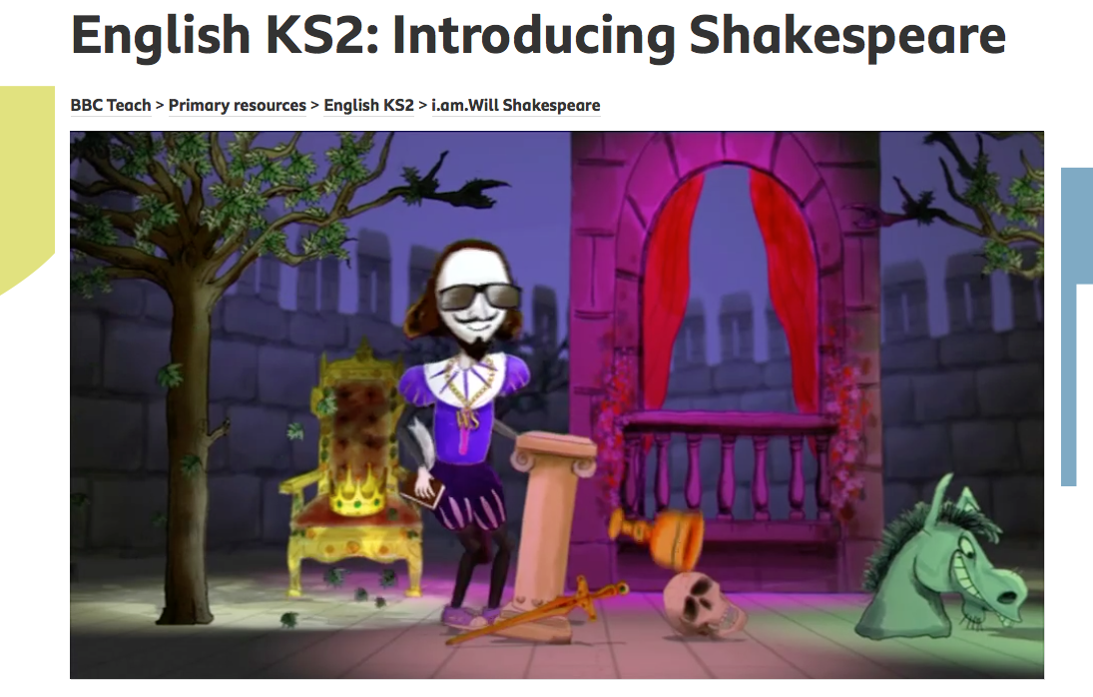
William Shakespeare
https://www.bbc.co.uk/teach/class-clips-video/english-ks2-introducing-shakespeare/zfr3cqt

Slide 3
Famous plays by Shakespeare
Romeo and Juliet
Macbeth
The Merchant of Venice
A Midsummer Night’s Dream
Twelfth Night
Hamlet
The Taming of the Shrew
As You like it
Much Ado About Nothing
The Tempest
Othello
The Winter’s Tale
Richard III
Julius Caesar
King Lear
Henry V
Antony and Cleopatra
Love’s Labour’s Lost
All’s Well That Ends Well
The Comedy of Errors

Slide 4
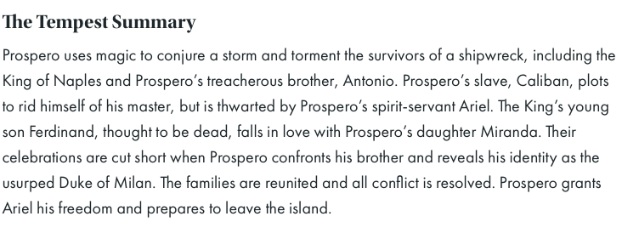
The tempest
Shakespeare’s comedy about a major act of betrayal, ill treatment, the development of magic arts and a plot of revenge.

Slide 5
The tempest
Go to the BBC Website and watch the videos of each part of The Tempest.
Across the 8 videos, the whole story is told.
You can explore the BBC website about The Tempest and look at all the videos, songs and resources to familiarise yourself with the story.
You can also read the summary of the story on the class page.

Slide 6
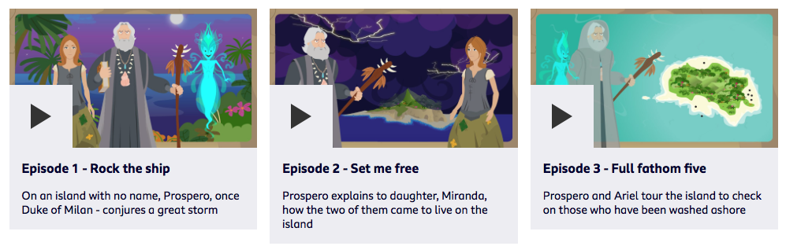
The tempest- bbc resources
https://www.bbc.co.uk/teach/class-clips-video/english-ks2-the-tempest-home/zfskxyc

Slide 7
Your task
Watch the videos and read the summaries of the story. Get to know the story.
Look at the pictures on the document called “Monday’s task”, which consists of pictures of different parts of the story.
Write numbers under the pictures to show the order they events happened in the story.

Slide 8
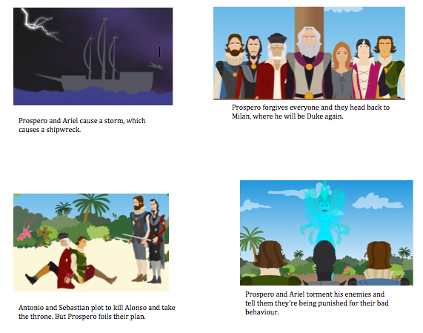
task
Order the events of the story.

Slide 9
The tempest
By William Shakespeare
Tuesday- retell the story

Slide 10
Your task
Look at yesterday’s task, watch the videos again, read the summaries again.
Write a short story version of “The Tempest”.
Write at least ¾ of a page to summarise the events of the story. You can write it in bullet points, but include as much detail as you can remember.
You can use yesterday’s sequencing events to guide what you write.
You can retell the story to an adult or sibling at home.

Slide 11
The tempest
By William Shakespeare
Wednesday- get to know the characters

Slide 12
The characters in the tempest
Fill in the sheet to describe each of the characters.
Choose adjectives to describe each character.
Write a sentence to explain each character’s situation, e.g. Miranda is Prospero’s daughter. She doesn’t remember her life before coming to the island. She meets and falls in love with Ferdinand.

Slide 13
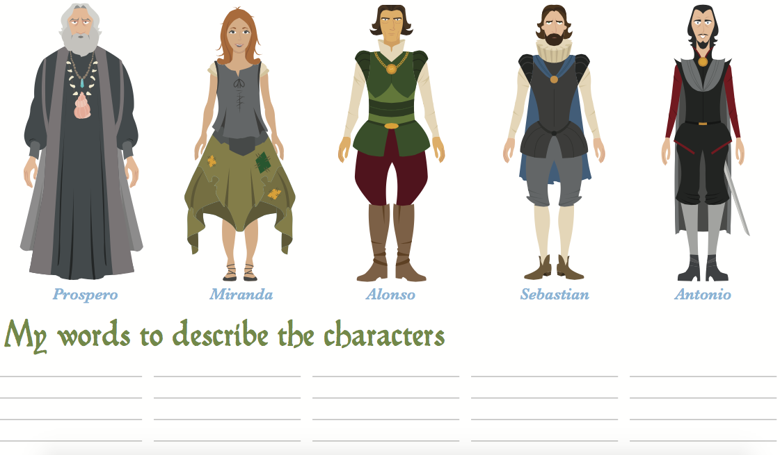
Task- complete the sheet
Write a sentence to explain each character.

Slide 14
The tempest
By William Shakespeare
Thursday- choose a scene to rewrite

Slide 15
Your task for the rest of the week
Today, you will choose a scene from the play to write as a play script.
Your scene should follow what happens in The Tempest video on the BBC website.
You will need to make up some of the dialogue between the characters, but you can also borrow what the characters say in the video.
Don’t forget to include stage directions to describe how characters say their lines and how they should move or act.
Once you’ve chosen a scene, think about the characters in the scene, their personalities and how they might be feeling. This will help you plan what they say/do.

Slide 16
today
Re-watch the videos or the scene you want to re-write.
Note down where your scene is set (which part of the island? E.g. the cave, the beach, the jungle etc.)
Note down which characters are in your scene.
Note down the main things that happen in your scene (E.g. Is there an argument, are the characters plotting something…)

Slide 17
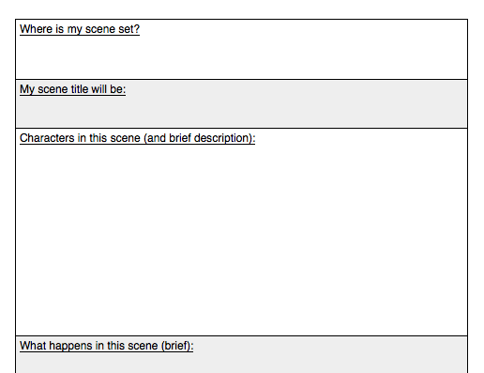
task

Slide 18
The tempest
By William Shakespeare
Friday- plan and write your scene

Slide 19
Planning and starting to write
Finish planning your scene using the template.
Remember to plan the stage directions.
You can start to write your scene when you are ready.
Don’t forget to include the title “The Tempest”
You can use the scene number from the BBC video, e.g. if you choose the fifth video, you could call it Scene 5.

Slide 20
Don’t forget
To write the character’s name followed by a colon and then the dialogue.
Stage directions in brackets.
Look back at last week’s PowerPoint to remind yourselves of the features to include.
You can finish writing your play script and edit it next Monday.

