Slide 1
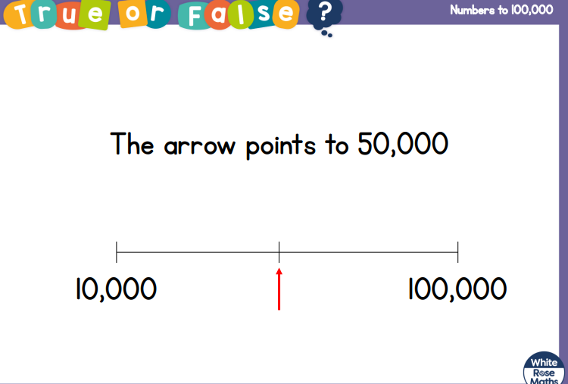

Slide 2
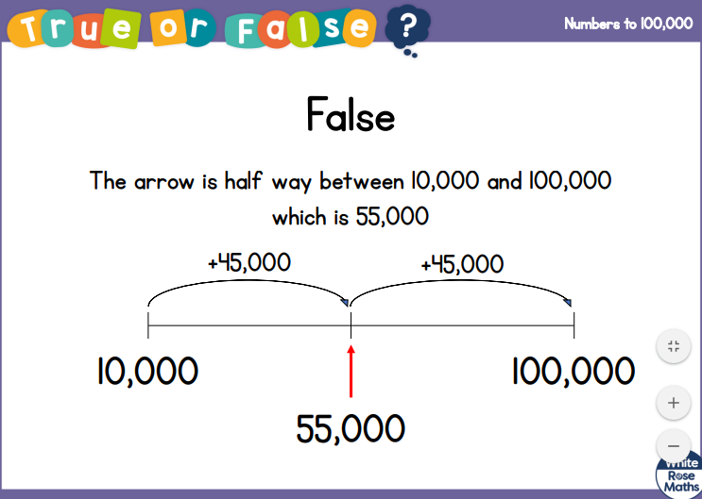

Slide 3
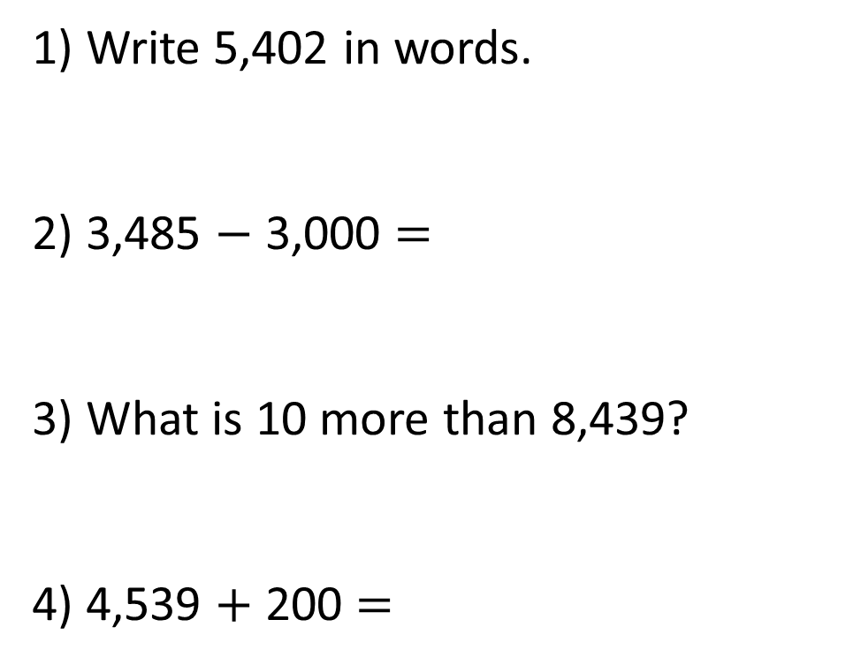
1) Write 5,402 in words.
2) 3,485 $−$ 3,000 $=$
3) What is 10 more than 8,439?
4) 4,539 $+$ 200 $=$

Slide 4
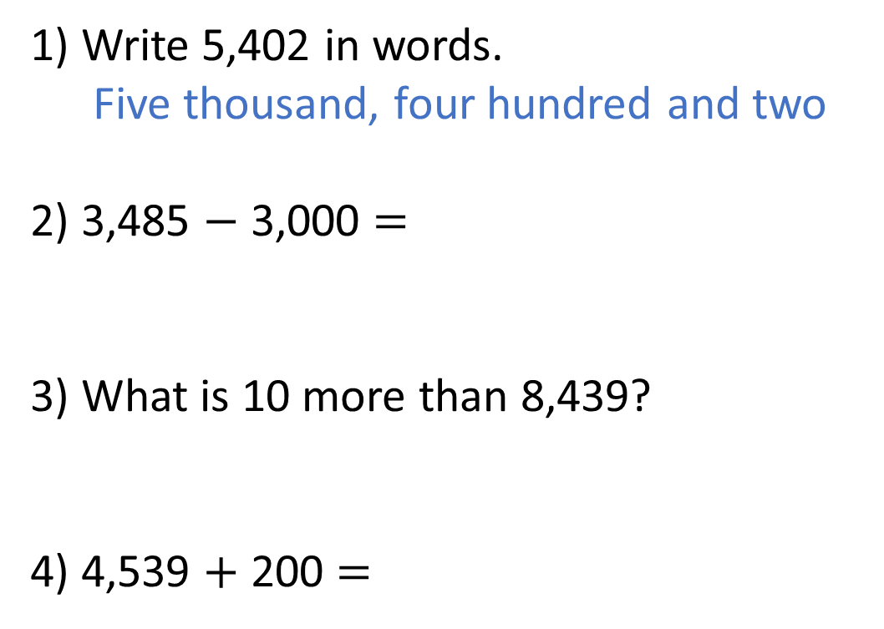
1) Write 5,402 in words.
Five thousand, four hundred and two
2) 3,485 $−$ 3,000 $=$
3) What is 10 more than 8,439?
4) 4,539 $+$ 200 $=$
485
8,449
4,739

Slide 6
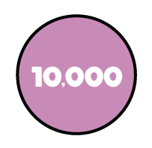




36,847
30,000
6,000
800
40
7
TTh | Th | H | T | O
Thirty-six thousand, eight hundred and forty-seven

Slide 7


Have a think
TTh | Th | H | T | O
I’m going to add 3 counters to the tens column.

Slide 8
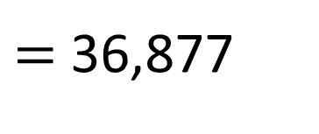
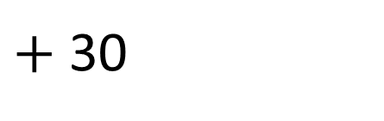
TTh | Th | H | T | O
$+$ 30
36,847
$=$ 36,877

Slide 9
Have a think
TTh | Th | H | T | O
I’m going to add 3 counters to the hundreds column.

Slide 10

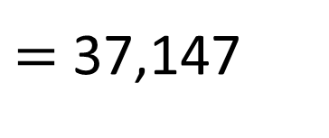
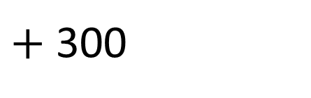
TTh | Th | H | T | O
$+$ 300
36,847
$=$ 37,147

Slide 11
Have a go at questions 1 - 3 on the worksheet

Slide 12
49,532
49,000
?
532
58,501
 | 500
58,001
?

Slide 13
Have a think
14,670
12,000
2,000
?
?
600
70
80,665
 | 660 |  | 10,000
?
70,000
5
?

Slide 14
Have a go at questions 4 - 6 on the worksheet

Slide 15
44,000
47,500
10,000
40,000
47,000
48,000
50,000
Difference between the start and end of the number line is 10,000
There are 10 intervals
10,000 $÷$ 10 $=$ 1,000

Slide 16
Estimate where 62,000 would be on the number line.
62,000
20,000
50,000
60,000
65,000
70,000

Slide 17
Have a go at question 7 on the worksheet

