Slide 1
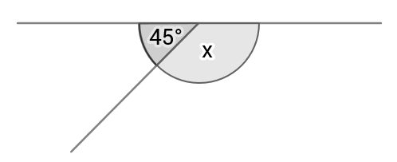
Angles on a straight line
Find x

Slide 2
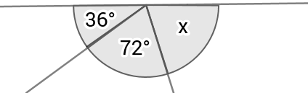
What about this angle?

Slide 3
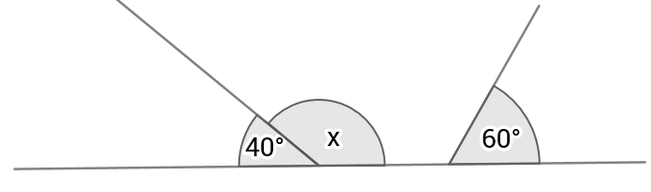
What about this angle?
A) 80
B) 120
C) 140
D) 260

Slide 4
What about this angle?
A) 80
B) 120
C) 140
D) 260

Slide 5
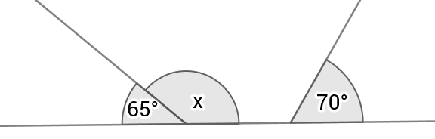
Try this one

Slide 6
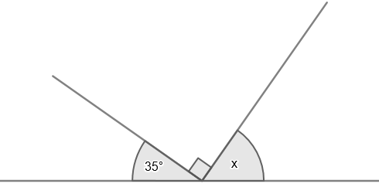
Q1

Slide 7
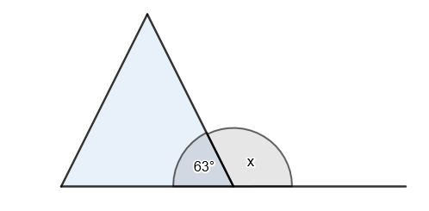
Q2

