Slide 1
Play scripts
Monday- features

Slide 2
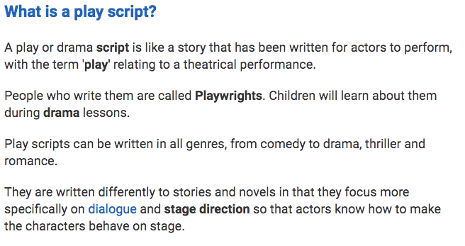

Slide 3
Famous plays- some examples
Shakespeare wrote many famous plays including: Romeo and Juliet, Hamlet, The Merchant of Venice,
A Midsummer Night’s Dream, Othello, Much Ado About Nothing.
Tennessee Williams wrote many famous plays such as: A Streetcar Named Desire, Cat on a Hot Tin Roof, The Glass Menagerie.
Arthur Miller wrote many famous plays such as: Death of a Salesman. The Crucible, All My Sons.
Anton Chekhov wrote many famous plays such as: Uncle Vanya, The Three Sisters and The Cherry Orchard.

Slide 4
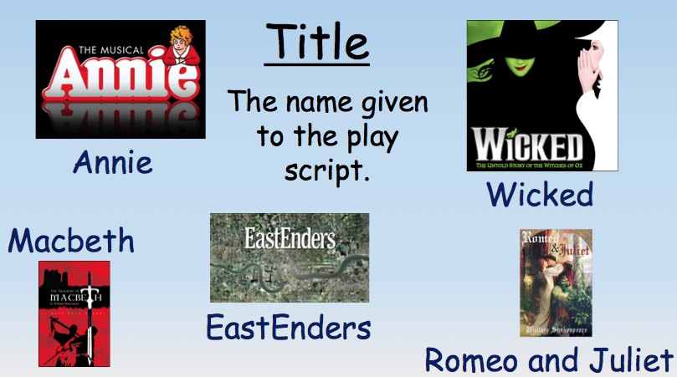
Features of a play script

Slide 5
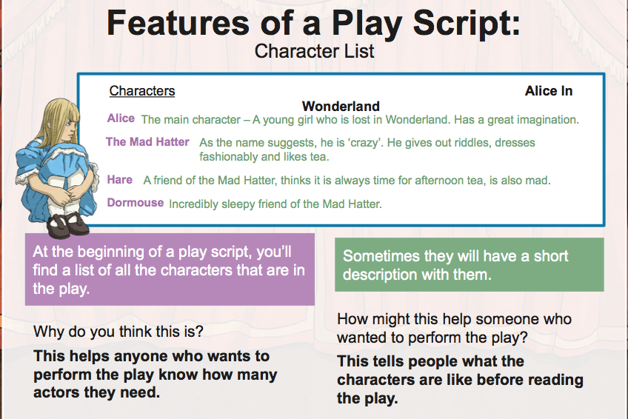

Slide 6
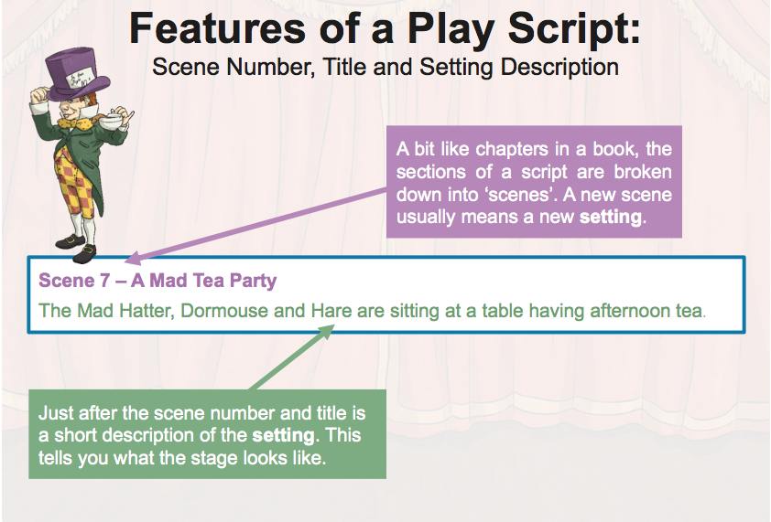

Slide 7
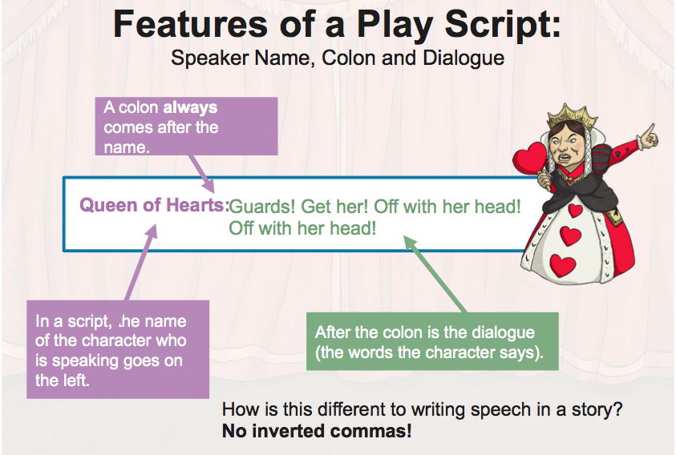

Slide 8
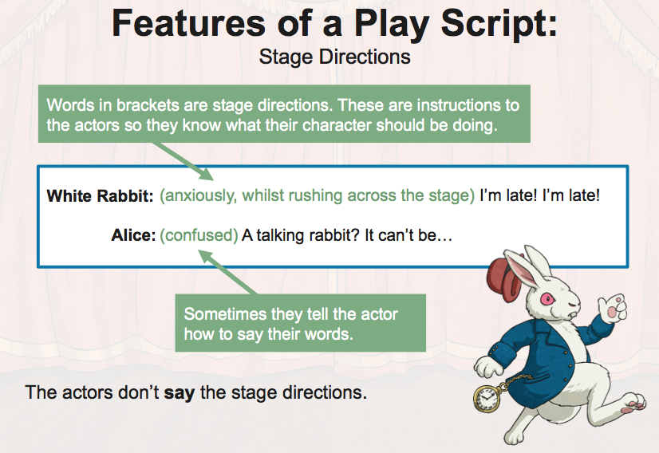

Slide 9
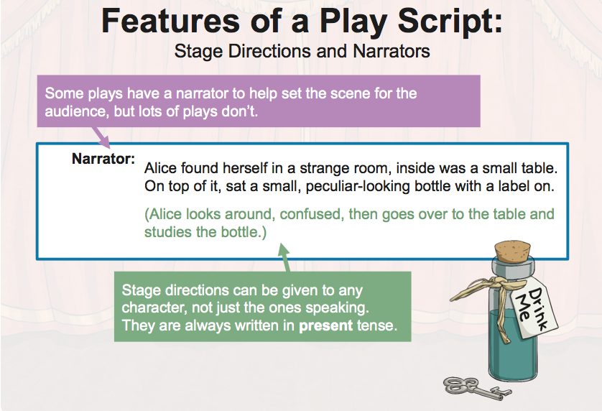

Slide 10
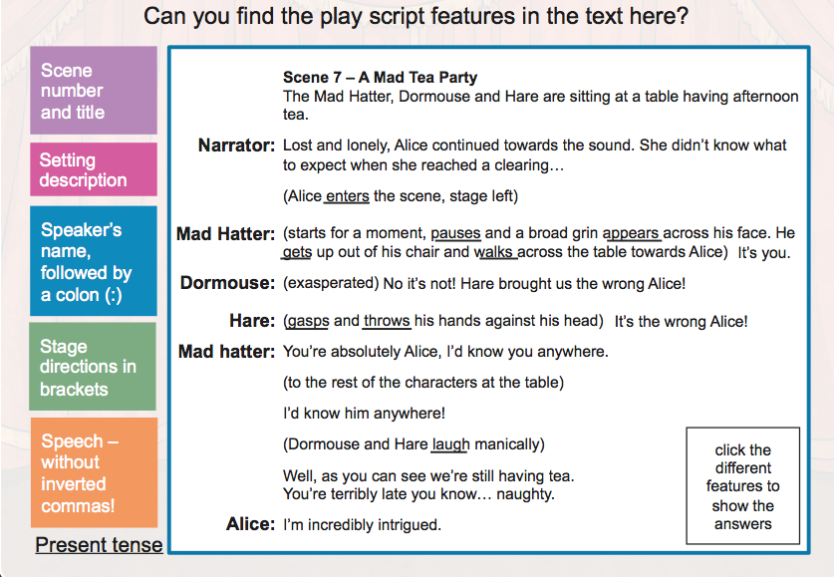

Slide 11
features
Title
Character list
Scene number and title
Setting description
Character’s name followed by dialogue (no speech marks, dialogue is separated by a colon)
Stage directions

Slide 12
Your task
Look at “A holiday at the beach” and notice how the story (narrative) has been turned into a play script.
Then identify the features of a play script.
Underline each different type of feature in a different colour and make a key.

Slide 13
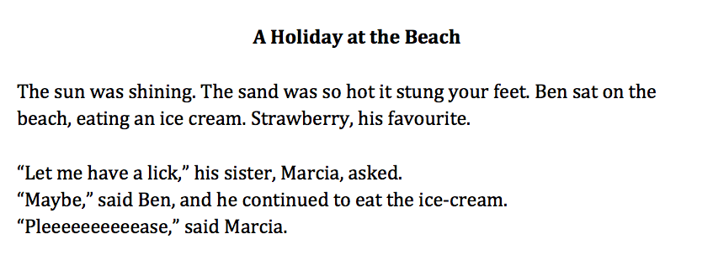
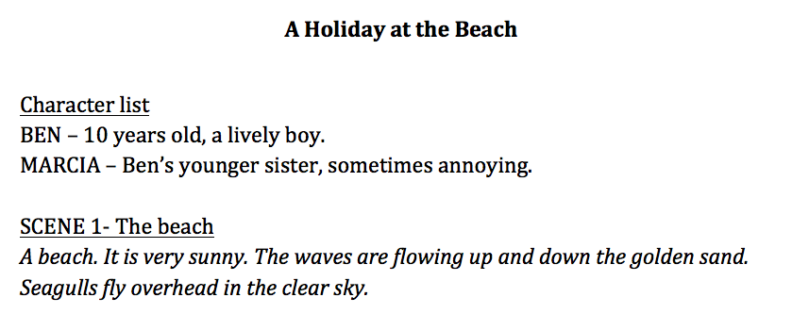

Slide 14
Play scripts
Tuesday- dialogue

Slide 15
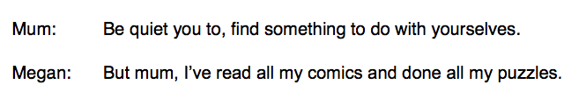
Writing speech
Writing speech in a play script is different to writing speech in a narrative (story).
Narrative
We use inverted commas (speech marks) before and after direct speech.
E.g. “I’m hungry,” she complained.
Each new piece of speech must start with a capital letter.
When a new/different person starts to speak, we start a new line.
Punctuation, such as full stops, exclamation marks and question marks go inside the inverted commas.
We use a reporting clause to show who is speaking, e.g. “Hello,” said Sally.
Play script
We write the name of the person talking, followed by a colon.
We start a new line when a different person starts talking.
New pieces of speech start with a capital letter.
E.g.

Slide 16
Writing speech- examples
Narrative
“Uncle Scrooge, good day to you. Please excuse the snow on my boots,” said Fred.
“What do you want? Can’t you see I’m working?” asked Scrooge, angrily.
“I have brought a gentleman to see you,” replied Fred.
Play script
Uncle Scrooge, good day to you. Please excuse the snow on my boots.
What do you want? Can’t you see I’m working?
I have brought a gentleman to see you
Fred:
Scrooge:
Fred:

Slide 17
Your task
Read the extract from “Little Red Riding Hood”
Convert the speech from narrative direct speech to play script style speech
Look at the previous example and explanation for guidance
CHALLENGE
Once you have finished, you could write a conversation in the style of a play script. It can be any conversation. For example, it could be a conversation you had with someone today, or it could be a made up conversation.

Slide 18
Play scripts
Wednesday-stage directions

Slide 19
What are stage directions?
They are instructions in a play script that tell the actors how to enter, where to stand, how to say their lines and how to move.
For example, stage directions might tell an actor to pace while delivering their lines, to pick up a prop while talking, to sit down or to move in a certain way (e.g. jump).
Although stage directions can sometimes include instructions for lighting, scenery and sound effects, their main job is to guide actors through their movements onstage.
Depending on the writer, stage directions might be written inside brackets, in italics or in bold.

Slide 20
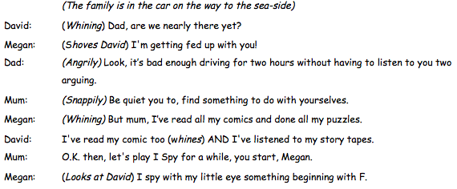
Can you spot the stage directions?

Slide 21
Your task
Complete “The Reluctant Swimmer” worksheet.
You will need to think about what the stage directions tell you about the characters’ feelings, and then continue the play script, including dialogue and stage directions.

Slide 22
Play scripts
Thursday- plan

Slide 23
Planning a play script
Plan it in the same way you’d plan a story.
Instead of doing chapters or sections, write scenes, with a scene number and title.
Don’t forget to include stage directions to describe what is happening and the way in which characters are speaking.
Don’t forget to write speech using the character's name and a colon.
If you’re struggling for inspiration, you could write a fairytale as a play script, e.g. Little Red Riding Hood, Goldilocks and the three bears etc.

Slide 24
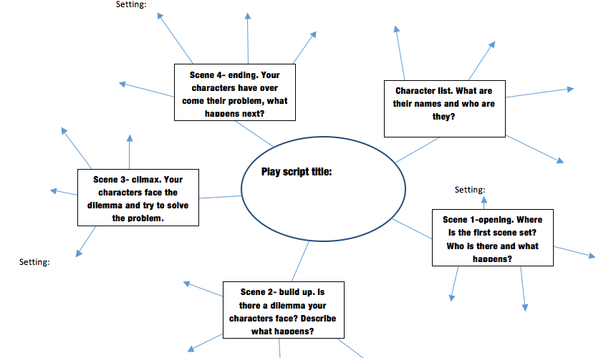

Slide 25
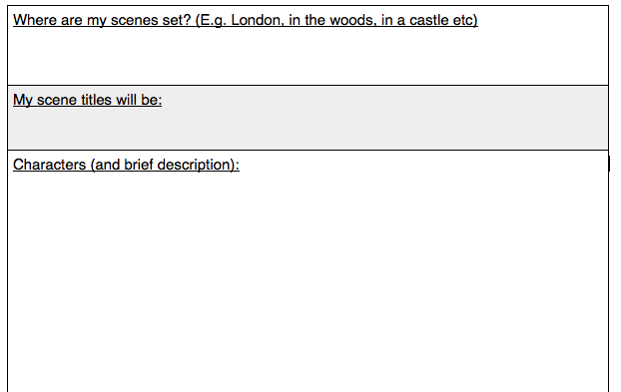

Slide 26
Play scripts
Friday- write and edit

Slide 27
Format of your playscript
Title – Little Red Riding Hood
Character list
Scene 1 – The woods
(Little Red Riding Hood is walking through the woods on her way to granny’s when she meets a wolf).
Wolf: Hello there.

