Slide 1
Tuesday 27th April 2021
L.O: To understand texts- inference skills
C: Boy

Slide 2
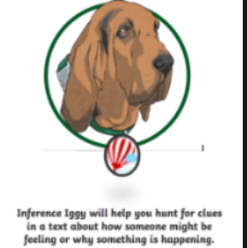
Today we are continuing to explore the character of Captain Hardcastle and the aftermath of the “pen-nib incident!
We are going to use our inference skills to help us understand what Roald Dahl might be thinking.

Slide 3

Starter: Thinking game
Imagine you have been told off and put on amber/red.
Can you fill your whiteboard with emotions to sum up what you might be feeling?

Slide 4
Class Read
Class Read p.137-143 “playing games”
Whilst we are reading consider how Roald Dahl might be feeling.

Slide 5
Our task
To write a thought bubble to show what Roald Dahl might be thinking in his head.
Let’s discuss some ideas!

Slide 6
Our task
Paddlers:
Write a thought bubble
Snorkellers:
Write a thought bubble using evidence from the text.
Divers:
Write a thought bubble using evidence from the text. Around the edge, add in some emotion words he may be feeling.

Slide 7

Red Pen Challenge!
Can you go through your work and add some punctuation to make your work more dramatic and expressive?
! … ?

