Slide 1
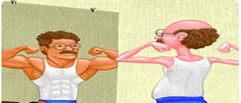
Understanding personal strengths and weaknesses

Slide 2

Do you have the X-factor?
What are your superstar personal qualities?

Slide 3
Evaluating your personal strengths and weaknesses
Your personal strengths are the ways you behave, think and feel that help you be happy and successful in life!
We all have natural strengths, you might call them gifts, or talents. For example, your top strengths might be your kindness, determination and creativity.
It is important to identify your strengths and use them in your day to day life to boost your happiness and self-esteem.
The following pages show some personal attributes/qualities. If you’re at school, get into partners and think about which 5 of these qualities describes your partner best.
If you’re at home, think of the 5 qualities that describe you the best.

Slide 4
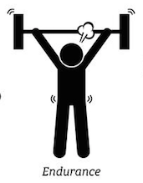

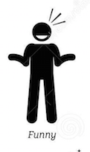





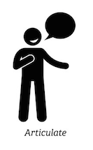


You never give up.
You like an adventure.
You make others laugh.
You want to succeed.
You care about and are respectful of others.
You are careful.
You look after people when they are suffering.
There is something you’re really good at.
You are good at explaining things to
other people.
You believe in yourself !
You know about lots of things.

Slide 5

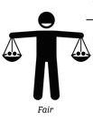

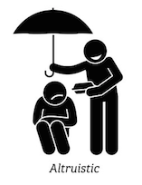






You are kind to everyone.
You treat everyone the same.
You enjoy learning.
You selflessly help others.
You always try to make the right choices.
You encourage and support others.
You forgive others for their mistakes.
You are always
on time.
You are fun and people enjoy your company.
You are brave.

Slide 6

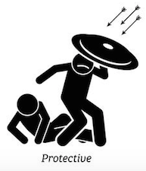
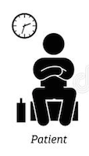

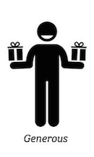



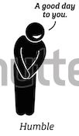
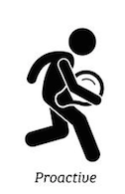
You always tell the truth.
You protect others from harm.
You enjoy life.
You are patient.
You follow your beliefs and do what you think is right.
You are happy to share and give things to others.
You easily make friends.
You have good manners and are always polite.
You are NOT arrogant or boastful. You don’t think you’re better or more important than anyone else.
You take ownership of your own learning and happiness.

Slide 7
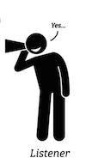




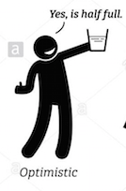
You listen to others.
You always do your best.
You know where your things are and like to plan ahead.
You show constant support and commitment to someone or something.
You are always hopeful and look for the good things in life.
You are happy to listen to new ideas and change your mind.

Slide 8


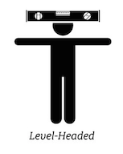

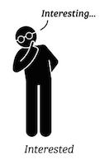
Other people admire you and want to copy you/ be like you.
You are calm and sensible.
You are powerful and able to have an effect on how others act.
You are creative and come up with new ideas.
You show an interest in many different things.

Slide 9
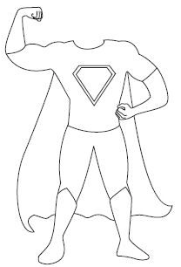
Choose your character outline.
Draw a head onto it.
Write your five strengths on your character.
If you’re at school, it is the 5 strengths your partner
chose for you. If you’re at home then it’s the 5
strengths you chose for yourself.
Colour your character in.
Generous
Humble
Kind
Fun
Ambitious

Slide 10
Extension: identifying our weaknesses
Sometimes, we might not enjoy thinking about our weaknesses, or things we need to improve at.
However, our strengths change through our lifetimes and it is possible to work on our weaknesses and turn them into strengths!
Look through the personal attributes again and identify 3 that you think you could work on and improve. Don’t do this in partners, think about your own weaknesses that you’d like to improve.

Slide 11
Generous
Humble
Careful
Kind
Choose your 3 “weaknesses” that you’ll work on.
Put the weaknesses outside the character.
Courageous
Fun
Ambitious
Listener

