Slide 1
Maths- 12.06.20

Slide 2
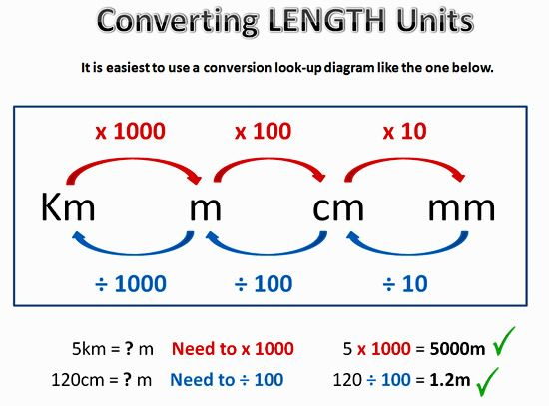


Slide 3


