Slide 1
Non-chronological reports
Monday

Slide 2
What is a non-chronological report?
A non-chronological report is a piece of writing that provides the reader with factual information about a chosen topic. The information provided in the report is not in any specific order so individuals can use reading techniques such as scanning and skim reading to find out the information they need.

Slide 3
Features of a non-chronological report
Look at the report on the next page and see if you can work out what some of the features might be.

Slide 4
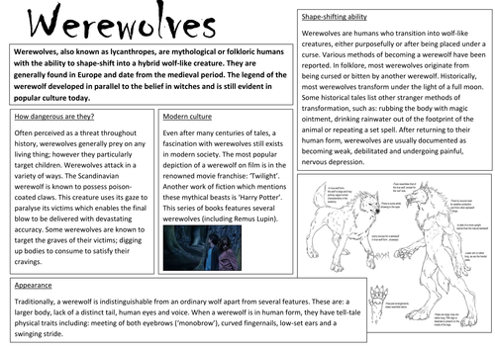
Introduction
Present Tense & Third person
Sub-headings
Factual information
Pictures/Diagrams
Formal language
Notes:
Children look at the image and try to identify the features of a non-chronological report.

Slide 5
Features of a non-chronological report
Heading
Introduction
Subheadings
Present tense
Third person
Formal language
Diagrams/ images
Captions
Factual information organised into paragraphs

Slide 6

Heading
The heading of a non-chronological report is often found at the top of the report. This informs the reader what the report is about.
Hammerhead sharks
Mosques

Slide 7
Introduction
The introduction tells the reader what they we will be reading about. This part of the report is extremely important. The text should be written in formal language.
What could the heading be to this introduction?
The Emperor Penguin, the largest species of penguin at 1.15m tall, is the only animal to inhabit the open ice of Antarctica during the winter months. With increasing temperatures (caused by global warming), the Emperor Penguin is considered as threatened by human activity.

Slide 8
Subheading
A subheading separates your information into easier chunks of information. This allows the reader to successfully scan and skim read the report to find the information they want to learn about.
Have a think…. What could be the subheadings for the heading ’Ultimate Frisbee’?

Slide 9
Subheading
A subheading separates your information into easier chunks of information. This allows the reader to successfully scan and skim read the recount to find the information they want to learn about.
Have a think…. What could be the subheadings for the heading ’Ultimate Frisbee’?
The Rules Playing safely
Throwing the Frisbee Correct clothing
Playing defense
Catching the Frisbee

Slide 10
Present tense
The present tense of verbs (doing words) expresses actions or events that are happening now. E.g. I feel happy, I am here, I like strawberries, I have a brother.
The present tense is also used to express actions or events that are habitually performed, but might not be happening now. E.g. I always walk to school, I practise the clarinet everyday.
Non chronological reports are written in the present tense.

Slide 11
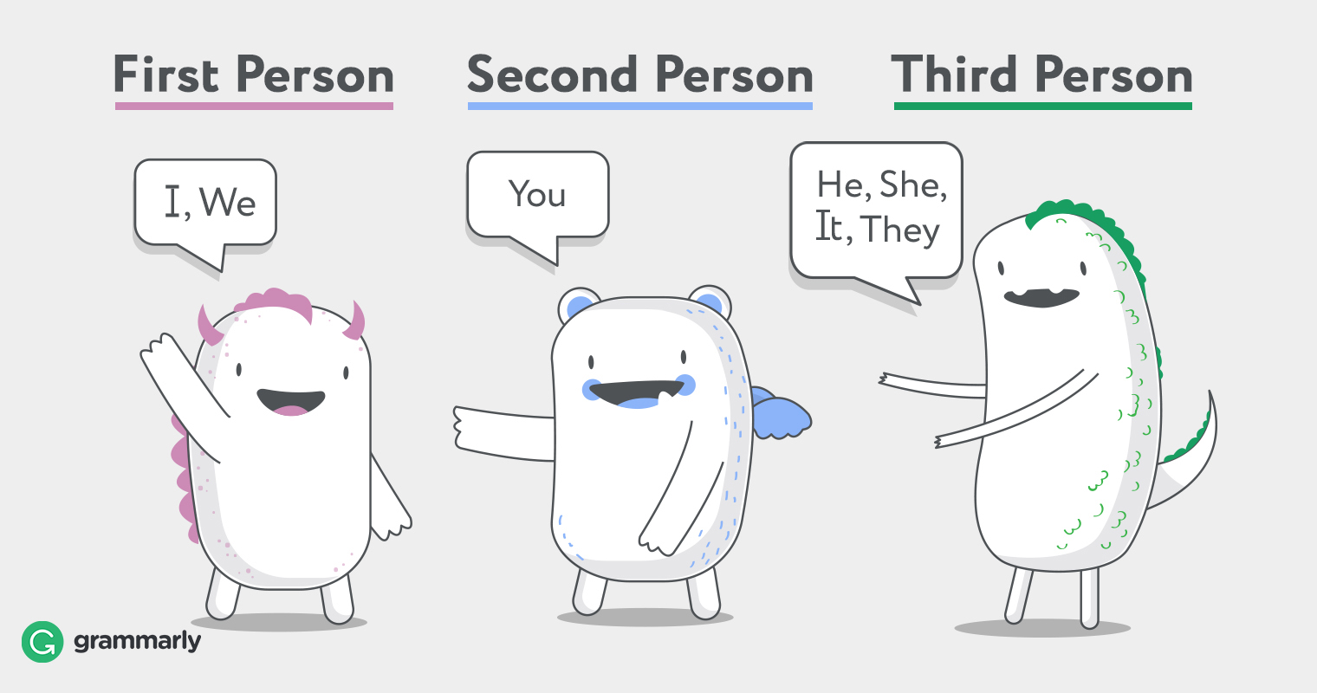
Third person
A text can be written in first, second or third person. Non- chronological reports are written in THIRD person as the reports are describing something or someone, e.g. an animal or another person. In a report written in third person, you might use the name of who you’re writing about (e.g. Joe), an appropriate noun (e.g. tiger) or a pronoun.
Third person pronouns:
Singular (one): he, she, it, him, her, his, its.
Plural (more than one): they, them, their,
theirs.

Slide 12
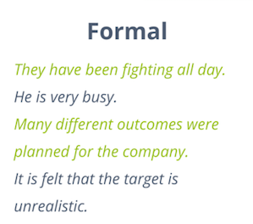
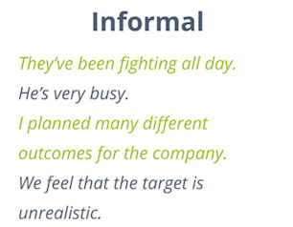
Formal language
Formal language is used when writing formal letters, especially to people we don’t know, and for writing non-fiction texts, such as instructions, explanations or reports.
Formal language uses Standard English (no slang or dialect), and uses more polite vocabulary. It also tends to avoid contractions (e.g. don’t, won’t, isn’t) and personal remarks or opinions.

Slide 13
Diagrams/pictures
Often we find diagrams or pictures in non-chronological reports to support the facts written in the report.
For example, if it was a report on a dinosaur, you might find a diagram about the different bones it has:

Slide 14
Captions
Captions appear underneath photos or diagrams in your report. This gives the reader a little bit more information about what they are seeing.
Try to write a caption for the photos below:

Slide 15
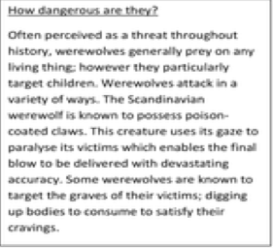
Factual information organised into subheadings
Your non-chronological report will be divided into sections and each section will have a subheading.
All of the information in each section will relate to the subheading.
E.g. All of the information in this paragraph relates to how dangerous
werewovles are. There should only be information relating to the subheading
in each section.

Slide 16
Identify the features
Look at the text and underline the features of non-chronological reports.

Slide 17
Non-chronological reports
Tuesday

Slide 18
Fronted adverbials
What is a fronted adverbial?
This is when a word or a phrase is put at the start of a sentence (followed by a comma), to explain how (manner), when (time) or where (place/location) something is being done.
Examples:
How (manner): Suddenly, Cautiously, Happily.
When (time): The next day, An hour later, Afterwards.
Where (place/location): Next door, In London, Under the bridge, In a faraway land.

Slide 19
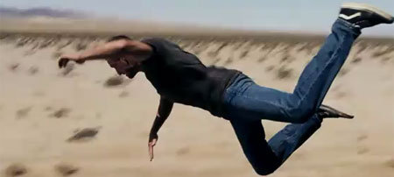
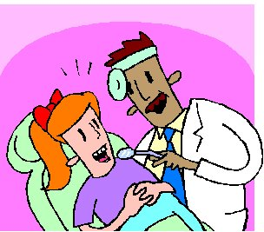
Examples-fronted adverbials
As soon as he could, Tom jumped off the train.
Last week, I went to the dentist.

Slide 20


Examples-fronted adverbials
In the winter, some animals hibernate.
Outside my house, I found a pizza.

Slide 21
Which fronted adverbial
Can you match the fronted adverbial to each sentence so they all make sense?
I clean my teeth.
The ground began to shake.
I lost my coat.
I play football.
She lifted the sleeping baby.
I reached the finish line.
Gently,
Before I go to bed,
At last,
Suddenly,
At the park,
Every playtime,

Slide 22

Which fronted adverbial
Gently, she lifted the sleeping baby.
Before I go to bed, I clean my teeth.
At last, I reached the finish line.
Suddenly, the ground began to shake.
At the park, I lost my coat.
Every playtime, I play football.

Slide 23
Your turn to write some sentences
When
Every week …
During playtime …
Once a year …
Before I go to bed …
When I go home …
How
Without …
Running …
Carefully …
Suddenly …
Gently …
Where
Beside my bed …
On holidays …
In the park …
At home …
Outside my house …
Write 10 of your own sentences using a fronted adverbial. You can use some of the examples above or
use your own!

Slide 24
Non-chronological reports
Wednesday

Slide 25
Formal writing- 3rd person
See the grammar video!

Slide 26
Non-chronological reports
Thursday

Slide 27
Planning your non-chronological report
You will be writing a non-chronological report about life in a Viking village.
You will need to plan an introduction to the Vikings, then 3-4 sections/paragraphs detailing different aspects of Viking life.
Some aspects you might want to research and write about could be:
Viking homes/ houses
Viking jobs
Viking laws
Viking entertainment
Viking daily life/routines

Slide 28
Planning your non-chronological report
You could include a diagram to show the layout of a Viking village or home. Don’t forget to include a caption with your diagram.
Use the planning template to help you plan your report.

Slide 29
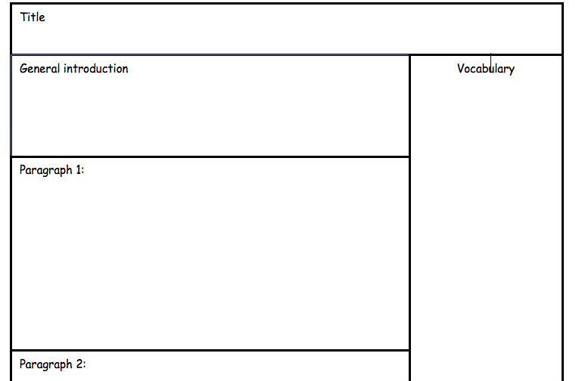

Slide 30
Planning your non-chronological report
Remember that you don’t need to write complete sentences on your planning template. You can write down all your ideas as bullet points, if you wish.
Use the word mats to choose some fronted adverbials that you’d like to use throughout your report.
Think of something you could draw a diagram of and you could draw a small draft of that diagram on your worksheet.
Remember that your introduction should start by introducing the Vikings generally (who were they, where did they come from). By the end of your introduction, you’ll want to mention life in Viking villages and explain that this is the focus of the report.

Slide 31
Non-chronological reports
FRIDAY

Slide 32
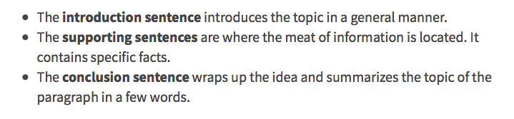
Writing your non-chronological report
Paragraph structure
A paragraph should contain one subject only. This subject will be introduced in the first sentence, which is then supported and explained in the rest of the paragraph.
Here is an example of a basic paragraph structure you could use.

Slide 33
Paragraph structure
Here is an example paragraph, written using the structure on the previous slide. This paragraph is from a section of a non-chronological report about chickens. The title of this paragraph is “What are chickens?”
Chickens are birds that have been around for centuries. They were domesticated to provide eggs and meat for humans to eat. One of the earliest recognised breeds is the Dorking, recorded in Italy in the mid-1700s. Female chickens are called hens, and males are called roosters. Chickens have two claw-like feet, two wings and are covered in feathers. These birds are so familiar that almost everyone in the world can identify them.
Introduction sentence- what is a chicken.
Supporting sentences- describing the history of chickens and some of their body parts.
Concluding sentence- a final sentence outlining the prominence of chickens and why they’re important enough to be written about.

Slide 34
Paragraph structure
When writing your paragraphs try to follow the previously discussed structure, starting with the introductory topic sentence that outlines what the paragraph will be about.
If you were writing a paragraph about Viking houses you could follow the structure like this:
Introduction/topic sentence: what were they famous for? Did they have a specific name or feature that is characteristic of a Viking house?
Supporting sentences: describe the features of the houses, e.g. roofs, walls, rooms, size, what they were made from.
Concluding sentence: say how the features of the houses made them nice places to live.

Slide 35
Writing your non-chronological report
Don’t forget to include all of the features of a non-chronological report.
Use this checklist to help you:
Heading- what are you writing about?
Introduction- introduce your topic generally, then explain the focus of your report.
Subheadings- you should have researched information about each of your chosen subheadings.
Factual information organised into paragraphs-see the structure discussed on previous slides.
Present tense- happening now, or habitually, e.g. I walk, I run etc.
Third person- he/she/it/they
Formal language- no slang, contractions or personal opinions.
Diagrams/ images
Captions- explain what is in your diagram.

Slide 36
Writing your non-chronological report
Once you have finished, don’t forget to edit your work and you can upload it onto Showbie for your teacher to see!

