Slide 1
Monday 26th April 2021
L.O: To understand texts- prediction skills
C: Boy

Slide 2
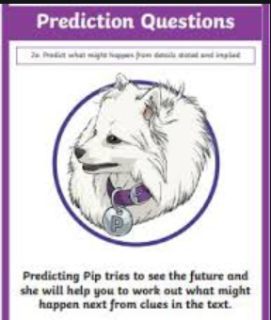
Today we are continuing to explore the character of Captain Hardcastle!
We are going to use our predicting skills to help us understand how the characters are going to interact.

Slide 3

Starter: Game
Let’s play fastest finger using p.132!

Slide 4
Class Read
Class Read p.132-137
Whilst we are reading, please focus how Captain Hardcastle interacts with the children.

Slide 5
Our task
To design a comic strip to show what is going to happen between Captain Hardcastle and Roald Dahl!
Let’s mini role-play some ideas!

Slide 6
Our task
Remember to include thought bubbles or speech bubbles in every picture!
Paddlers:
Work with the TA to come up with 3 bullet points of what is going to happen. Then independently draw your comic.
Snorkellers:
Write four bullet point ideas on your whiteboard, then draw your comic.
Divers:
Five-part comic strip.

Slide 7
Plenary
Classroom Museum!
Let’s walk around and look at everyone’s amazing comics!

