Slide 1
Formal language for a non-chronological report

Slide 2
Watch this video to get an idea of how to write a formal report.
https://www.bbc.co.uk/bitesize/clips/zdmw2hv

Slide 3
What did you notice?
What did the two men say was important for writing a factual report?
The main points in the video were that formal reports should include:
Facts, not opinions (I think)
Long, complicated sentences with posh words
Standard English and technical
vocabulary!

Slide 4
No opinions
When people are reading factual reports, such as the non-chronological report you’ll be writing, they are looking for information, not other people’s opinions.
Generally, it is best to avoid giving your opinion in a factual report.
To avoid any confusion over whether the writing consists of fact or opinion, the 3rd person is generally used in factual texts.

Slide 5
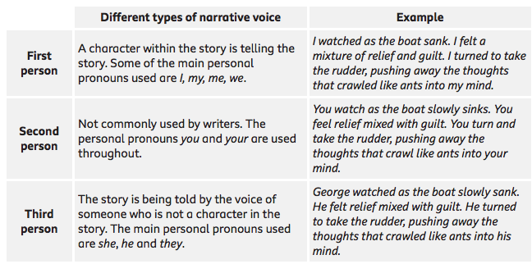
What is 3rd person
When you are writing, you are using a narrative voice.
The narrative voice is the perspective that the story, or writing is being told from.

Slide 6
3rd person in factual reports
1st person – I, my, we, our.
2nd person – you, your.
3rd person- he, she, his, her, they, their, it. E.g. The sharks have lots of teeth.
We DON’T want opinions, so 1st person isn’t a good choice for this style of writing.
2nd person wouldn’t make sense when writing factually as the writer is telling the reader the facts.
3rd person- enables the writer to communicate the facts as statements without any personal opinion.

Slide 7
3rd person in factual reports
Sharks star in blockbuster movies as blood-seeking villains, but in reality they are far more fascinating and complicated than they seem in popular culture.
Based on fossilized teeth and scales, scientists believe that sharks have been around for more than 400 million years- long before the dinosaurs. The ocean’s top predators have evolved into roughly 500 species that come in all different sizes and colours and have varying diets and behaviours.

Slide 8
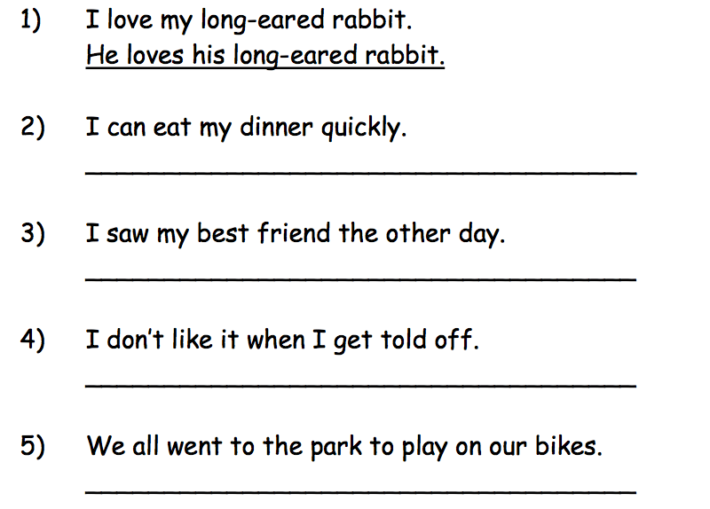
3rd person in factual reports
Can you have a go at changing the following sentences from 1st to 3rd person?

Slide 9
Standard English and technical vocabulary
Don’t use colloquialisms (slang)
Coz
innit
gonna
wud
wat
Use the proper words for things, as the man in the video said “posh words”. Use scientific vocabulary where appropriate. For example, if you were writing about tigers you might call them carnivores, rather than meat-eaters.

Slide 10
No contractions
Limit your use of contractions.
Don’t
Won’t
Can’t
Isn’t
Do not
Will not
Cannot
Is not

Slide 11
Try rewriting these sentences into formal language
Have a go before reading
the suggested answer on the
next slide.
This humungous whale went past the Houses of Parliament. What these rescue blokes did was to try and fish it out with the help of these blow up balloon things.
YES
3rd person
Facts
Standard English
Politeness
No
Opinions
I think…
Contractions
Slang

Slide 12
Try rewriting these sentences into formal language
Written formally, it might look something like this:
A 6 metre bottlenose whale was spotted swimming past the Houses of Parliament yesterday. Rescue efforts involved beaching the whale at low tide and refloating it with the help of pontoons.
YES
3rd person
Facts
Standard English
Politeness
No
Opinions
I think…
Contractions
Slang

Slide 13
Try rewriting these sentences into formal language
Have a go before reading
the suggested answer on the
next slide.
Some people reckon that it got split up from its family & got mixed up by listening to some dodgy sonar sounds.
YES
3rd person
Facts
Standard English
Politeness
No
Opinions
I think…
Contractions
Slang

Slide 14
Try rewriting these sentences into formal language
Written formally, it might look something like this:
The whale is believed to have been separated from its pod and may have travelled up the Thames as a result of confused sonar signals.
YES
3rd person
Facts
Standard English
Politeness
No
Opinions
I think…
Contractions
Slang

Slide 15
Try rewriting these sentences into formal language
Have a go before reading
the suggested answer on the
next slide.
Pretty soon there were loads of people looking at it and before you know it, it was all over the news. Worldwide, innit!
YES
3rd person
Facts
Standard English
Politeness
No
Opinions
I think…
Contractions
Slang

Slide 16
Try rewriting these sentences into formal language
Written formally, it might look something like this:
Bystanders quickly lined the banks of the Thames and the incident quickly became a worldwide news story.
YES
3rd person
Facts
Standard English
Politeness
No
Opinions
I think…
Contractions
Slang

Slide 17
Try rewriting these sentences into formal language
Have a go before reading
the suggested answer on the
next slide.
This woman Mary Bridges who was about 50 and came from Wolverhampton was on holiday. She saw it and she was like, “You don’t get many whales in Wolverhampton! It was a real shock.”
YES
3rd person
Facts
Standard English
Politeness
No
Opinions
I think…
Contractions
Slang

Slide 18
Try rewriting these sentences into formal language
Written formally, it might look something like this:
Mary Bridges, 52, from Wolverhampton was visiting the capital on a shopping trip when she spotted the whale. She said, “You don’t get many whales in Wolverhampton! It was a real shock.”
YES
3rd person
Facts
Standard English
Politeness
No
Opinions
I think…
Contractions
Slang

Slide 19
Try rewriting these sentences into formal language
Try rewriting these more
formally:
Give us a lift.
Oi! Open the window!
Bob is dead slow in class and his work is a load of rubbish.
YES
3rd person
Facts
Standard English
Politeness
No
Opinions
I think…
Contractions
Slang

Slide 20
Try rewriting these sentences into formal language
A LETTER OF COMPLAINT:
Hey,
I’m scribbling this ‘cause that kettle what I bought is a load of pants. It don’t work! I want it fixed or I want a new one. And get a move on!
Jennifer
YES
3rd person
Facts
Standard English
Politeness
No
Opinions
I think…
Contractions
Slang

Slide 21
Try rewriting these sentences into formal language
Give us a lift → Could we have a lift, please?
Oi! Open the window! → Excuse me, could you open the window?
Bob is dead slow in class and his work is a load of rubbish. → Bob works too slowly, which means his work is not as good as it could be.

Slide 22
Try rewriting these sentences into formal language
A LETTER OF COMPLAINT:
Dear Sir/Madam,
I am writing to you because the kettle that I bought is not working. I would appreciate being given a refund or a new kettle that does work. Thank you.
Yours sincerely,
Jennifer
YES
3rd person
Facts
Standard English
Politeness
No
Opinions
I think…
Contractions
Slang

