Slide 1
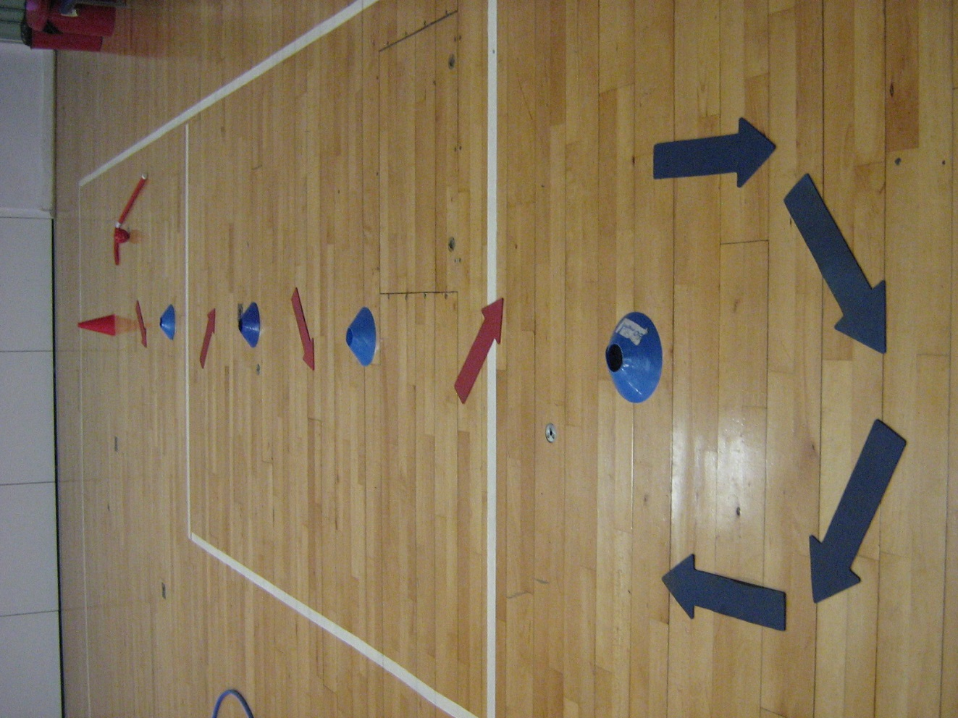
Hockey Dribble
Dribble the hockey ball in and out of the cones and back again.
Hold the stick in two hands at all times
Look at the ball and look where you are travelling.
Your teacher is looking to see good, close control.

Slide 2
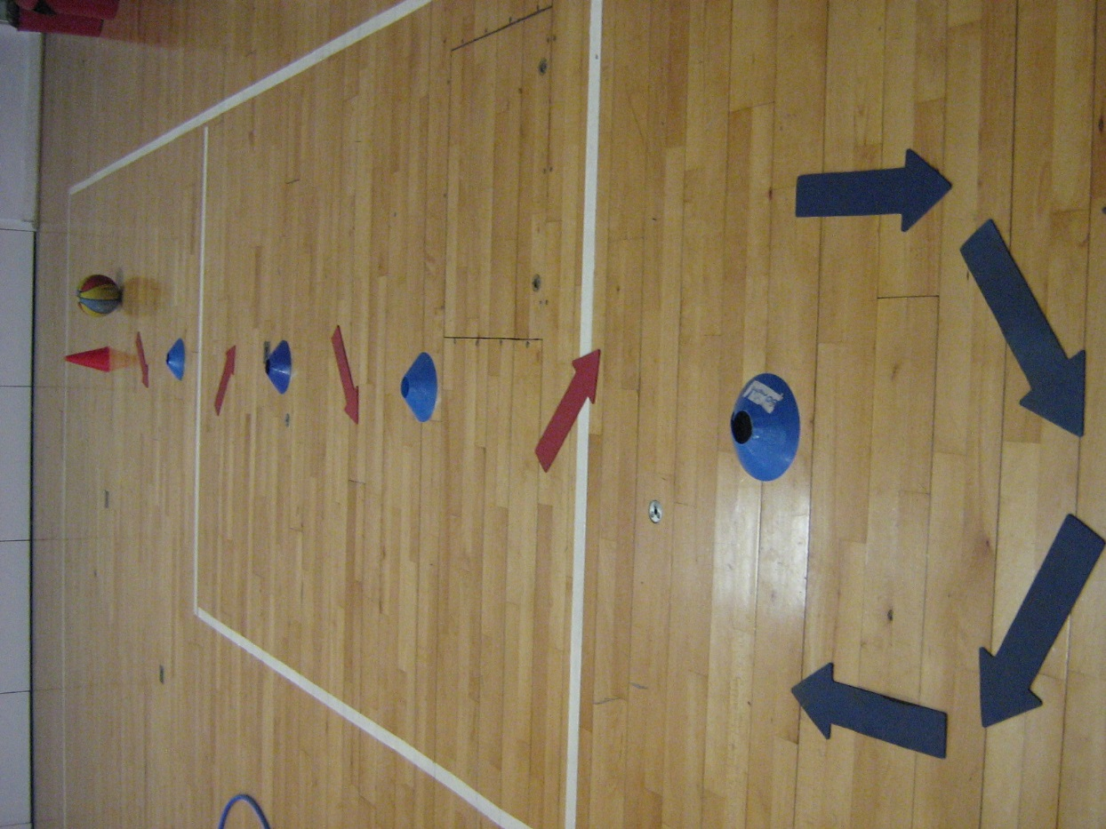
Basketball Dribble
Dribble the basketball in and out of the cones and back again.
Bounce the basketball with one hand at a time.
Use your fingers to give you the best control.
Your teacher is looking to see good, close control.

Slide 3
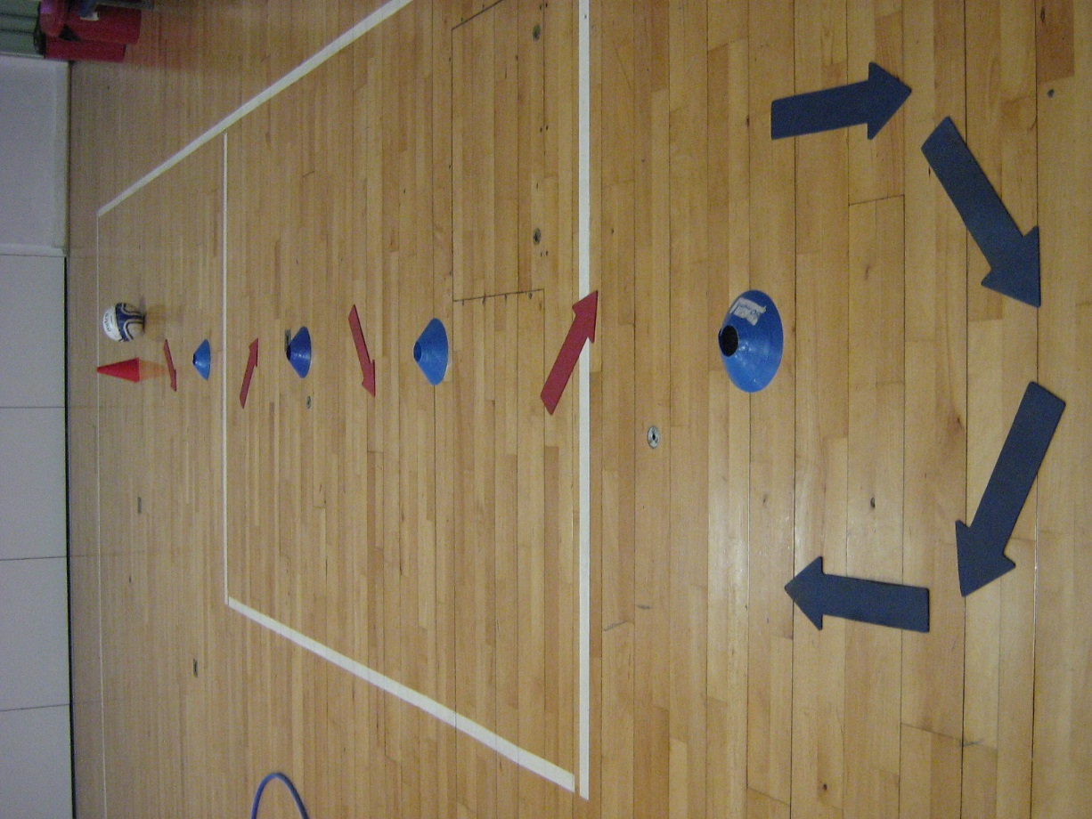
Football Dribble
Dribble the football in and out of the cones and back again.
Keep the ball close to your feet .
Use soft, gentle, small kicks.
Your teacher is looking to see good, close control.

Slide 4
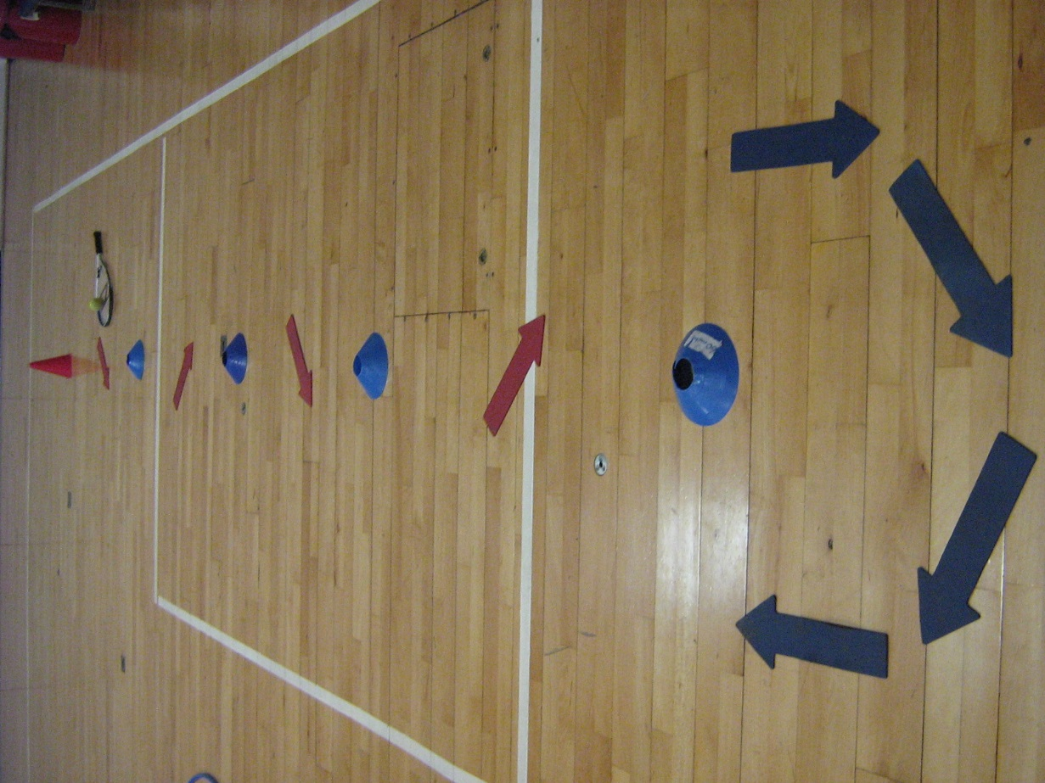
Egg & Spoon
Travel in and out of the cones and back again while balancing the tennis ball on the face of the racket.
Try to keep the ball in the centre of the racket face.
Hold your hand as still as you can.
Your teacher is looking to see good, close control.

Slide 5
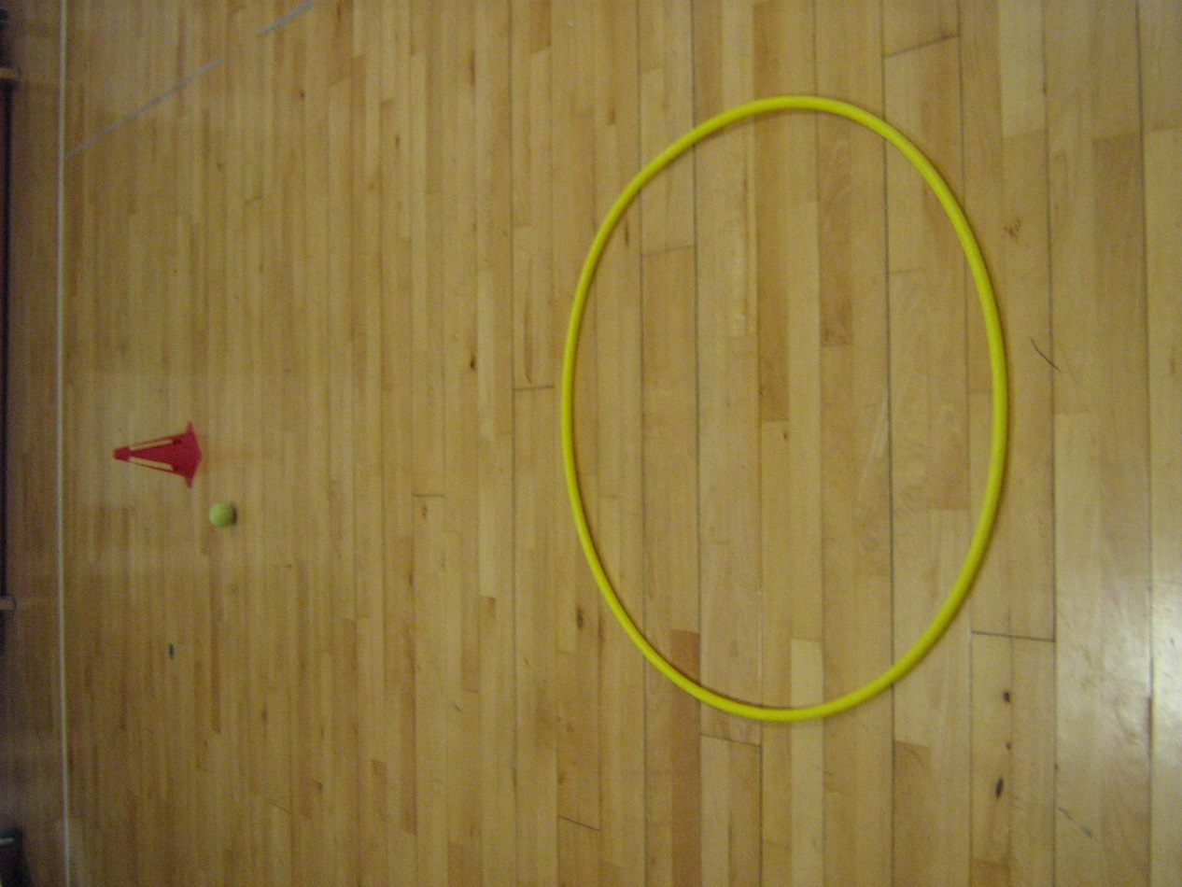
Rolling A Ball
Roll the ball into the hoop.
Roll the ball at just the right speed, not too fast and not too slow.
Bend your knees and swing your arm gently near to the floor.
As you let go of the ball point all four fingers towards the centre of the hoop .

Slide 6
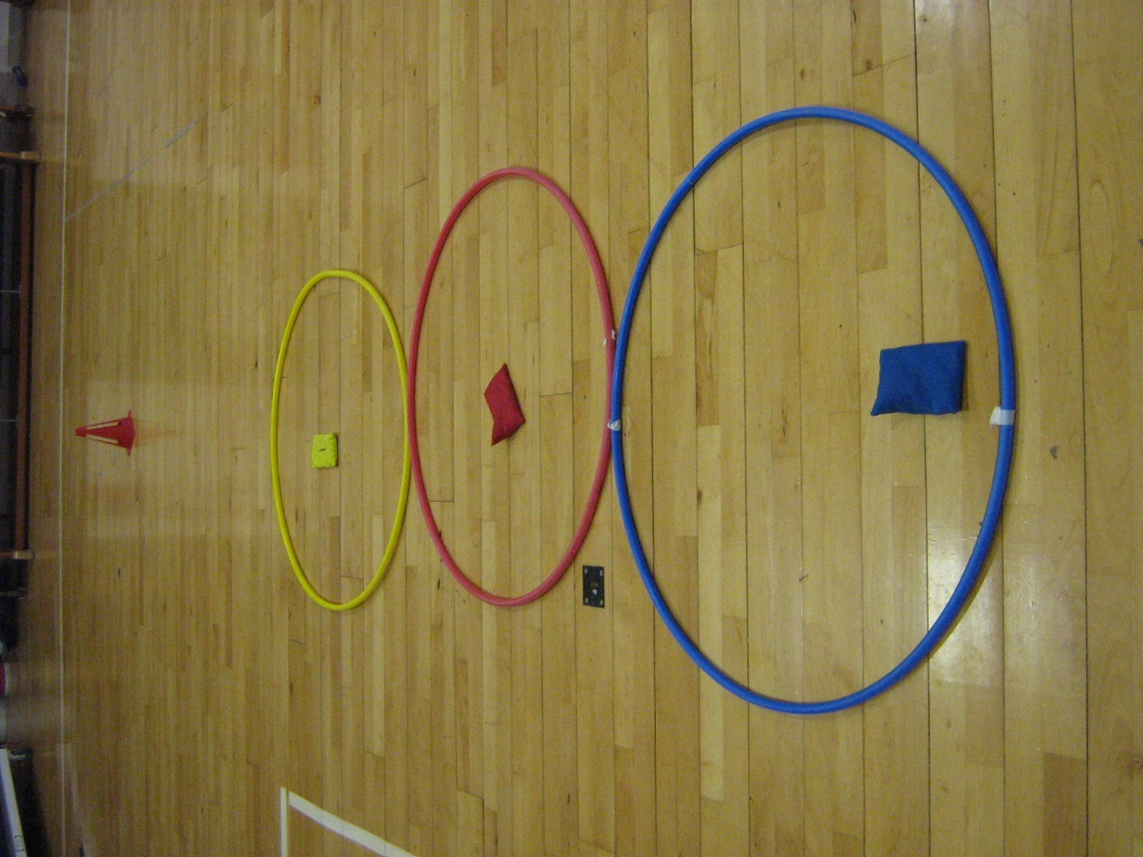
Throwing Underarm
Throw each beanbag (underarm) into the correct hoop.
If you are throwing with your right hand step forwards with your left foot.
Swing your arm near to your waist
As you let go of the beanbag point all four fingers towards the centre of the hoop .

Slide 7
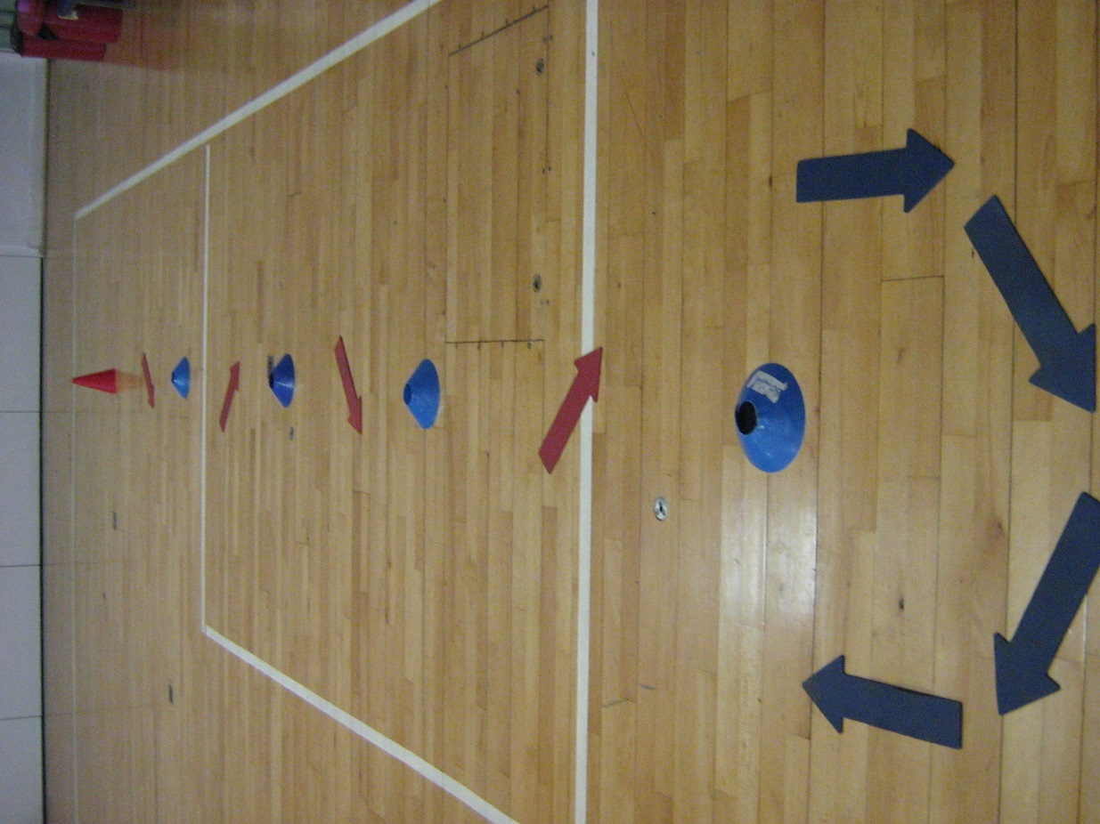
Zig Zag Running
Run as quickly (safely) as you can in and out of the cones and back again.
Show control at all times.
Run on the balls of your feet
Use your arms to control your speed and balance.

Slide 8
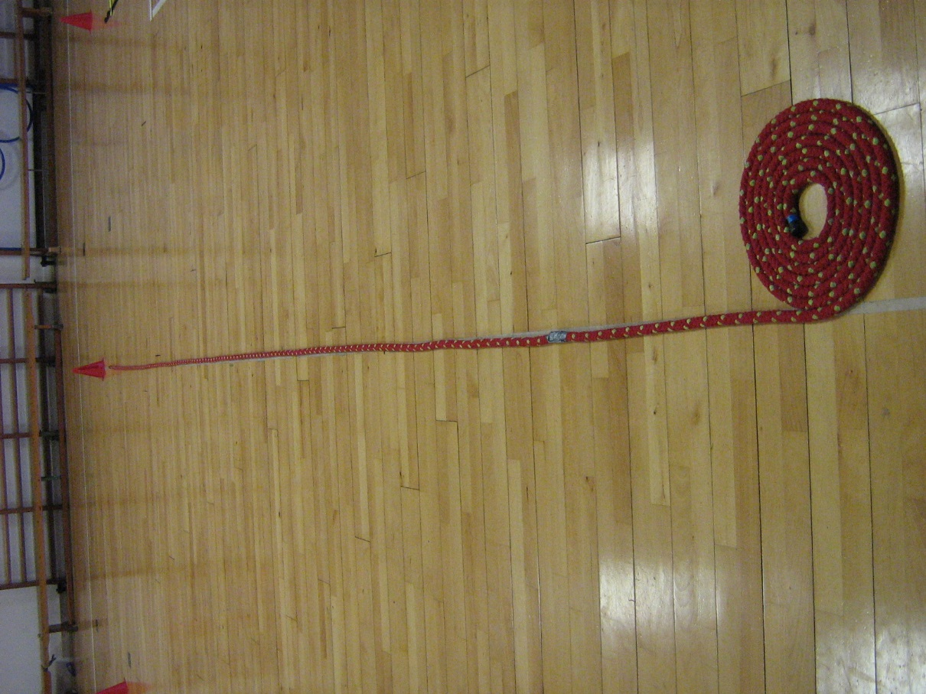
Wobbley Walking
Walk in a straight line placing your left foot on the right side of the rope and your right foot on the left side of the rope.
Show control at all times.
Once you are confident and can complete the task walking try to increase your speed.
Use your arms to control your speed and balance.

Slide 9
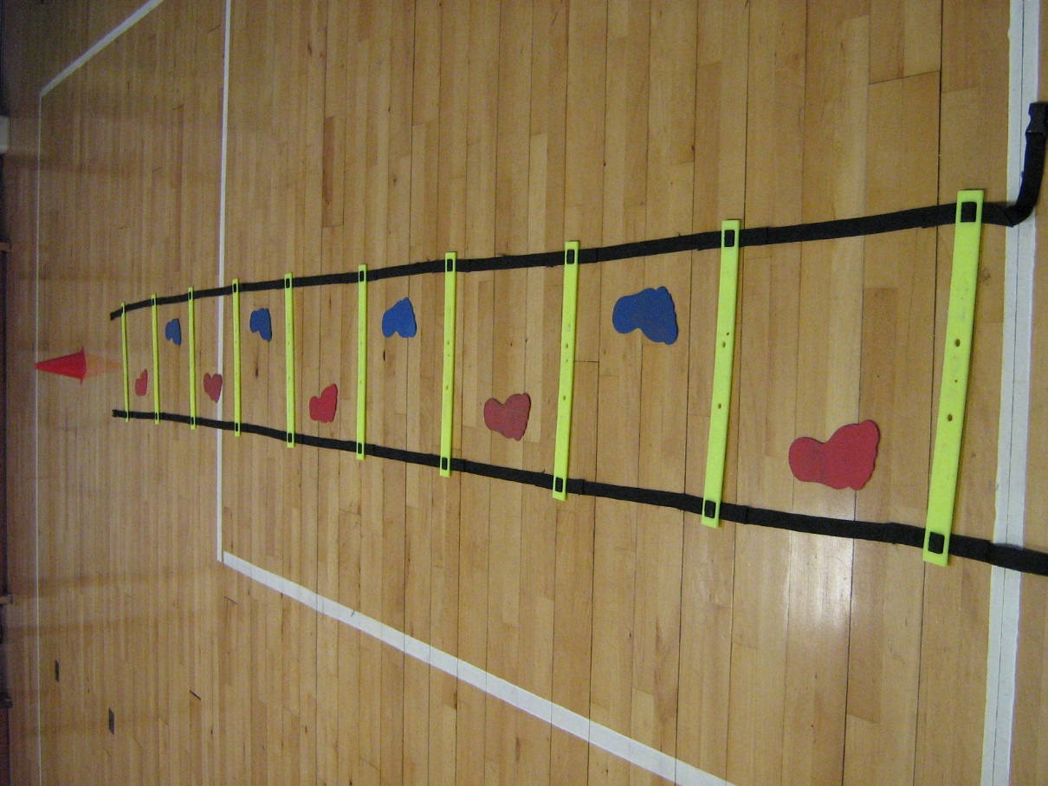
Ladder (Stepping)
Walk along the ladder placing alternate feet in each space along the ladder.
Show control at all times.
Once you are confident and can complete the task walking try to increase your speed.
Use your arms to control your speed and balance.

Slide 10
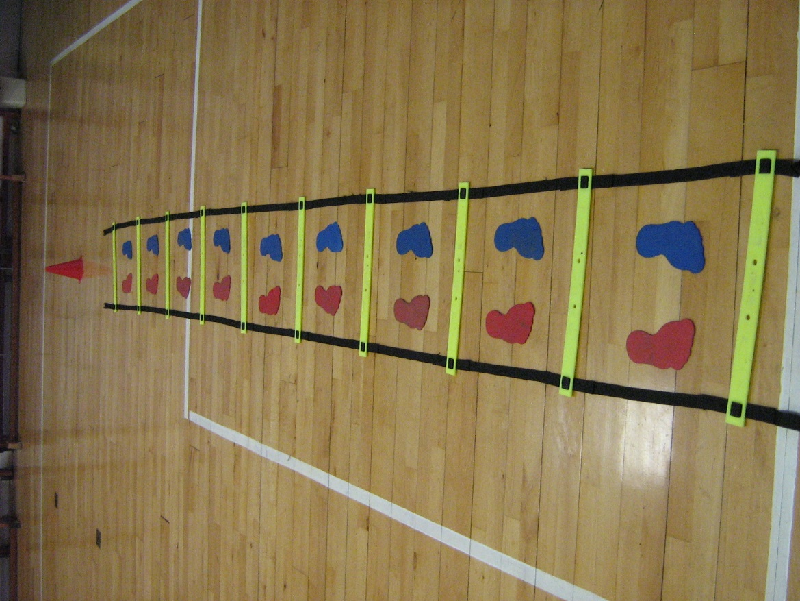
Ladder (Jumping)
Jump along the ladder placing your feet in each space along the ladder.
Show control at all times.
Once you are confident and can complete the task slowly try to increase your speed.
Use your arms to control your speed and balance.

Slide 11
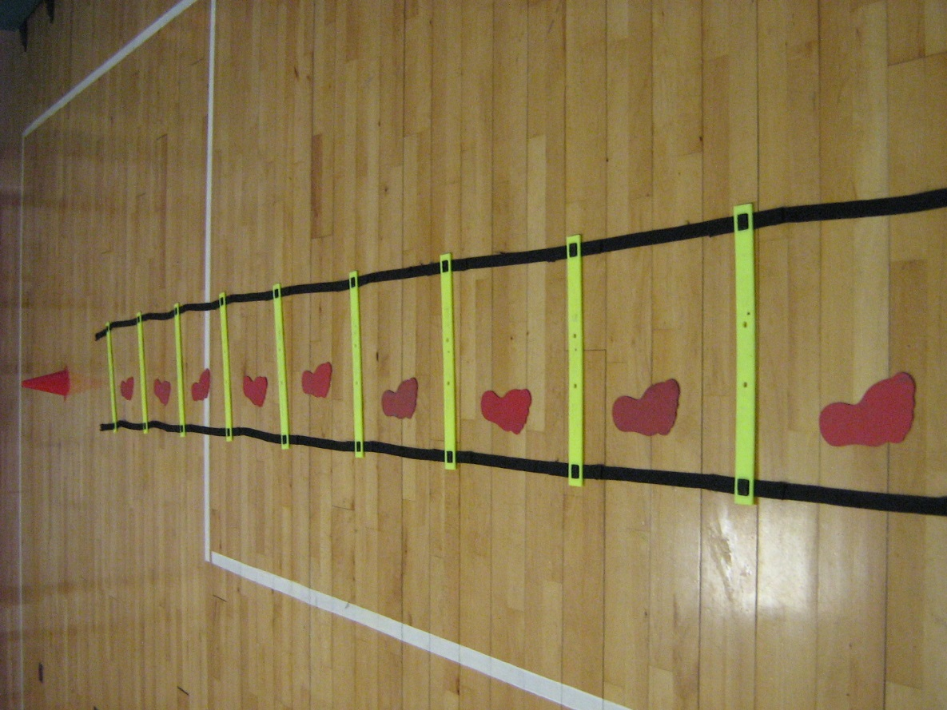
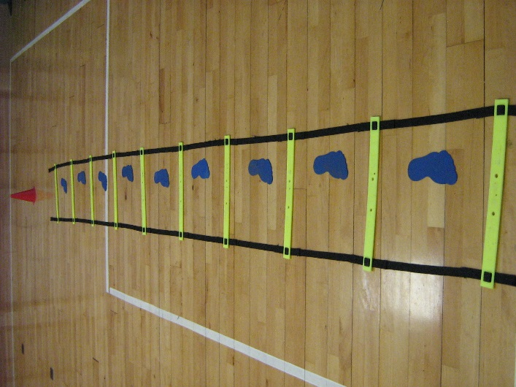
Ladder (Hopping)
Hop on your preferred foot along the ladder placing your foot in each space along the ladder.
Show control at all times.
Once you are confident and can complete the task swap onto your other foot.
Use your arms to control your speed and balance.

Slide 12
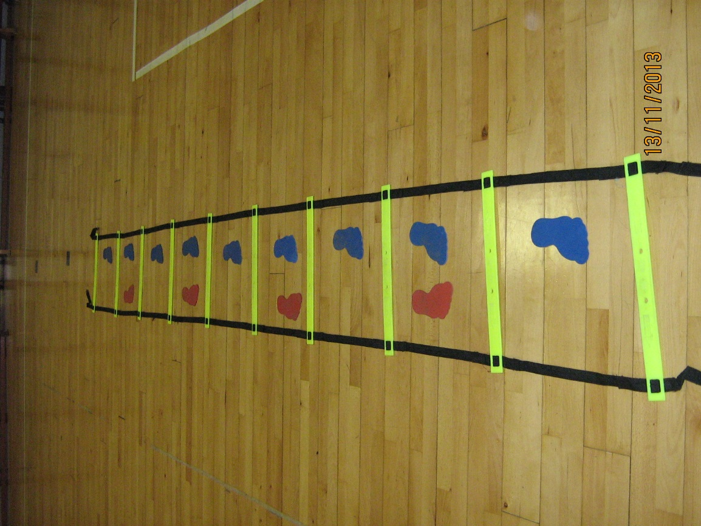
Ladder (Hopscotch)
Travel along the ladder in a jump, hop, jump, hop,
sequence.
Show control at all times.
Once you are confident and can complete the task slowly try to increase your speed.
Use your arms to control your speed and balance.

Slide 13
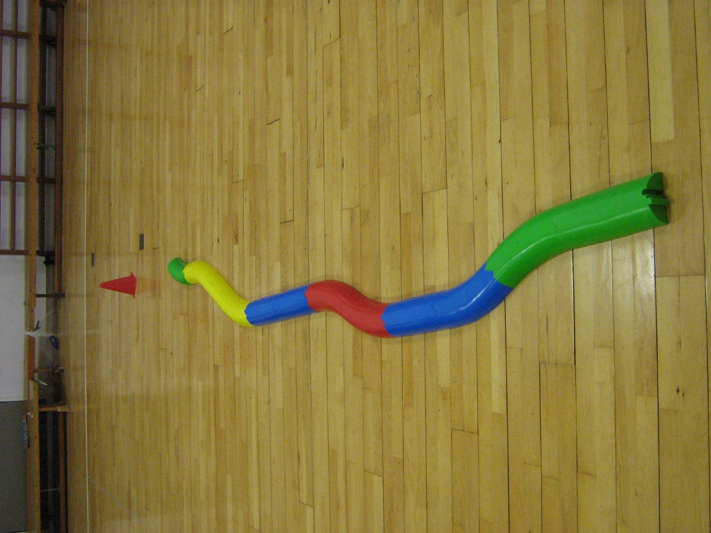
Balancing Bar
Walk along the balance bar placing one foot in front of the other.
Show control at all times.
Move at a steady speed, try not to stop.
Use your arms to control your speed and balance.

Slide 14
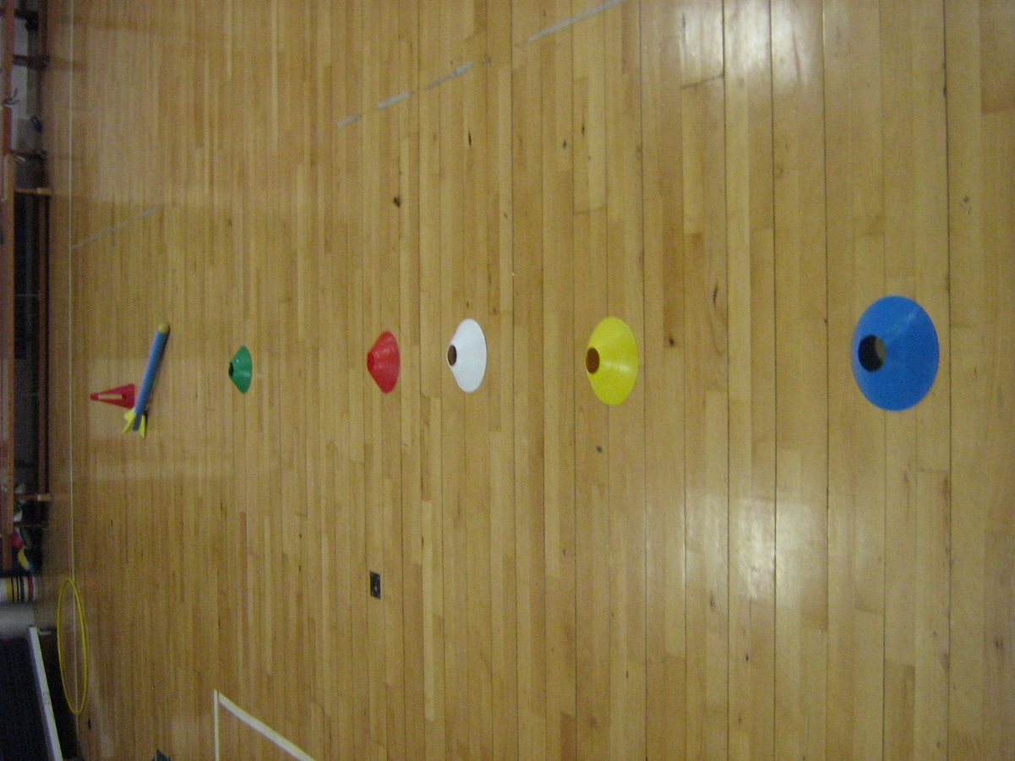
Throwing Overarm
Throw the rocket as far as you can overarm.
Stand sideways and make a star shape.
Hold the rocket in the hand furthest away from the line of cones.
Throw the rocket in a controlled manner.

Slide 15
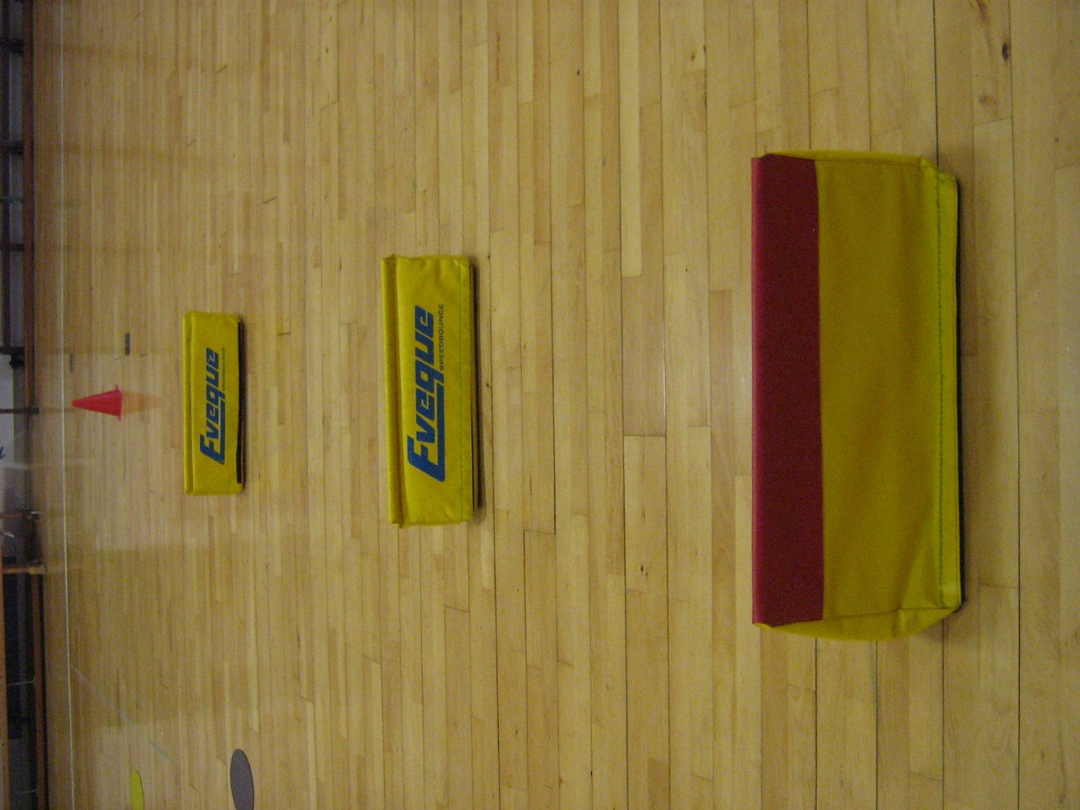
Hurdles (Leaping)
Run and leap over the barriers.
Bend your knee and push off the balls of your feet.
Use your arms to control your speed and balance.
Show control at all times

Slide 16
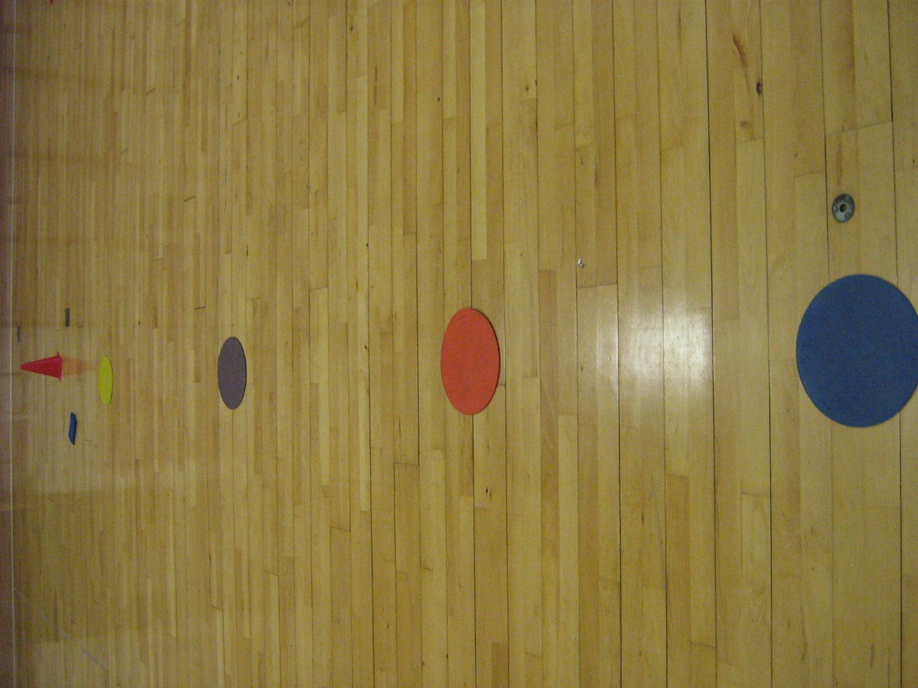
Throwing and Catching
Throw the beanbag along the line of people stood on the rubber mats.
Make sure that the person you are throwing to is ready.
Hold you hands in a cup shape to create a target for the person throwing.
Throw the beanbag into the catchers hands at a controlled speed.

Slide 17
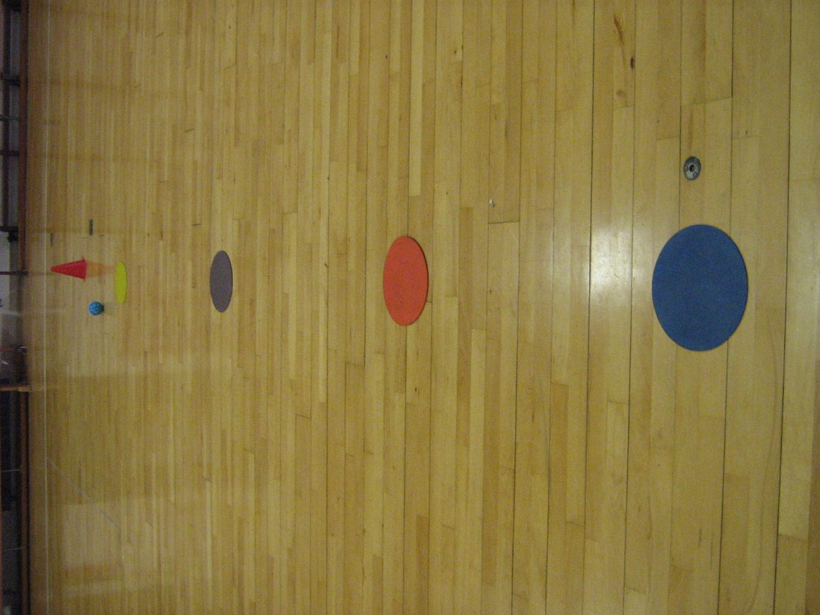
Throwing and Catching
Throw the small ball along the line of people stood on the rubber mats.
Make sure that the person you are throwing to is ready.
Hold you hands in a cup shape to create a target for the person throwing.
Throw the ball into the catchers hands at a controlled speed.

Slide 18
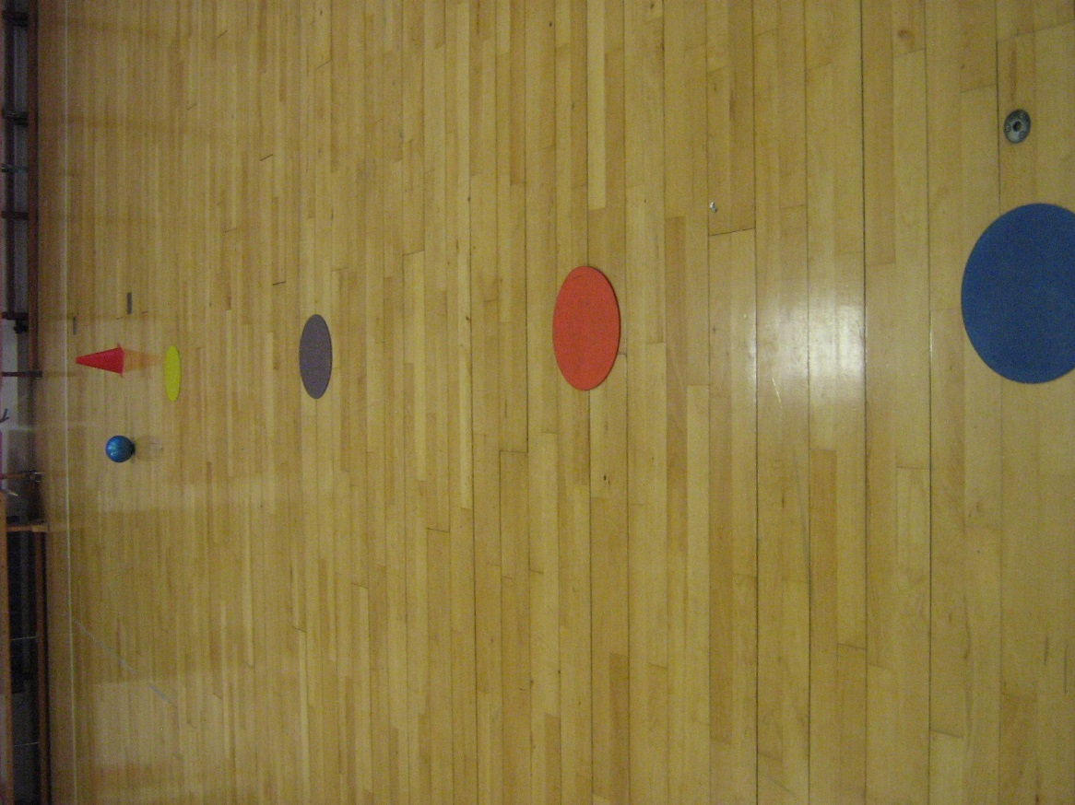
Throwing and Catching
Throw the medium sized ball along the line of people stood on the rubber mats.
Make sure that the person you are throwing to is ready.
Hold you hands in a bowl shape to create a target for the person throwing.
Throw the ball into the catchers hands at a controlled speed.

Slide 19
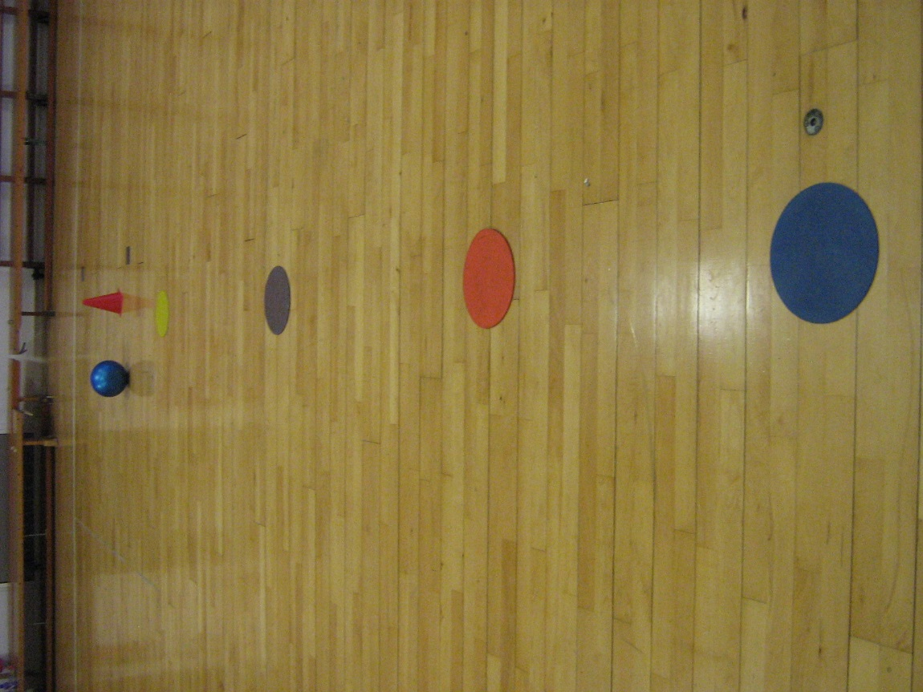
Throwing and Catching
Throw the large ball along the line of people stood on the rubber mats.
Make sure that the person you are throwing to is ready.
Hold you hands in a bowl shape to create a target for the person throwing.
Throw the ball into the catchers hands at a controlled speed.

Slide 20
Make your own Task
Outline of task: ________________
_____________________________
_____________________________
Tip 1) ________________________________________________________
Tip 2) ________________________________________________________
Draw your task here

