Slide 1
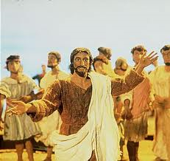
Why do Christians call ‘Good Friday’ good?
Christians believe this dark day was necessary to bring about the resurrection — good came from the crucifixion, as part of God’s offering of himself to restore humanity. Christians remember it as the anniversary of Jesus suffering and dying for their sins. Because of his death, they believe that when they die they can be with God and Jesus in Heaven.

Slide 2
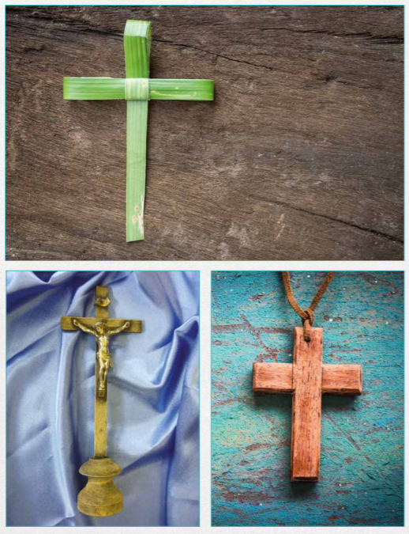
Which cross would do you think would be good to display in a church on Good Friday? Why?

Slide 3
Task
Paddling: Stick in or draw a photograph of the cross that you think would be good to display in a church on Good Friday.
Underneath, write:
- why you chose this cross
- why Christians call the day Jesus died ‘Good Friday’
Red Pen: Think of an alternative name for the day Jesus died. Why would you call it that?
Snorkelling: Draw a picture of the cross that you think would be good to display in a church on Good Friday.
Underneath, explain your choice, including why you think Christians call the day Jesus died ‘Good Friday.’
Red Pen: Do you think the day Jesus died should be called ‘Good Friday’? Why/why not?
Diving: Draw a picture of the cross that you think would be good to display in a church on Good Friday.
Underneath, explain your choice, including why you think Christians call the day Jesus died ‘Good Friday.’
Red Pen: Do you think the day Jesus died should be called ‘Good Friday’? Explain your reasoning.

Slide 4
Plenary
How are the Guru’s deaths similar/different to Jesus’ death? Do you think Sikhs would call the day the Guru’s died ‘good’? Why/why not?

