Slide 1
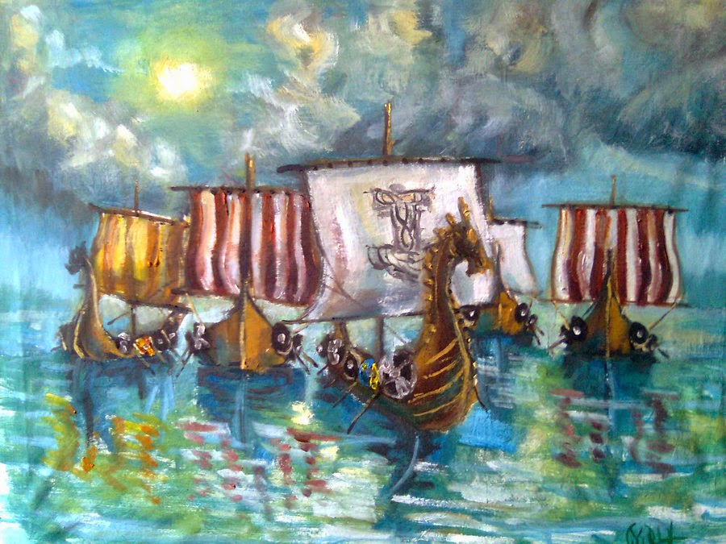
Viking raids
The success of the Vikings in the British Isles

Slide 2
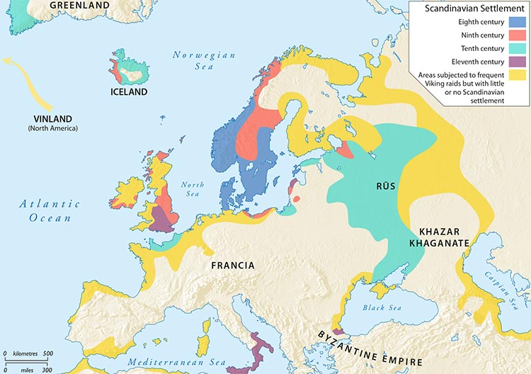
The success of the Vikings
They were able to travel
long distances to trade,
invade and settle in
foreign lands.
They even made it as far
as North America!
As well as the brilliant
design of their ships, they
were capable warriors
Who were willing to
fight to the death. This
made them terrifying
adversaries for the Anglo-
Saxons in Britain.

Slide 3
Their success in the British Isles
Watch the video below to find out about the Viking Invasion and settlement of Britain.
https://www.youtube.com/watch?v=WAjFKzyunrc

Slide 4
We can still see evidence of the Viking settlement in the British Isles today.
Place names ending in:
-by e.g. Derby, Grimsby
-thorpe e.g. Scunthorpe
-thwaite e.g. Lothwaite
Words in English:
Words beginning with sk- e.g sky, skin
Words related to law, e.g. hustings, wrong and law.
Lots of everyday words, e.g.
Window, give, dream ,egg., sister, take, get, happy, ill.
Viking hoards of
treasure
E.g. Vale of York
How did they go about invading Britain…

Slide 5
Viking raids
Viking raids were terrifying experiences for the Anglo-Saxons.
The raids nearly always came as a total surprise.
The Vikings would carefully plan their attacks in advance.
The Vikings had the fastest ships of the day, so they were able to suddenly arrive, seemingly out of nowhere, and be close to their targets.
It was difficult for the locals to defend themselves due to the speed of the attacks.
The Vikings stole valuable objects, took people to become slaves, killed people and destroyed buildings.

Slide 6
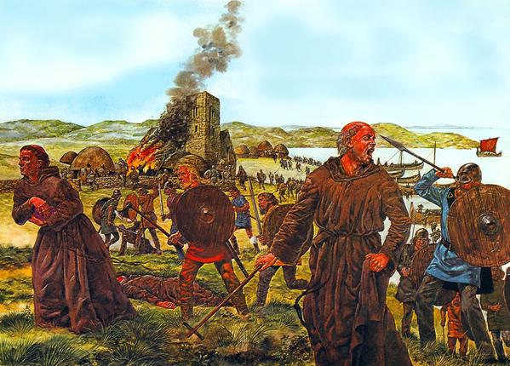
Accounts of the raids
"Here terrible portents came about over the land of Northumbria, and miserably frightened the people: these were immense flashes of lightening, and fiery dragons were seen flying in the air.
A great famine immediately followed these signs; and a little after that in the same year on 8 June the raiding of heathen men miserably devastated God's church in Lindisfarne island by looting and slaughter."

Slide 7
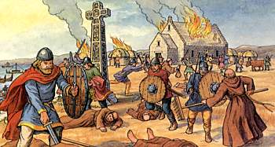
Accounts of the raids
"Lo, it is nearly 350 years that we and our fathers have inhabited this most lovely land, and never before has such terror appeared in Britain as we have now suffered from a pagan race, nor was it thought that such an inroad from the sea could be made.
Behold, the church of St. Cuthbert spattered with the blood of the priests of God, despoiled of all its ornaments; a place more venerable than all in Britain is given as a prey to pagan peoples."

Slide 8
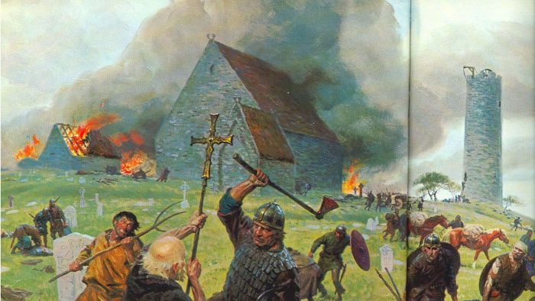
Accounts of the raids
"In the same year the pagans from the northern regions came with a naval force to Britain like stinging hornets and spread on all sides like fearful wolves, robbed, tore and slaughtered not only beasts of burden, sheep and oxen, but even priests and deacons, and companies of monks and nuns.
And they came to the church of Lindisfarne, laid everything waste with grievous plundering, trampled the holy places with polluted steps, dug up the altars and seized all the treasures of the holy church. They killed some of the brothers, took some away with them in fetters, many they drove out, naked and loaded with insults, some they drowned in the sea..."

Slide 9
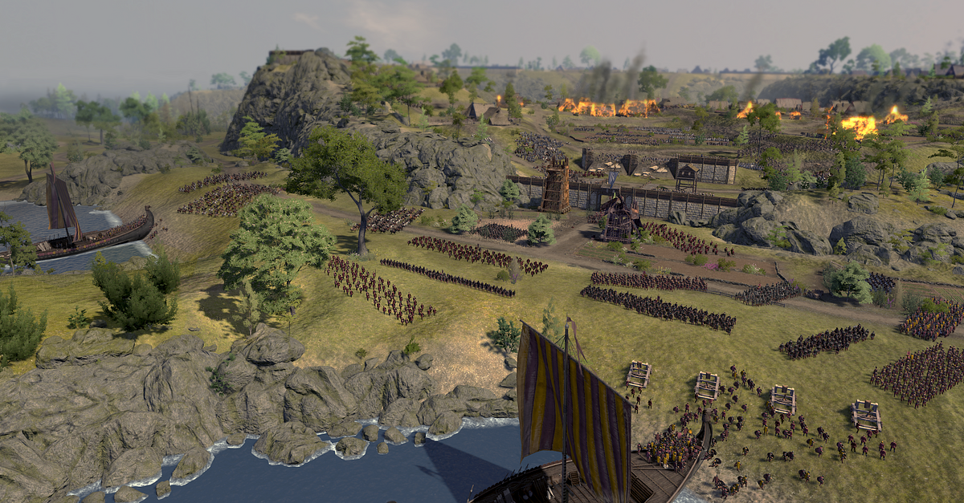
Accounts of the raids
The Vikings "burned and demolished, killed abbots and monks and all that they found there, brought it about so that what was earlier very rich was as it were nothing."

Slide 10
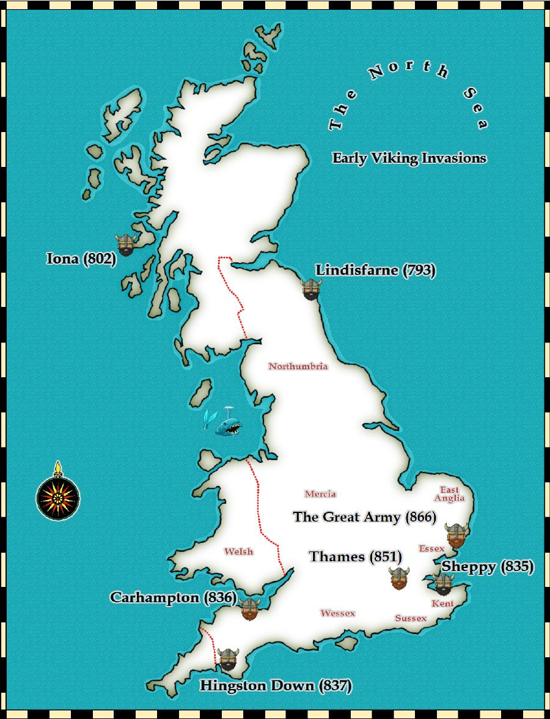
Raids on monasteries
Some of the first Viking raids reported in Western Europe were on monasteries in the British Isles.
One famous example is Lindisfarne- a monastery that was victim of a terrible Viking raid in 793 AD. Lindisfarne was a very important religious site to the Anglo-Saxons, making this attack particularly upsetting.
Watch the videos to find out more about Lindisfarne.
https://www.bbc.co.uk/bitesize/clips/zrpnvcw
https://www.youtube.com/watch?time_continue=271&v=rS3YfhAiXHU&feature=emb_title

Slide 11
Why did they invade monasteries?
Monasteries were wealthy and contained valuable items such as silver and gold.
They were not very well protected- monks did not have weapons.
The Vikings were not Christians, they were pagans, so monasteries were not sacred or important places to them.

Slide 12
Viking treasures
Various hoards of Viking treasure have been found.
The Vale of York hoard is one of the most important Viking discoveries ever made in Britain.
It contained a mixture of different precious metal objects including coins, jewellery, complete ornaments and chopped up fragments of silver.
This hoard also contained objects from all over the world, including Afghanistan, Ireland, Russia and Scandinavia. This shows how far the Vikings travelled to trade and steal.
Remember, there were no banks in Viking times so people buried their treasure in holes in the ground. If the Viking forgot where they hid it or died, then the treasure could stay in the ground for centuries!

Slide 13
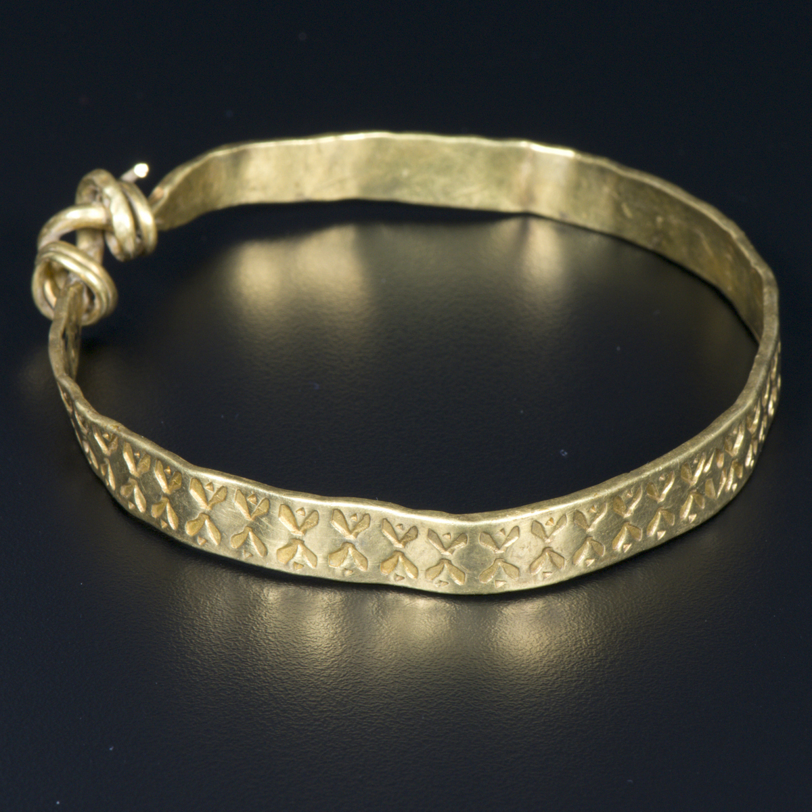
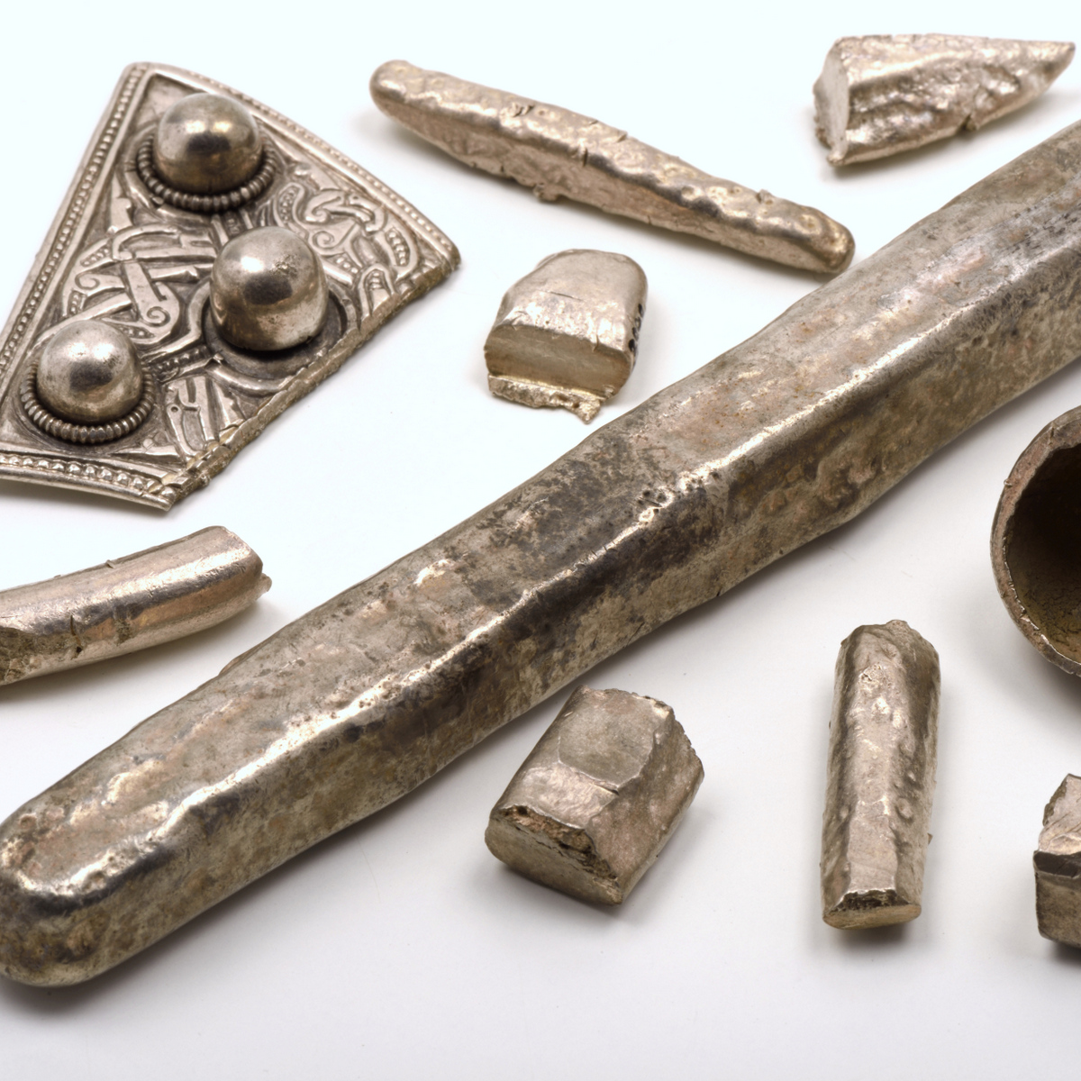
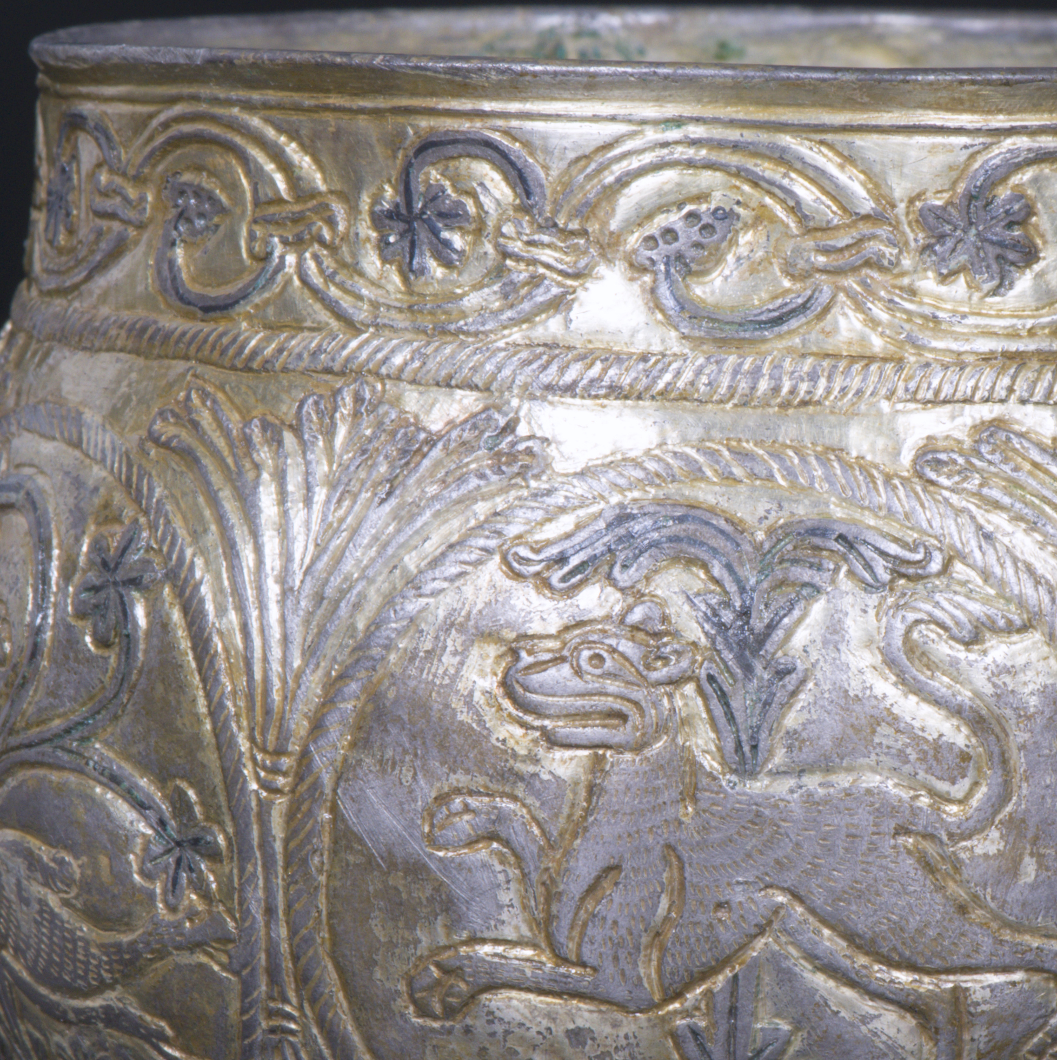
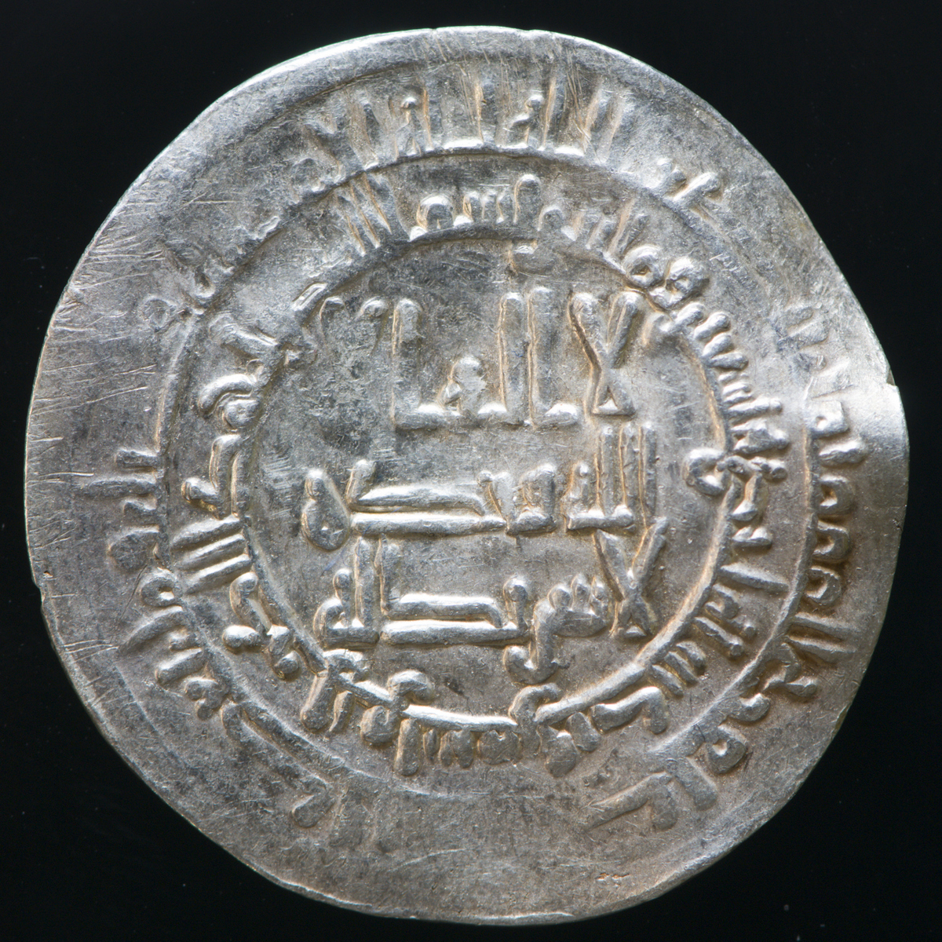
Vale of York

Slide 14
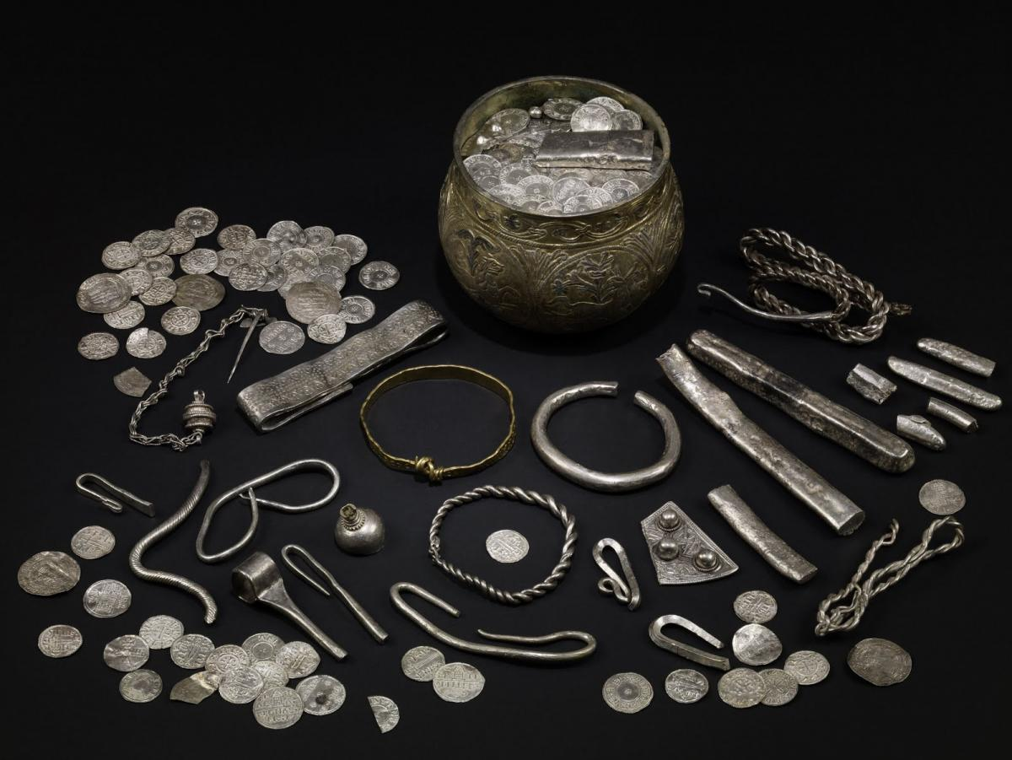
Other Viking artifacts found in hoards

Slide 15
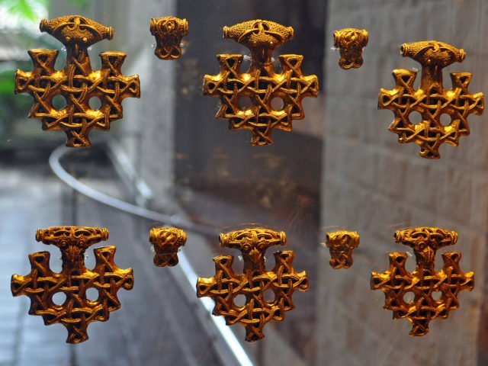
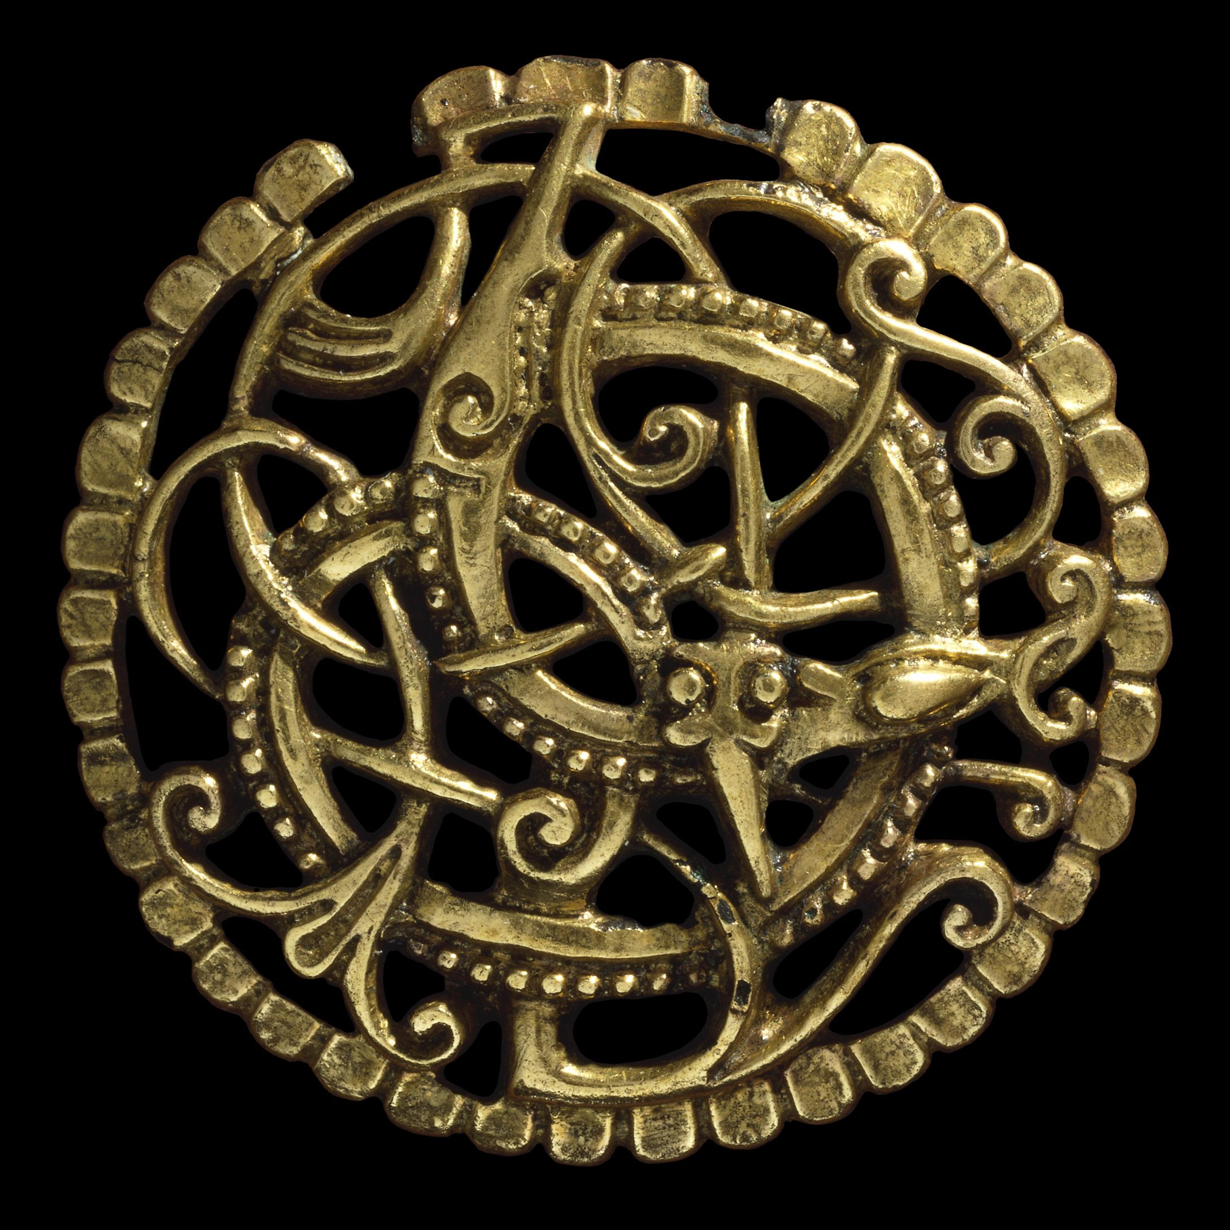
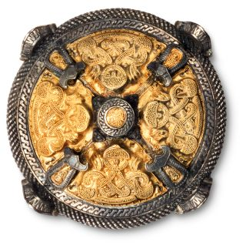
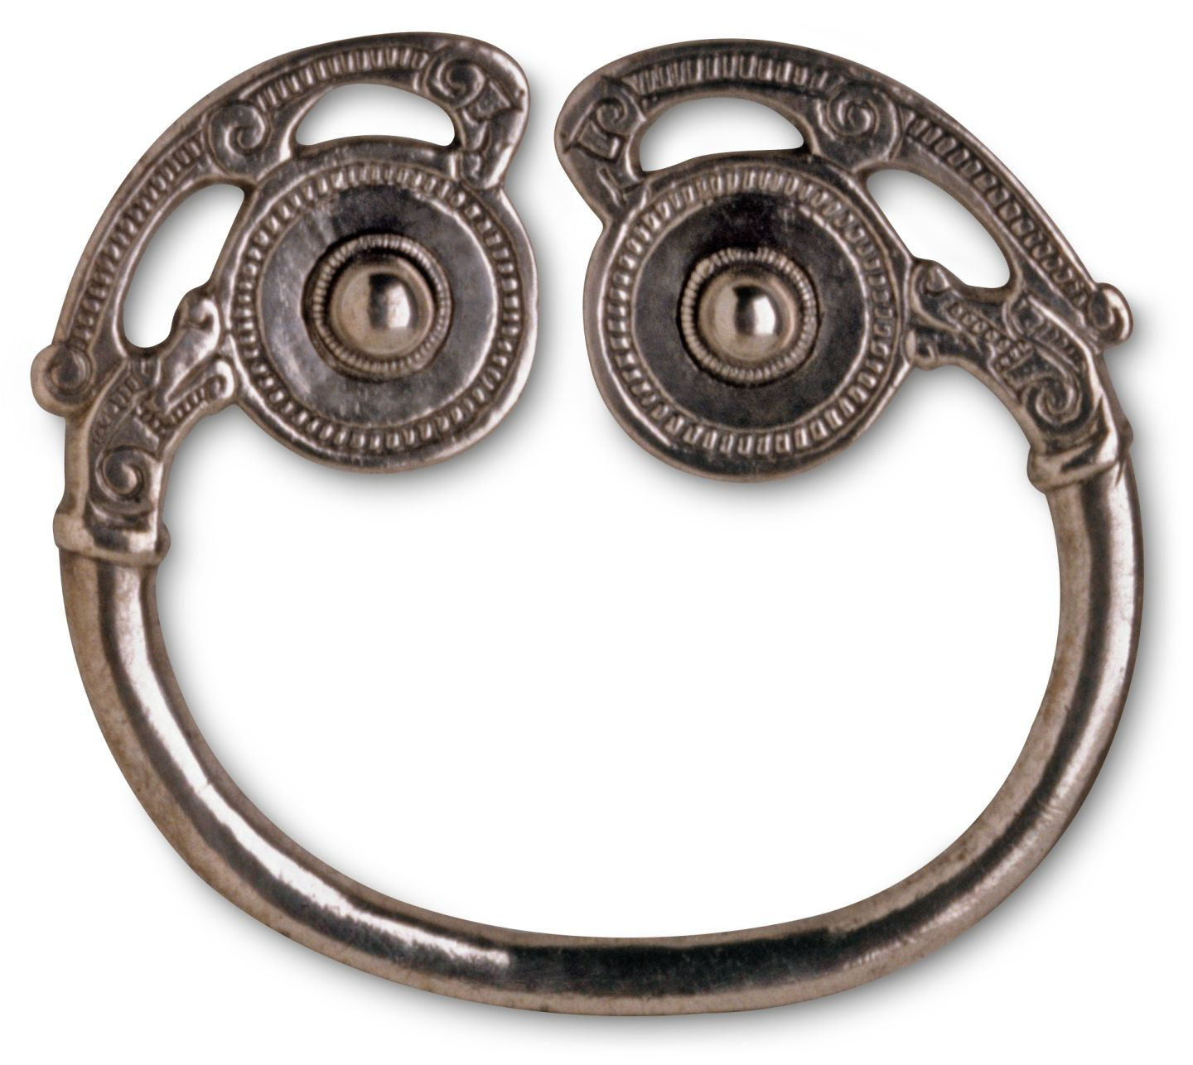
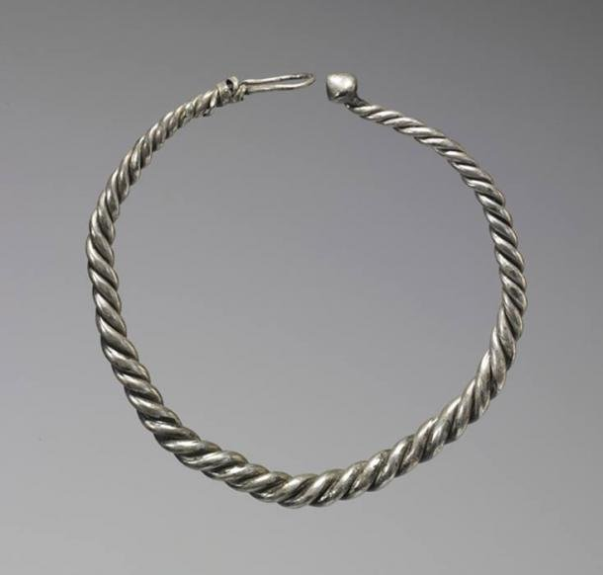
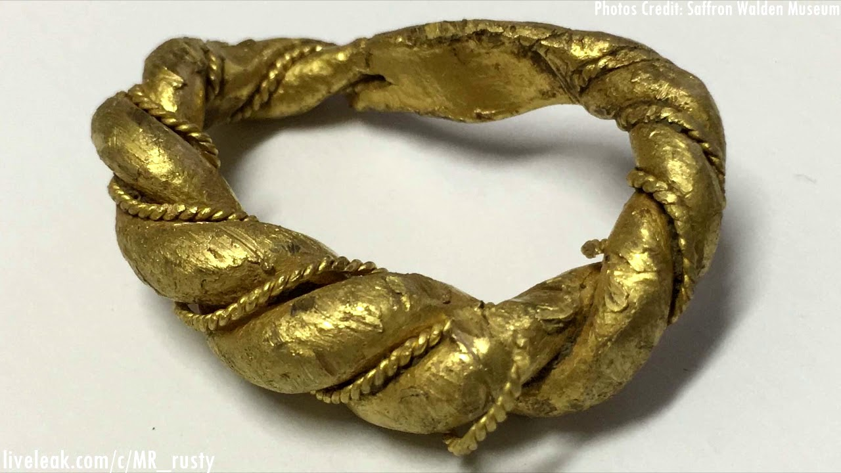
Viking jewellery
They stole and made jewellery. These were prized objects.

Slide 16
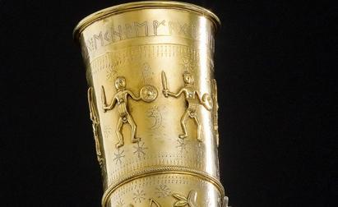
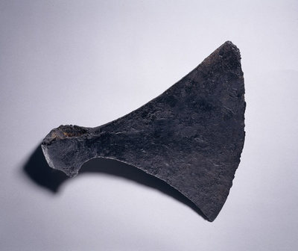
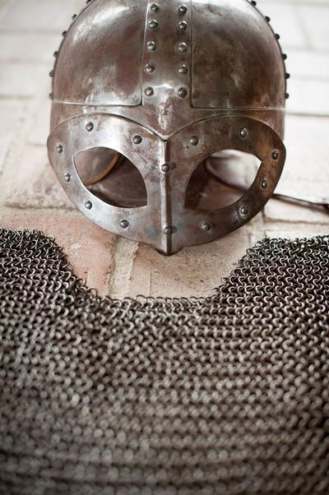
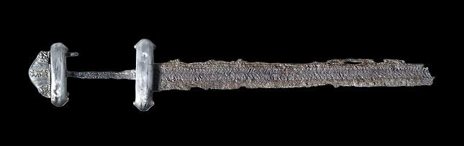
Viking weapons

Slide 17
Your task- newspaper report
Write a report detailing the Viking raid on Lindisfarne monastery.
This newspaper report needs to explain what happened at Lindisfarne and CONVINCE the Anglo-Saxons of the dangers posed by the Vikings.
The Anglo-Saxons must act now to protect themselves from the threat of the Vikings!

Slide 18
Include
A description of the sudden arrival of the Viking ships.
The fast-paced, brutal nature of the raid (destroyed buildings, people hurt, precious things stolen).
Describe some of the objects taken- jewels, silver, gold, bibles, holy objects.
Include quotes from local people (see the “Accounts of raids section in this PowerPoint”).
Encourage the readers to be wary and to protect their villages and possessions.

Slide 19
Don’t forget!
The newspaper report is trying to convince and persuade the reader that the Vikings are dangerous and unpleasant.
Include features of a persuasive text like superlatives and emotional language to scare the readers into taking action to save themselves!
Use the planning template to help you!

Slide 20
Lindisfarne
Some links to help:
https://www.youtube.com/watch?time_continue=271&v=rS3YfhAiXHU&feature=emb_title
https://www.bbc.co.uk/bitesize/clips/zrpnvcw
https://www.english-heritage.org.uk/visit/places/lindisfarne-priory/History/viking-raid/

