Slide 1
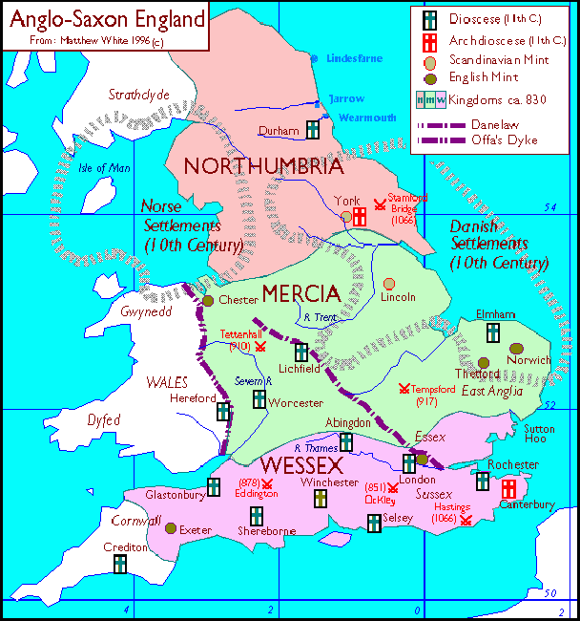

Persuasive writing week 2
Writing a letter to King Aethelred I of Northumbria in 793 AD

Slide 2
Your task this week:
You are going to write a letter from an Anglo-Saxon person in 793 AD to the king of Northumbria, Aethelred I.
You will be writing to the king to try and persuade him to put together an army to defend Northumbria from the Vikings who have just carried out an attack on Lindisfarne monastery.
Use last weeks PowerPoint to help you write persuasively.

Slide 3
Use the same structure as last week
Introduction
Who are you writing your letter to? What is the topic of your letter?
Explanation
Why is the topic so important to you?
1st reason
Remember to use a whole paragraph to explain each reason.
2nd reason
Remember to use a whole paragraph to explain each reason.
3rd reason
Remember to use a whole paragraph to explain each reason.
Conclusion
Remind the reader of the reason for your letter and what you hope the outcome will be.
Thanks
Thank the reader for taking time reading your letter and sign with Yours sincerely or Yours faithfully.

Slide 4
Content of your letter
Use the history lesson PowerPoint to learn about Viking raids on monasteries and about Lindisfarne in particular.
When you write to the king you might want to explain the brutality of the Viking warriors, the things they have stolen and the fact that they attacked a monastery.
To the Anglo-Saxons, the monasteries were very important and holy places. They were devastated that such a sacred place had been ruined.

Slide 5
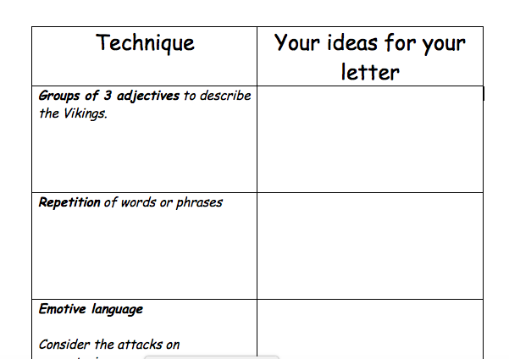
Monday
Use what you
know about the
Vikings to think
of ways to describe
them that will
persuade the King
that they are a
very dangerous
threat.

Slide 6
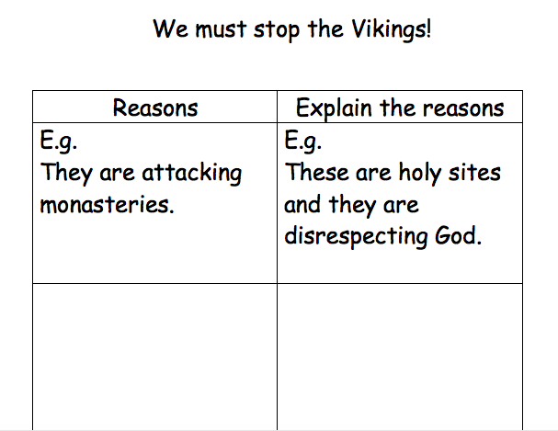
Tuesday
Use the history PowerPoint
and your own research to
come up with the reasons
that you will use to
persuade the king to fight
the Vikings.

Slide 7
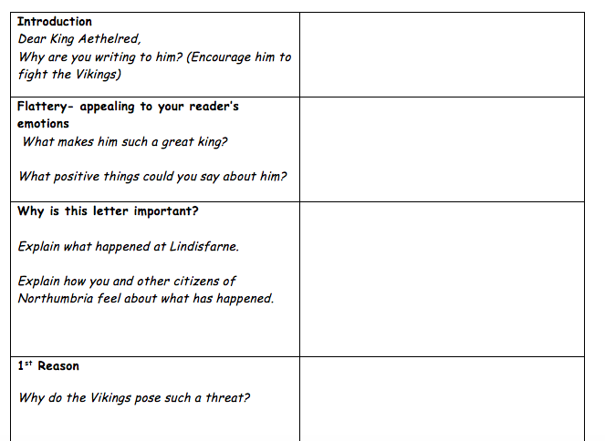
Wednesday- plan your letter

Slide 8
Thursday and Friday
Write your letter and edit it!
After you have have written it, you could rewrite it on aged paper to make it look more authentic.
For example, you could use cold, wet tea bags to stain the paper brown before leaving it to dry and then writing on it the next day.

