Slide 1
Prefixes, suffixes and root words
Introduction
Notes:
This lesson is a follow on lesson from ‘Homophones’

Slide 2
Re cap...
Homophones are...
Words that sound the same but are spelt differently. Such as;
Where + wear there + their whether + weather
What can you use to help you work out which word to use?
Write down 5 sentences using the following words. Remember to use the words in the correct context:
there witch you’re knew no

Slide 3
What can i do to help remember which is which?
Use a dictionary
Use spell check on a P.C. Carefully! – Take time to proof read your work. If you are unsure, highlight the word and press the ‘shift’ key and press ‘F7’. This will bring up a thesaurus.
Widen vocabulary
Apply spelling techniques, for example;
There Their
over there i - person

Slide 4
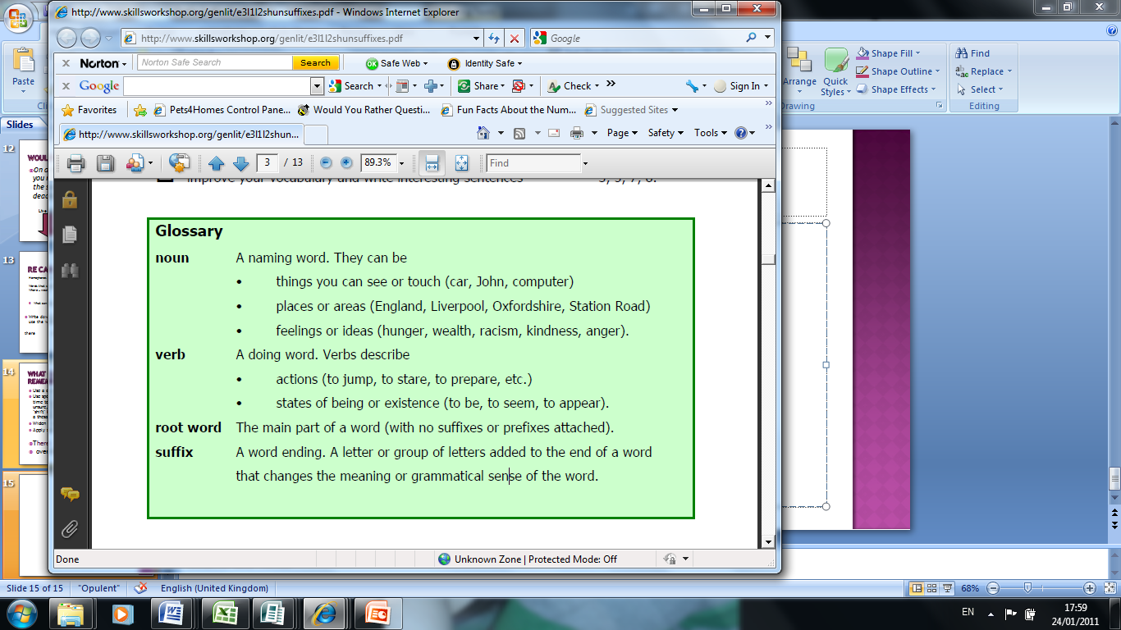
Glossary
Notes:
Taken from www.skillsworkshop.org

Slide 5
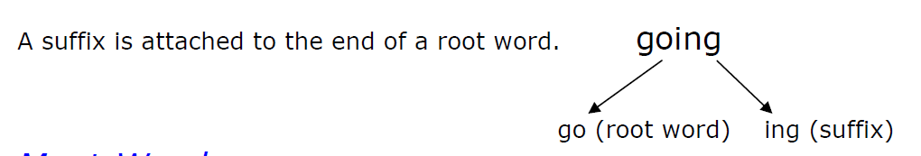
Root words
A root word is a real word and you make new words from it by adding prefixes and suffixes.
Root words are helpful because:
You can use a root word to help you with other spellings.
If you recognise the root of a word when you are reading it can help you to work out what the word is and what it means.
There are spelling rules for adding suffixes and prefixes to root words.
successful
Learning
Learn ing
Success ful

Slide 6
Suffixes
Adding suffixes to words can change or add to their meaning, but most importantly they show how a word will be used in a sentence and what part of speech (e.g. noun, verb, adjective) the word belongs to.
e.g. If you want to use the root word 'talk' in the following sentence:
I was (talk) to Samina.
You need to add the suffix 'ing' so that the word 'talk' makes better sense grammatically:
"I was talking to Samina".

Slide 7
suffixes
Activity 1:
In pairs write down as many suffixes as you can think of.
You have 5 minutes!

Slide 8
Suffix | Example |  | Suffix | Example
ed | walk + ed = walked |  | ness | happy + ness = happiness
ing | say + ing = saying |  | al | accident + al = accidental
er | tall + er = taller |  | ary | imagine + ary = imaginary
tion | educate + tion = education |  | able | accept + able = acceptable
sion | divide + sion = division |  | ly | love + ly = lovely
cian | music + cian = musician |  | ment | excite + ment = excitement
fully | hope + fully = hopefully |  | ful | help + ful + helpful
est | large + est = largest |  | y | ease + y = easy

Slide 9
Suffixes... Common errors
-less with less than two ss is useless.
Careless hopeless relentless
Root words ending in ‘e’. Remember to drop the ‘e’ when adding ‘ing’!
Take + ing = taking make + ing = making
-ful is always a three-letter word - unless it's used as a word on its own:
Someone who's full of care is careful.
Mindful successful hopeful regretful

Slide 10
Prefixes
A prefix is a group of letters which you can add to the beginning of a root word to change the meaning of the word.
e.g. mis + fortune = misfortune
Prefix meanings:
Every prefix has a meaning, for example:
The prefix 'un' means 'not'
The root word 'clear' means 'bright', 'free from difficulty'
un + clear = unclear which means 'not clear' or 'dim', 'difficult to see or understand'

Slide 11
prefixes
Activity 1:
In pairs write down as many prefixes as you can think of.
You have 5 minutes!
Extra points if you can also write down the meaning of the prefix!

Slide 12
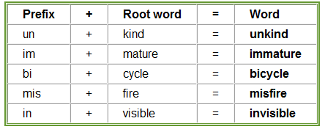
Prefixes
Generally when you add a prefix to a root word the spelling of the prefix and the root words stays the same.
(Think of mobile phone tariffs, you can choose to add ‘bolt ons’ to your contract to suit a purpose)
www.bbc.co.uk/skillswise/prefixes
Notes:
Table taken from www.bbc.co.uk/skillswise/prefixes

Slide 13
prefixes... Common errors
When the prefix 'all' is added to a root word the final 'l' of 'all' is dropped.
all + together = altogether
all + ways = always
dis – only has one ‘s’ when being used at the start of a word:
Dis+ appear = disappear dis + respect = disrespect

Slide 14
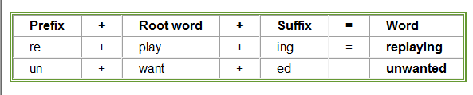
Mix it up!
You can also add a prefix to a word which already has a suffix added to it.

Slide 15
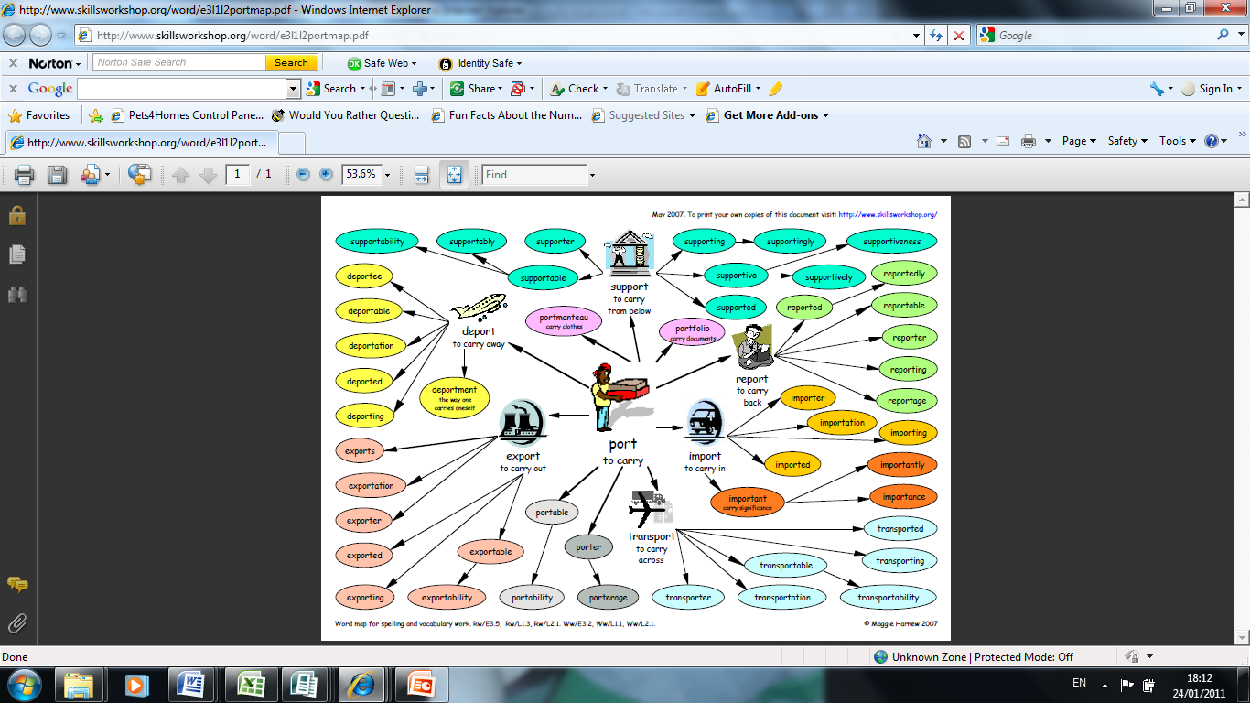
How many words can you make?
Notes:
Word map used from www.skillsworkshop.org

Slide 16
Answer
Notes:
Word map used from www.skillsworkshop.org

Slide 17
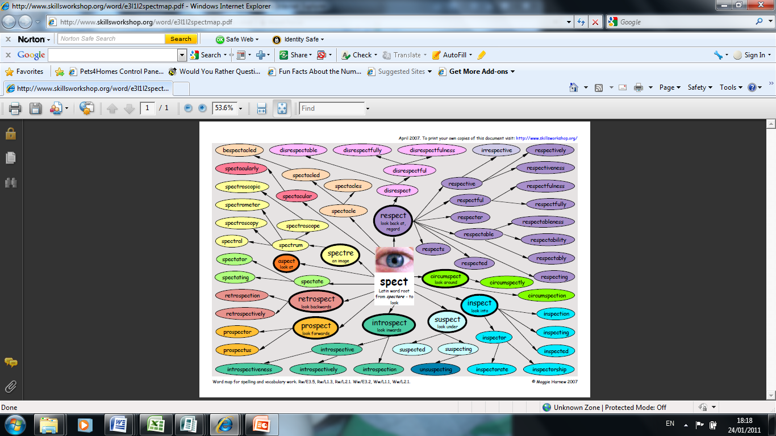
Create your own word map
Choose a root word from the list below and create a word map adding suffixes and prefixes.
spect – use
late act
If you are uncertain whether the prefix you have used is correct, check the word in a dictionary when you proof-read your writing!

Slide 18
Word maps
Notes:
Word map used from www.skillsworkshop.org

Slide 19
To sum up
A root word is...
A suffix is...
For example:
Identify the prefix in the word below:
Antibacteria
Is it ‘full’ or ‘ful’ at the end of a word?
Is it ‘dis’ or ‘diss’ at the start of a word?

