Slide 1
Grammar
Using dashes as parentheses

Slide 2
WHAT ARE PARENTHESES
When writing, you can add parenthesis to the middle of a sentence to add extra information. Parenthesis is when a word, phrase or clause is inserted into the sentence to give extra information.
Brackets are often used for parentheses. However, depending on the type of writing, commas and dashes are also sometimes used.

Slide 3
As well as using brackets, we can use commas or dashes to indicate parentheses.
E.g.
Andrew (last year’s losing finalist) is expected to win this heat.
Andrew, last year’s losing finalist, is expected to win this heat.
Andrew - last year’s losing finalist - is expected to win this heat.
Andrew is expected to win this heat.
Albert the Alien (who had no training) was in charge of the wrecking ball.
Albert the Alien, who had no training, was in charge of the wrecking ball.
Albert the Alien - who had no training - was in charge of the wrecking ball.
Albert the Alien was in charge of the wrecking ball.
These all have the same
meaning.
These all have the same
meaning.
Remember: the words in red can be removed from the sentences and the sentences would still make sense.

Slide 4
Using dashes
These are less formal than using brackets and tend to be found in informal writing.
Pairs of dashes are used for parentheses around additional information.
E.g. The tiny girl – bold and confident – sang to the audience.
A single dash can be used to link complete sentences (main clauses)
E.g. Some people believe that I am a normal boy – they have no idea that I’m actually a god.
They are sometimes used instead of a colon for emphasis.
E.g. Shock, horror, despair – Jamie had totally forgotten his wife’s birthday!
They are used to show interruptions in speech
E.g. “What do you mean? I am speaking like I al – ” Nick jumped as a heavy book flew off the shelf and landed at his feet with a thud.

Slide 5
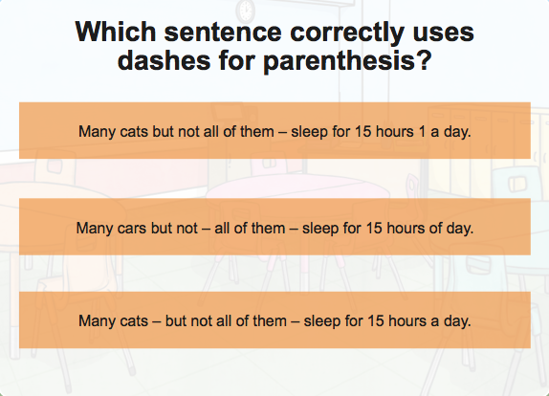

Slide 7
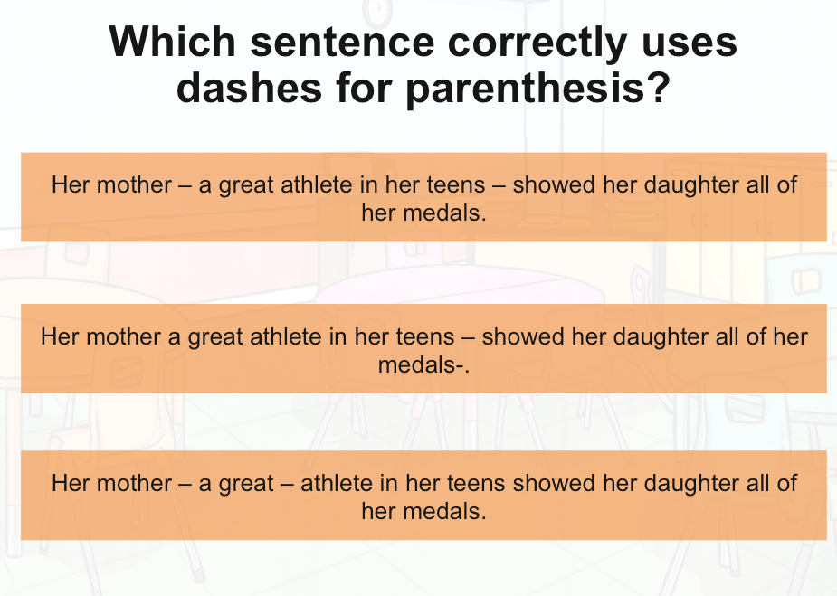

Slide 9
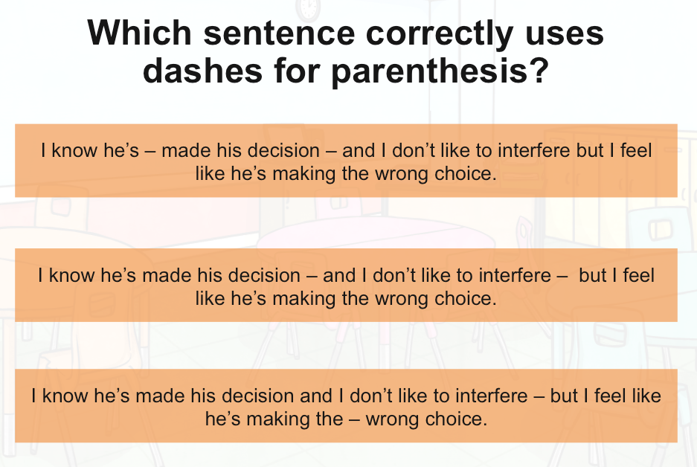

Slide 11
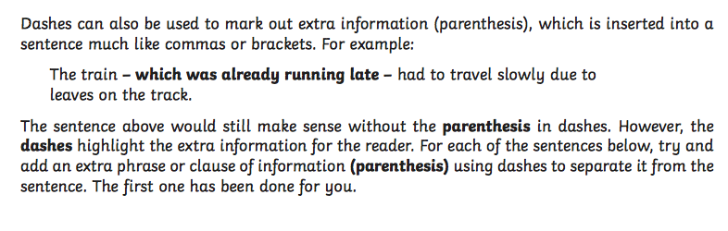
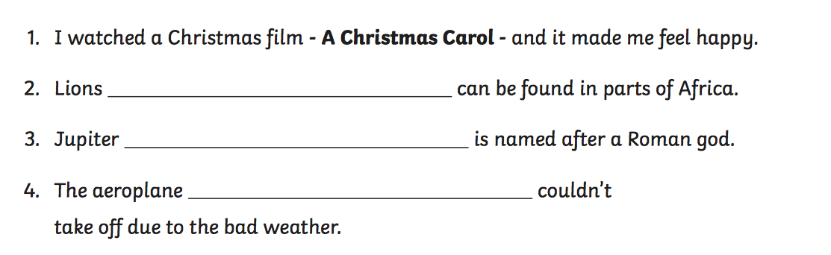

Slide 12
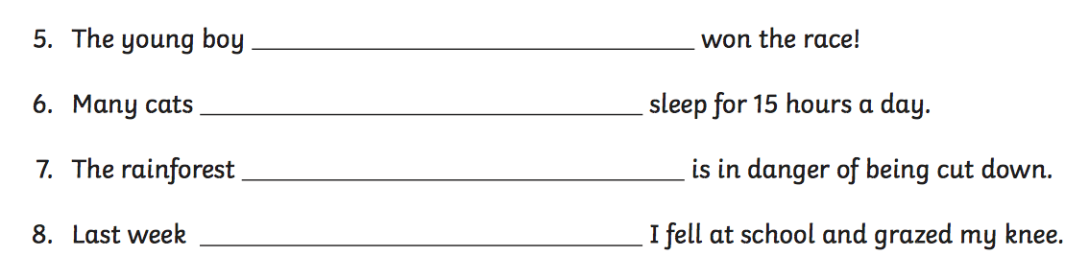

Slide 13
Challenge- Add dashes for parentheses
The vast desert lush with flowers after the rain storm contained lots of interesting plant life.
One day last month I’m sure it was on a Tuesday I fell down and grazed my knee.
I have given the letter which you sent me two days ago to my dad.
HINT: Read the sentences and identify the extra information that could be removed without the sentence becoming nonsensical.

Slide 14
EXTRA Challenge
Can you write 3 – 5 sentences using dashes for parentheses?

