Slide 1
Biographies week 2
Monday

Slide 2
Planning a biography
This week, you will write a biography of a character related to
the Viking topic.
This is a fictional biography, so you will be using your own
imagination to fill in the details.
Use the same planning template as last week to plan the facts
for your character’s biography.

Slide 3
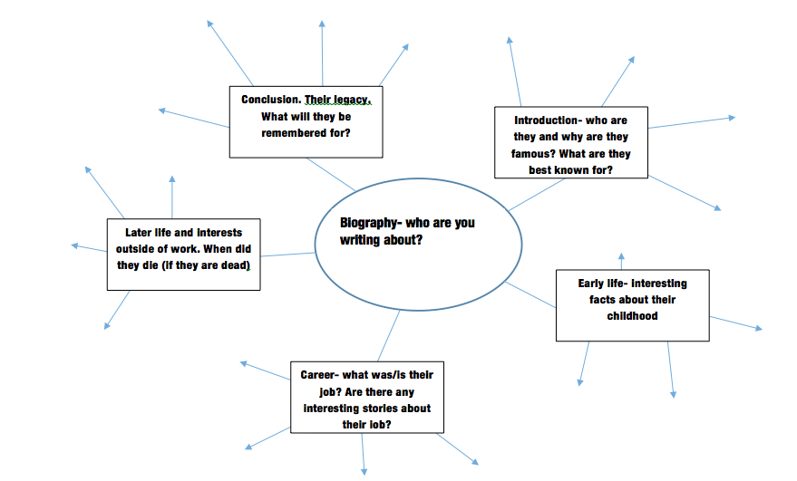
Use the template to record your ideas

Slide 4
Who could you write about?
You could write a biography about:
Beowulf
A Viking warrior who has travelled from Scandinavia and settled in Britain
An Anglo-Saxon person who lived through the Viking invasion
Another character from a Viking/Norse legend or story. E.g. Thor.

Slide 5
How to come up with facts about your character
Remember, this is a FICTIONAL biography, based on a made up character.
You can base your character on a Viking and research what life was like for a Viking to come up with facts about them.
If you base your biography on a character from a legend or story, e.g. Beowulf or Thor, then re-read the stories about them so you can think about what their life might have been like.

Slide 6
biographies
Tuesday- types of sentences

Slide 7
Types of sentence
Statement
Question
Exclamation
Command

Slide 8
statement
A statement is a sentence that simply tells the reader something.
E.g.
Very few people have actually met an alien.
Lisa was working all night.
It is going to rain later.

Slide 9
Question
A sentence that asks the reader something. There is a question mark (?) at the end to indicate that a question has been asked.
E.g.
Do you have a pen?
Did you watch Eastenders last night?
Have you had any lunch?
Are you hungry?

Slide 10
command
A command is telling the reader to do something. Commands usually start with a verb.
Tidy up your room.
Get out!
Complete the work and put down your pencil.

Slide 11
exclamation
An exclamation is a FORCEFUL statement that expresses a high level of emotion or excitement.
They begin with “What” or “How” and end with an exclamation mark.
E.g.
What a beautiful day!
How lovely!

Slide 12
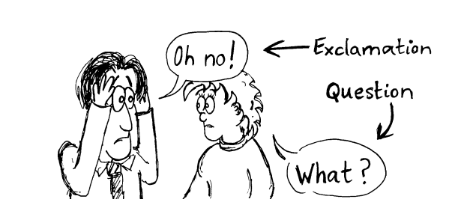

Slide 13
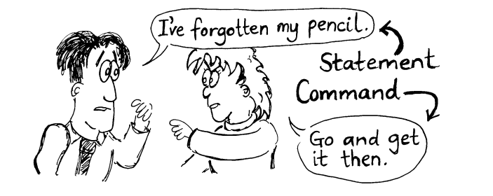

Slide 14
Match the sentence to the sentence type
Are you going home? a) command
Come here now! b) statement
I like oranges. c) question
How exciting! d) exclamation

Slide 15
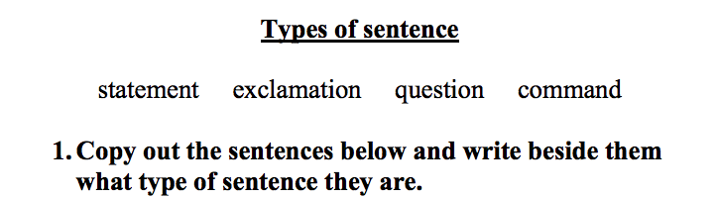
Have you been swimming?
Go and get the bags!
The boy was running.
Can you think of another sentence?
How bizarre!
Put your chairs on the table.
What a coincidence!

Slide 16
Can you write your own examples of each sentence type?
Statement
Question
Command
Exclamation

Slide 17
biographies
Wednesday- writing your biography

Slide 18
Features of a biography
Heading – the name of the person you are writing about.
Introduction – Who is the person and why are they important? Summarise their main achievement or what they are famous for, e.g. Neil Armstrong was the first man to walk on the moon.
Write about the important events in the person’s life.
Chronological order – write about events in the order that they happened in time. E.g. start with their birth and end with their death.
Include the dates of the events.
Use fronted adverbials of time to indicate the passage of time, e.g. Two years later, Soon after… etc.
Past tense – You are writing about what has already happened in someone’s life- so it needs to be in past tense.
Third person – You are writing about someone else- so third person (he, she, his, her).
Conclusion – how are they/ how will they be remembered?

Slide 19
Content of biographies
What information should be included?
Birth and (death) dates.
Details of the person’s early life- family, school.
Details of the person’s career- jobs, successes and failures at work.
Later life and death- how did they die.
Dates of any important events.
Legacy- what will be the legacy of the person, why will we remember them?

Slide 20
Write the biography of your chosen fictional character/ person
Don’t forget to include the features of biographies.
Remember- you are writing about a FICTIONAL character. You can do research to help you with facts relating to Vikings or a fictional character, but the character in your biography should be FICTIONAL.

Slide 21
biographies
Thursday- Grammar video on dashes

Slide 22
biographies
Friday

Slide 23
Edit your biography
Check your spelling, punctuation and grammar.
Have you used different sentence starters to help your writing flow and to make it clear to the reader that time passed between different events in your character’s life?
Have you used paragraphs correctly?
Is there anything you could add to make it better? E.g. improve vocabulary or extra facts?
Is your biography so full of interesting facts that it could convince a parent or sibling that your character is actually real?

