Slide 1
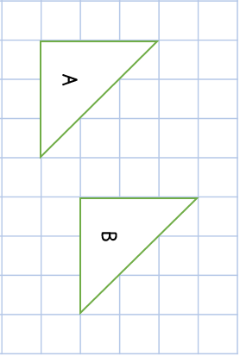
Year 5 | Week 2 | Day 1

Slide 2

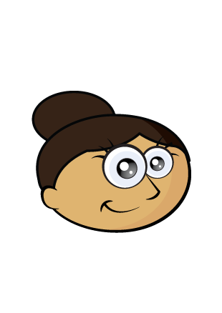
Have a think
Dora is thinking of a number.
It rounds to 400 to the nearest 100
It rounds to 450 to the nearest 10
What could Dora’s number be?
445
446
447
448
449
450
451
452
453
454
455

Slide 3

Round to the nearest 10
0
one
1
one
2
ones
3
ones
4
ones
5
ones
6
ones
7
ones
8
ones
9
ones
Round to the nearest 100
0
tens
1
ten
2
tens
3
tens
4
tens
5
tens
6
tens
7
tens
8
tens
9
tens

Slide 4
Have a go at the rest of the worksheet

