Slide 1
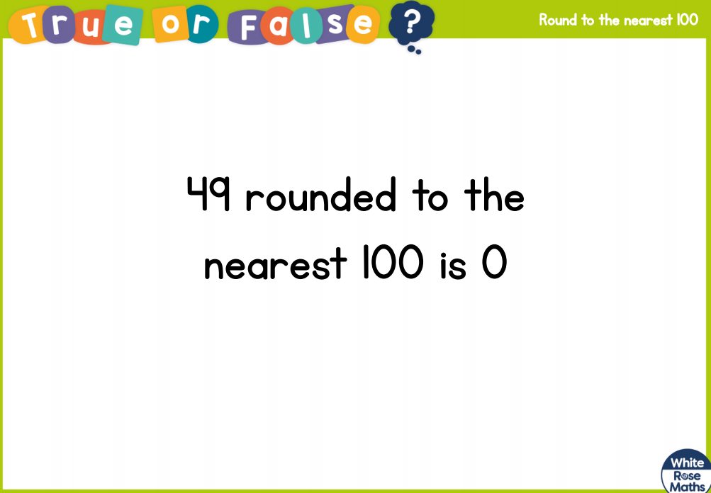

Slide 2
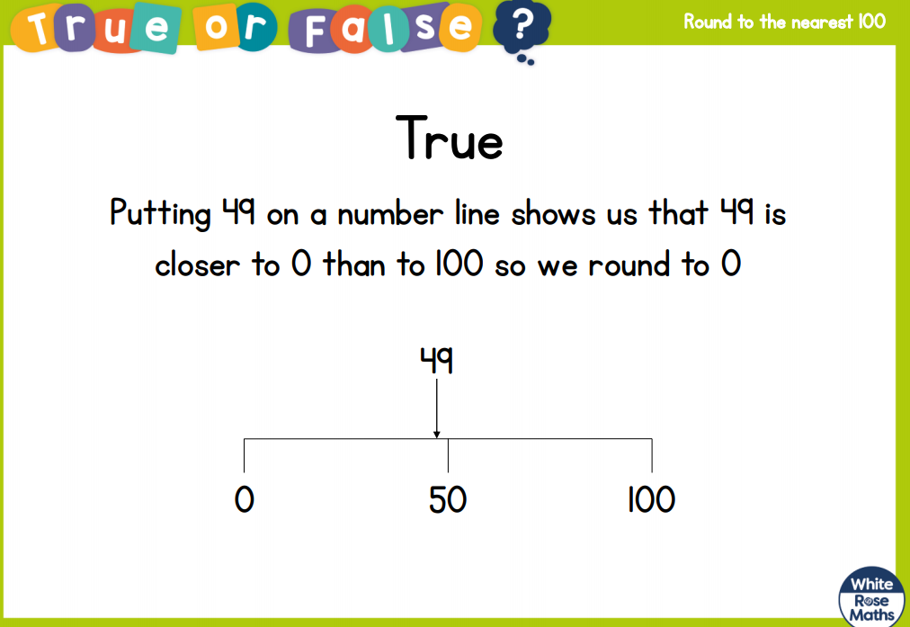

Slide 3
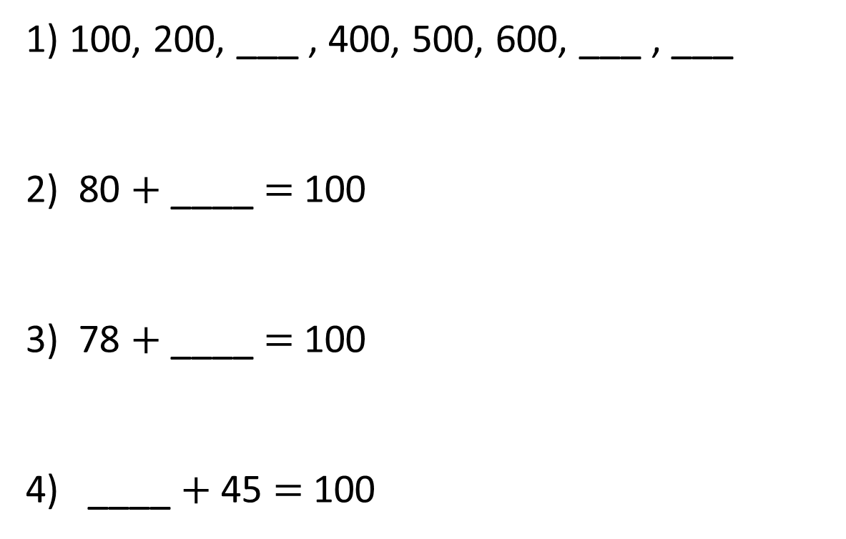
1) 100, 200, ___ , 400, 500, 600, ___ , ___
2) 80 $+$ ____ $=$ 100
3) 78 $+$ ____ $=$ 100
4) ____ $+$ 45 $=$ 100

Slide 5
Round 130 to the nearest 100
100
100
110
120
130
140
150
160
170
180
190
200

Slide 6
Round 130 to the nearest 100
30
70
100
110
120
130
140
150
160
170
180
190
200
130 is closer to 100 than 200
130 rounded to the nearest 100 is 100

Slide 7
Round 138 to the nearest 100
38
62
100
138
200
138 is closer to 100 than 200
138 rounded to the nearest 100 is 100

Slide 8
Have a go at questions 1 – 4 on the worksheet

