Slide 1
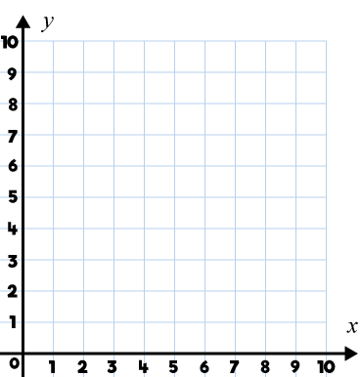
Year 5 | Week 1 | Day 4

Slide 2
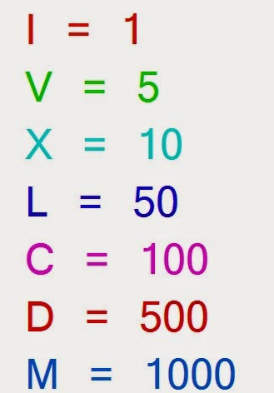
What numbers can we make?

Slide 3
Have a go at the rest of the worksheet
If you finish – extention questions

