Slide 1
Monday 29th March 2021
L.O: To understand texts- retrieval skills
C: Boy

Slide 2
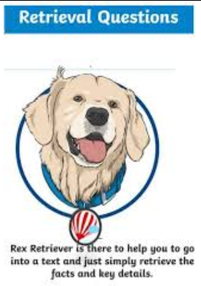
Today we are continuing to explore our new book! We are going to explore Roald’s time in boarding school.
We are going to use our Rex Retriever skills to help us draw information out from the text.

Slide 3

Starter: Game
Can you rate these synonyms of nervous?
Anxious
Fearful
Hysterical
Concerned

Slide 4
Class Read
Class Read p.85-90 “Our large family before”
While we are reading, I would like you to focus on the tuck-boxes.

Slide 5
Our task
Paddlers:
Use your skim reading skills and fastest finger to find the correct information.
Snorkellers:
Work with TA to re-read the text and find the key information.
Divers:
Answer the questions by thinking about both what the character’s say and also by what they may be thinking.

Slide 6
Question 1
What is the full postal address of the school?
I have noticed lots of you are not copying exactly. You must have all the correct spelling and punctuation to get the marks.

Slide 7
Question 2
Can you identify three items of Roald’s new school uniform?
I have noticed lots of you are not copying exactly. You must have all the correct spelling and punctuation to get the marks.

Slide 8
Question 3
Why did the Headmaster encourage the families to send food parcels? DIVERS: What did he actually tell the families instead?

Slide 9

Red Pen Challenge:
:
If you went to boarding school, what three treasures would you keep in your tuck-box and why?

