Slide 1
Alfred the Great
Was he really that great?

Slide 2
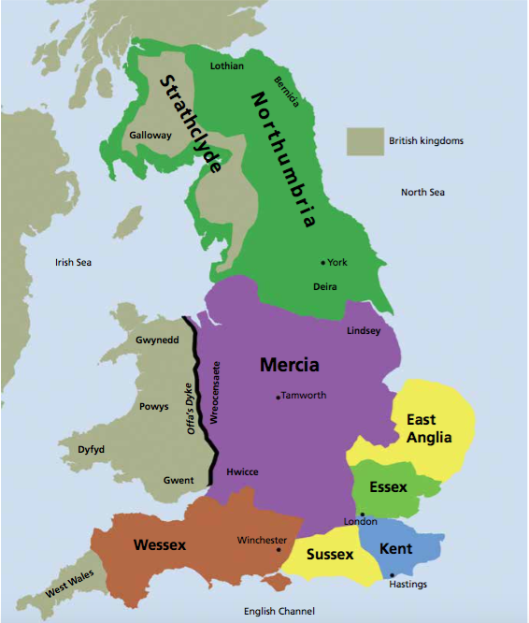
Anglo-Saxon kingdoms
The Anglo-Saxons invaded as
different tribes and Britain.
This led to the formation of
different kingdoms, each with
their own king.
The 7 main kingdoms during the
early days of the Anglo-Saxons
were:
Northumbria
Mercia
East Anglia
Essex
Kent
Sussex
Wessex

Slide 3
Anglo-Saxon kingdoms
The boundaries for the different kingdoms changed through time as the different kingdoms had wars between themselves.
The Anglo-Saxons would call a king “cyning”.
From time to time, one king would become more powerful than the rest and he would claim to be “bretwalda”, which meant ruler of all of Britain.

Slide 4
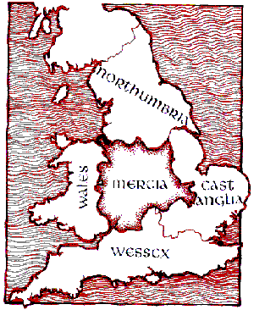
Anglo-Saxon kingdoms
Eventually, there were 4 Anglo-Saxon kingdoms:
Northumbria
Mercia
East Anglia
Wessex

Slide 5
Anglo Saxon kings
Through the Anglo-Saxon period, there were many kings of the different kingdoms. Some of the most famous kings were:
Offa of Mercia- known as being a ruthless king. He managed to take over several small kingdoms, leading to Mercia covering most of England south of Yorkshire.
Edwin of Northumbria- he was one of the first Anglo-Saxon kings to convert to Christianity, opening the path for Christianity to spread in Britain. Through successful warfare, he also became king of 3 kingdoms before dying in a battle against Mercia.
Alfred of Wessex- he was possibly the most famous Anglo-Saxon king, and the subject of today’s lesson.

Slide 6
King Alfred of Wessex
He is the most famous Anglo-Saxon king, and the only English king known as “The Great”.
He was originally the king of Wessex, which he started ruling in 871AD.
During Alfred’s time as king, the Vikings were able to invade and take over all the Anglo-Saxon kingdoms, except Wessex.
Alfred launched a strong resistance against the Vikings and beat them in many battles.
He also brought about many changes to society, including changes to education, laws and the military.

Slide 7
Why was Alfred great?
Military reforms (changes)
He was successful in preventing the Vikings from taking over all of Britain. He successfully held them back and agreed on the location of the boundary between the Viking kingdom of Danelaw and the Anglo-Saxon kingdom.
He created a defence system of ‘burghs’ (fortresses) to help protect against Viking attacks.
The ‘burgs’ were fortified towns, often found in strategic positions on hills or near the coast.
They were places of refuge for people during enemy attacks.
He also expanded his naval fleet, building many fast ships.

Slide 8
Why was Alfred great?
Legal reforms (changes)
He issued his own Anglo-Saxon legal code (laws).
When he issued his laws, no other English king had done so for over 100 years. Therefore, it could be argued that Alfred wanted fairness and equality for the people in his kingdom.
He included laws that he hoped would reduce the violence and bloodshed of wars.
King Alfred’s laws became the root of the English and American laws, trial by jury and habeas corpus.

Slide 9
Why was Alfred great?
Education reforms (changes)
Alfred was sad about the lack of education during his childhood and he wanted every Englishman to read, so he devised a plan for the general education of the people.
He donated a lot of his personal money to church schools and rebuilt monasteries, which were important places of learning.
He started a school at court for the sons of noblemen and encouraged his noblemen to learn to read.
He also translated many texts from Latin to English and educated young men in reading English.

Slide 10
Why was Alfred great?
Religious reforms (changes)
Alfred was a devout Christian.
He thought that local government should follow Christian values to prevent it from becoming unfair and corrupt.
He based his laws on the 10 commandments and was able to translate many religious Latin texts to English to allow the Britons to understand.
He gave to charities and took care of strangers and needy people.
As part of the peace treaty between Alfred and the Vikings, he forced the Viking leader Guthrum to convert to Christianity. This is how Christianity was eventually brought to Danelaw and the Vikings.

Slide 11
Your task
Research Alfred the Great, then write 3-5 paragraphs to persuade your teacher about whether Alfred was “Great” or not.
Consider all the things Alfred achieved as king and whether they make him great, or not.
Start your research here:
https://www.bbc.co.uk/bitesize/topics/zxsbcdm/articles/z9tdq6f
https://www.bbc.co.uk/bitesize/clips/zthb4j6
http://www.bbc.co.uk/history/historic_figures/alfred_the_great.shtml
https://www.historyextra.com/period/anglo-saxon/king-alfred-great-facts-life-death-famous-buried/

Slide 12
Norse Gods and Goddesses
ART/ D.T

Slide 13
Norse beliefs
Before the Norse people (Vikings) converted to Christianity, they had their own pagan religion.
The Norse religion included a set of important stories that gave meaning to the Vikings’ lives. These stories involved many gods and goddesses, including Odin, Thor, Loki and Freya.
Here are some videos of some of the stories.
https://www.bbc.co.uk/teach/school-radio/english-ks1-english-viking-sagas/zkyqd6f

Slide 14
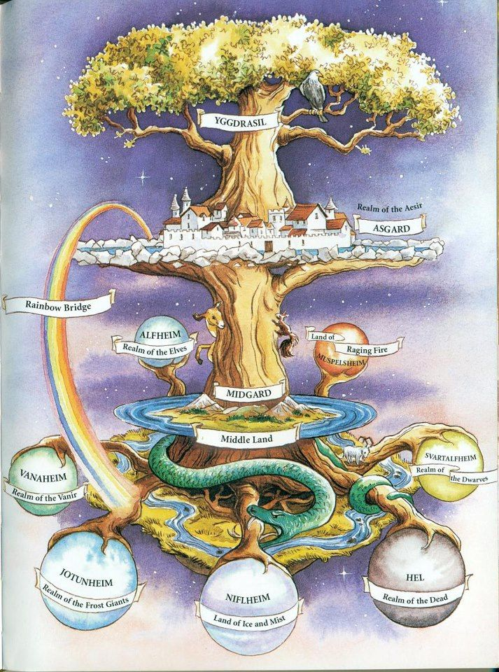
Yggdrasil- the tree of life
According to Norse beliefs, Yggdrasil is a huge ash tree, with its branches reaching into the heavens and its roots extending down into the underworld.
The Norse people believed in 9 worlds that existed on and around this special tree.
Here we will think about 2 of those worlds, Midgard and Asgard.
https://historiska.se/norse-mythology/mythological-world-of-the-vikings/

Slide 15
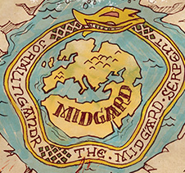
Midgard- Middle Earth
The Vikings called the land in which they, human beings, lived Midgard (Middle Earth) or Mannaheim (Home of Man).
They believed that Midgard was surrounded by a serpent called Jormungandr.

Slide 16
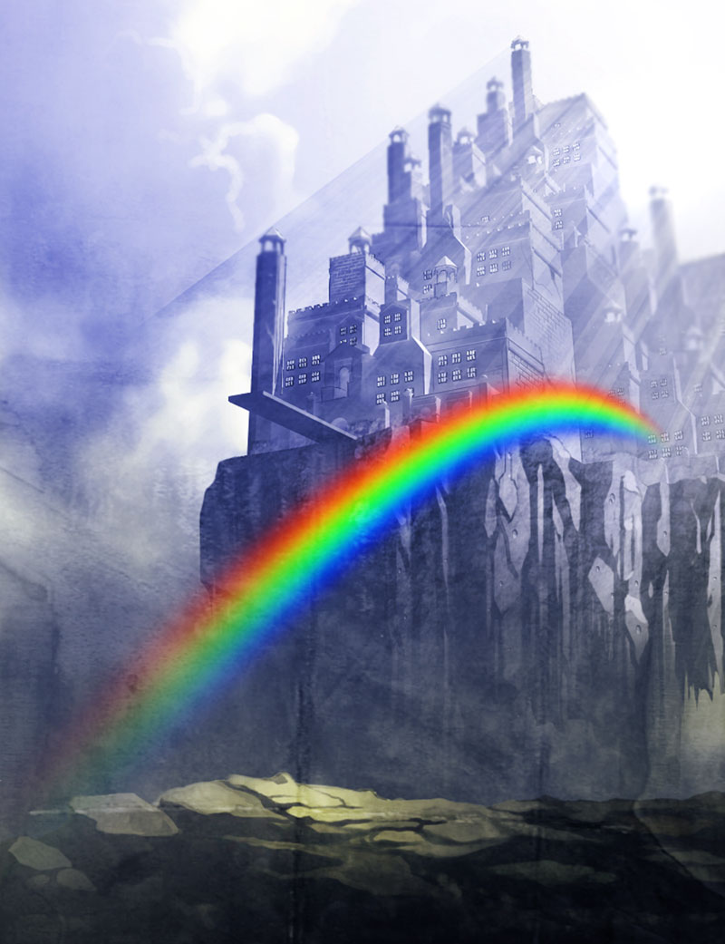
Asgard- home of the Gods
Asgard is the dweling place (home) of the gods, and each god had their own place/ area of Asgard.
An important place in Asgard was Valhalla - the hall of slain warriors. Viking warriors dreamt of dying on the battlefield and going to Valhalla to feast with the god Odin.
The legend says that the warriors wait in Valhalla until doomsday (Ragnarok), which is when the giants will come to fight the gods.
The only way to get to Asgard from Midgard is by crossing the Bifrost bridge (rainbow bridge).

Slide 17
Some of the Gods…
Choose one of the Gods for your drawing/model.
The next pages show some of the Gods.
Watch these videos, too, as they will give you more information.
https://www.bbc.co.uk/bitesize/clips/zyy9wxs
https://www.youtube.com/watch?v=8WbGEXzZgbY

Slide 18
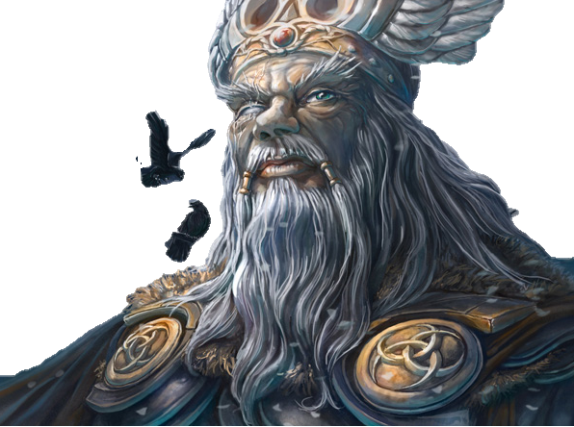
Odin- father of the Gods
Odin was the ruler of the Gods. He was the God of war, as well as poetry and magic.
Odin had two ravens called Memory and Thought who flew around the world every morning to find out everything that was happening.
In order to gain more knowledge, he sacrificed one of his eyes.
He was known to diguise himself and wander throughout all 9 worlds in pursuit of knowledge.
Odin has many names, and one of them is Woden. Wednesday was originally called Woden’s day, named after Woden (Odin).

Slide 19
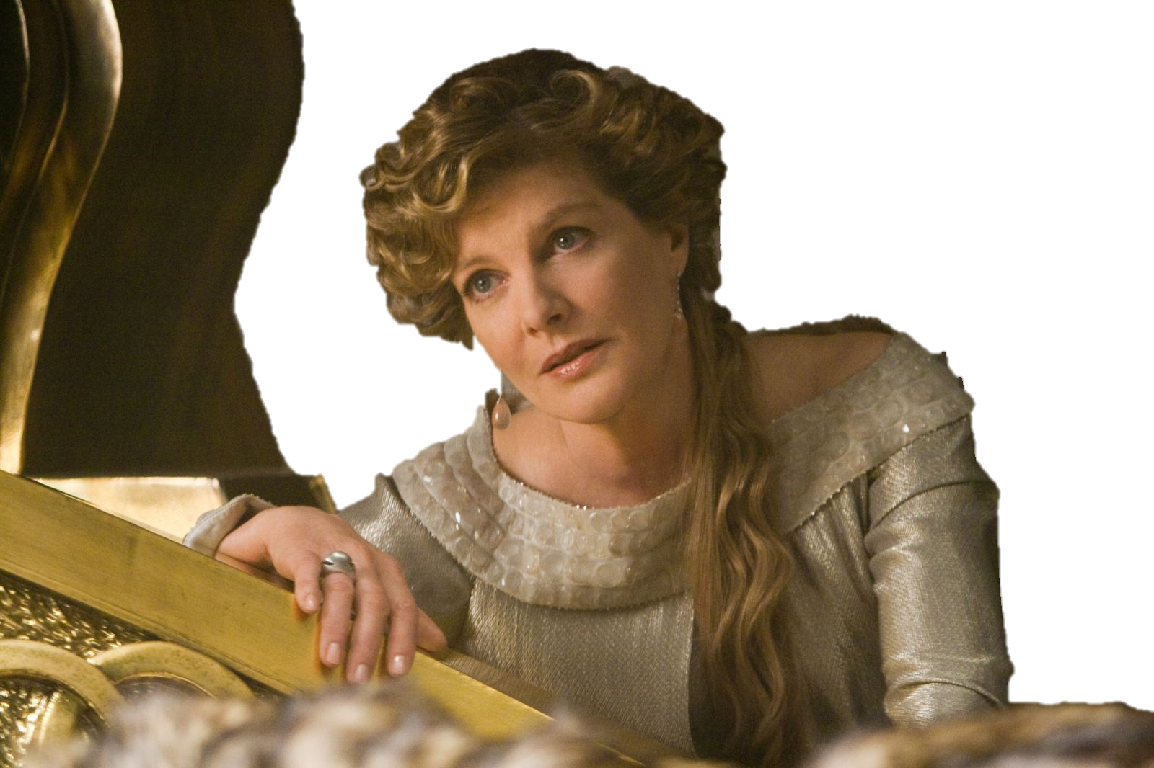
Frigg- mother of Gods
She is the Goddess of love, marriage and destiny. She is also the protector of children.
She is believed to know the future.
Some believe that Friday is named after her.

Slide 20
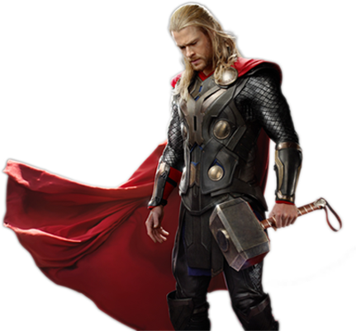
Thor- God of thunder
He is the God of thunder, skies and storms.
He has iron gloves, a magic belt and a hammer called Mjolnir.
He was a loyal and honorable warrior, and many vikings aspired to be like him.
He defended Asgard from the giants.

Slide 21
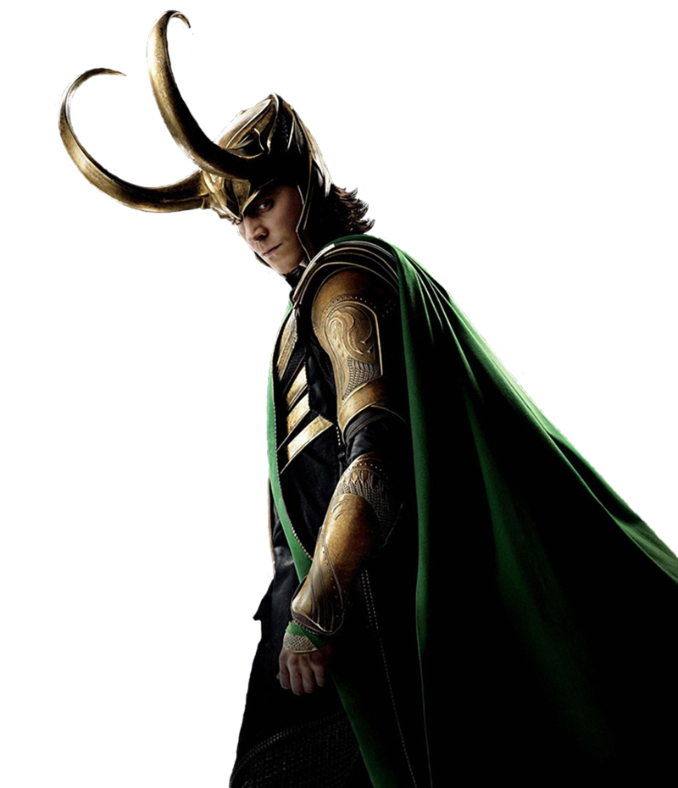
Loki- God of mischief
He is the God of mischief, and is a terrible trickster.
He can shape shift.
He often gets the other gods into terrible situations. But also helps them afterwards.
He has three monstrous children: Jormungandr the serpent, Fenrir the wolf and Hel, Goddess of the underworld.

Slide 22
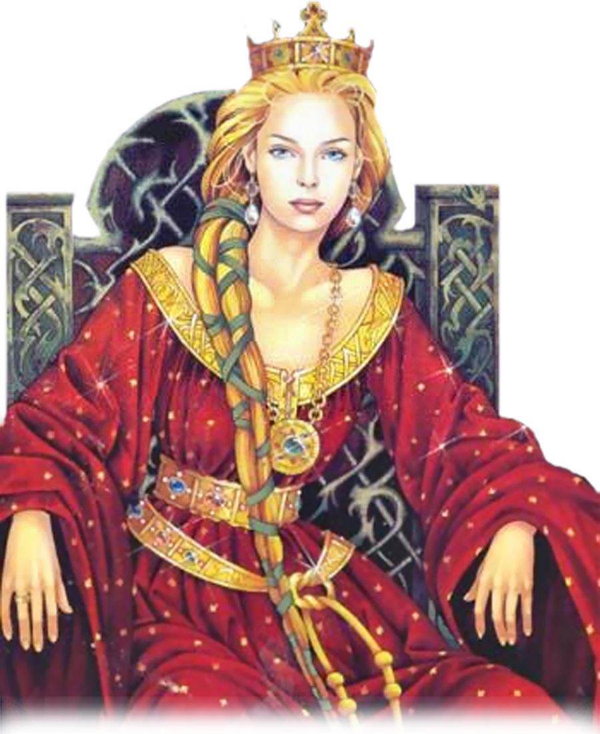
Freyja- Goddess of love
She is the Goddess of love, beauty and fertility.
When she is unhappy, she cries golden tears.
She wears a coat made of falcon feathers, that she can use to fly.
She rides a chariot pulled by two cats!
Some believe Friday was named after either her or Frigg.

Slide 23
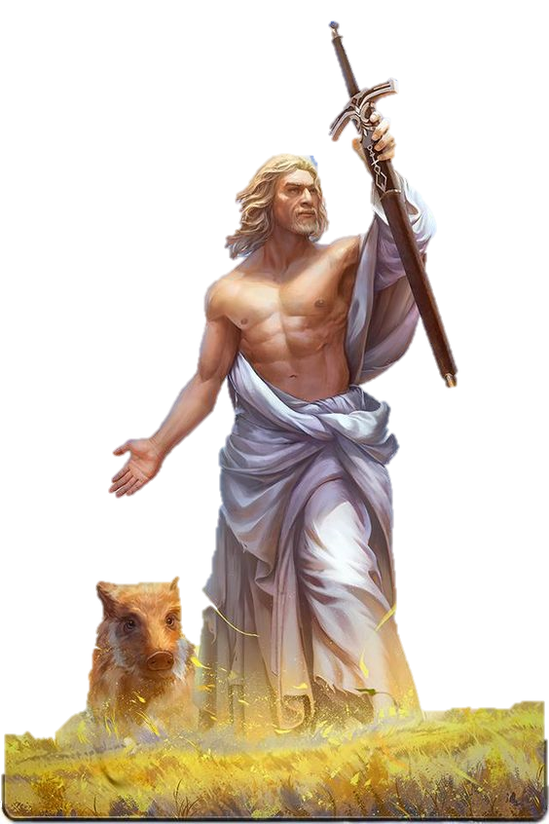
Freyr- God of fertility and peace
He is the God of fertility and peace.
He is Freya’s twin brother.
He has a strong link to the sun.
He has a giant boar, Gullinbursti.

Slide 24
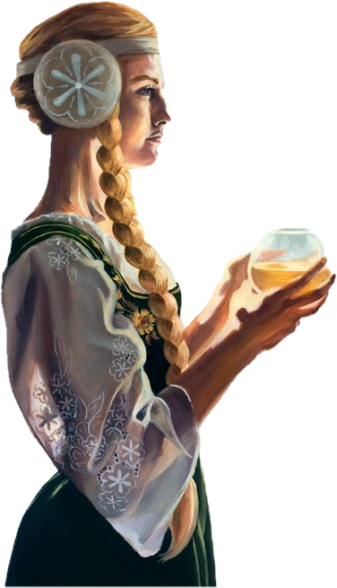
Sif- Goddess of Earth
She is the Goddess of Earth.
She is Thor’s wife.
She is responsible for the growth of crops and the Earth itself.
She had long, golden hair. Loki once cut her hair off when he was feeling mischevious. Loki was then forced to replace her hair using strands of gold made by dwarves.

Slide 25
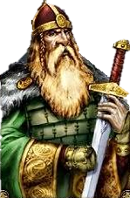
Tyr- God of war
He is the God of war, law and justice and is the bravest of the Gods.
He inspired courage and heroism in battle.
He has one hand as the other hand was bitten off by a wolf called Fenrir.
Tuesday may come from Tyr’s day.

Slide 26
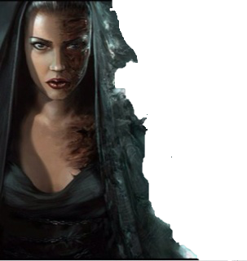
Hel- Goddess of death
Hel is the Goddess who rules the underworld.
She is greedy, harsh and cruel.
You can see her skeleton on one side of her body.
It is unknown if she is alive or dead.

Slide 27
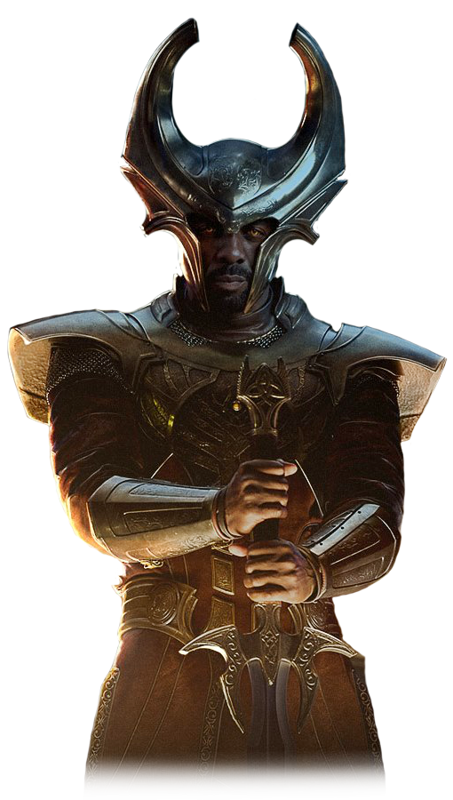
Heimdall- watchman of Gods
He is responsible for watching over the Gods, and guards the Bifrost bridge at the entrance to Asgard.
He needs minimal sleep and has heightened senses and golden teeth.
He carries a horn called Gjallarhorn to warn the Gods of trouble.

Slide 28
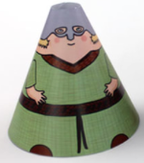
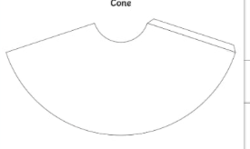
Your task
Pick a God.
Draw them and colour them in however you like- you could use pencils, pens, paints, or anything else you have. Cut out their body once you’re finished. You can use the cone template to help prop your character up.
Or you can draw your design onto the cone template if you like.

