Slide 1
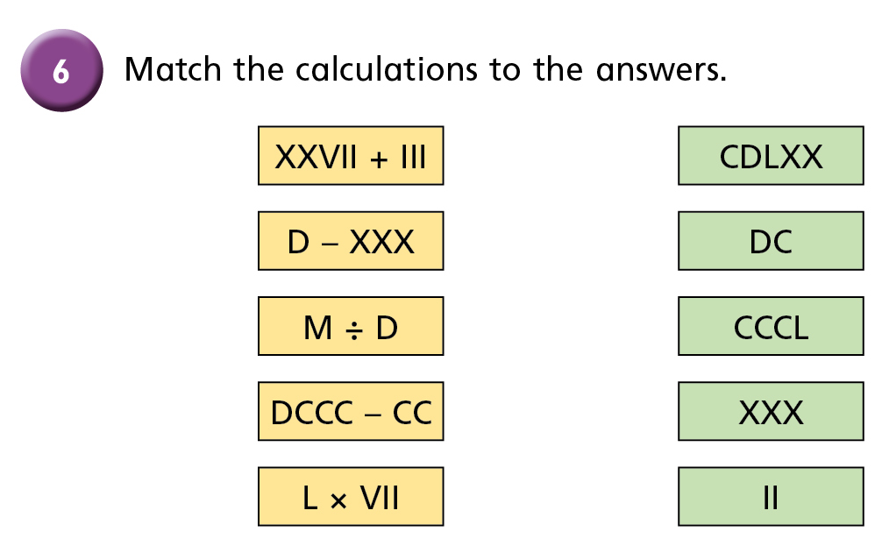
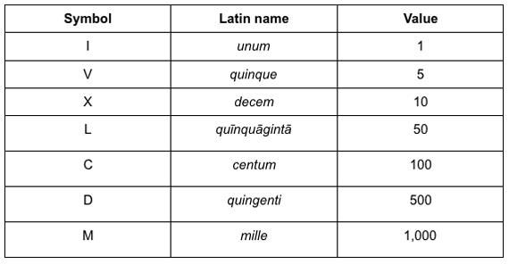
LO: To Add and Subtract
C: Round to estimate and approximate
Children write date and LO, then complete the table on whiteboard.
7. Create your own

Slide 2





Discuss how we estimated to solve these problems when we were in the BOLE.
£1,219.40
£2,138.95
Hang on, I’ll just work it out…
How?! I haven’t written the numbers yet!
I have £3,800 in my bank. Can I afford to buy the TV and laptop?
STOP! I already know he can afford it.
2
1
3
8
.
9
5
1
+

Slide 3
Discuss how we estimated to solve these problems when we were in the BOLE.
£1,219.40
£2,138.95
I rounded £2,138.95 to £2,100
I rounded £1,219.40 to £1,200
£2,100 plus £1,200 is £3,300
so Ron has enough money

Slide 4
Repeat this A LOT!
An estimate – a sensible but
not exact answer.

Slide 5

Discuss how we estimate the answer to this subtraction.
7,116 – 3,655 =
7,000
7,116 rounded to the nearest 1,000 is
4,000
3,655 rounded to the nearest 1,000 is
7,000 – 4,000 =
3,000
7,100
7,116 rounded to the nearest 100 is
3,700
3,655 rounded to the nearest 100 is
7,100 – 3,700 =
3,400
Have a think
Which is the more accurate estimate?

Slide 6

Let children try this on their wipe boards before working through as a class.
 | Shop A | Shop B | Shop C
Morning | £4,000 | £6,231 | £2,002
Afternoon | £11,613 | £9,199 | £14,508
Estimate which shop made the most money.
Shop C
Shop A: 4,000 + 12,000 =
That’s already rounded to the nearest 1,000!
£ 16,000
Shop B: 6,000 + 9,000 =
£ 15,000
Shop C: 2,000 + 15,000 =
£ 17,000
Have a think
Did shop B make more or less than £ 15,000?
More

Slide 7
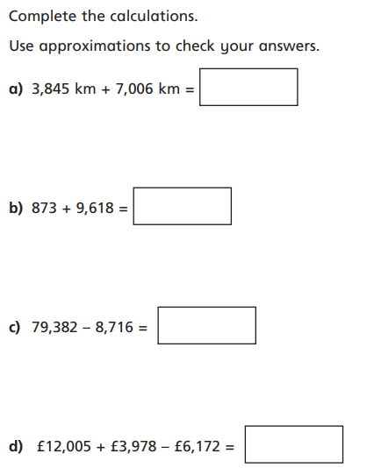
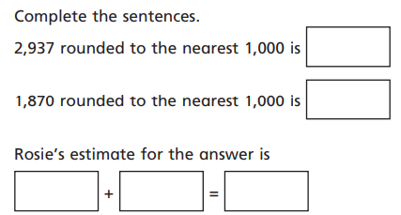
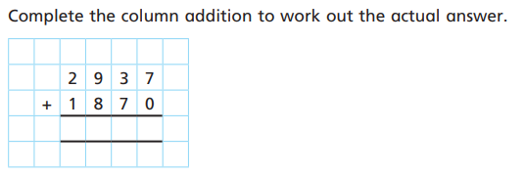
Children complete these calculation in books.
Extension: Write an explanation of why estimation is useful.
Paddling/ Snorkelling start here
Diving start here

Slide 8
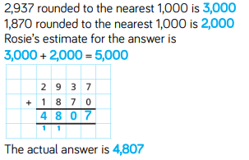
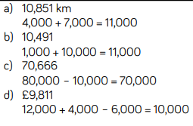
Children red-pen their answers

Slide 9
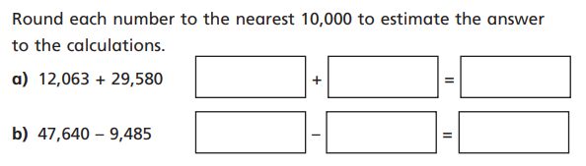
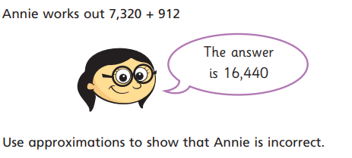
Paddling/ Snorkelling
If there is time:
Children complete these calculation in books.
Diving

Slide 10


Paddling/ Snorkelling
If there is time:
Children complete these calculation in books.
Diving

