Slide 1
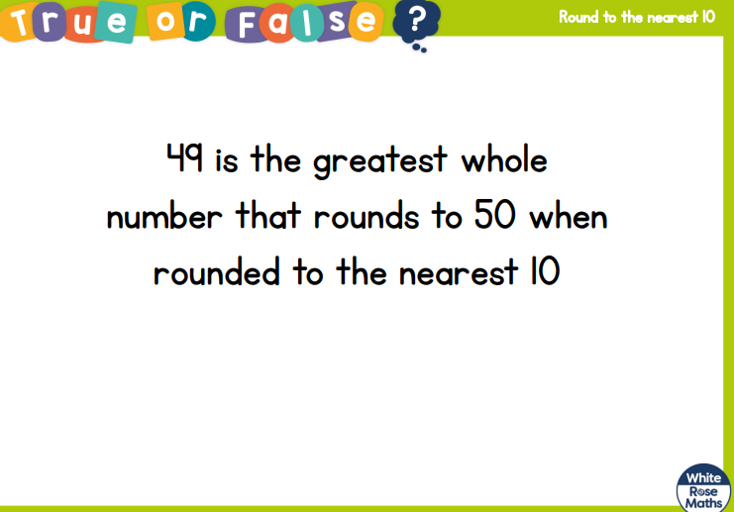


Slide 2
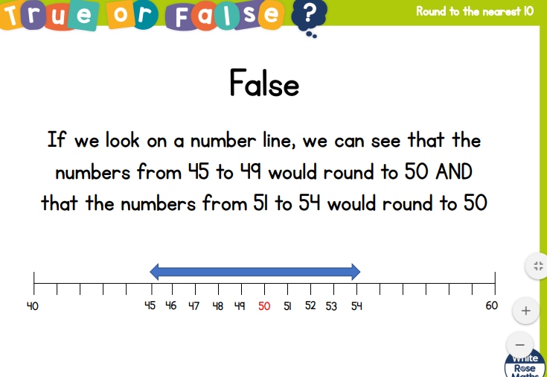

Slide 4
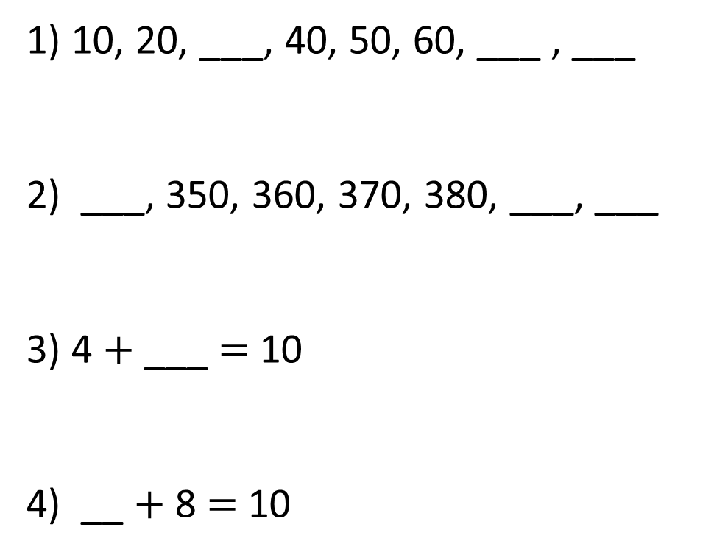
1) 10, 20, ___, 40, 50, 60, ___ , ___
2) ___, 350, 360, 370, 380, ___, ___
3) 4 $+$ ___ $=$ 10
4) __ $+$ 8 $=$ 10

Slide 5
30
70
80
1) 10, 20, ___, 40, 50, 60, ___ , ___
2) ___, 350, 360, 370, 380, ___, ___
3) 4 $+$ ___ $=$ 10
4) __ $+$ 8 $=$ 10
340
390
400
6
2

Slide 7
Round 73 to the nearest 10
10
70
71
72
73
74
75
76
77
78
79
80
The nearest multiple of ten to ___ is ___.
___ is ___ when rounded to the nearest ten.

Slide 8
Round 73 to the nearest 10
3
7
70
71
72
73
74
75
76
77
78
79
80
73 is closer to 70 than 80
73 rounded to the nearest 10 is 70

Slide 9
Round 78 to the nearest 10
8
2
70
71
72
73
74
75
76
77
78
79
80
The nearest multiple of ten to ___ is ___.
___ is ___ when rounded to the nearest ten.

Slide 10
Round 35 to the nearest 10
5
5
30
31
32
33
34
35
36
37
38
39
40
35 rounded to the nearest 10 is 40

Slide 11
Round 144 to the nearest 10
4
6
140
141
142
143
144
145
146
147
148
149
150
The nearest multiple of ten to ___ is ___.
___ is ___ when rounded to the nearest ten.

Slide 12
Have a go at questions on the worksheet.
Extension – annotate with sentences using the stem sentence.

