Slide 1
10 times greater
10 greater
TTh | Th | H | T | O
Th | H | T | O
20
2
12

Slide 2
10 times greater
TTh | Th | H | T | O
30,000
3,000

Slide 3


3,104
TTh | Th | H | T | O
3,000
100
0
4
3,104
Have a think
3,000
4
100
The number being represented is _____.
I know this because there are __ thousands, __ hundreds, __tens and __ ones.

Slide 4
3,104
TTh | Th | H | T | O
3,104
10
10 ÷ 10 = 1
3,101
3,102
3,103
3,100
3,110
The number being represented is _____.
I know this because there are __ thousands, __ hundreds, __tens and __ ones.

Slide 5

Have a think
Place 650 on the number line.
1,000
650
1,000 ÷ 10 = 100
200
300
400
500
600
700
800
900
1,000
100
1,100
It’s impossible! Each interval is worth 1
The number being represented is _____.
I know this because there are __ thousands, __ hundreds, __tens and __ ones.

Slide 6




3,841
3,741 + 100 =
Th | H | T | O
The number being represented is _____.
I know this because there are __ thousands, __ hundreds, __tens and __ ones.

Slide 7
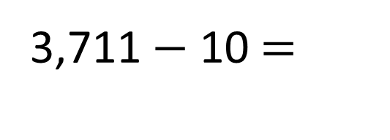
3,711 $−$ 10 =
3,701
Th | H | T | O
3,000
700
0
1
The number being represented is _____.
I know this because there are __ thousands, __ hundreds, __tens and __ ones.

Slide 8
Have a think
 | 1 more | 10 more | 100 more | 1,000 more
5,000
5,001
5,010
5,011
5,100
6,000
6,430
6,431
6,440
6,530
7,430
100 less
The number being represented is _____.
I know this because there are __ thousands, __ hundreds, __tens and __ ones.

