Slide 1


Slide 2
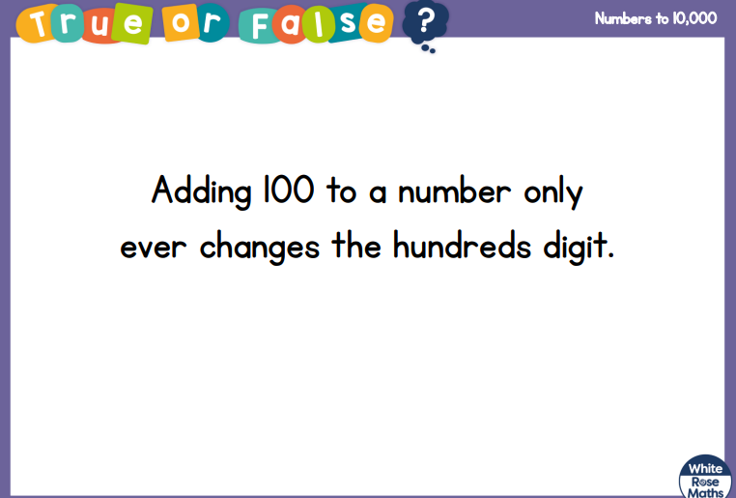

Slide 3
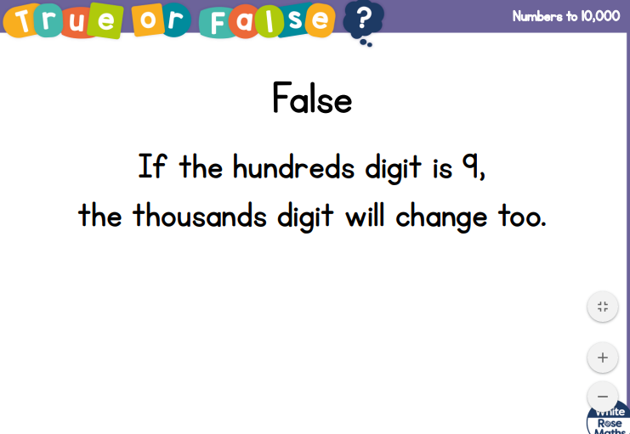

Slide 5



What number is represented?
Draw counters to represent 2,362
3) What number is represented?
Thousands | Hundreds | Tens | Ones
Thousands | Hundreds | Tens | Ones
The number being represented is _____.
I know this because there are __ thousands, __ hundreds, __tens and __ ones.

Slide 6
What number is represented?
Draw counters to represent 2,362
3) What number is represented?
2,256
Thousands | Hundreds | Tens | Ones
Thousands | Hundreds | Tens | Ones
3,033
The number being represented is _____.
I know this because there are __ thousands, __ hundreds, __tens and __ ones.

Slide 8
Have a go at question 1 and 2 and 3 on the worksheet extension – write some annotate the sheet using the stem sentence

