Slide 1
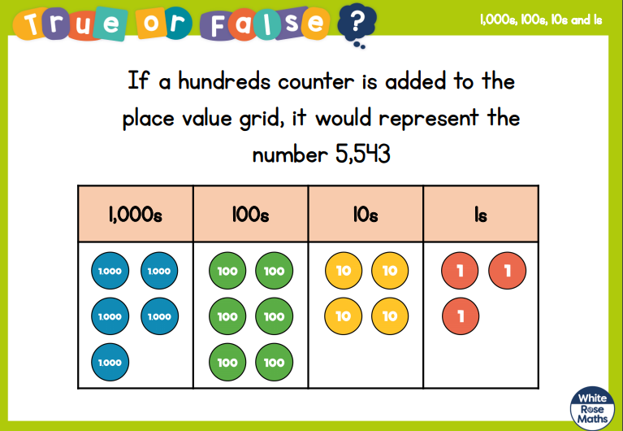

Slide 2
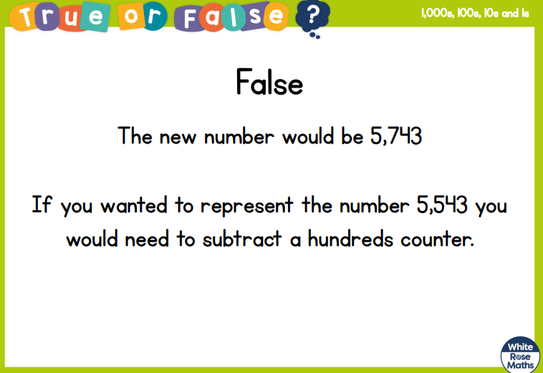

Slide 4
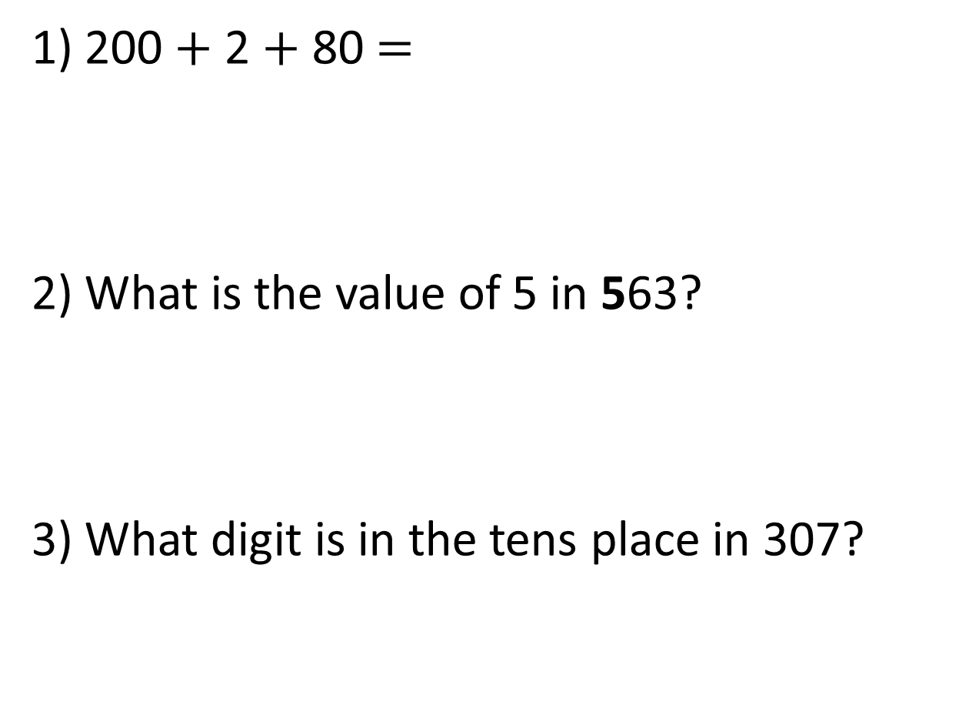
1) 200 $+$ 2 $+$ 80 $=$
2) What is the value of 5 in 563?
3) What digit is in the tens place in 307?

Slide 5
1) 200 $+$ 2 $+$ 80 $=$
2) What is the value of 5 in 563?
3) What digit is in the tens place in 307?
282
500
0

Slide 7
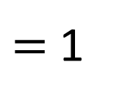
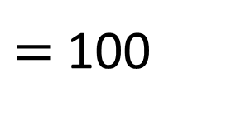

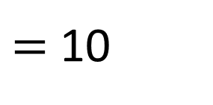

$=$ 1
$=$
$=$ 10
__ lots of ___ make ____
$=$
$=$ 100

Slide 8
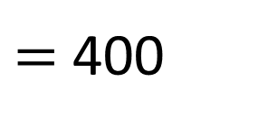
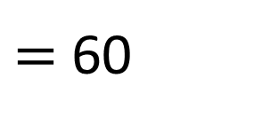
$=$ 60
__ lots of ___ make ____
$=$ 400

Slide 9
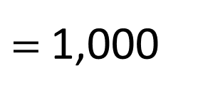
$=$ 1,000
__ lots of ___ make ____

Slide 10
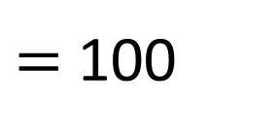
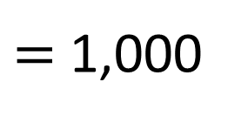
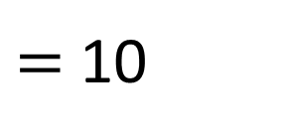
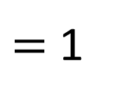
$=$ 1
$=$ 10
$=$ 100
__ lots of ___ make ____
$=$ 1,000

Slide 11
Thousands | Hundreds | Tens | Ones
3,000
200
30
5
3,235
__ lots of ___ make ____
The value of the __ is ____

Slide 12
Thousands | Hundreds | Tens | Ones
3,000
0
30
5
3,035
__ lots of ___ make ____
The value of the __ is ____

Slide 13





Have a think
Thousands | Hundreds | Tens | Ones
1,000
300
40
0
1,340
This number is 134
__ lots of ___ make ____
The value of the __ is ____

Slide 14

5,132
Have a think
100
What is the value of the 1?
Thousands | Hundreds | Tens | Ones
__ lots of ___ make ____
The value of the __ is ____

Slide 15
5,132
5,000
What is the value of the 5?
Thousands | Hundreds | Tens | Ones
__ lots of ___ make ____
The value of the __ is ____

Slide 16
5,132
Have a think
2
What is the value of the 2?
Thousands | Hundreds | Tens | Ones
What is this number written in words?
Five thousand,
one hundred
and thirty-two
__ lots of ___ make ____
The value of the __ is ____

Slide 17
Have a go at the rest of the worksheet
If you finish – annotate with some statements we have said together

