Slide 1
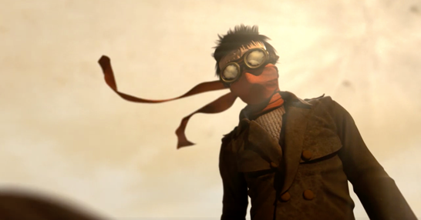
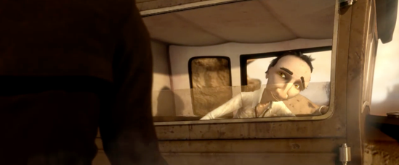
Describe the two characters below. Using amazing adjectives as these will be used in your planning this week

