Slide 1
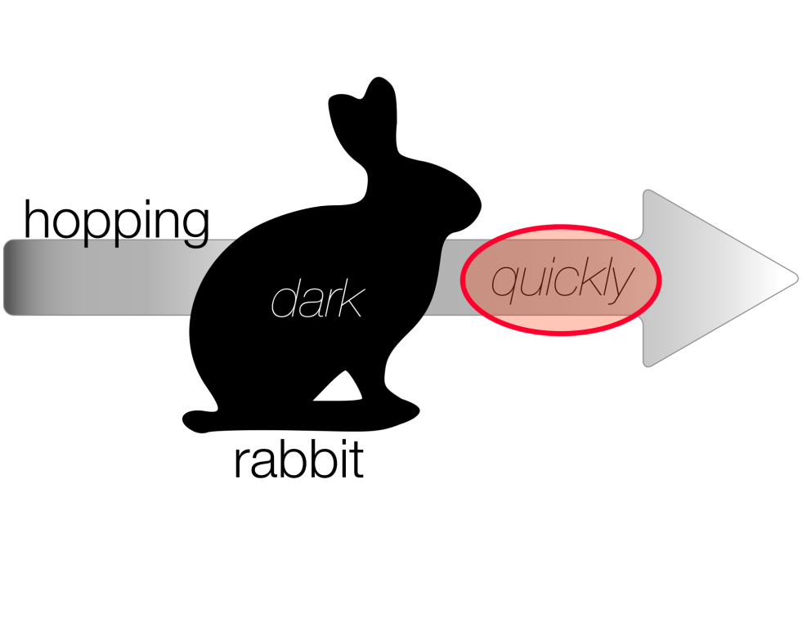
JonTeaches
Jonfkirk
Adverbs and Fronted Adverbials KS2
For KS2
Years 3-6
Full unit with exercises

Slide 2
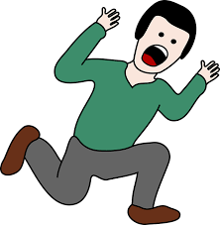
JonTeaches
Jonfkirk
The scared man ran quickly down the hill.
How did he run? What’s the adverb?

Slide 3
JonTeaches
Jonfkirk
The scared man ran quickly down the hill.
The adverb is quickly. It tells us how he ran. Adverbs often end in –ly.

Slide 4
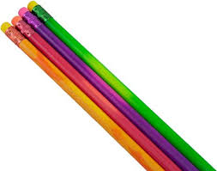
Find a red, green, orange and purple pencil.

Slide 5
Colour nouns in Red
Colour verbs in Green
Colour adjectives in Orange
Colour adverbs in Purple
JonTeaches
Jonfkirk
The
scared
man
ran
quickly
down
the
hill.

Slide 6
Colour nouns in Red
Colour Verbs in Green
Colour adjectives in Orange
Colour adverbs in Purple
JonTeaches
Jonfkirk
The
scared
man
ran
quickly
down
the
hill.

Slide 7
scared
man
JonTeaches
Jonfkirk
Adjectives describe or modify nouns. This means that they give more information about them. Here, the adjective “scared” is modifying the noun “man”.
What do we use adjectives for?
What do we mean by modify?
What do adjectives modify?
ran
quickly
Adverbs describe or modify verbs. This means that they give more information about them.
Here, the adverb “quickly” is modifying the verb “ran”.
What do we use adverbs for?
What do we mean by modify?
What do adverbs modify?

Slide 8
scared
man
JonTeaches
Jonfkirk
Adjectives describe or modify nouns. This means that they give more information about them.
Here, the adjective “scared” is modifying the noun “man”.
What do we use adjectives for? | To modify nouns
What do we mean by modify? | Give more information about
What do adjectives modify? | nouns

Slide 9
scared
man
JonTeaches
Jonfkirk
Adjectives describe or modify nouns. This means that they give more information about them.
Here, the adjective “scared” is modifying the noun “man”.
What do we use adjectives for? | To modify nouns
What do we mean by modify? | Give more information about
What do adjectives modify? | nouns
ran
quickly
Adverbs describe or modify verbs. This means that they give more information about them.
Here, the adverb “quickly” is modifying the verb “ran”.
What do we use adverbs for? | To modify verbs
What do we mean by modify? | Give more information about
What do adverbs modify? | verbs

Slide 10
We can use adverbs to describe or modify verbs.
JonTeaches
Jonfkirk
 | Sentence | Modified Verb | Adverb
Example | He ran quickly. | ran | quickly
1 | He slept soundly
2 | She came in suddenly.
3 | He sat uncomfortably.
4 | She listened carefully.
5 | They played happily.
6 | He braked hard to avoid an accident.
7 | She hid quietly in the wardrobe.
8 | The dog barked angrily.
9 | Carefully, he picked up the pieces of the broken glass.
10 | The baby lambs slept peacefully.

Slide 11
JonTeaches
Jonfkirk
 | Sentence | Modified Verb | Adverb
Example | He ran quickly. | ran | quickly
1 | He slept soundly | slept | soundly
2 | She came in suddenly. | came | suddenly
3 | He sat uncomfortably. | sat | uncomfortably
4 | She listened carefully. | listened | carefully
5 | They played happily. | played | happily
6 | He braked hard to avoid an accident. | braked | hard
7 | She hid quietly in the wardrobe. | hid | quietly
8 | The dog barked angrily. | barked | angrily
9 | Carefully, he picked up the pieces of the broken glass. | picked up | carefully
10 | The baby lambs slept peacefully. | slept | peacefully

Slide 12
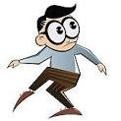
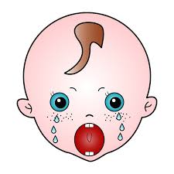
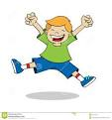
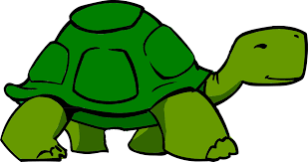
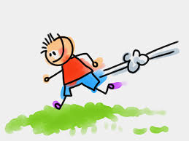
 |  | What does he do? VERB |  |  | How does he do it? ADVERB
1 |  | walk | run | swim | quietly | quickly | loudly
2 |  | play | cry | eat | loudly | carefully | secretly
3 |  | sit | run | jump | happily | sadly | carefully
4 |  | fall | walk | talk | slowly | fast | tearfully
5 |  | talk | run | ski | strangely | unusually | quickly

Slide 13
 |  | Who? | What does he do? VERB |  |  | How does he do it? ADVERB
1 | walk quietly | The man | walks |  |  | quietly.
2 | cry loudly | The baby | _______________________ |  |  | _______________________
3 | jump happily | The boy | _______________________ |  |  | _______________________
4 | walk slowly | The tortoise | _______________________ |  |  | _______________________
5 | run quickly | The boy | _______________________ |  |  | _______________________

Slide 14
1 | walk quietly | The man walks quietly.
2 | cry loudly | The baby cries ______________________________________
3 | jump happily | The boy ____________________________________________
4 | tortoise walk slowly | ____________________________________________
5 | boy run quickly | ____________________________________________

Slide 15
Write sentences about the pictures. Use adverbs.
1
2
3
4
5

Slide 16
Noun | Verb | Adjective | Adverb
Person, place, thing | Action, doing word | Describes a noun | Describes a verb
man, baby, car, school | do, eat, play, have | big, small, clever | quickly, slowly, loudly
1 | The naughty man walks quietly.
 | Noun: | Verb: | Adjective: | Adverb:
2 | The angry baby cries loudly.
 | Noun: | Verb: | Adjective: | Adverb:
3 | The small boy jumps happily.
 | Noun: | Verb: | Adjective: | Adverb:
4 | The green tortoise walks slowly.
 | Noun: | Verb: | Adjective: | Adverb:
5 | The late boy runs quickly.
 | Noun: | Verb: | Adjective: | Adverb:

Slide 17
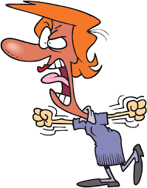
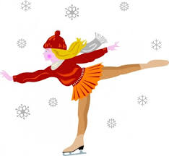
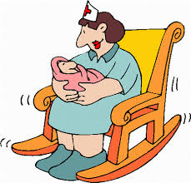
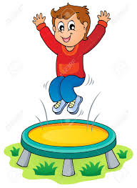
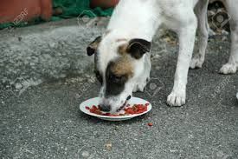
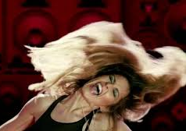
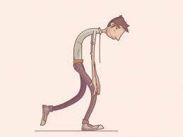
1 | The teacher shouted ____________at the children.
2 | The ice skater glided ____________ across the ice.
3 | The nurse rocked the baby _____________.
4 | The boy jumped ____________ on the trampoline.
5 | What did the dog do? _________________________________________
6 | What did the baby do? _________________________________________
7 | What did the girl do? _________________________________________
8 | What did the boy do? _________________________________________
angrily
elegantly
gently
happily
hungrily
loudly
wildly
sadly

Slide 18
 | Which word tells us more about the noun? | Which word tells us more about the verb?
The sleepy baby cried loudly. | sleepy | loudly
The young boy jumped happily on the trampoline.
The nasty dog barked loudly at the girls.
Quickly, the blonde girl stood up.
The hungry lion crawled carefully behind the zebra.
Adjectives | Adverbs
sleepy | loudly

Slide 19

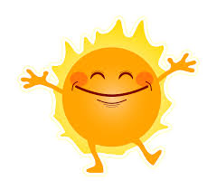


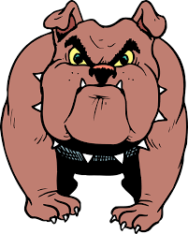

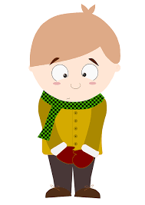

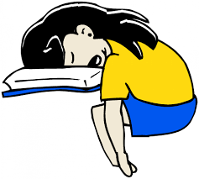
JonTeaches
Jonfkirk
1 | 2. | 3. | 4.
5. | 6. | 7. | 8.
9. | 10. | 11. | 12.
Match the adverb to the picture.
a. dangerously
b. happily
c. tearfully
d. carefully
e. tiredly
f. slowly
g. silently
h. angrily
i. quickly
j. loudly
k. shyly
l. secretly

Slide 20
JonTeaches
Jonfkirk
1 | 2. | 3. | 4.
5. | 6. | 7. | 8.
9. | 10. | 11. | 12.
Match the adverb to the picture.
a. dangerously | 6
b. happily | 4
c. tearfully | 3
d. carefully | 2
e. tiredly | 12
f. slowly | 11
g. silently | 1
h. angrily | 5
i. quickly | 7
j. loudly | 8
k. shyly | 9
l. secretly | 10

Slide 21
Extension
WALT: Write using adverbs
JonTeaches
Jonfkirk
Use the pictures to make 3 sentences with adverbs.

Slide 22
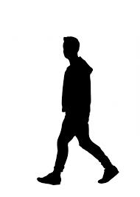

Look at these two sentences.
What do you notice?
JonTeaches
Jonfkirk
Silently
Paul
walked
to
school.
Paul
walked
silently
to
school.

Slide 23
Adverbs can be used at the beginning of a sentence.
JonTeaches
Jonfkirk
Silently
Paul
walked
to
school.
OR adverbs can be used directly after the verb that they are modifying.
Paul
walked
silently
to
school.
True or False?
Adverbs modify verbs.
Adverbs cannot go at the beginning of a sentence.
Adverbs always go straight after the verb.
Sometimes we can even put the adverb before the verb: Paul silently walked to school.

Slide 24
Adverbs can be used at the beginning of a sentence.
JonTeaches
Jonfkirk
Silently
Paul
walked
to
school.
OR adverbs can be used directly after the verb that they are modifying.
Paul
walked
silently
to
school.
True or False?
Adverbs modify verbs. | True
Adverbs cannot go at the beginning of a sentence. | False
Adverbs always go straight after the verb. | False
Sometimes we can even put the adverb before the verb: Paul silently walked to school.

Slide 25

JonTeaches
Jonfkirk
Silently
Paul
walked
to
school.
When we use adverbs at the beginning of a sentence, we can call them FRONTED. This is because they come at the beginning or “front” of the sentence.

Slide 26
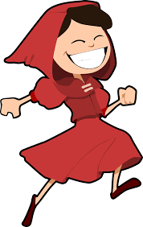
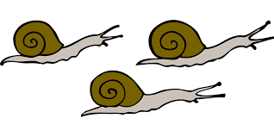

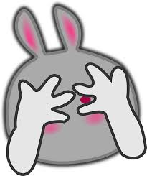


LO/ WALT:Use adverbs to modify verbs.
JonTeaches
Jonfkirk
Write sentences using adverbs to describe the following pictures. Try the adverb in different positions and see what sounds best to you.
1 slide | 2 skip | 3 growl
4 look | 5 creep | 6 swim

Slide 27
Write sentence using adverbs to describe the following pictures.
JonTeaches
Jonfkirk
1 The snails slid slowly. | 2 The girl skipped happily. | 3 The tiger growled dangerously.
4 Timidly the rabbit looked through her fingers. | 5 Tiredly the leopard crept home. | 6 The whale swam angrily.

Slide 28
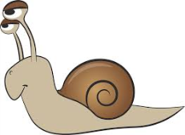

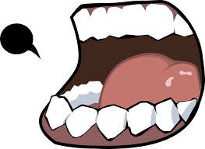
Adverbs describe, modify or tell us more information about the verb in a sentence.
JonTeaches
Jonfkirk
The snail slid slowly along the wall.
Quickly the bee collected the honey.
The boy shouted loudly to his friend.
Colour the adverbs in purple.

Slide 29
JonTeaches
Jonfkirk
Adverbs describe, modify or tell us more information about the verb in a sentence.
The snail slid slowly along the wall.
Quickly the bee collected the honey.
The boy shouted loudly to his friend.

Slide 30
JonTeaches
Jonfkirk
In each of these sentences, the adverb tells us how the action was done.
The snail slid slowly along the wall. How did the snail slide? He slid slowly.
Quickly the bee collected the honey. How the bee collect the honey. He collected it quickly.
The boy shouted loudly to his friend. How did the boy shout to his friend. He shouted loudly.
Adverbs can tell us how an action happened or was done.

Slide 31
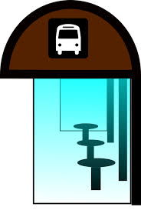

JonTeaches
Jonfkirk
Now look at these sentences. What is the adverb?
How is the adverb modifying the verb? What does the adverb tell us?
The bus stops here.
The boy arrived early.

Slide 32
JonTeaches
Jonfkirk
Now look at these sentences. What is the adverb?
How is the adverb modifying the verb? What does the adverb tell us?
The bus stops here. Where does the bus stop? ______________________ What does the adverb “here” tell us? ______________________
The boy arrived early. When did the boy arrive? ______________________ What does the adverb “early” tell us? ______________________

Slide 33
JonTeaches
Jonfkirk
Now look at these sentences. What is the adverb?
How is the adverb modifying the verb? What does the adverb tell us?
The bus stops here. Where does the bus stop? here What does the adverb “here” tell us? where the bus stops
The boy arrived early. When did the boy arrive? early What does the adverb “early” tell us? when the boy arrived

Slide 34



JonTeaches
Jonfkirk
1. Adverbs can tell us how an action happened.
Quickly the bees collected the honey.
2. Adverbs can tell us where an action happened.
The bus stops here.
3. Adverbs can tell us when an action happened.
The boy arrived early.

Slide 35
Identify the adverb.
Is the adverb telling us how, where or when the action happened/ is completed?
JonTeaches
Jonfkirk
 | Sentence | Adverb | How, where or when
1 | He shouted angrily. | angrily | how
2 | She swims weekly.
3 | He put his bag there.
4 | He plays football nearby.
5 | Tomorrow he will eat at his Grandma’s house.
6 | He scored unexpectedly.
7 | She stared at him icily.
8 | Yesterday we did a maths project.
9 | He climbed up.
10 | Can you walk backwards?

Slide 36
Identify the adverb.
Is the adverb telling us how, where or when the action happened/ is completed?
JonTeaches
Jonfkirk
 | Sentence | Adverb | How, where or when
1 | He shouted angrily. | angrily | how
2 | She swims weekly. | weekly | when
3 | He put his bag there. | there | where
4 | He plays football nearby. | nearby | where
5 | Tomorrow he will eat at his Grandma’s house. | tomorrow | when
6 | He scored unexpectedly. | unexpectedly | how
7 | She stared at him icily. | icily | how
8 | Yesterday we did a maths project. | yesterday | when
9 | He climbed up. | up | where
10 | Can you walk backwards? | backwards | where

Slide 37
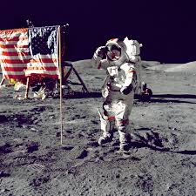
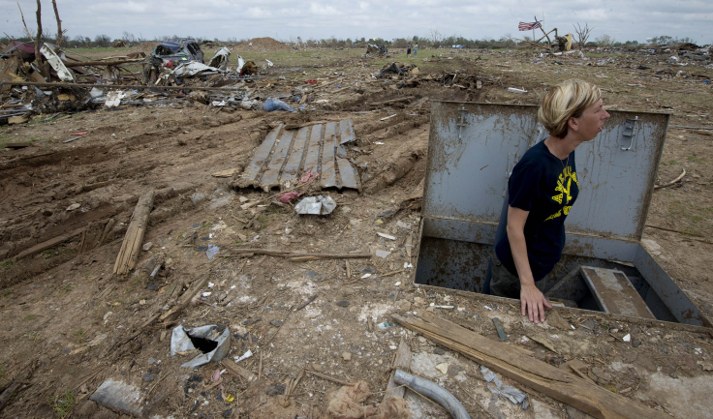
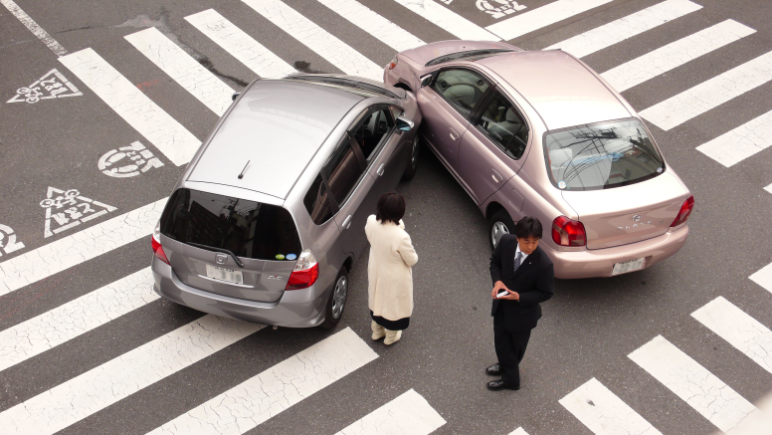
JonTeaches
Jonfkirk
Use the pictures as inspiration to write a short story.
Use adverbs as much as you can.
How | Where | When
happily fast slowly excitedly perfectly cautiously | here outside inside somewhere nearby downstairs | tomorrow yesterday now soon still monthly
You can use any of your own adverbs too.
Write between 140 and 190 words.

Slide 38
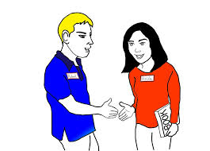
JonTeaches
Jonfkirk
Where did Bob and Sandra meet?
Bob and Sandra
met
here.
Where did Bob and Sandra meet?
Which word modifies (or gives more information about) the verb “met”?
What type of word is here?
how adverb | where adverb | when adverb

Slide 39
JonTeaches
Jonfkirk
Where did Bob and Sandra meet?
Bob and Sandra
met
here.
Where did Bob and Sandra meet? |  |  | here
Which word modifies (or gives more information about) the verb “met”? |  |  | here
What type of word is here?
 | where adverb

Slide 40
JonTeaches
Jonfkirk
Now compare these two sentences.
Bob and Sandra
met
here.
Bob and Sandra
met
at
school.
preposition
noun
Which words tell us where Bob and Sandra met in each of the sentences?

Slide 41
JonTeaches
Jonfkirk
We know that “here” is an adverb of place.
It tells us where the verb “met” happened.
here
at
school
The phrase “at school” is telling us the same thing. It tells us where the verb “met” happened.
preposition
noun
What do you think we call this type of phrase?
“At” is a preposition.
“School” is a noun.
Put them together and you have a phrase which is acting like an adverb.

Slide 42
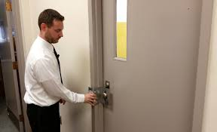
Adverbial phrases do the same things as adverbs. They tell us how, when or where an action happened.
Adverbs are just one word.
Adverbial phrases are more than one word.
JonTeaches
Jonfkirk
Adverb
Silently
Chris
locked
the door.
Without making a sound
Chris
locked
the door.
Adverbial phrase

Slide 43
When the adverbial phrase comes at the beginning or “front” of a sentence, we call it a “fronted adverbial”.
JonTeaches
Jonfkirk
Fronted adverbial
Without making a sound
Chris
locked
the door.
What does “without making a sound” tell us in the sentence ?
how the action happened | where the action happened | when the action happened
What is the function of “without making a sound”?
It is acting as a verb | It is acting as an adjective | It is acting as an adverb

Slide 44
When the adverbial phrase comes at the beginning or “front” of a sentence, we call it a “fronted adverbial”.
JonTeaches
Jonfkirk
Fronted adverbial
Without making a sound
Chris
locked
the door.
What does “without” making a sound tell us in the sentence ?
how the action happened
What is the function of “without making a sound”?
 |  | It is acting as an adverb

Slide 45
Identify the fronted adverb or adverbial phrase.
Is the fronted adverb or adverbial telling us how, where or when the action happened/ is completed?
JonTeaches
Jonfkirk
 | Sentence | Fronted adverb or adverbial | What does it tell us? (how, when, where)
1 | At night the owl hooted. | at night | when
2 | On the boat the sailors sang.
3 | On Tuesdays I play football.
4 | Without thinking he wrote the wrong answer.
5 | At the weekend my team lost the game.
6 | Before eating his breakfast, my brother had a shower.
7 | Suddenly the witch swooped in and put a spell on the boys.
8 | Under the table the mice played happily.
9 | Crying loudly, the baby wouldn’t eat his food.
10 | As soon as possible, I handed in my work.

Slide 46
JonTeaches
Jonfkirk
 | Sentence | Fronted adverb or adverbial | What does it tell us? (how, when, where)
1 | At night the owl hooted. | at night | when
2 | On the boat the sailors sang. | on the boat | where
3 | On Tuesdays I play football. | on Tuesdays | when
4 | Without thinking he wrote the wrong answer. | without thinking | how
5 | At the weekend my team lost the game. | at the weekend | when
6 | Before eating his breakfast, my brother had a shower. | before eating his breakfast | when
7 | Suddenly the witch swooped in and put a spell on the boys. | suddenly | how
8 | Under the table the mice played happily. | under the table | where
9 | Crying loudly, the baby wouldn’t eat his food. | crying loudly | how
10 | As soon as possible, I handed in my work. | as soon as possible | when

Slide 47
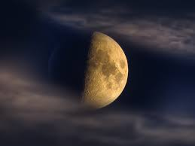
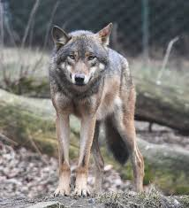
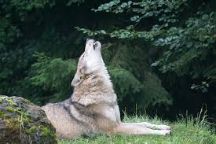

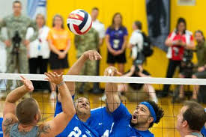
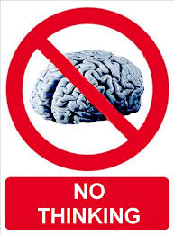
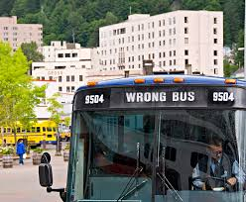

WALT/ LO Use Fronted Adverbials to write sentences about the pictures.
JonTeaches
Jonfkirk
1 |  |  |  | Night Wolf howl
2 |  |  |  | Mondays Volleyball
3 |  |  |  | Without thinking Get on Wrong bus
4 |  |  |  | Hurry Run School

Slide 48
WALT/ LO Use Fronted Adverbials to write sentences about the pictures.
JonTeaches
Jonfkirk
1 |  |  |  | At night the wolf howled.
2 |  |  |  | On Mondays, he plays volleyball.
3 |  |  |  | Without thinking they got on the wrong bus.
4 |  |  |  | In a hurry, he ran to school.

Slide 49
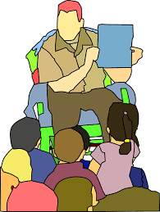
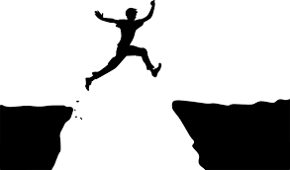
Now look at these sentences. What do you notice?
My teacher read an extremely interesting story.
What is being modified by the adverb “extremely”?
He jumped very carefully over the ravine.
What is being modified by the adverb “very”?

Slide 50
My teacher read an extremely interesting story.
Here the adverb “extremely” is modifying the adjective “interesting”.
He jumped very carefully over the ravine.
Here the adverb “very” is modifying another adverb “carefully”.

Slide 51
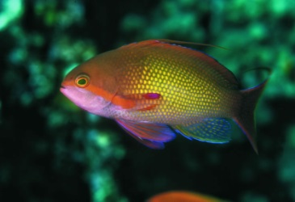
So, what is an adverb?
An adverb is a word that modifies a verb, an adjective or another adverb.
A verb is an action word (jump, run, swim, ski, fish, talk)
An adjective is a descriptive word that describes a noun (pretty, happy, silly, sunny)
It cannot modify a noun. An adjective modifies a noun.
Circle what adverbs can modify.
What can adverbs modify?
NOUN ADJECTIVE VERB ADVERB PREPOSITION

Slide 52
So, what is an adverb?
An adverb is a word that modifies a verb, an adjective or another adverb.
A verb is an action word (jump, run, swim, ski, fish, talk)
An adjective is a descriptive word that describes a noun (pretty, happy, silly, sunny)
It cannot modify a noun. An adjective modifies a noun.
Circle what adverbs can modify.
What can adverbs modify?
NOUN ADJECTIVE VERB ADVERB PREPOSITION

Slide 53
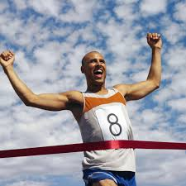
Defining an Adverb
Look at these sentences. What is the adverb modifying?
He runs quickly.
She walks slowly.
He chatters happily.
He runs very quickly.
In this sentence, quickly is an adverb modifying the verb runs. Very is another adverb, this time modifying the adverb quickly.
The very pretty girl sat down.
In this sentence, pretty is an adjective modifying the noun girl. Very is an adverb modifying the adjective pretty.
The adverb modifies the ______.
Quickly modifies __________.
The adverb modifies another ______.
Very modifies ___________.
The adverb modifies an _________.
Very modifies__________.

Slide 54
Defining an Adverb
Look at these sentences. What is the adverb modifying?
He runs quickly.
She walks slowly.
He chatters happily.
He runs very quickly.
In this sentence, quickly is an adverb modifying the verb runs. Very is another adverb, this time modifying the adverb quickly.
The very pretty girl sat down.
In this sentence, pretty is an adjective modifying the noun girl. Very is an adverb modifying the adjective pretty.
The adverb modifies the verb.
Quickly modifies runs.
The adverb modifies another adverb.
Very modifies quickly.
The adverb modifies an adjective.
Very modifies pretty.

Slide 55
 | Sentence | Adverb (s) | What is adverb modifying? | Word class of modified word
1 | He ran quickly down the hill. | quickly | ran | verb
2 | He walked carefully along the edge of the cliff.
3 | The night was very dark.
4 | The rain fell heavily on the rooftops.
5 | Your presentation was very interesting.
6 | She often goes to the beach.
7 | They whispered very quietly so that no one would hear them.
8 | She smiled kindly at the children.
9 | They calmly put on their coats and left.
10 | Can you make your writing more imaginative?

Slide 56
 | Sentence | Adverb (s) | What is adverb modifying? | Word class of modified word
1 | He ran quickly down the hill. | quickly | ran | verb
2 | He walked carefully along the edge of the cliff. | carefully | walked | verb
3 | The night was very dark. | very | dark | adjective
4 | The rain fell heavily on the rooftops. | heavily | fell | verb
5 | Your presentation was very interesting. | very | interesting | adjective
6 | She often goes to the beach. | often | goes | verb
7 | They whispered very quietly so that no one would hear them. | very quietly | quietly whispered | adverb verb
8 | She smiled kindly at the children. | kindly | smiled | verb
9 | They calmly put on their coats and left. | calmly | put on | verb
10 | Can you make your writing more imaginative? | imaginative | more | adjective

Slide 57
Underline the adverb(s) in each of the following sentences.
Joe walked slowly and steadily up the hill.
The boy ate quickly and then felt sick.
Jim will miss the many wonderful people at work.
Unfortunately, Joe is a very late man.
Clark wanted desperately to be in the Nativity play.
He worked extremely hard to finish his homework.
The dog barked loudly until his owners came home.
Gently, the leaves fell from the autumn trees.
The storm rumbled ominously in the distance.
The ugly troll aggressively attacked the unsuspecting village.

Slide 58
Answers
Joe walked slowly and steadily up the hill.
The boy ate quickly.
Jim will miss the many wonderful people at work.
Joe is a very late man.
Clark wanted desperately to be in the Nativity play.
He worked extremely hard to finish his homework.
The dog barked loudly until his owners came home.
Gently, the leaves fell from the autumn trees.
The storm rumbled ominously in the distance.
The ugly troll aggressively attacked the unsuspecting village.

Slide 59



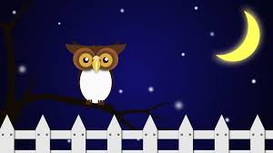
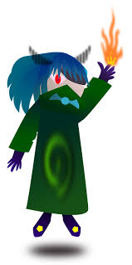
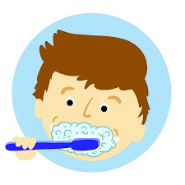
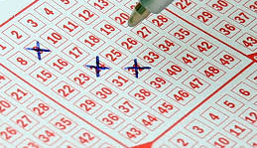
WALT/ LO: Create sentences using the following adverbs
1) suddenly | 2) very | 3) at night | 4) quite
5) enough | 6) wickedly | 7) randomly | 8) regularly

Slide 60
WALT/ LO: Create sentences using the following adverbs
The bomb exploded suddenly. | 2) He ran very fast. | 3) At night the owl hooted. | 4) He was quite happy.
5) She didn’t sleep enough. | 6) Wickedly, the monster attacked. | 7) She picked the numbers randomly. | 8) You should brush your teeth regularly.

