Slide 1
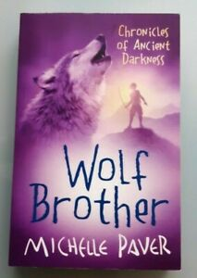
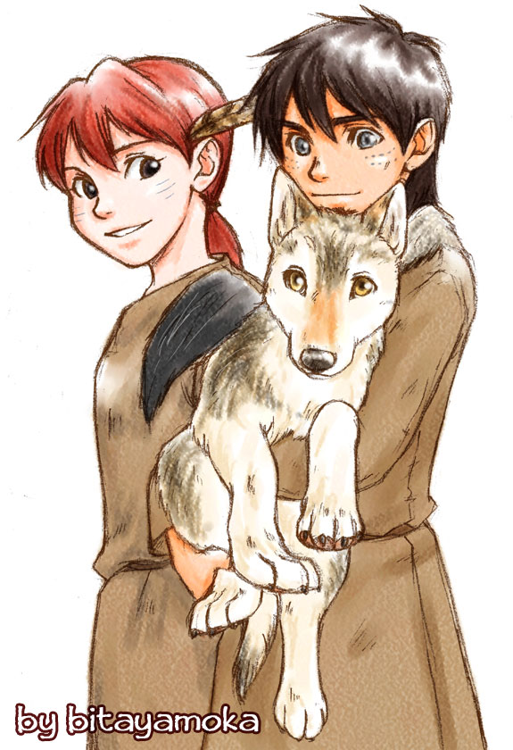
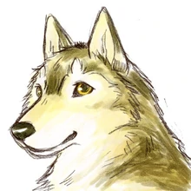
Guided reading
Wolf Brother
Week 2

Slide 2
Lesson 1: 2d: Make inferences from the text/ explain and justify inferences with evidence from the text.
Answer these questions using the extract to help you (Ch.15).
He hallucinated because he’s so cold- where is this? (p.109)
p.110- why does Torak not dare to close his eyes?
p.111- what gives him strength right at the end of the chapter?
What’s the cliffhanger at the end of the chapter- Is Torak blind?

Slide 3
Lesson 2: 2b: Retrieve and record information/ identify key details from fiction and non-fiction.
Answer these questions using evidence from the text (Ch.15):
1. Find a copy a phrase that tells you that Torak is in danger on page 109. Explain what this does to you as a reader.
2. Look at the paragraph beginning…. The cold made his eyes ache.’ (p.110) Why are dashes used in this section? What does this tell you about the events that are happening?
3. Look at page 109. Which word has the closest meaning to exhausted
Merciless, languid, gulping, leered
4. When Torak is frightened of ‘opening his fist in case they slipped free.’ Why is it so important to him that he keeps hold of the pearls?

Slide 4
Lesson 3: 2g: Identify/ explain how meaning is enhanced through choice of words and phrases.
Skim read your copy of chapter 14:
You will need to draw the camp that Renn and Torak have made. Include in your drawing Renn, Torak and Wolf in as well as the possessions they have.
Select suitable quotes from the text and write these around the outside of your drawing.

Slide 5
Lesson 4: 2a: Give/ explain the meaning of words in context.
Fastest finger first- p.g. 114-115
See if you can highlight these words in your extract:
Fetched
Wriggling
Crumbled
Unclench
Gloriously
Soared

Slide 6
Lesson 5: 2b: Retrieve and record information/ identify key details from fiction and non-fiction
2c: Summarise main ideas from more than one paragraph
Create a double bubble map, comparing Renn and Torak an example has been done for you:
Miss Fa
Renn
Torak

