Slide 1
Wednesday 31st March 2021
L.O: To understand texts- inference skills
C: Boy

Slide 2

Today we are continuing to explore our new book! We are going to explore Roald’s time in boarding school.
We are going to use our Inference Iggy skills to help us read between the lines.

Slide 3
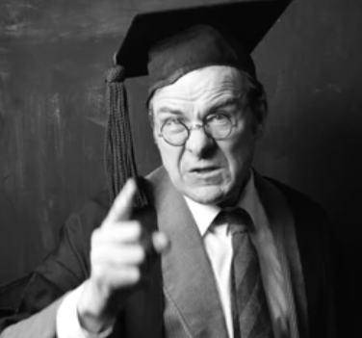
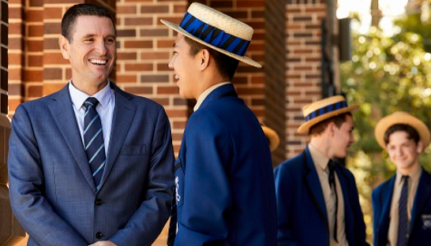
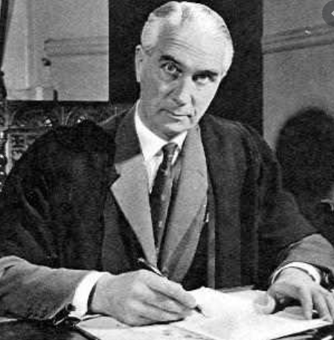
Starter: Game
Which of these pictures best shows Roald’s view of his headmaster?

Slide 4
Class Read
Class Read p.95-97
Whilst we are reading, please focus on the Headmaster.

Slide 5
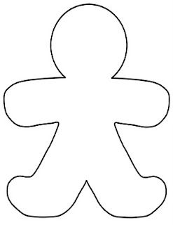
Our task
We are going to complete a gingerbread man activity- focusing on the Headmaster.
Inside the gingerbread man: his inner/secret thoughts/hidden agenda.
Outside the gingerbread man: How the parents see/view him.
I WILL MODEL THIS FOR YOU

Slide 6
Our task
Paddlers:
Work with the teacher for further group discussion.
Snorkellers:
TA will walk around and give you extra help or talking time if you need it.
Divers:
Use exact evidence from the text on your gingerbread man character.

Slide 7

Red Pen Challenge:
Why do you think Roald Dahl stuttered when talking to the headmaster? Do you think you would react in the same way?

