Slide 1

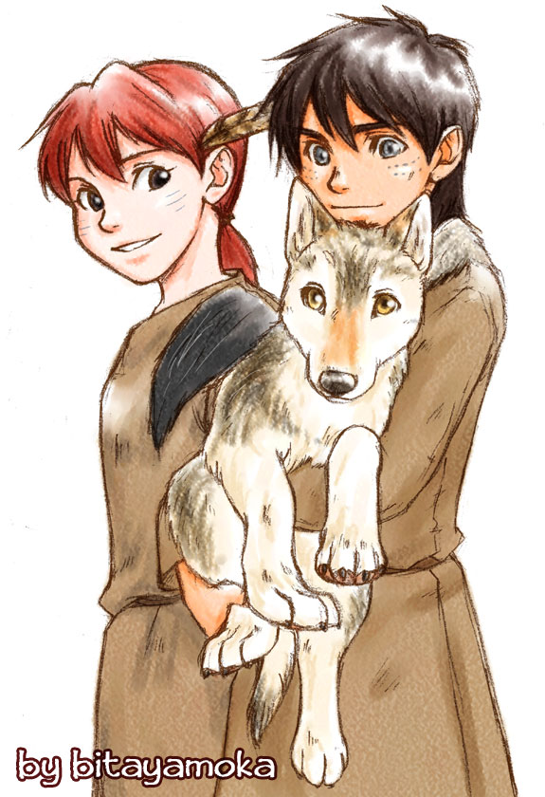
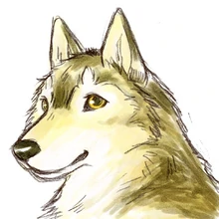
Guided reading
Wolf Brother
Week 7

Slide 2
Lesson 1:2a: Give/ explain the meaning of words in context
Continue reading Wolf Brother.

Slide 3
Lesson 2: 2g: Identify/ explain how meaning is enhanced through choice of words and phrases.
Look at p.g. 179 and 180.
Task 1:
Draw Torak in this particular scene. Make sure you quote from the text and write it around the picture.

Slide 4
Lesson 3:
Book review:
Now, that we have come to an end in reading Wolf Brother. I want you to complete a book review detailing what you enjoyed about the book and whether you would recommend this book to someone else.

