Slide 1
Why were the Vikings so successful?
Here are a few ideas to help you start thinking
about why the Vikings were so successful at
travelling vast distances and settling in new places.

Slide 2
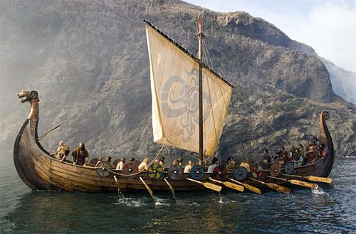
Travelling long distances
How were they able to travel far distances?
What was special about their boats?

Slide 3
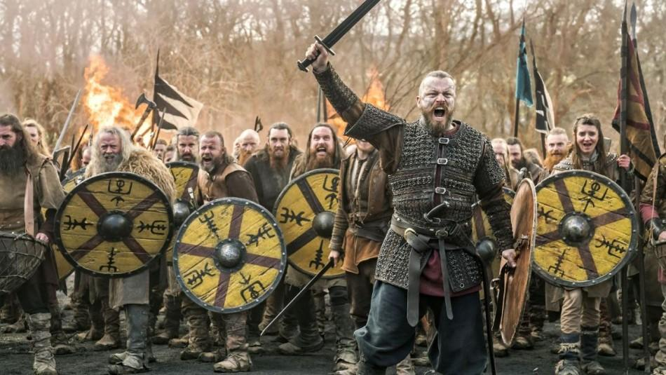
Successful raids
Why were they such feared warriors?
Was it their weapons, their armour or their tactics?

Slide 4
Colonised areas
The Vikings colonised places such as Iceland and were able to establish permanent settlements in Britain.
How did they survive in harsh environments like Iceland?
How did they take land from the Anglo-Saxons?

