Slide 1

French
This PowerPoint will show you the different body parts and will give the words for each part in English and French.
Click on these symbols to hear the French!

Slide 2
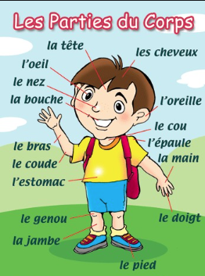

The parts of the body
Les parties du corps

Slide 3

Head
La tête

Slide 4
Face
Le visage

Slide 5
Eye
L’oeil
Eyes
Les yeux

Slide 6
Nose
Le nez

Slide 7
Ear
L’oreille

Slide 8
Mouth
La bouche

Slide 9
Lips
Les lèvres

Slide 10
Teeth
Les dents

Slide 11
Hair
Les cheveux

Slide 12
Neck
Le cou

Slide 13
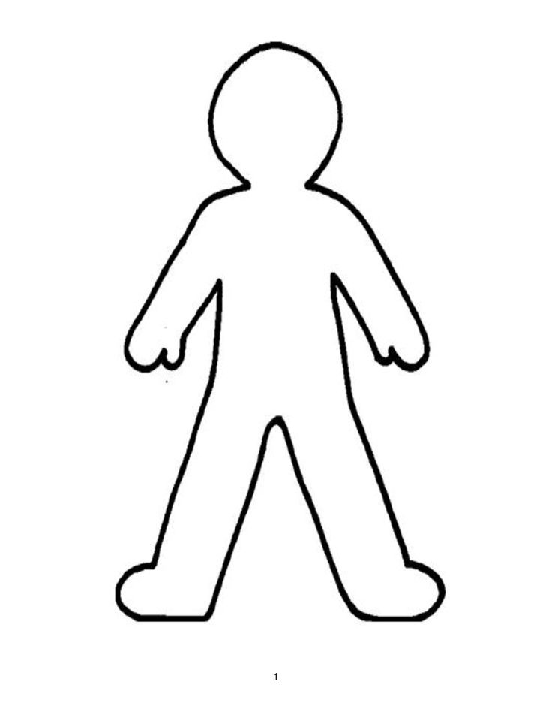
Shoulder
l'épaule
Shoulders
les épaules

Slide 14
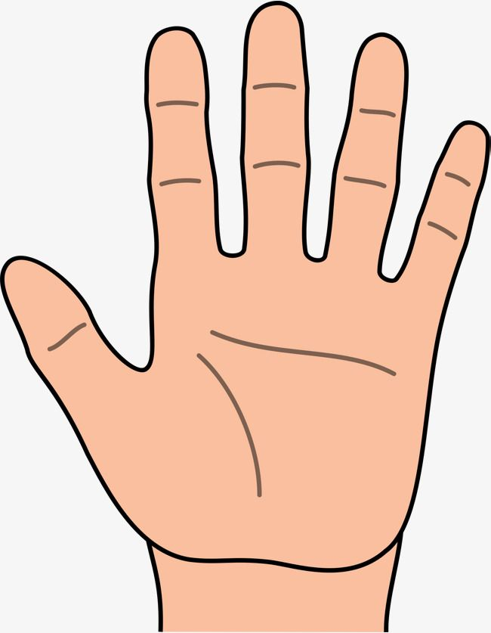
Hand
La main
Hands
Les mains

Slide 15
Finger
Le doigt
Fingers
Les doigts

Slide 16
Chest
La poitrine
Tummy
Le ventre

Slide 17

Back
Le dos

Slide 18
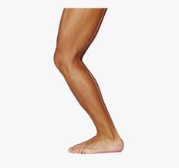
Leg
La jambe
Legs
Les jambes

Slide 19
Knee
Le genou
Knees
Les genoux

Slide 20
Foot
Le pied
Feet
Les pieds

Slide 21
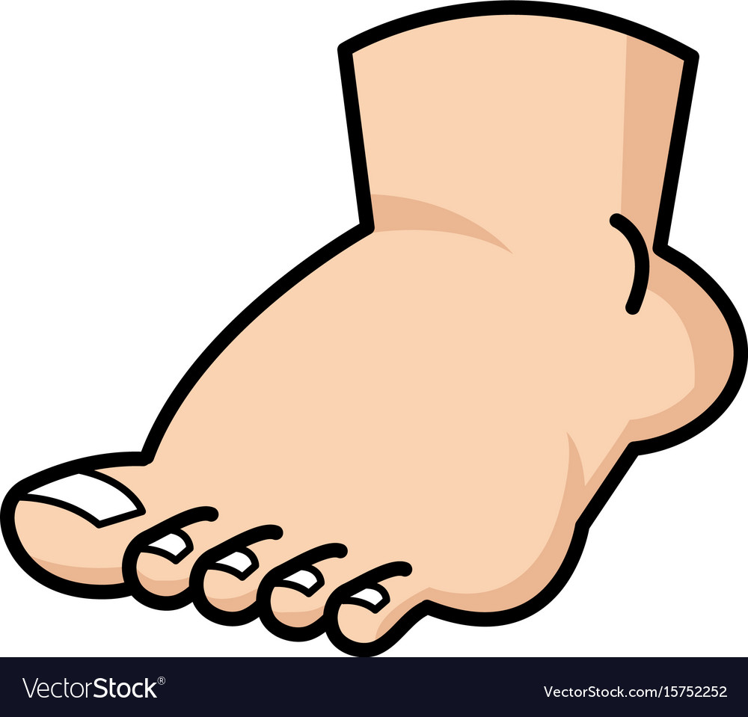
Toes
Les doigts de pied

Slide 22
Head, shoulders, knees and toes
Watch this video and see if you can sing along with the body parts!
https://www.youtube.com/watch?v=7YEZAwUfaeE

