Slide 1
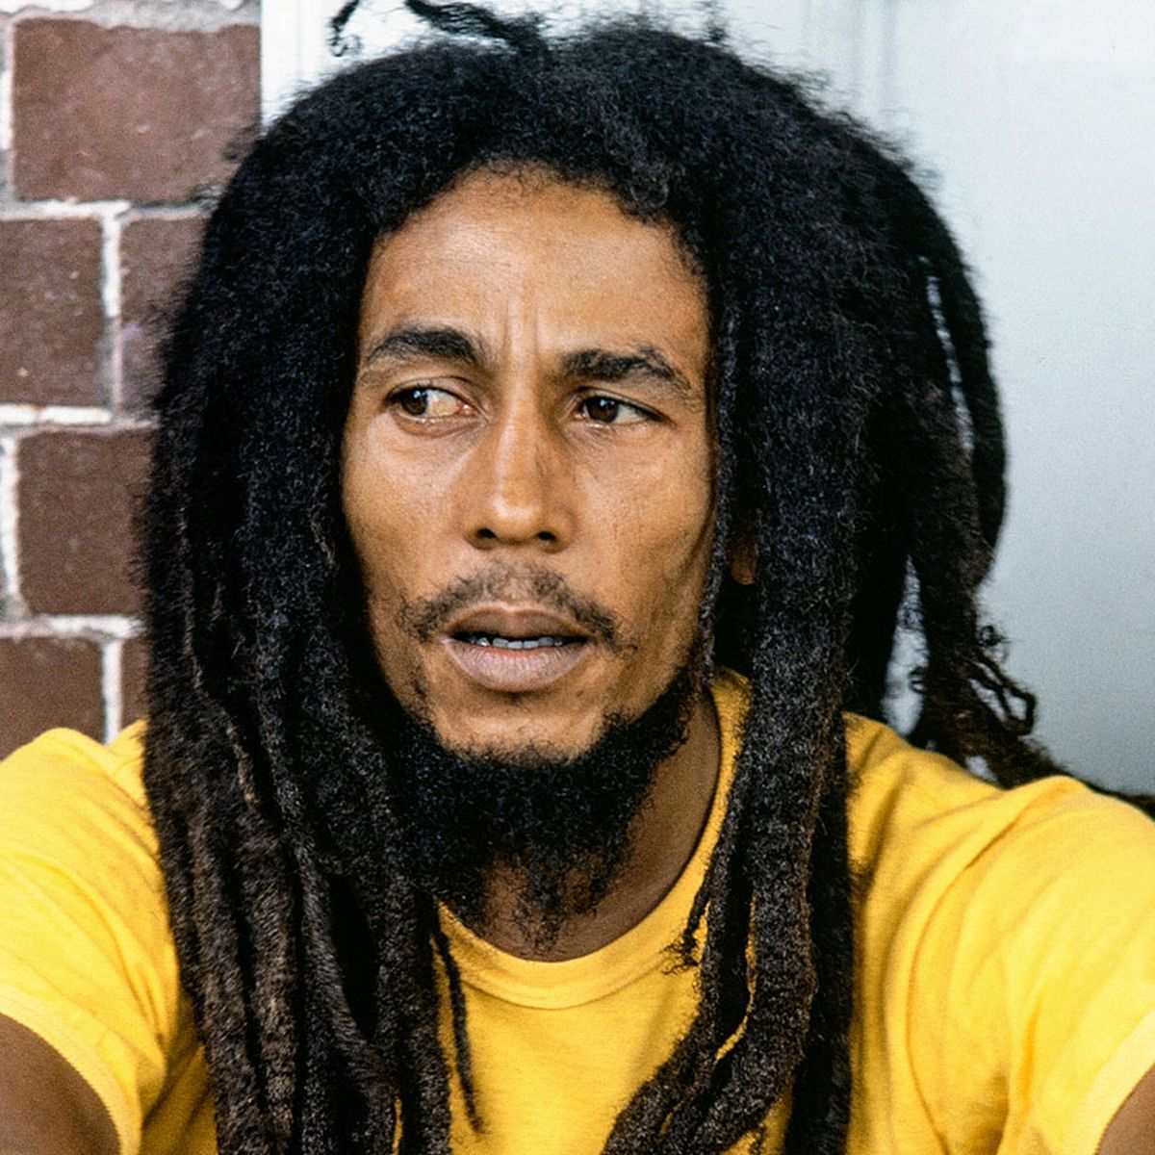
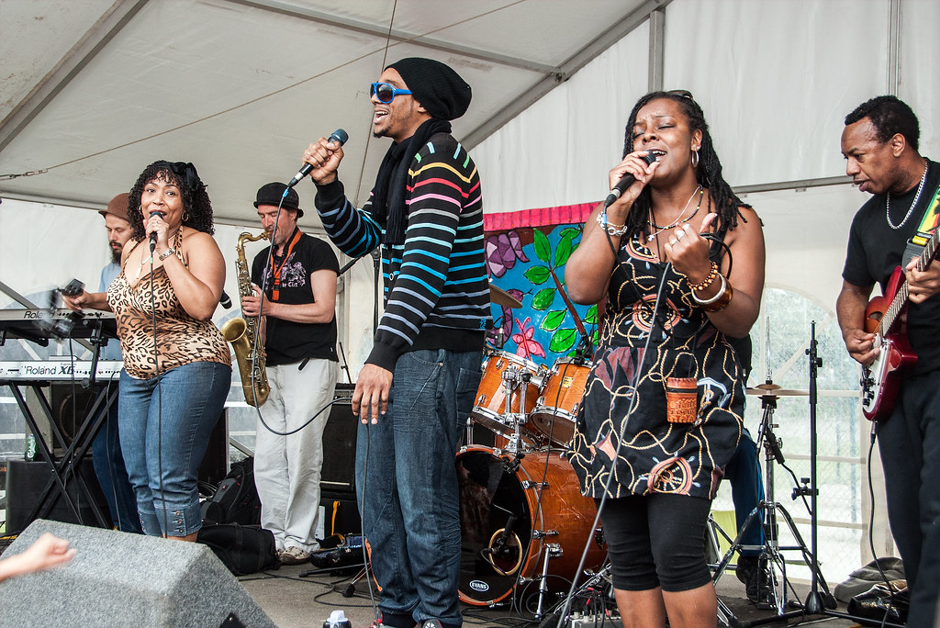
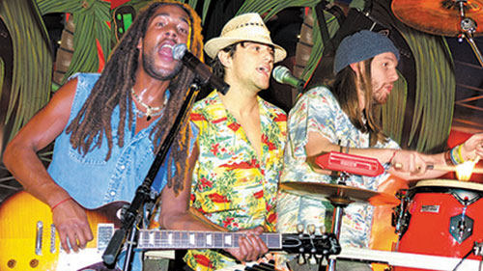
Reggae Music
This music of from the Caribbean - let’s find it on Google Earth
Artists include: Bob Marley, Desmond Decker and many others
Listen to “Buffalo Soldier” https://www.youtube.com/watch?v=S5FCdx7Dn0o

Slide 2
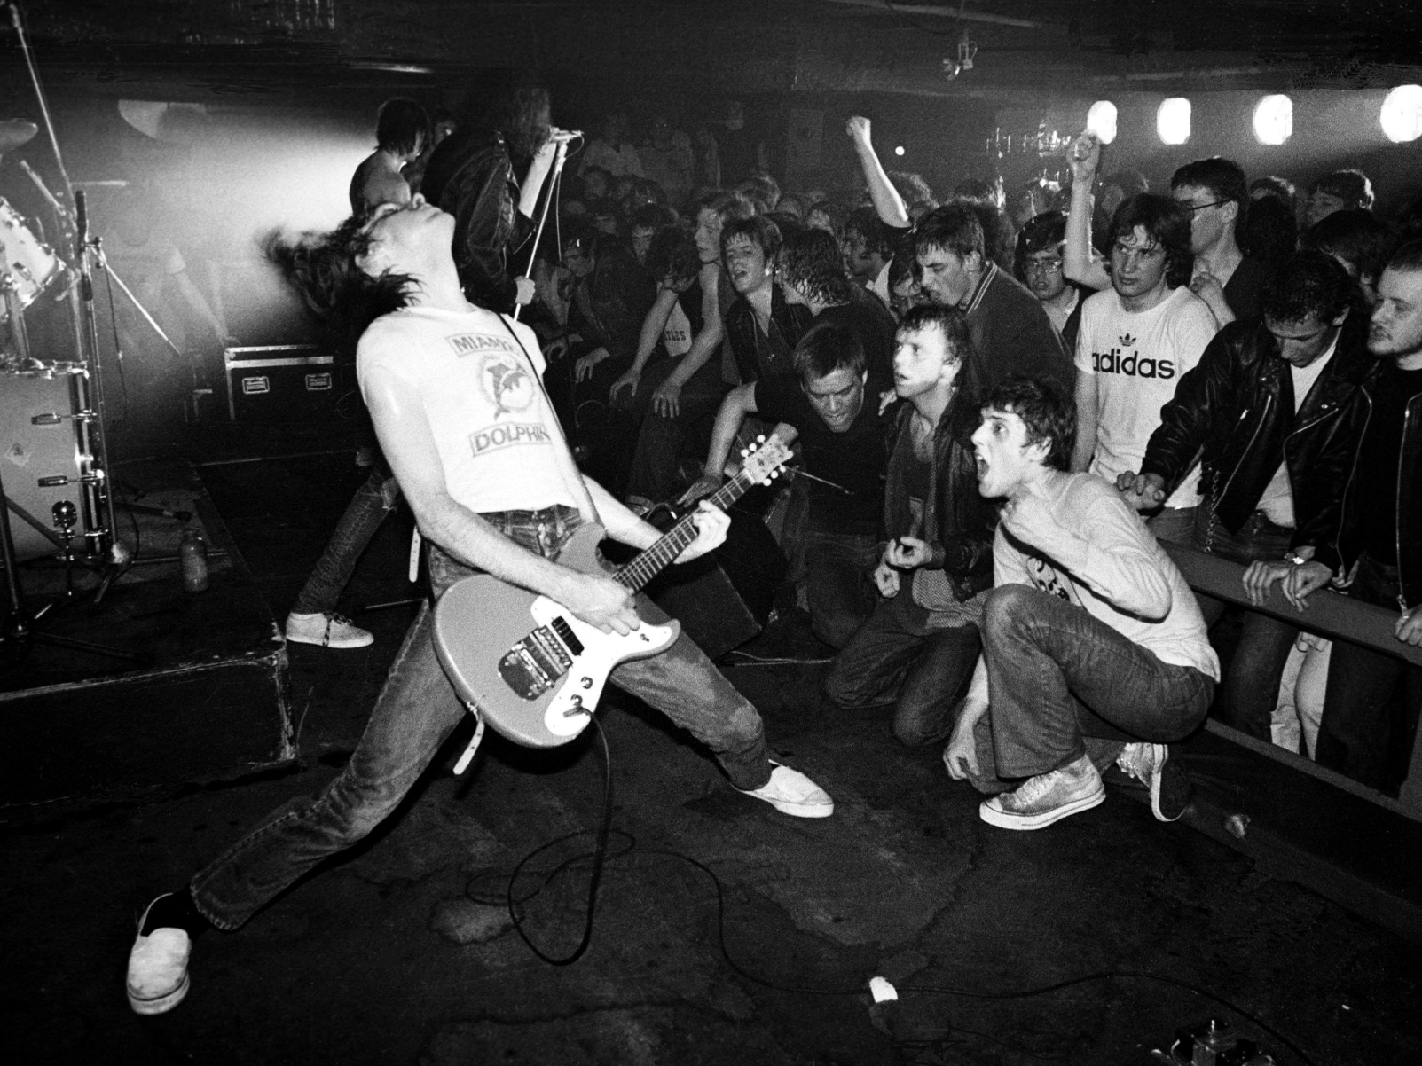

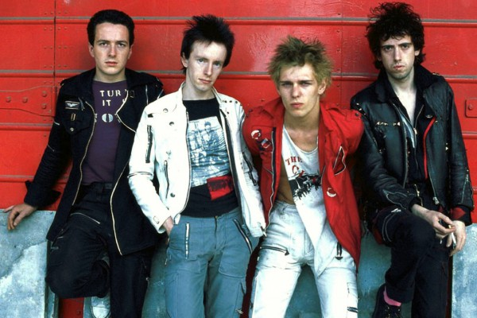
Punk Rock
Punk Rock is a type of music from the 1970s which is usually fast, short and quite aggressive sounding.
Punk banks include, The Clash, The Adverts and many more.
https://www.youtube.com/watch?v=EfK-WX2pa8c

Slide 3
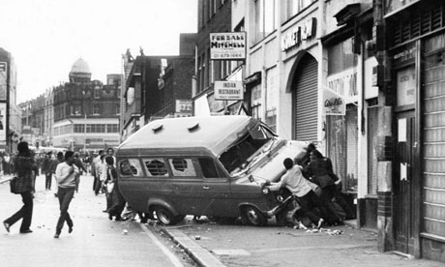
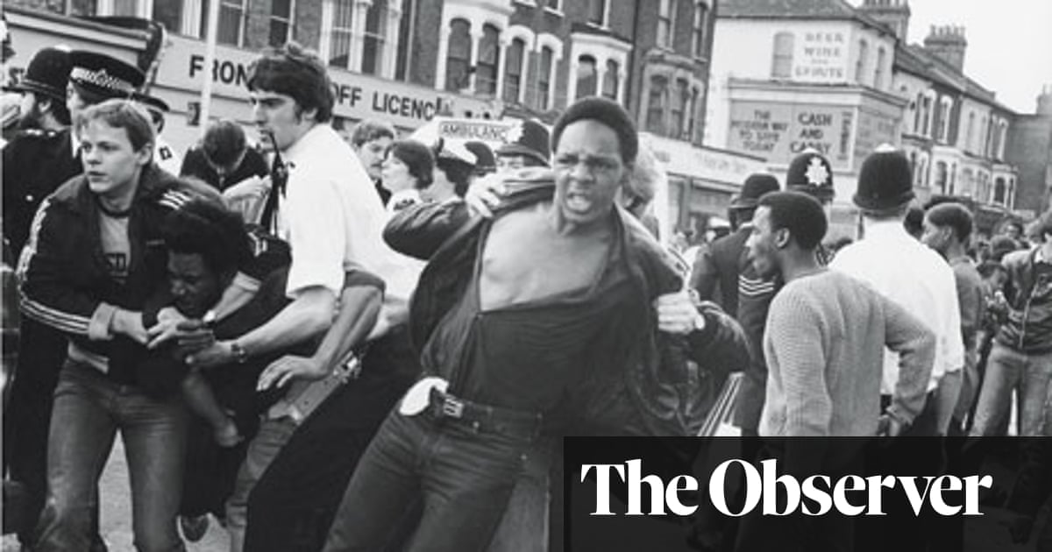
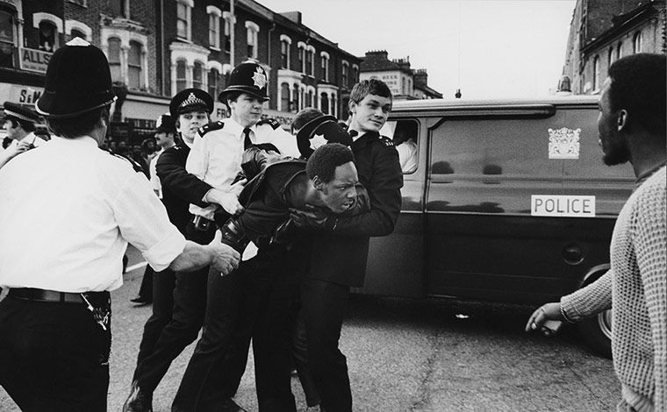
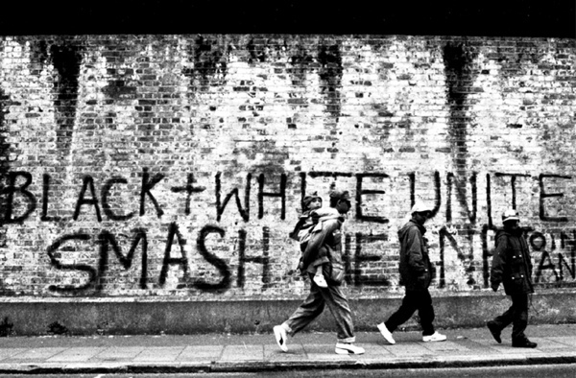

Slide 4

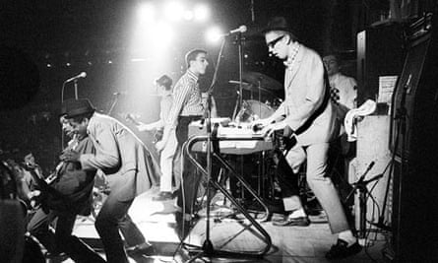
Two-tone or 2 tone is a genre of British popular music of the early 1980s that fused traditional Jamaican music with elements of punk rock.
It originated in Coventry in the UK

Slide 5
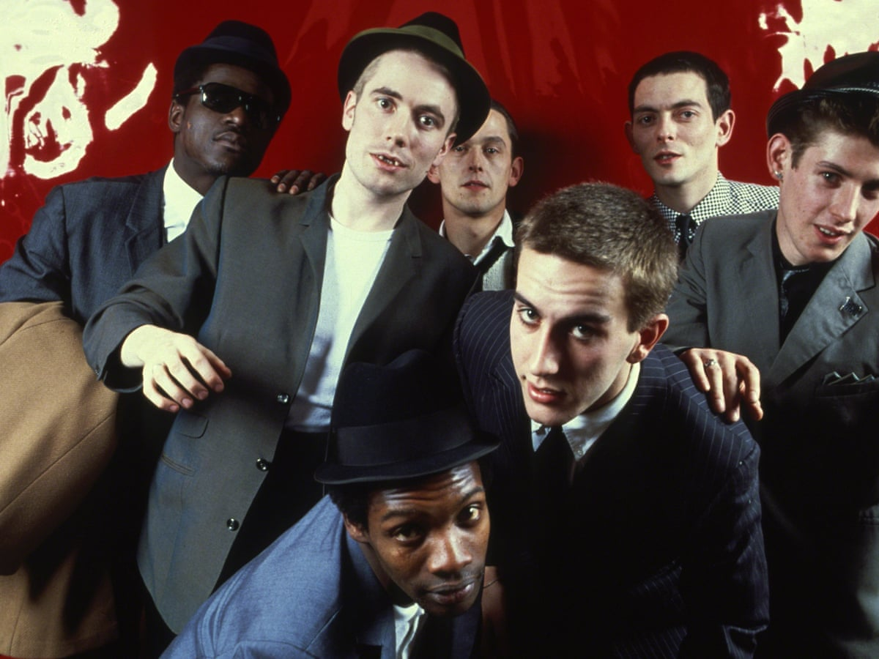
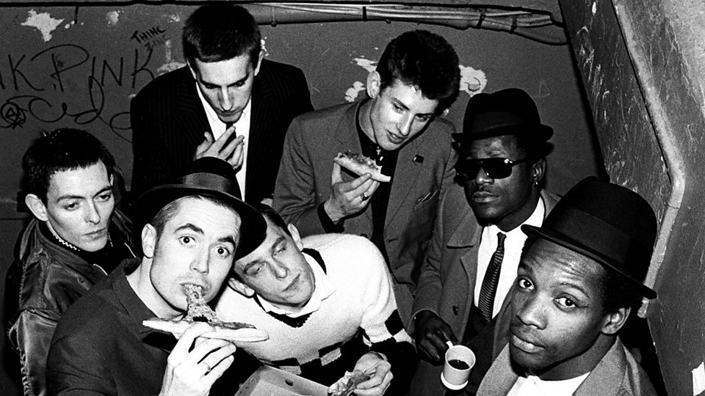
Bands included The Specials, The Selecter, and The Beat featured a mix of black, white, and multiracial people.

Slide 6
The Specials: https://www.youtube.com/watch?v=cntvEDbagAw&list=PLrQbejEuqapMW-spfy_4TELOsZFJnGLQa
The Selector https://www.youtube.com/watch?v=sZmWGJDsBWs
The Beat https://www.youtube.com/watch?v=q1OVYFNUZT8

Slide 7

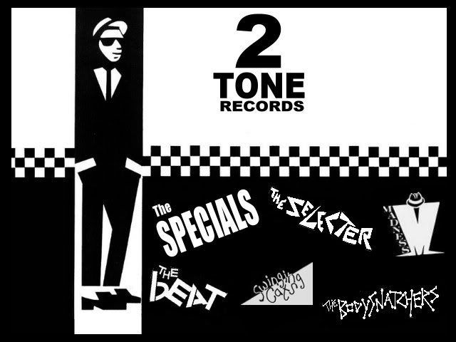
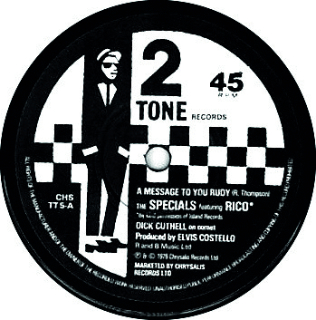
Chequers

