Slide 1
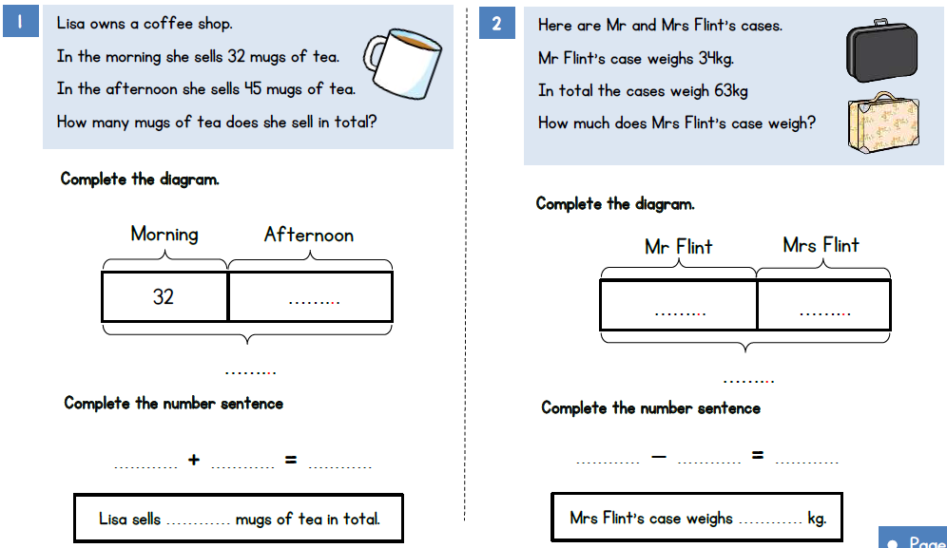

Slide 2
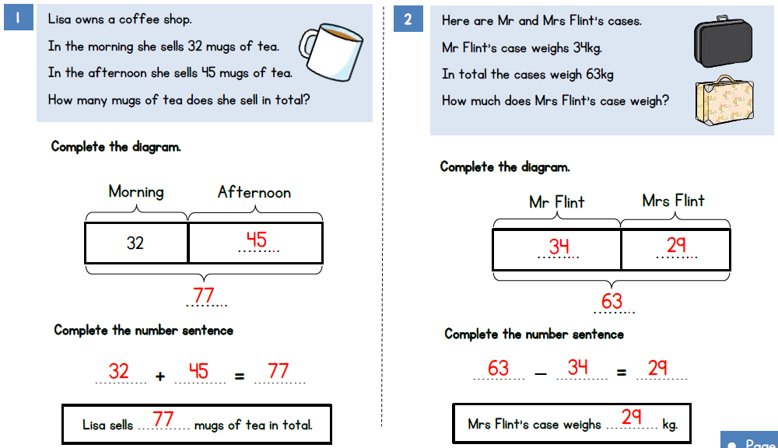

Slide 3
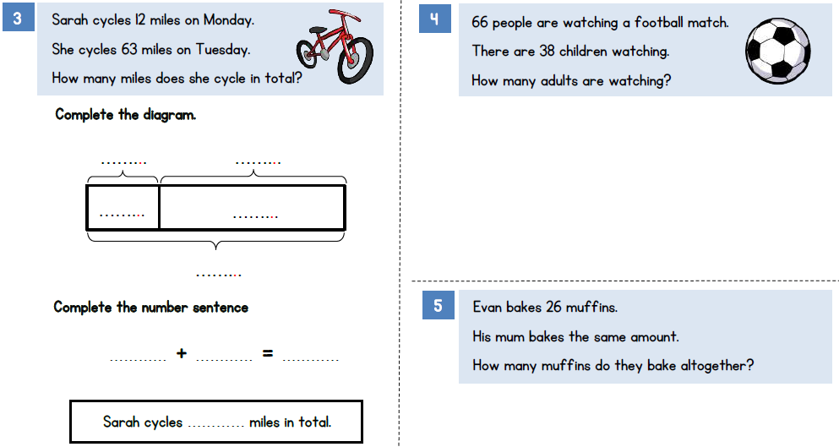

Slide 4
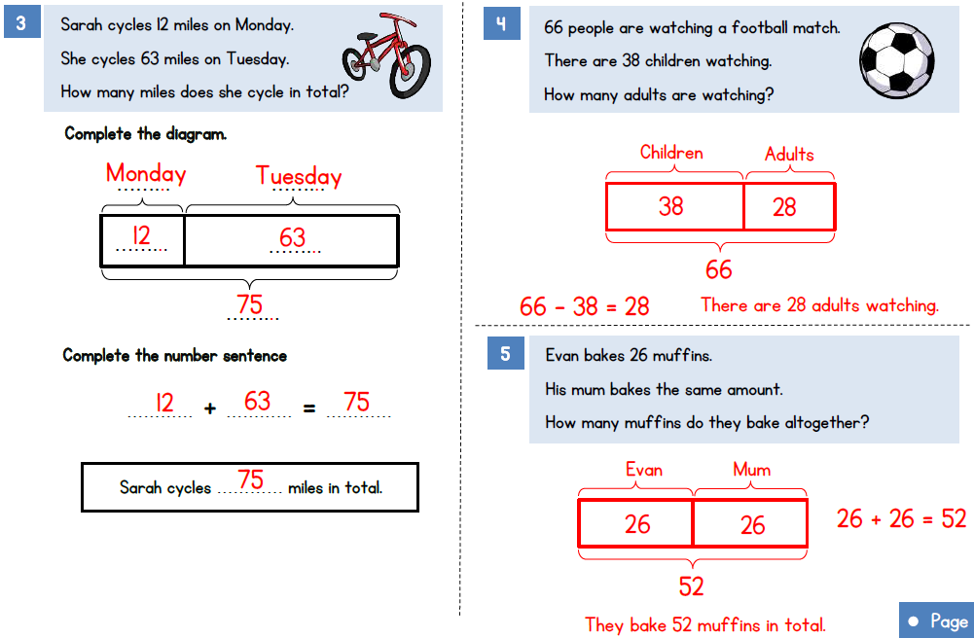

Slide 5
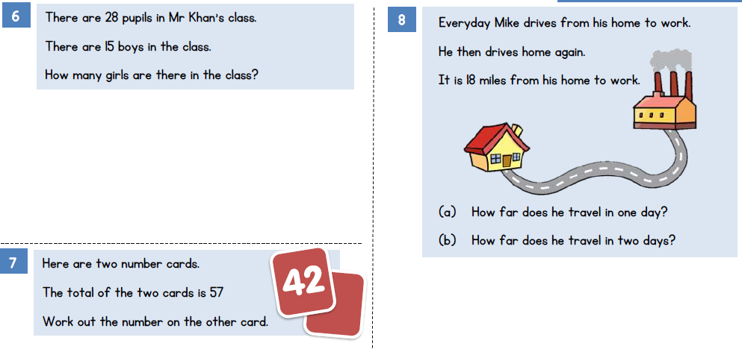

Slide 6
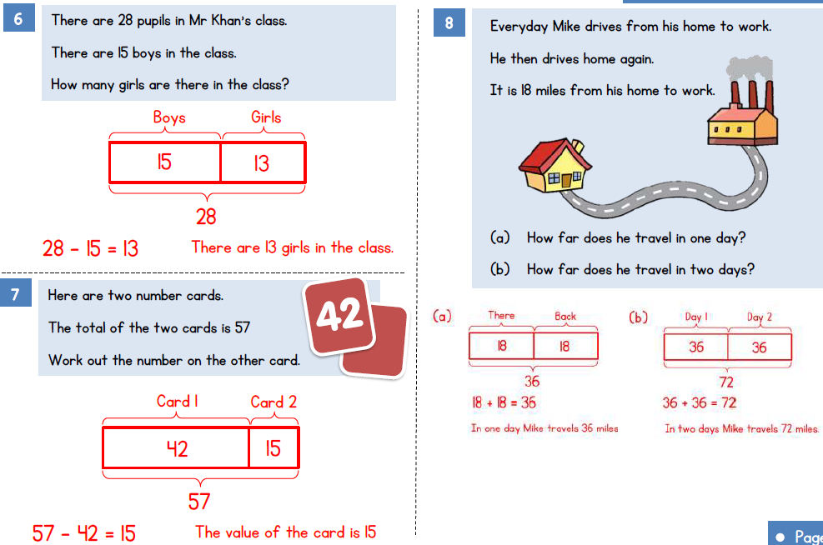

Slide 7


Slide 9
2 4 6 8 10
The numbers increase by _______ each time.
Write the number 839,004 in words.
23,553 24,553 25,553
Which place value column changes each time?

Slide 10
2 4 6 8 10
The numbers increase by _______ each time.
Write the number 839,004 in words.
23,553 24,553 25,553
Which place value column changes each time?
2
Eight hundred and thirty-nine thousand and four
The thousands column

Slide 12

8
,135
10
,135
6,135 7,135 _____ 9,135 _____
Have a think
What’s stayed the same?
What’s changed?
The hundreds, tens and ones digits
The thousands digits
It is 1 thousand greater each time

Slide 13
1,718
1,818
2,018
1,618 _____ _____ 1,918 _____
What’s stayed the same?
What’s changed?
Have a think
300
300 ÷ 3 = 100
1,618
1,718
1,818
1,918

Slide 14
+ 10,000
+ 10,000
+ 10,000
45 10,045 20,045 30,045
Have a think
10,000s
This sequence is counting up in __________.

Slide 15

+ 10
+ 10
+ 10
+ 10
8,803
……8,763 8,773 8,783 8,793……
Which numbers will appear in this sequence?
8,753 8,803
13 5,342
800,003
This number won’t appear because it doesn’t have a 7 in the hundreds place.

Slide 16
Have a go at questions 1 - 3 on the worksheet

Slide 17
1 | 2 | 3 | 4 | 5 | 6 | 7 | 8 | 9
10 | 20 | 30 | 40 | 50 | 60 | 70 | 80 | 90
100 | 200 | 300 | 400 | 500 | 600 | 700 | 800 | 900
1,000 | 2,000 | 3,000 | 4,000 | 5,000 | 6,000 | 7,000 | 8,000 | 9,000
10,000 | 20,000 | 30,000 | 40,000 | 50,000 | 60,000 | 70,000 | 80,000 | 90,000
100,000 | 200,000 | 300,000 | 400,000 | 500,000 | 600,000 | 700,000 | 800,000 | 900,000
What number is shown here?
500,000 + 30,000 + 3,000 + 900 + 80 =
533,980
What number has been added?
1,000
500,000 + 30,000 + 4,000 + 900 + 80 =
534,980

Slide 18
1 | 2 | 3 | 4 | 5 | 6 | 7 | 8 | 9
10 | 20 | 30 | 40 | 50 | 60 | 70 | 80 | 90
100 | 200 | 300 | 400 | 500 | 600 | 700 | 800 | 900
1,000 | 2,000 | 3,000 | 4,000 | 5,000 | 6,000 | 7,000 | 8,000 | 9,000
10,000 | 20,000 | 30,000 | 40,000 | 50,000 | 60,000 | 70,000 | 80,000 | 90,000
100,000 | 200,000 | 300,000 | 400,000 | 500,000 | 600,000 | 700,000 | 800,000 | 900,000
What number is shown here?
Have a think
600,000 + 50,000 + 3,000 + 100 + 60 + 5 =
653,165
What number has been subtracted?
100
What number has been subtracted?
100,000
500,000 + 50,000 + 3,000 + 0 + 60 + 5 =
553,065
500,000 + 50,000 + 3,000 + 100 + 60 + 5 =
553,165

Slide 19

HTh | TTh | Th | H | T | O
Whitney must add 3 counters to the place value chart and make an even number.
What number could Whitney make?
214,322

Slide 20
HTh | TTh | Th | H | T | O
3
Whitney must add 3 counters to the place value chart and make an even number.
What number could Whitney make?
214,304

Slide 21
Have a go at the rest of the questions on the worksheet

