Slide 1
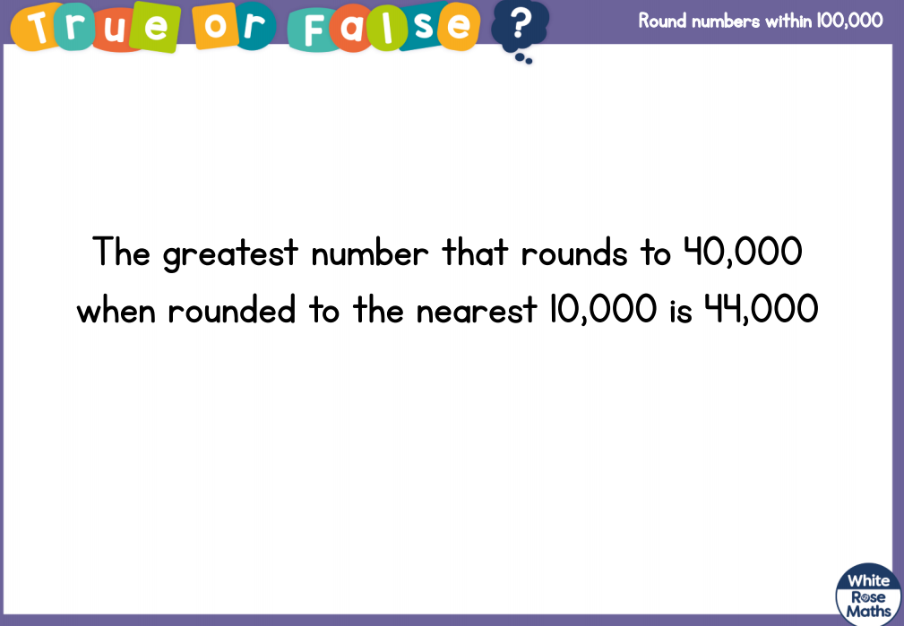


Slide 2
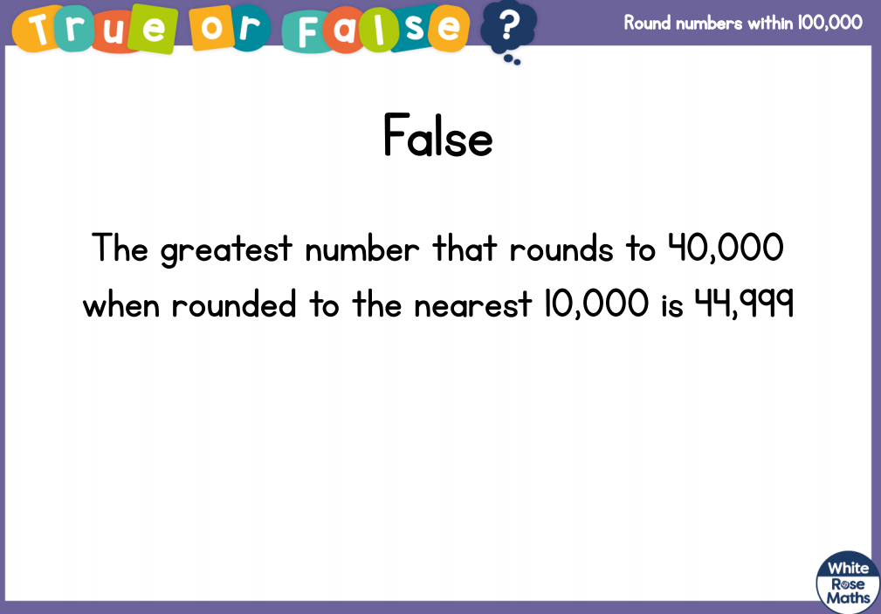

Slide 4
Round 7,443 to the nearest 1,000
2) 38,000 39,000 _____ _____
3) _____ 60,000 61,000 _____

Slide 5
Round 7,443 to the nearest 1,000
2) 38,000 39,000 _____ _____
3) _____ 60,000 61,000 _____
7,000
40,000
41,000
59,000
62,000

Slide 7

Have a think
Round to nearest 10
Ones column
Round to nearest 100
Tens column
Round to nearest 1,000
Hundreds column
Round to nearest 10,000
Thousands
________ column

Slide 8
Round 84,000 to the nearest 10,000
80,000
10,000
10,000 ÷ 10 =
1,000
81,000
80,000
90,000
84,000

Slide 9
Round 84,000 to the nearest 10,000
80,000

Slide 10
Round 45,000 to the nearest 10,000
50,000
Round 42,989 to the nearest 10,000
40,000
Round 3,606 to the nearest 10,000
00,000
0

Slide 11
Have a go at questions 1 - 4 on the worksheet

Slide 12
Which numbers round to 90,000 when rounded to the nearest 10,000?
Have a think
99,999
79,985
100,000
80,000
85,000
90,000
8,733
94,935
10,000
90,000

Slide 13

My number is 20,000 when I round it to the nearest 10,000
What is the greatest number Alex could be thinking of?
24,999
25,000
Have a think
15,000
17,000
19,000
21,000
23,000
25,000
16,000
18,000
20,000
22,000
24,000
24,999

Slide 14
Alex is thinking of a number
Rounds to 70,000 to the nearest 10,000
Has an odd multiple of 3 as its ones digit
Has 4 tens
Has a tens digit double the hundreds digit
Has the same digit in the ten thousands and thousands places
65,000
67,000
69,000
71,000
73,000
75,000
66,000
68,000
70,000
72,000
74,000
6
6
2
4
3
9
,

Slide 15
Have a go at the rest of the worksheet

