Slide 1
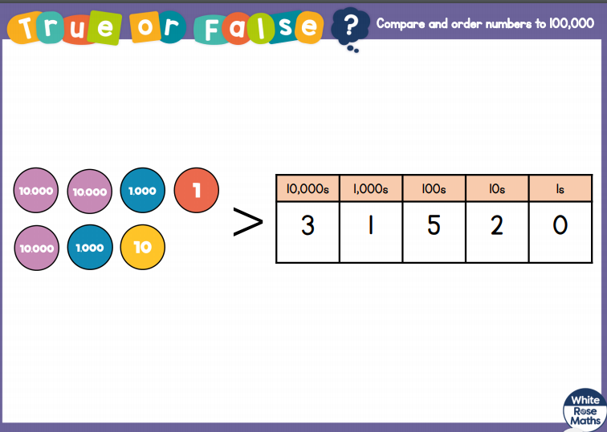

Slide 2
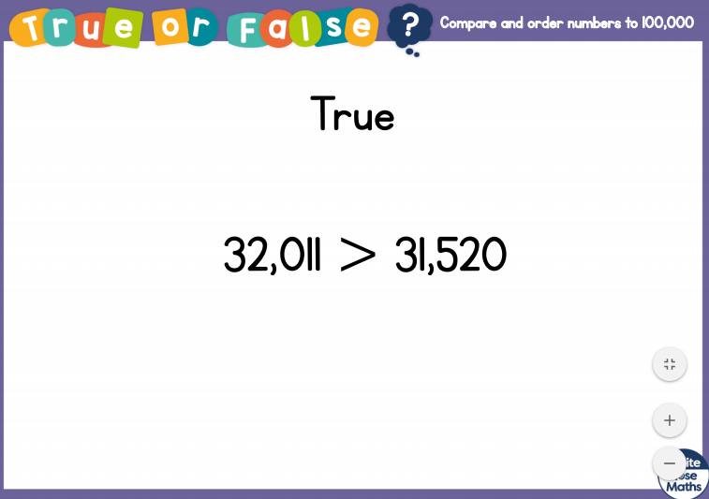

Slide 3
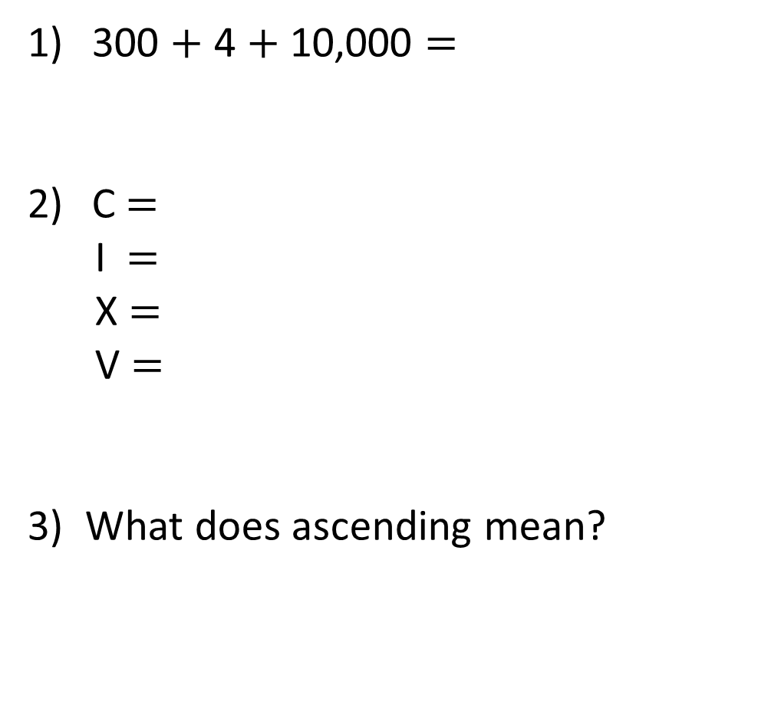
300 $+$ 4 $+$ 10,000 $=$
C $=$
I $=$
X $=$
V $=$
3) What does ascending mean?

Slide 4
300 $+$ 4 $+$ 10,000 $=$
C $=$
I $=$
X $=$
V $=$
3) What does ascending mean?
10,304
100
1
10
5
Getting larger

Slide 6



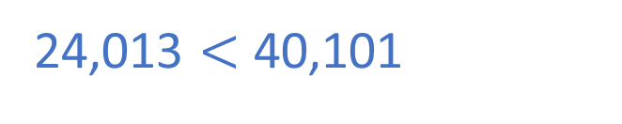
TTh | Th | H | T | O
Dexter’s number
24,013
2
4
0
1
3
24,013 $<$ 40,101
TTh | Th | H | T | O
Dora’s number
40,101
4
0
1
0
1
Dexter’s number is greater! He has used 10 counters whereas Dora has only used 6

Slide 7
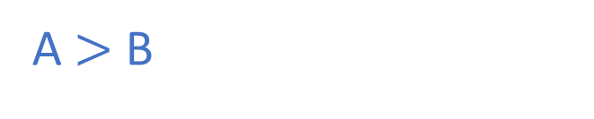
TTh | Th | H | T | O
A
2
2
5
A $>$ B
TTh | Th | H | T | O
B
2
2
4

Slide 8
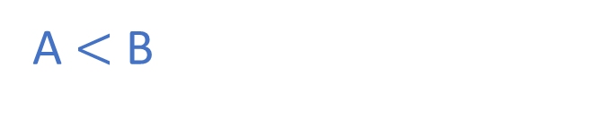
A) 7,996
TTh | Th | H | T | O
0
B) 21,253
TTh | Th | H | T | O
A $<$ B
2

Slide 9
Order the numbers, starting with the smallest.
5,109
99
11,022
513
5,122
99
513
5,109
5,122
11,022
_____ _____ _____ _____ _____

Slide 10
Have a go at questions 1 - 4 on the worksheet

Slide 11

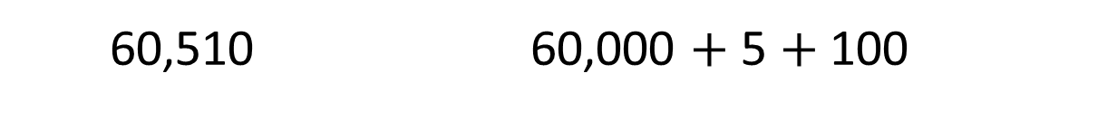

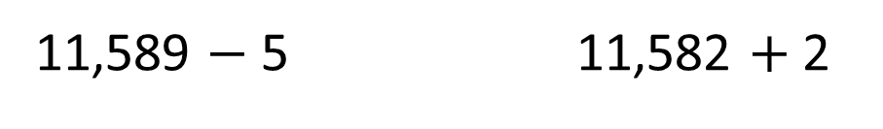
$=$
11,589 $−$ 5 11,582 $+$ 2
11,584
11,584
$>$
60,510 60,000 $+$ 5 $+$ 100
60,105
TTh | Th | H | T | O

Slide 12

34,000
Have a think
10,000
31,000
38,000
30,000
40,000
10,000 ÷ 10 = 1,000
30,500
38,890

Slide 13
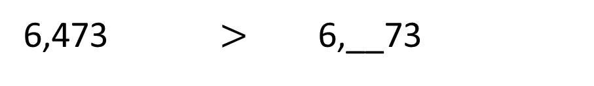
6,473 $>$ 6,__73
1
Th | H | T | O
2
3
0
Have a think
Th | H | T | O

Slide 14
Have a go at the rest of the worksheet

