Slide 1
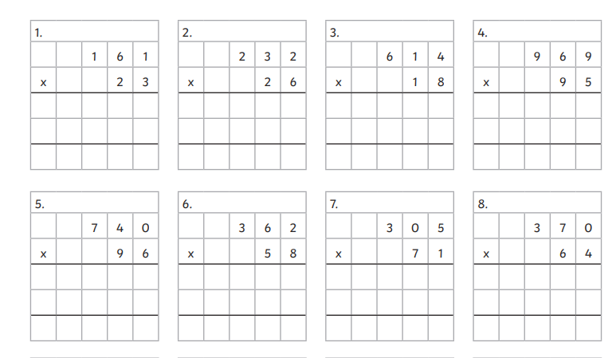
L.O. To multiply and divide
C: solving multiplication and division problems

Slide 3
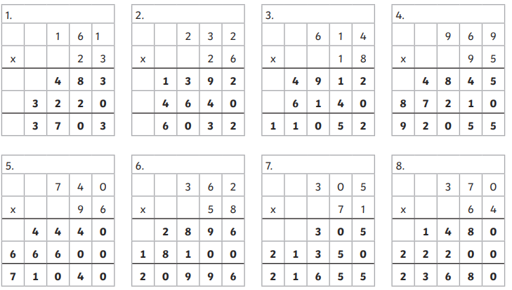

Slide 4
Lesson 2
L.O. To multiply and divide
C: solving multiplication and division problems

Slide 5
Expanded Long Multiplication
Complete the following calculation:
multiplicand
2652 × 32
multiplier
Go onto the next slide to see the multiplication process for
this calculation.

Slide 6
Multiply the number in the tens column by the unit multiplier.
TTh
Th
H
T
U
2
6
5
2
×
3
2
(2 × 2)
4

Slide 7
Multiply the number in the tens column by the unit multiplier.
TTh
Th
H
T
U
2
6
5
2
×
3
2
4
(2 × 2)
1
0
0
(2 × 50)

Slide 8
Multiply the number in the hundreds column by the unit multiplier.
TTh
Th
H
T
U
2
6
5
2
×
3
2
4
(2 × 2)
1
0
0
(2 × 50)
1
2
0
0
(2 × 600)

Slide 9
Multiply the number in the thousands column by the unit multiplier.
TTh
Th
H
T
U
2
6
5
2
×
3
2
4
(2 × 2)
1
0
0
(2 × 50)
1
2
0
0
(2 × 600)
4
0
0
0
(2 × 2000)

Slide 10
Multiply the number in the units column by the tens multiplier.
TTh
Th
H
T
U
Remember to take into account the fact that you are multiplying a multiple of 10. There needs to be a zero in the answer holding place in the units column.
2
6
5
2
×
3
2
4
(2 × 2)
1
0
0
(2 × 50)
1
2
0
0
(2 × 600)
4
0
0
0
(2 × 2000)
6
0
(30 × 2)

Slide 11
Multiply the number in the tens column by the tens multiplier.
TTh
Th
H
T
U
2
6
5
2
×
3
2
4
(2 × 2)
1
0
0
(2 × 50)
1
2
0
0
(2 × 600)
4
0
0
0
(2 × 2000)
6
0
(30 × 2)
1
5
0
0
(30 × 50)

Slide 12
Multiply the number in the hundreds column by the tens multiplier.
TTh
Th
H
T
U
2
6
5
2
×
3
2
4
(2 × 2)
1
0
0
(2 × 50)
1
2
0
0
(2 × 600)
4
0
0
0
(2 × 2000)
6
0
(30 × 2)
1
5
0
0
(30 × 50)
1
8
0
0
0
(30 × 600)

Slide 13
Multiply the number in the thousands column by the tens multiplier.
TTh
Th
H
T
U
2
6
5
2
×
3
2
4
(2 × 2)
1
0
0
(2 × 50)
1
2
0
0
(2 × 600)
4
0
0
0
(2 × 2000)
6
0
(30 × 2)
1
5
0
0
(30 × 50)
1
8
0
0
0
(30 × 600)
6
0
0
0
0
(30 × 2000)

Slide 14
Using column addition method, combine the eight separate answers.
TTh
Th
H
T
U
2
6
5
2
×
3
2
4
(2 × 2)
1
0
0
(2 × 50)
1
2
0
0
(2 × 600)
4
0
0
0
(2 × 2000)
6
0
(30 × 2)
1
5
0
0
(30 × 50)
1
8
0
0
0
(30 × 600)
6
0
0
0
0
(30 × 2000)
8
¹
4
8
6
4

Slide 15
Quick check 1. If your answer doesn’t look right, round the multiplicand to the nearest hundred and multiplier to the nearest ten, then multiply that. If your answer is way off, you know you need to go through it again.
e.g. 2700 × 30 = 81 000
TTh
Th
H
T
U
2
6
5
2
×
3
2
4
(2 × 2)
1
0
0
(2 × 50)
1
2
0
0
(2 × 600)
Quick check 2. Sometimes your calculations will all be right, but you just haven’t multiplied all the numbers. An easy way to check how many rows of numbers you should have in your answers is by multiplying the number of digits in the multiplicand by the number of digits in the multiplier. In this case, 4 × 2=8.
4
0
0
0
(2 × 2000)
6
0
(30 × 2)
1
5
0
0
(30 × 50)
1
8
0
0
0
(30 × 600)
6
0
0
0
0
(30 × 2000)
8
4
8
6
4

Slide 16
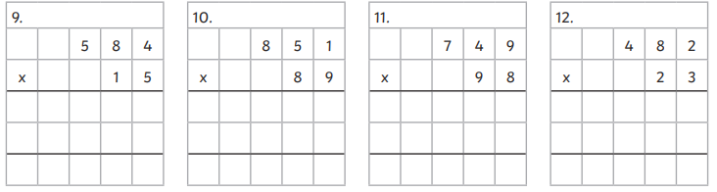

Slide 17
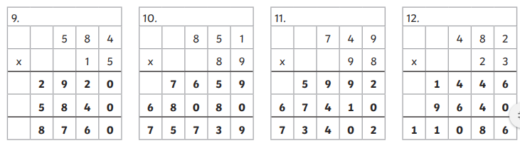

Slide 18
Lesson 3
L.O. To multiply and divide
C: solving multiplication and division problems

Slide 19
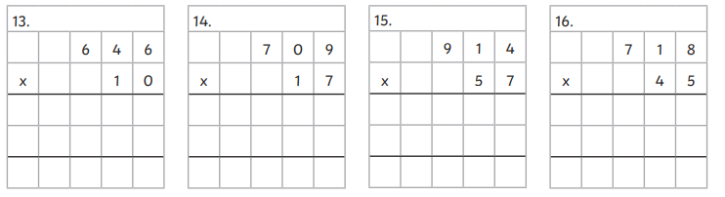

Slide 20
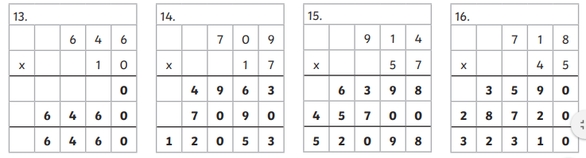

Slide 21
Lesson 4
L.O. To multiply and divide
C: solving multiplication and division problems

Slide 22
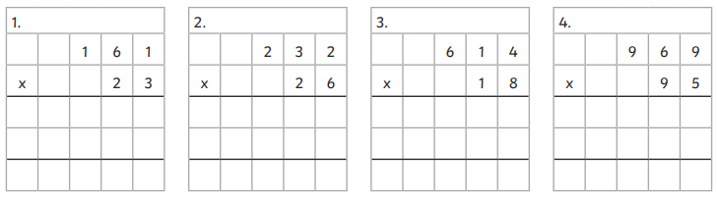
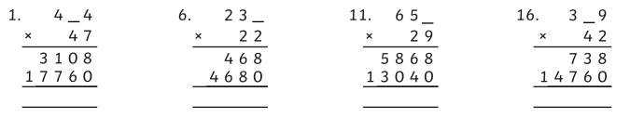

Slide 23


