Slide 1
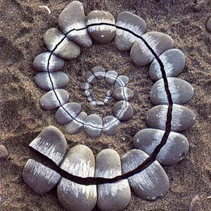
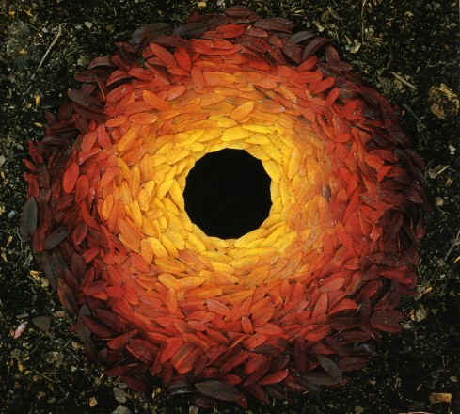
Andy Goldsworthy

Slide 2
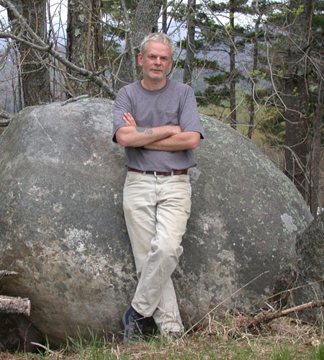
Who is Andy Goldsworthy?
Andy Goldsworthy is an artist from Scotland. He makes sculptures and other works of art out of natural materials: like wood, leaves or stones.

Slide 3
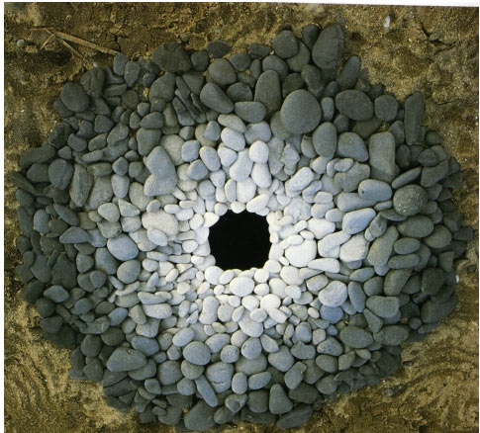
This sculpture is made of stones.

Slide 4
This is made of stones too

Slide 5
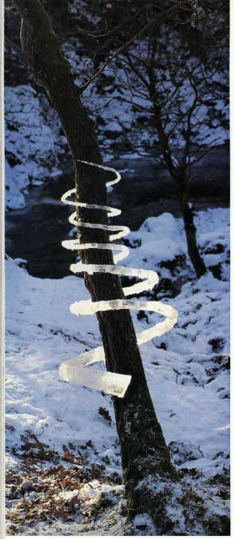
Can you see what he’s wrapped around this tree?
It’s ice!

Slide 6
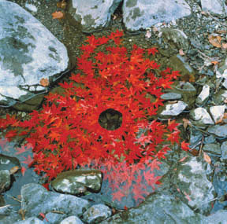
This is made of ice and maple leaves.

Slide 7
This is made from leaves too.

Slide 8
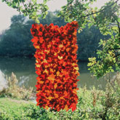
Today, you will be making your own Andy Goldsworthy-style picture!
Now, create your own Andy Goldsworthy inspired artwork using the materials in your garden.

