Slide 1

Year 6 Assessment

Slide 2
AIM OF THE MEETING
1
2
3
Explain how your child will be assessed at the end of Year 6
Tell you when, and how, each test will be administered
Information and examples for you to see
Notes:
Who are the tests for?
Lead on assessment
A great deal has changed in the way children are assessed over the past few years, and you need to know so we can work together for the benefit of your child.
We understand there is a great deal of information to take in, so the aim of this workshop is to support you in understanding the assessment arrangements for year 6 and give you some more information about the tests that each of your children will be facing in year 6. So let’s start at the beginning….

Slide 3
What are SATS?
(Statutory Assessment Tests)
Week commencing 11th May 2026
Monday 11th | Tuesday 12th | Wednesday 13th | Thursday 14th | Friday
English GPS: 1.Questions 2.Spelling | English: Reading Test | Maths: 1.Arithmetic 2.Reasoning | Maths: 3.Reasoning
*Timetable subject to possible change
Notes:
2 forms of assessments – tests and teacher assessments
Tests are reading, grammar and maths
Why do they do them?
Ultimately, it’s a way of seeing what results are like across the country, government and ofsted do look at results, but its not the only thing they look at
Always lots of opinions on testing in school…whether we believe in them or not, Statutory – have no choice, have to do them.
Secondary school ask for our predictions on the results and ask us to send them the results as soon as we have them, sometimes using them to stream, although aware they also do some testing on entry

Slide 4
Tests
20 | 94
21 | 95
22 | 95
23 | 96
24 | 97
25 | 97
26 | 98
27 | 99
28 | 100
29 | 100
30 | 101
31 | 102
32 | 102
33 | 103
34 | 104
35 | 105
36 | 106
37 | 106
38 | 107
39 | 108
40 | 109
41 | 110
42 | 111
43 | 113
44 | 114
45 | 115
46 | 117
47 | 118
48 | 120
49 | 120
50 | 120
Test Week – 11th May 2026
The test will be sent away for independent marking.
Raw scores are then converted into a ‘scaled score’
A scaled score of 100 will be used as the expected level.
A scaled score of 110 will be used as the expected level.
2019 reading test scaled scores
Notes:
Test week is set nationally.
Because these are national tests, and they have to ensure results are accurate, we have strict guidance on how the tests should be administered. For example, we are not allowed to open the tests until we are about to hand them out etc.
Scaled scores are not set in stone so it is not always possible to know exactly how many marks in each test children will need to get in order to pass, as the pass mark can change each year, depending on how the rest of the country do.
The National Curriculum has a focus on depth of learning….which means a bigger focus has been placed on children being able to apply their learning in a variety of contexts. It also had a focus on fluency in all areas.
You will be just given a result of whether they’ve met the expected standard, got greater depth (above average) or not met, along with their scaled score

Slide 5
TEACHER ASSESSMENT
Science:
                Met expected Standard
                Not Met expected Standard
Writing:
                working towards the expected standard,
                working at the expected standard,
                working at a greater depth within the expected standard.
Notes:
Once the tests have been returned to us and we have checked them, you will be sent their scores.
You will also receive teacher assessment for reading, writing , maths and science.
For Reading and Maths there will be only two judgements, either Met the expected standard or not met the expected standard.
For writing there will be one of three judgements. Working below the expected standard,
Working at the expected standard,
Working at a greater depth within the expected standard.

Slide 6
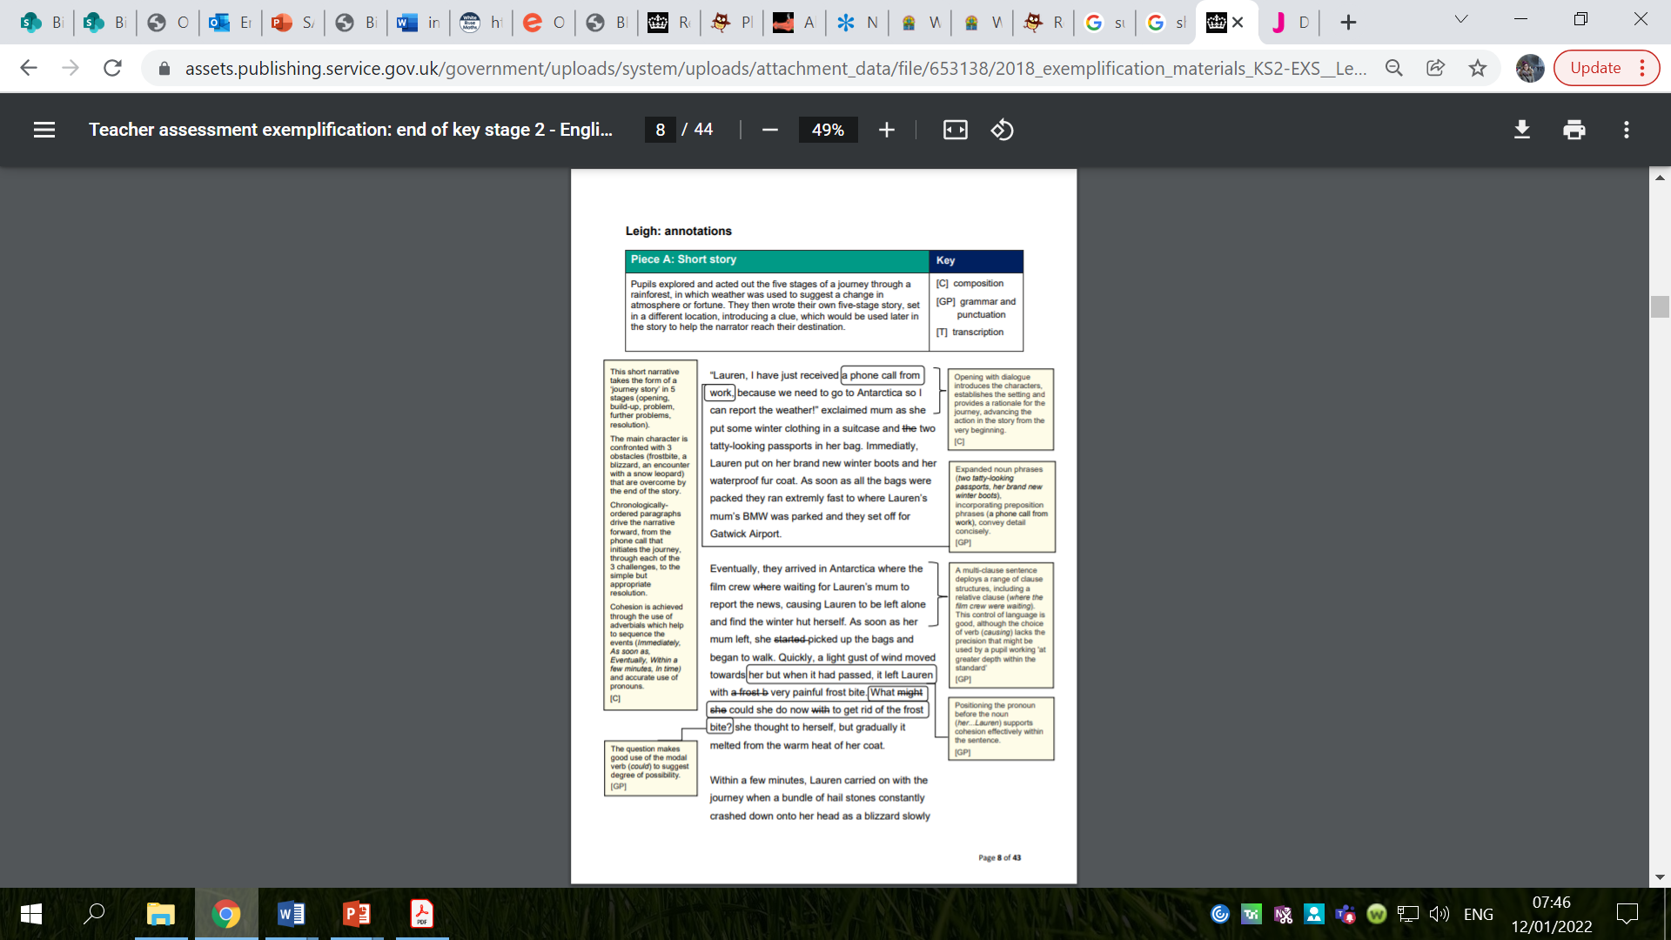
EXS Exemplification
Notes:
Exemplification materials available online.
Need to apply grammar knowledge taught to writing.

Slide 7
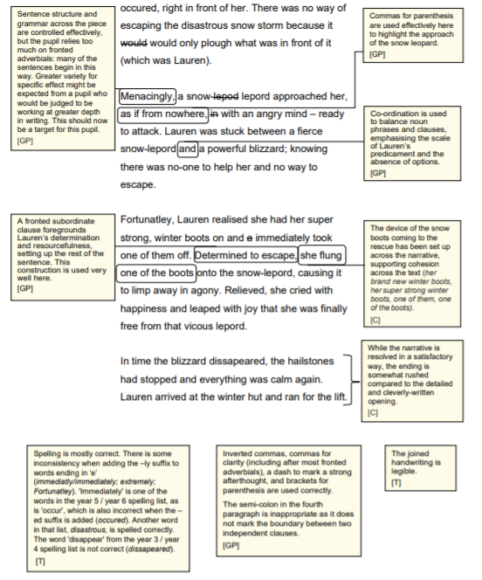
EXS Exemplification

Slide 8
Maths Tests
Notes:
We want your child to be the best reader and most confident they can be.
This underpins all other subjects as well as their enjoyment of information, detail and the literary world (whether on screen or on paper).
At the end of the KS – this is measured in 2 ways – test and teacher assessment

Slide 9
Maths Papers
Paper 1 – Arithmetic: 30mins
Paper 2 – Reasoning: 40mins
Paper 3 – Reasoning: 40mins
Reflects the curriculum.
Notes:
Aims of national curriculum for maths:
Become fluent in fundamentals in maths through varied practice, complex problems
Reason mathematically – not enough to just calculate in 4 operations
Solve problems – multi-step

Slide 10
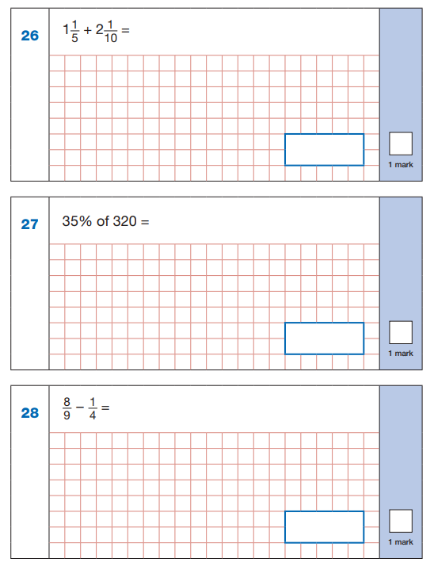
Arithmetic Paper
Notes:
This is what the test paper looks like
Out of ….marks? 40?
Our aim is to help children become fluent and find simple routes to arithmetic questions, which will aid them across all areas of maths

Slide 11
Arithmetic Papers – One Mark Questions
Notes:
A lot of the questions aren’t actually too challenging, but some may catch a child out
Eg second question here requires BODMAS
How many marks on this paper for using formal methods?
36 questions, 40 marks
4 questions, 4 marks – 10%
Formal methods were 10% of the arithmetic paper.

Slide 12
Arithmetic Papers – Two Mark Questions
Notes:
Simple mistakes can be made. Very important to show working out, as a mark can be awarded for a correct, logical method, even if there has been a simple calculation error leading to an incorrect final answer.

Slide 13
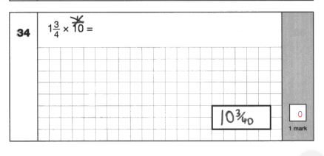
Notes:
An example from a very high scoring child on the arithmetic paper who missed greater depth overall.
On the surface it originally looks difficult…could have been made easier by…..

Slide 14
Reasoning Papers
Notes:
These papers are about children applying their learning.
Some of the calculations are not too tricky, but they need to apply it

Slide 15
Reasoning Papers
Notes:
Big spread of the content in these papers

Slide 16
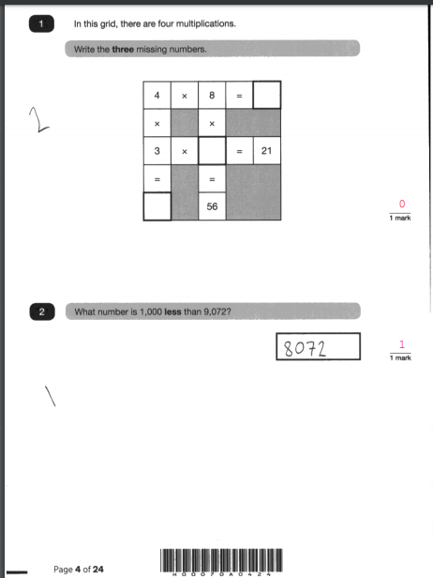
Child close to achieving the standard.
Notes:
Four operations:
This child could have answered 4 x 8 = , 4 x 3 =, 3 x _ = 21 and 8 x _ = 56 - why do you think she didn’t get this?

Slide 17
Reasoning Papers
Notes:
Often children can recall factors, but here is an example where there are 2 steps to the problem

Slide 18
What we do
Maths lessons – equipment, concepts, reasoning
Arithmetic practice
Maths club – starting in the Spring Term
LSA support and intervention groups
Teacher support
Century Tech nuggets set weekly

Slide 19
Test Techniques
Highlighting
Asking for questions to be read to them
Asking to read out questions
Drawing out the question
Using the bar model

Slide 20
What will help?
Century Tech
Times tables (TT Rockstars)
Explaining reasoning
Being specific with vocabulary
Drawing/writing out how we know
If you know… then you know…
Revision booklets – coming in the Spring Term
Notes:
5 x 6 so you know 0.5 x 0.6

Slide 21
Reading Assessment
Notes:
We want your child to be the best reader and most confident they can be.
This underpins all other subjects as well as their enjoyment of information, detail and the literary world (whether on screen or on paper).
At the end of the KS – this is measured in 2 ways – test and teacher assessment

Slide 22
Reading SATs paper
1 hour to include reading time and answering / checking time
It will contain a reading booklet with usually 3 texts (fiction, non-fiction and poetry)
An answer booklet with questions roughly in order of difficulty and in sections mirroring the reading booklet
Notes:
Strict guidance as to what we can and can’t do/help/support within the test.
Only test where we are not able to read anything for the children – including the questions/instructions other than the general instructions.
Fluent reading – speed development – development of stamina with reading – hard going to get through the full test
60 second reads, short Home Learning tasks, fastest finger first, speedy retrieval etc.

Slide 23
Raw scores and scaled scores.
What is the expected standard?
50 marks in total
Awarded over a range of 1, 2 and 3 mark questions depending on the level of detail or depth needed in the response
Notes:
50 marks total.
In 2019, to gain the expected standard, 28 marks were required in total.
To gain 110, which was deemed to be at the higher standard (greater depth), 40+ marks were needed.

Slide 24
What skills are tested?
2a | give / explain the meaning of words in context
2b | retrieve and record information / identify key details from fiction and non-fiction
2c | summarise main ideas from more than one paragraph
2d | make inferences from the text / explain and justify inferences with evidence from the text
2e | predict what might happen from details stated and implied
2f | identify / explain how information / narrative content is related and contributes to meaning as a whole
2g | identify / explain how meaning is enhanced through choice of words and phrases
2h | make comparisons within the text
Notes:
Will cover range of reading skills:
Word Reading – applying growing knowledge of known words, patterns, root words and affixes to aid this
Comprehension – clarify and summarise to show understanding, retrieve information, explain and reason
Inference – use the clues and what they know about situations to suggest likely outcomes / actions
Use of language to create effect / impact the reader
Themes and Conventions – why certain types of writing are like they are, comparing different genres and types of writing

Slide 25
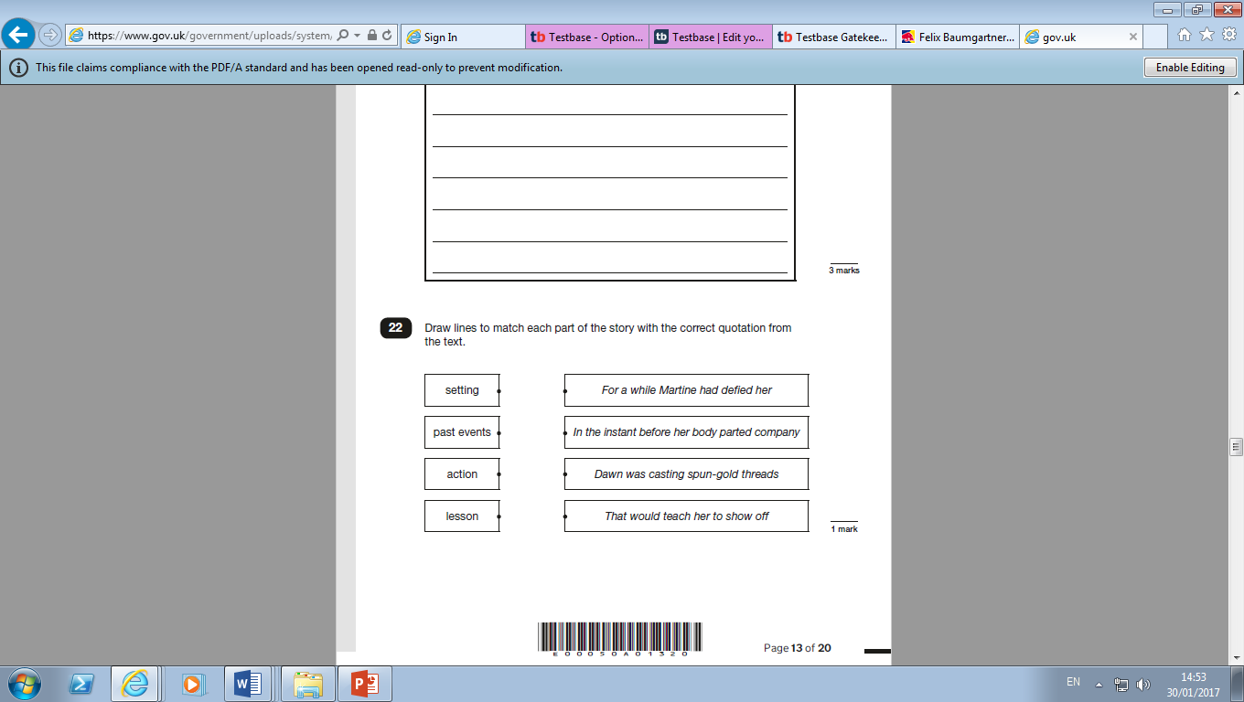
Matching
Labelling

Slide 26
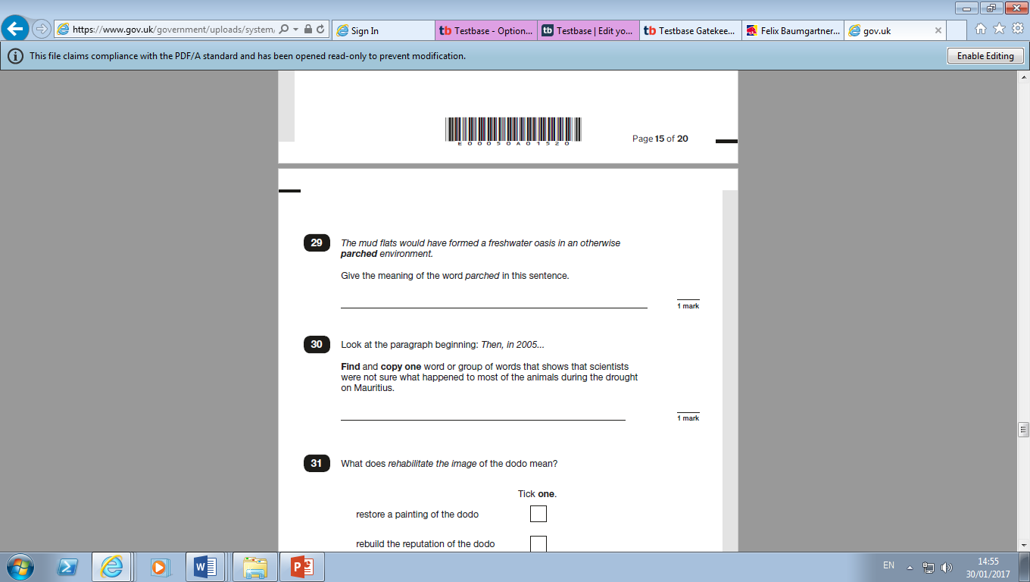
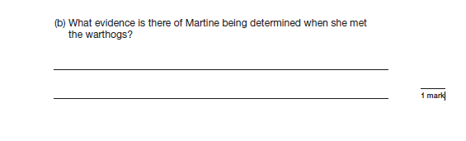
Find and copy
Short response

Slide 27
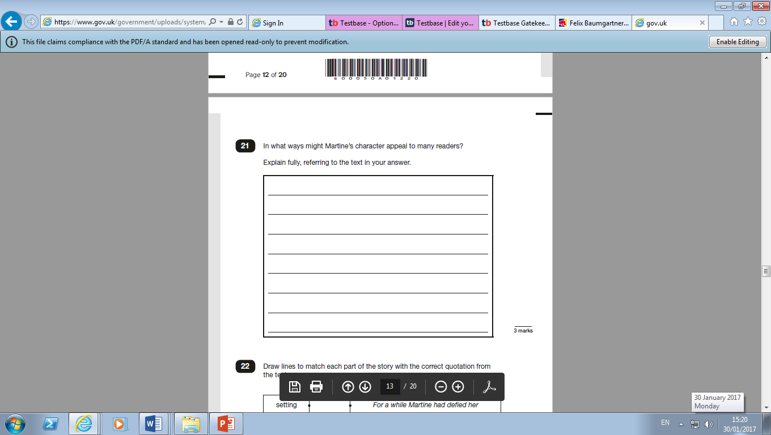
Extended response

Slide 28
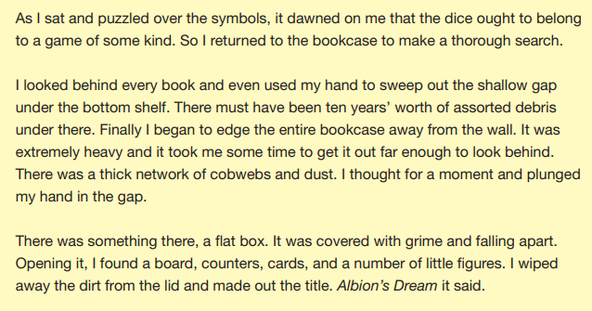
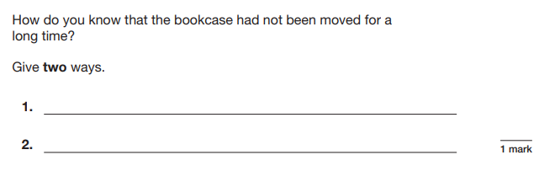
Notes:
A minute to read this extract – it is from 2018’s Reading paper from a text called ‘Albion’s Dream’ about a boy who finds a peculiar game.
Using the extract, please have a go at the question – you need to get both reasons for the 1 mark.
This goes to show that the children have to be very precise when they’re answering their questions – the markers will not give them the benefit of the doubt.
Cobwebs and dust = 1 mark; needed two different things. Specific mark scheme, be really clear
Assorted debris under there
Covered with grime
Can't just put one word, have to answer what the question is asking, i.e. 'dust' doesn't answer the question.

Slide 29
Teacher assessment
A more-rounded view
Includes elements that are not easily testable in written paper test including:
    read age-appropriate books with confidence and fluency
    read aloud with expression
Notes:
Have to take a more rounded view and include elements that are not easily testable in written paper test.
Key statements that we are assessing your children against and tracking their progress on and tailoring/altering teaching to develop are:
The pupil can:
read age-appropriate books with confidence and fluency (including whole novels)
read aloud with intonation that shows understanding
work out the meaning of words from the context
explain and discuss their understanding of what they have read, drawing inferences and justifying these with evidence
predict what might happen from details stated and implied
retrieve information from non-fiction
summarise main ideas, identifying key details and using quotations for illustration
evaluate how authors use language, including figurative language, considering the impact on the reader
make comparisons within and across books.

Slide 30
What are we doing?
Familiarity with questions and format
Using a range of texts
Teach strategies to understand different questions and how to respond to them
Hearing children read regularly
Notes:
Familiarity with the types of questions and test format is important to make sure that they are able to show their best.
In school – we use similar worded questions and a toolkit to help children understand the type of reading skill and strategy they might use to help them understand.
At home, you can help by asking them a range of questions including, justifying and asking them to quote the word or words that have given them their ideas

Slide 31
What can you do to help your child?
Encourage them to read a range of texts.
Encourage them to practise reading in their head for a sustained period of time.
Hear them read aloud – talk to them about it!
Encourage them to visualise the action.
Ask them to summarise what has happened.
Ask them to explain words or phrases, using the context to help.
Ask them why they think the author might have chosen that word or phrase and not a different one.
Help them use their reading records effectively.
Notes:
At home – encourage them to read a range – poetry, newspaper, magazine article as well as fiction books
Balance reading in their heads with reading aloud – need to read with reasonable speed – practice to keep eyes moving.
Re-read section if unsure / doesn’t make sense.
Hear them read aloud a few times a week to ensure that they are taking account of punctuation (this will also support their awareness of and development in grammar and punctuation)
If there is a section of a story or a poem that they don’t understand encourage them to visualise it (create a mental photo or film of it)
Use their reading logs effectively to collect words and phrases, acknowledge the range of reading they are doing and to collect questions that arise when they are reading.

Slide 32
Spelling, Punctuation and Grammar Test
Notes:
One important thing to mention is that there are two parts to the grammar 1) knowing it and passing the test 2) applying it to their writing, as if they don’t punctuate etc. accurately they can’t be assessed as ‘meeting expectations’ for writing either. (mention writing group if we have one)
Today, I will just being speaking about the test aspect of the spelling, grammar and punctuation part.

Slide 33
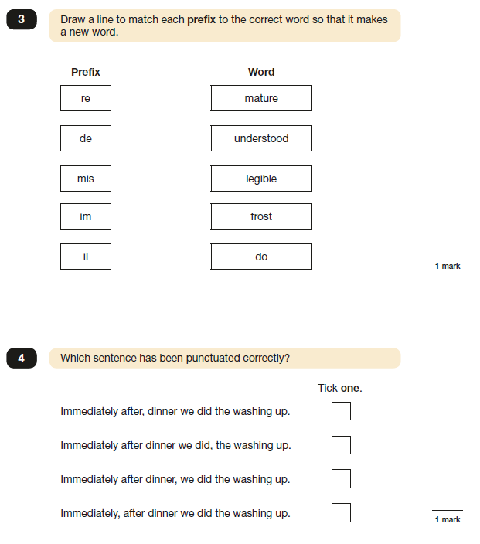
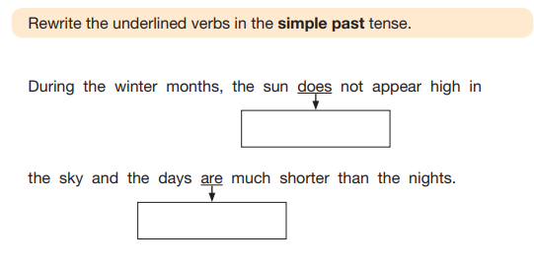
What does the grammar test look like?
Notes:
45 minutes, approx. 50 questions.
Range of topics. All on grammar glossary (give out)
CGP books and grammar homework booklets – designed to help!

Slide 34
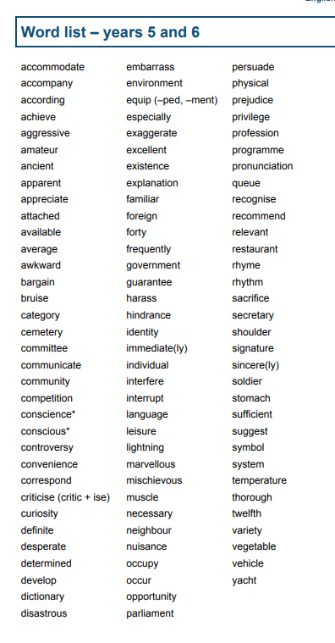
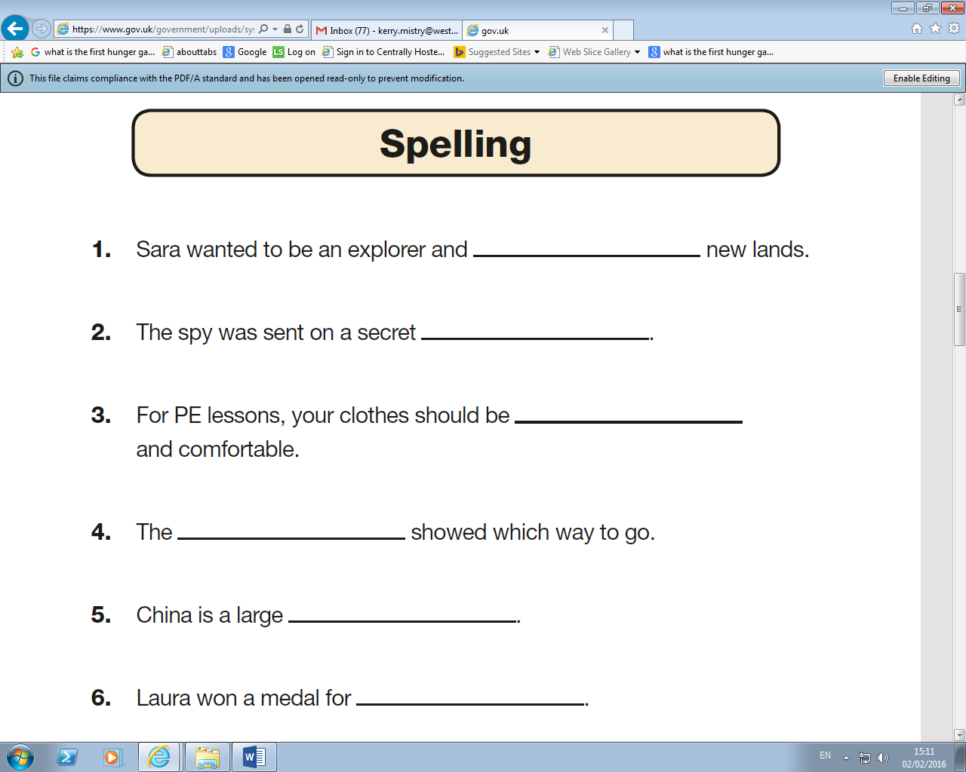
Spelling Test
Notes:
Spelling is assessed within their writing, (mention writing group if we have one), but they will also been given a test.
It looks like this.
Close procedure. Teacher reads out word, then sentence, then word again. Takes approx. 20 mins
Apply all words learnt in primary school – familiar patterns
Year 5 and 6 spelling list – give out

Slide 35
What are we doing?
Familiarity with questions and format
Grammar taught specifically in English lessons
Grammar focus in marking / editing lessons
Century Tech nuggets set weekly
Revision booklets – coming in the Spring Term

Slide 36
What can you do to help your child?
CGP books are useful
Grammar discussions after reading
Writing at home and discussing features used

Slide 37
SATS week 2026
What to expect during the week

Slide 38
What will my child see when they arrive?
Your child will go to their normal classroom for registration.
The room will be set up, ready for the tests a couple of weeks before the tests:
    Tables separated
    Displays covered
    Bookcases covered
Their teacher will put them at ease and encourage them to go to the toilet if they need to.
Their teacher will then tell the children to go to their seats ready for the test.
School will provide all the equipment for the tests.
Water bottles may be placed beneath the desk, with any words covered.
Notes:
The timetable for the rest of the week will involve plenty of active lessons, e.g. PE, so please make sure your child’s PE kit is in school.
Couple of weeks before get used to it
Not ideal but government rules.
Reason behind spellings could come up, maths workings out,
Every school consistent . Every school does it
Can do inspections to check its done – has happened before

Slide 39
How can I help my child during the week?
Keep everything as normal as possible!
Tell them to do their best - that’s all we expect.
Model staying calm to your child.
Arrive at school on time.
Go to bed at a sensible time.
Ensure they have a healthy breakfast.
Many children actually enjoy the week of the tests!
Notes:
1. What we tell them in school. Tests are part of life but we want them to do their best
2. Encouraging. Reassuring.
3. On time, helps them settle, focus more
4. As said before, the tests are taxing on them. Good night sleep. They will be tired. End goal so they try really hard and get excited!

Slide 40
What if my child has Special Educational Needs?
A small number of pupils with Special Educational Needs may need additional arrangements so they can take part in the KS2 tests.
Some SEN are entitled to
-a reader
-prompter
-a scribe
-additional time
Mrs Brazell will contact parents of pupils individually to discuss this.
Notes:
Lot of rules. Some entitled to a reader, a prompter, a scriber.
So schools don’t abuse this, strict guidelines,
Many children won’t fit this.
If you want to check yourself, Mrs Brazell go to
Apply for it and be accepted

Slide 41
What happens if my child is ill?
Children who miss a test will sit the test as soon as they return to school.
If a child is ill during the test, the test will be stopped and restarted to ensure the other children have the amount of time they need to complete it.

Slide 42
Home-learning preparation
Practice booklets will go home as part of home learning in the Spring term for children to practise a couple of questions each night.
Secondary schools have commented on this approach from Binfield as being good preparation.
Encourage your child to highlight/star any questions they find tricky to go over in class with their teacher.

Slide 43




