Slide 1
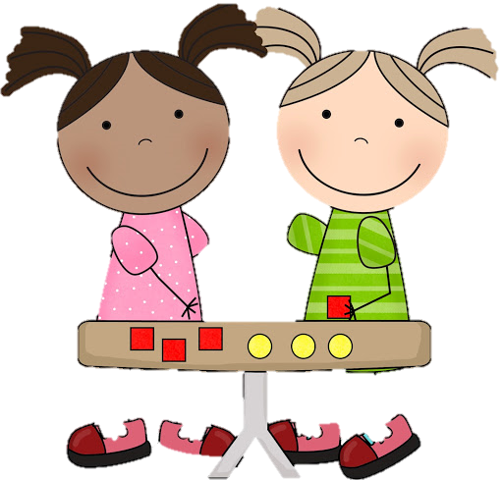

25.1.2021
L.O: Multiplication and Division
C: Dividing by 5.

Slide 3
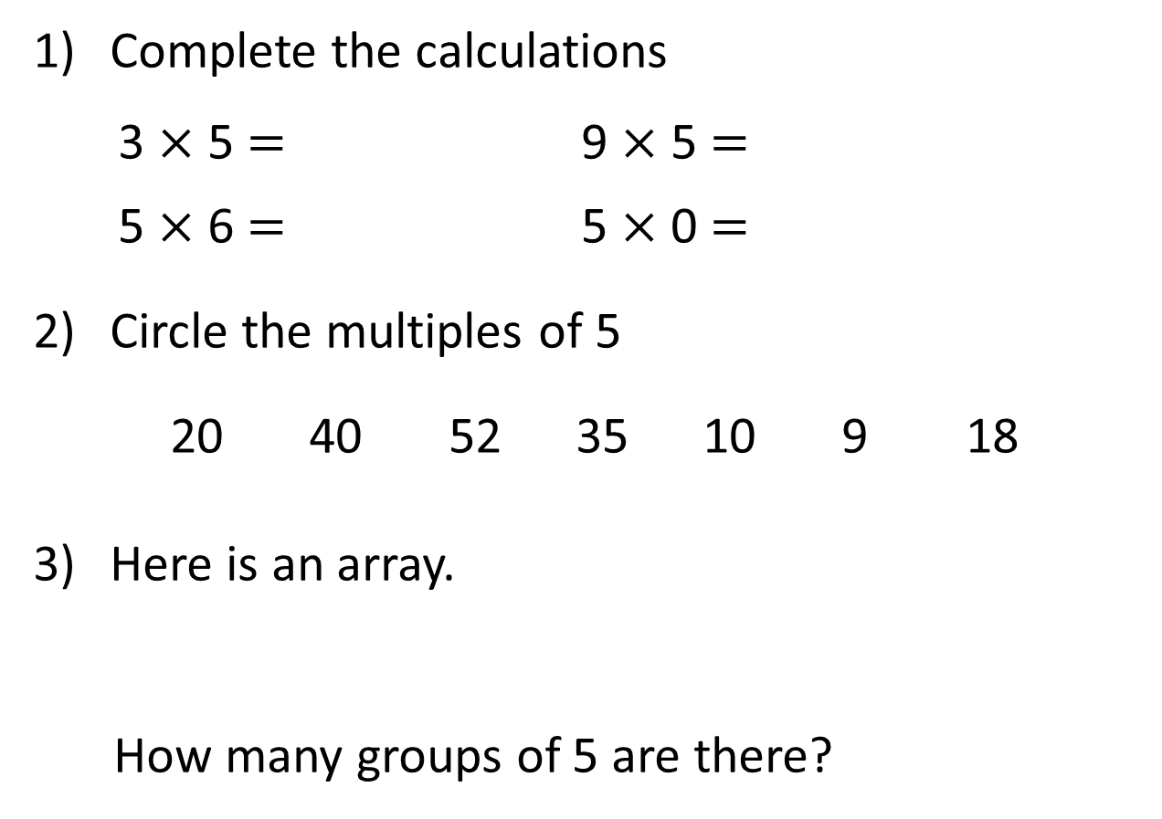
Complete the calculations
3 $×$ 5 $=$ 9 $×$ 5 $=$
5 $×$ 6 $=$ 5 $×$ 0 $=$
Circle the multiples of 5
20 40 52 35 10 9 18
Here is an array.
How many groups of 5 are there?

Slide 4
Complete the calculations
3 $×$ 5 $=$ 9 $×$ 5 $=$
5 $×$ 6 $=$ 5 $×$ 0 $=$
Circle the multiples of 5
20 40 52 35 10 9 18
Here is an array.
How many groups of 5 are there?
15
45
30
0
2

Slide 6

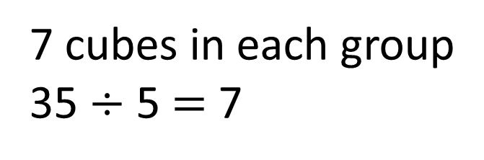
Whitney has 35 cubes.
She shares the cubes into 5 equal groups.
How many will be in each group?
7 cubes in each group
35 $÷$ 5 $=$ 7

Slide 7
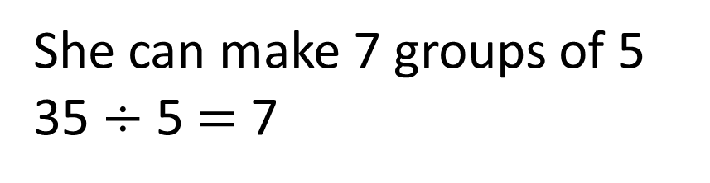
Whitney has 35 cubes.
She groups the cubes into 5s.
How many groups can she make?
She can make 7 groups of 5 35 $÷$ 5 $=$ 7

Slide 8
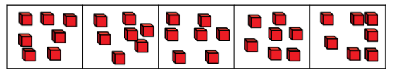
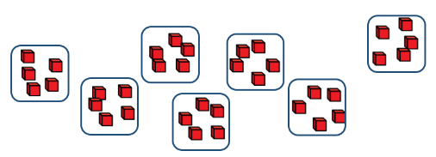
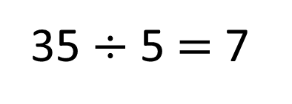
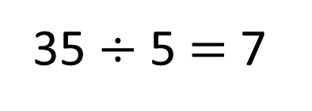
Sharing
There are 7 cubes in each group.
35 $÷$ 5 $=$ 7
Grouping
There are 7 groups of 5
35 $÷$ 5 $=$ 7

Slide 9


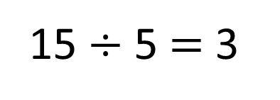
Here are 15 conkers.
The conkers are shared into 5 equal groups.
The cubes are grouped into 5s.
Have a think
15 $÷$ 5 $=$ 3

Slide 10
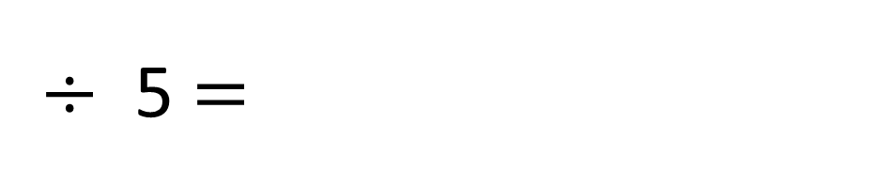

Use the array to complete the calculations
$×$ 5 $=$
$÷$ 5 $=$
6
30
30
6

Slide 11



The farmer has picked 25 apples.
He puts them into bags of 5
How many bags of 5 can he make?
5
10
15
20
25
0
5
10
15
20
25
He can make 5 bags of apples.
Have a think

Slide 12
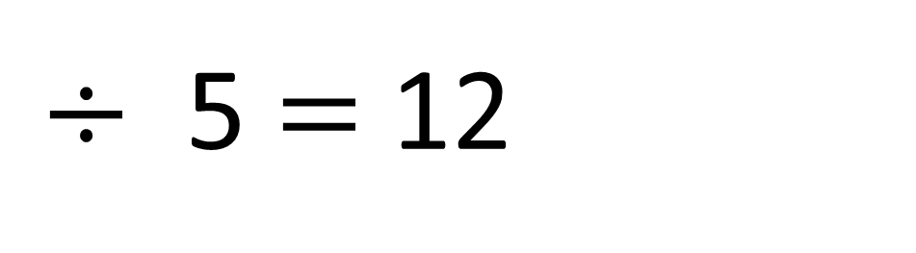

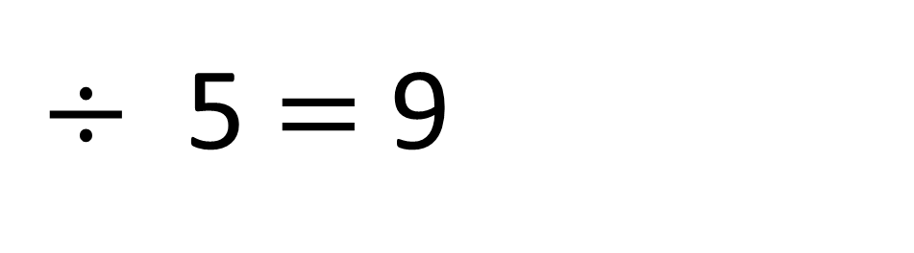

45
$÷$ 5 $=$ 9
$×$ 5
60
$÷$ 5 $=$ 12
$×$ 5
Have a think

Slide 13


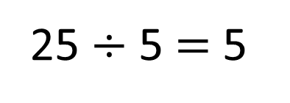

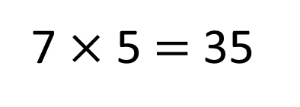
Amir uses some cubes to build a tower.
His tower is 25 cm tall.
He adds 2 more cubes to his tower.
How tall will his tower be now?
25 $÷$ 5 $=$ 5
Have a think
1 cube $=$ 5 cm tall.
25 cm
7 $×$ 5 $=$ 35
The tower is 35 cm tall.

