Slide 1

28.1.2021
L.O: Multiplication and Division
C: Dividing by 3.

Slide 3

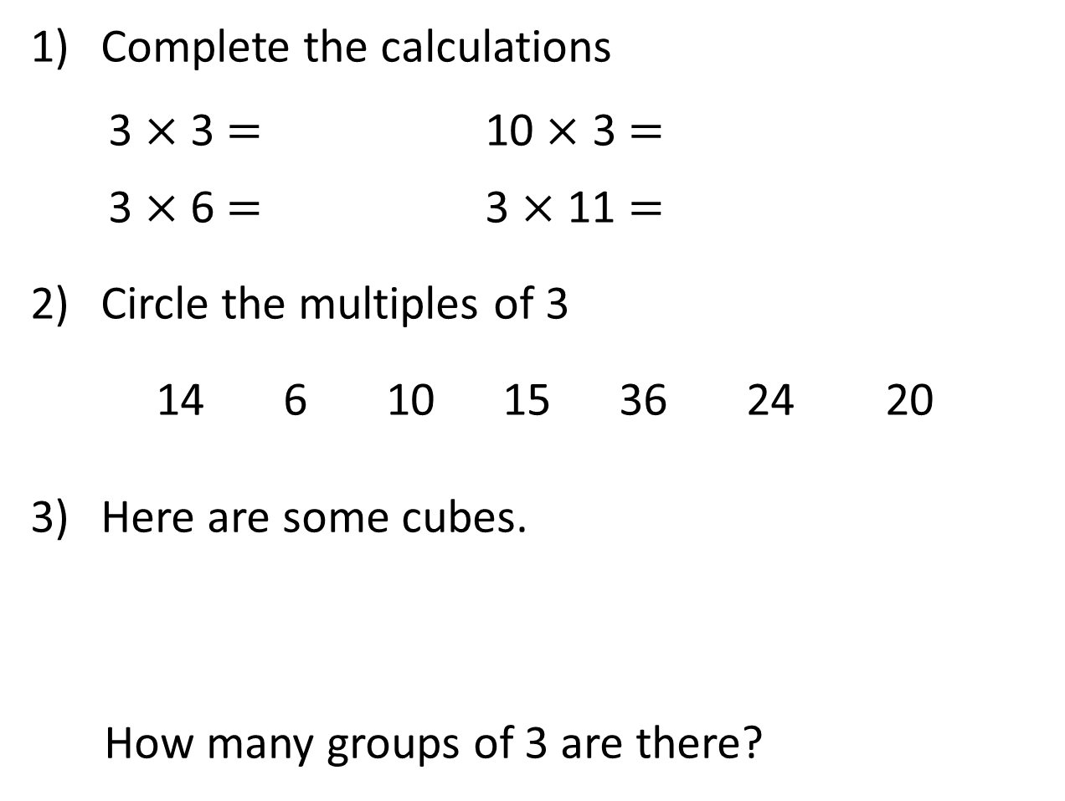
Complete the calculations
3 $×$ 3 $=$ 10 $×$ 3 $=$
3 $×$ 6 $=$ 3 $×$ 11 $=$
Circle the multiples of 3
14 6 10 15 36 24 20
Here are some cubes.
How many groups of 3 are there?

Slide 4
Complete the calculations
3 $×$ 3 $=$ 10 $×$ 3 $=$
3 $×$ 6 $=$ 3 $×$ 11 $=$
Circle the multiples of 3
14 6 10 15 36 24 20
Here are some cubes.
How many groups of 3 are there?
9
30
18
33
4

Slide 6
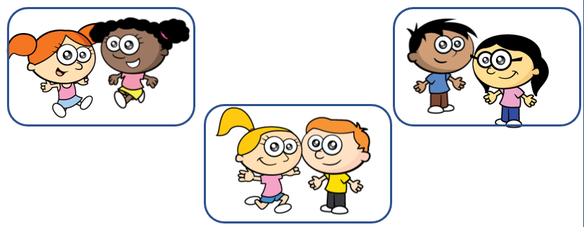

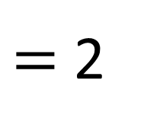
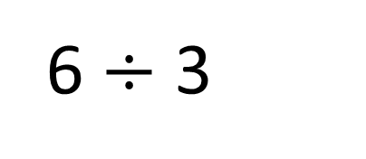
$=$ 2
6 $÷$ 3
Shared into 3 equal teams
There are 2 children in each team.
Grouped into teams of 3
There are 2 groups of 3 children.

Slide 7







Here are 21 cakes.
They are shared equally between 3 plates.
They are divided into groups of 3
Have a think

Slide 8

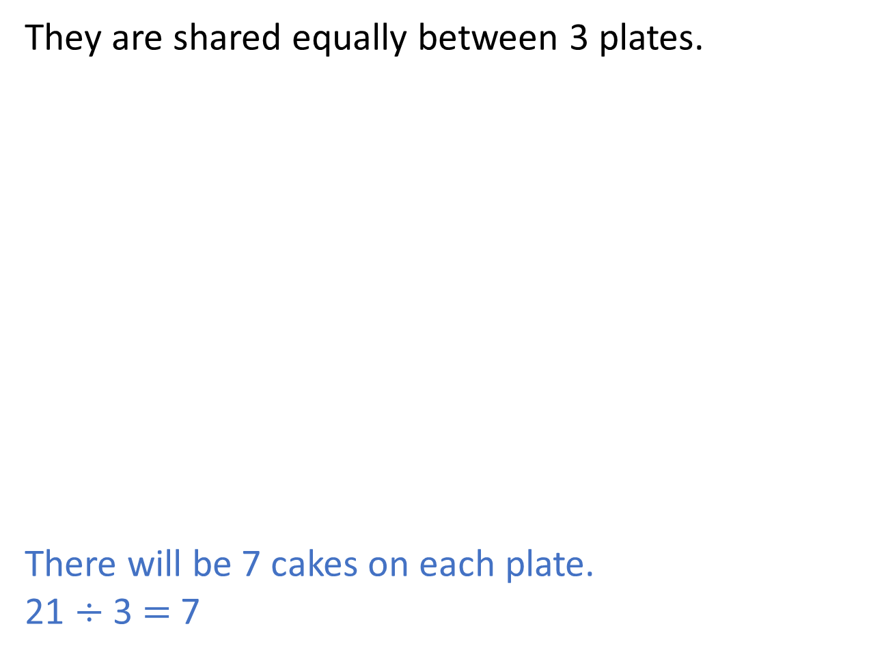
They are shared equally between 3 plates.
There will be 7 cakes on each plate.
21 $÷$ 3 $=$ 7

Slide 9
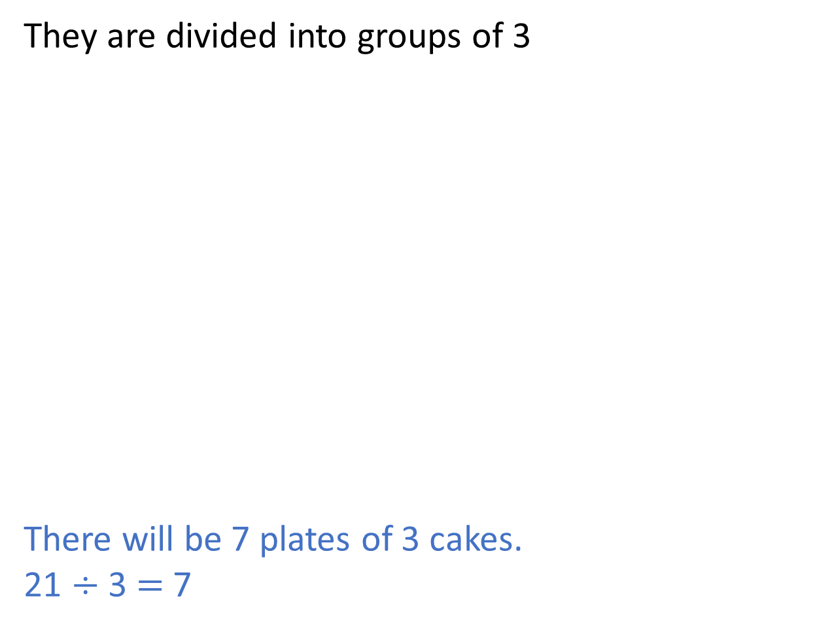
They are divided into groups of 3
There will be 7 plates of 3 cakes.
21 $÷$ 3 $=$ 7

Slide 10
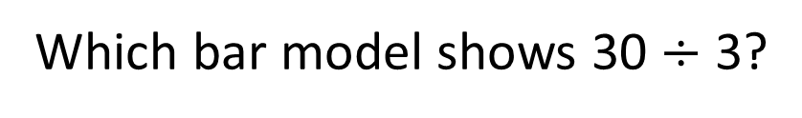
Which bar model shows 30 $÷$ 3?
30
3 | 3 | 3 | 3 | 3 | 3 | 3 | 3 | 3 | 3
30 divided into groups of 3
Have a think
30
10 | 10 | 10
30 divided into 3 equal parts

Slide 11


Which numbers will divide exactly by 3?
13
33
3 | 3 | 3 | 3 | 1
11 | 11 | 11
23
27
8 | 8 | 7
3 | 3 | 3 | 3 | 3 | 3 | 3 | 3 | 3
Have a think

Slide 12



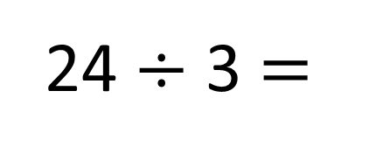
24 $÷$ 3 $=$
The baker has 24 tarts.
He puts 3 tarts into each box.
How many boxes can he fill?
8
$+$ 3
0
3
6
9
12
15
18
21
24
$−$ 3
0
3
6
9
12
15
18
21
24

Slide 13
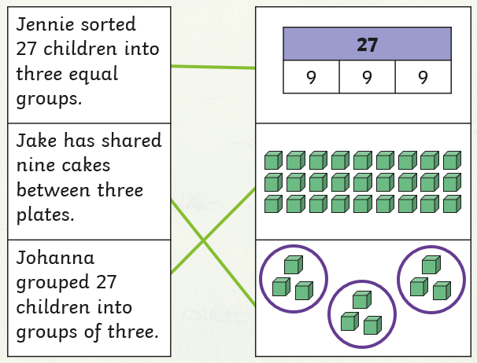
Match the number story to the picture!

