Slide 1


26.1.2021
L.O: Multiplication and Division
C: Dividing by 10.

Slide 2
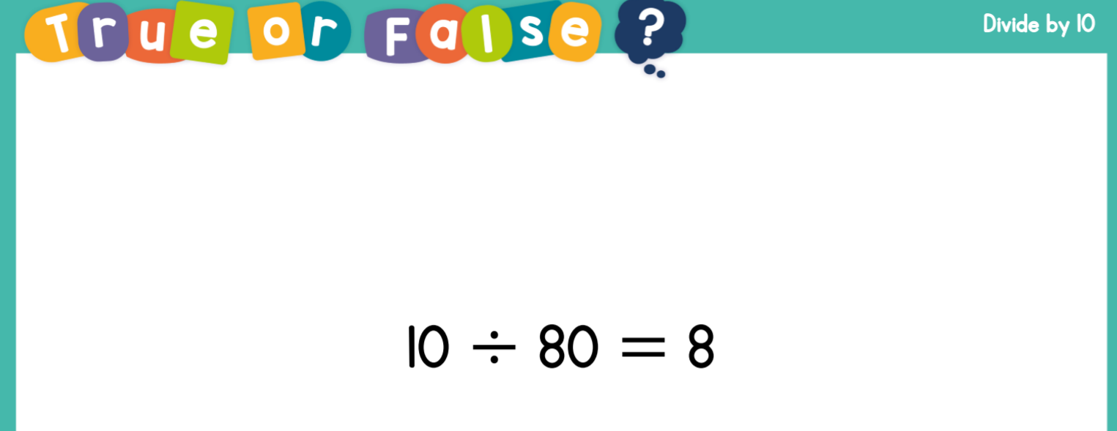

Slide 3
Your Task!
Write a sentence explaining whether the claim is true or false!
Try to include: commutative, equal groups, sharing/grouping, divide, inverse operation.

