Slide 1
LO. To build an overview of world history.
Context: Roman invasion

Slide 2
Topic enquiry question
‘What did the Romans ever do for me?’

Slide 3
Settlement survey
Who has moved from another town, village or country since they were born?
Who has travelled the longest distance?
Who has travelled the shortest?
Who has lived in the same house since they were born?

Slide 4

Invader Settler
What do these words mean?

Slide 5
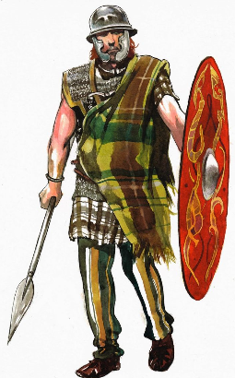
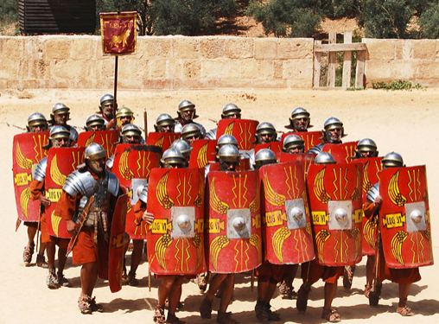
The Romans invaded Britain they were the invaders.
The settlers there were the Celts.

Slide 6
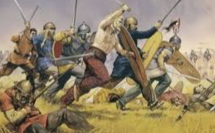
Who occupied Britain?
Around 2,000 years ago, Britain was ruled by tribes of people called the Celts. But this was about to change. For around a century, the Roman army had been building an Empire across Europe. Now it was coming for Britain!

Slide 7
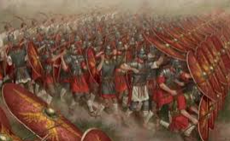
In AD43, the full might of the Roman army landed on the beaches in Kent. Over the next year it battled inland, storming through hillforts and chopping down anyone who stood in their way.

Slide 8
https://www.bbc.co.uk/bitesize/articles/z9j4kqt
How do you think the Celts felt?

Slide 9
How would you feel if someone suddenly came into your house and told you that you had to leave?
How would you feel if they took over Binfield and changed everything?

Slide 10



Tasks
Children to produce a bubble map for how they think the Celts felt when they were invaded by the Romans. Then write a couple of sentences on how they would feel if Binfield were invaded.
Children to write a paragraph on how the Celts might have felt and how they would feel if Binfield was invaded. Are there any similarities?
Children to write a diary entry using emotive language to describe how the Celts may have felt when they were invaded by the Romans.

