Slide 1
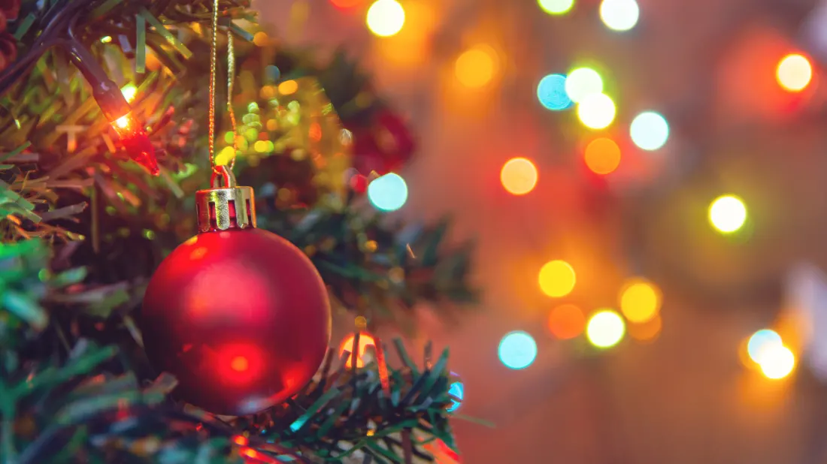
Christianity
Symbolism in the Christmas Story

Slide 2
Lesson 1
LO:
*to understand how beliefs are conveyed
*to understand beliefs and teachings
C: Christianity

Slide 3
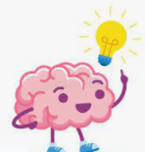
How do you express ideas that are most important to you?
Are there some ideas and experiences that are too difficult to express in words?
How could you express who you are without words?

Slide 4
Symbol
Have you heard of this word before?
What does this word mean?
A symbol is a sign, shape or object with a special meaning that is used to represent something else.
Symbols are often used in religious events and festivals.

Slide 5
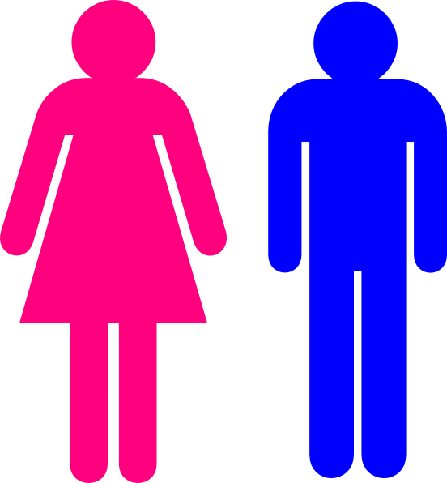


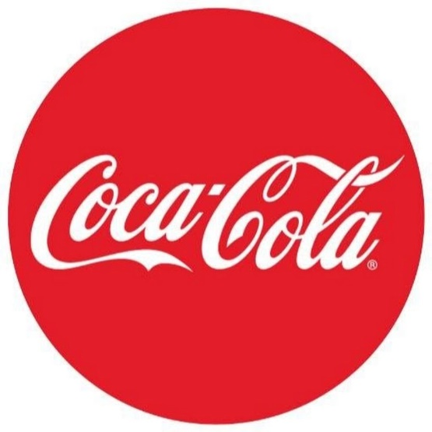


Symbols are something we recognise.

Slide 6
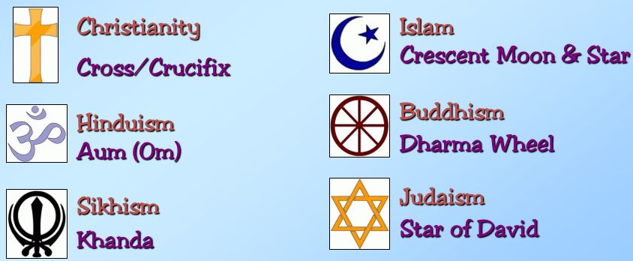
Symbols are something we recognise.

Slide 7

Think of as many symbols as you can to do with Christmas.
They could be religious or non-religious.

Slide 8
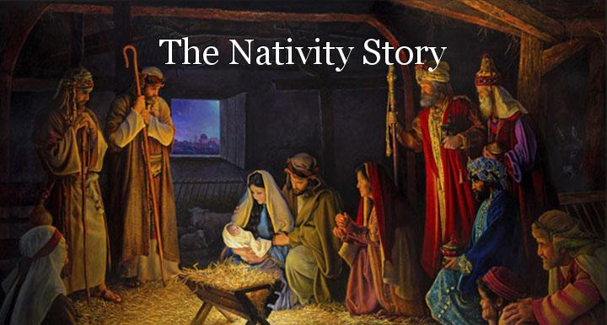
Read the Christmas story over the next few slides.

Slide 9
Luke 2:1-20 The Birth of Jesus
In those days Caesar Augustus issued a decree that a census should be taken of the entire Roman world. (This was the first census that took place while Quirinius was governor of Syria.) And everyone went to their own town to register.
So Joseph also went up from the town of Nazareth in Galilee to Judea, to Bethlehem the town of David, because he belonged to the house and line of David. He went there to register with Mary, who was pledged to be married to him and was expecting a child. While they were there, the time came for the baby to be born, and she gave birth to her firstborn, a son. She wrapped him in cloths and placed him in a manger, because there was no guest room available for them.
And there were shepherds living out in the fields nearby, keeping watch over their flocks at night. An angel of the Lord appeared to them, and the glory of the Lord shone around them, and they were terrified. But the angel said to them, “Do not be afraid. I bring you good news that will cause great joy for all the people. Today in the town of David a Savior has been born to you; he is the Messiah, the Lord. This will be a sign to you: You will find a baby wrapped in cloths and lying in a manger.”
Suddenly a great company of the heavenly host appeared with the angel, praising God and saying,
“Glory to God in the highest heaven,
and on earth peace to those on whom his favor rests.”
When the angels had left them and gone into heaven, the shepherds said to one another, “Let’s go to Bethlehem and see this thing that has happened, which the Lord has told us about.”
So they hurried off and found Mary and Joseph, and the baby, who was lying in the manger. When they had seen him, they spread the word concerning what had been told them about this child, and all who heard it were amazed at what the shepherds said to them. But Mary treasured up all these things and pondered them in her heart. The shepherds returned, glorifying and praising God for all the things they had heard and seen, which were just as they had been told.

Slide 10
The Visit of the Wise Men
Now after Jesus was born in Bethlehem of Judea in the days of Herod the king, behold, wise men from the east came to Jerusalem, saying, “Where is he who has been born king of the Jews? For we saw his star when it rose and have come to worship him.” When Herod the king heard this, he was troubled, and all Jerusalem with him; and assembling all the chief priests and scribes of the people, he inquired of them where the Christ was to be born. They told him, “In Bethlehem of Judea, for so it is written by the prophet:
“‘And you, O Bethlehem, in the land of Judah,
are by no means least among the rulers of Judah;
for from you shall come a ruler
who will shepherd my people Israel.’”
Then Herod summoned the wise men secretly and ascertained from them what time the star had appeared. And he sent them to Bethlehem, saying, “Go and search diligently for the child, and when you have found him, bring me word, that I too may come and worship him.” After listening to the king, they went on their way. And behold, the star that they had seen when it rose went before them until it came to rest over the place where the child was. When they saw the star, they rejoiced exceedingly with great joy. And going into the house, they saw the child with Mary his mother, and they fell down and worshiped him. Then, opening their treasures, they offered him gifts, gold and frankincense and myrrh. And being warned in a dream not to return to Herod, they departed to their own country by another way.

Slide 11

What symbols did you spot?
What do they mean?

Slide 12
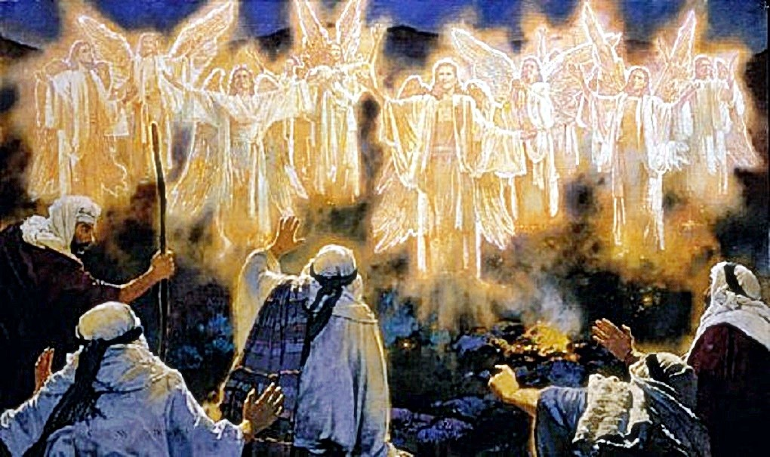
The angels symbolise that Jesus was not just an ordinary man.
Angels are not an everyday occurrence and were there to show people that Jesus was a special gift from God.

Slide 13
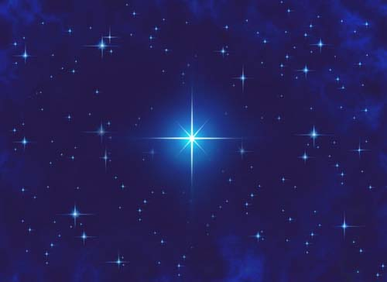
The star guided the wise men just as Jesus is the light that guides people to God.

Slide 14
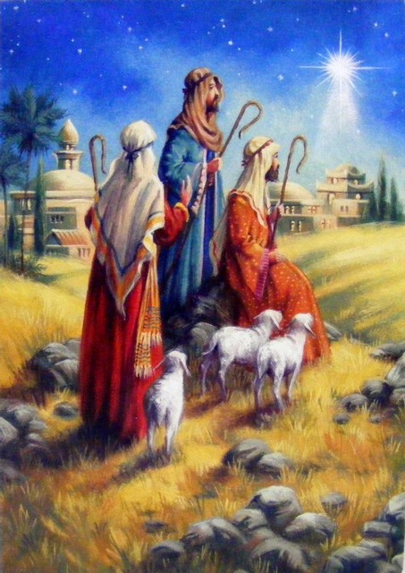
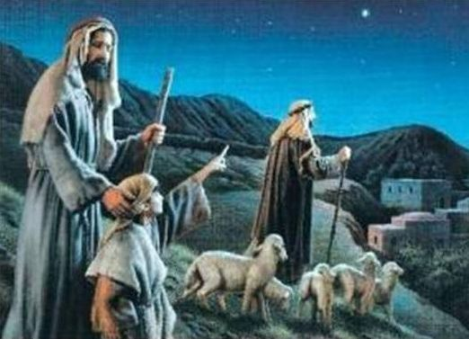
The wise men and the Shepherds are an interesting contrast between rich and poor, symbolising that Jesus is a gift to everyone.

Slide 15
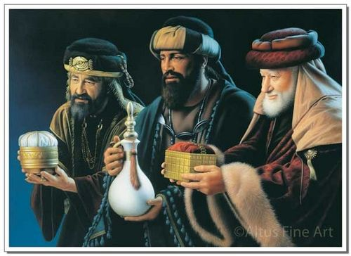
The gifts from the wise men: gold is a precious metal symbolising how precious Jesus is and represents his Kingship. Frankincense is used in perfume and incense and represents Jesus’ priestly role. Myrrh is also used in perfumes and incense and in Jesus’ day was an embalming ointment which symbolises his death.

Slide 16
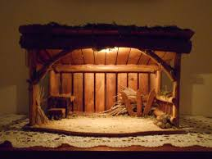
The manger and stable were humble beginnings for a ‘King’.
The stable continues to represent humble beginnings as there was no room for Jesus which runs parallel to people not finding room in their lives for God.

Slide 17

Paddling | Snorkelling | Diving
Choose 2 or 3 symbols we have looked at today which you think best represent the Christian understanding of the Christmas story. Red Pen: Draw some objects that express the meaning and importance of Christmas for you. Why have you drawn these symbols? | Which Christmas symbol do you think is most important? Draw your symbol and explain why. Red Pen: Draw some objects that express the meaning and importance of Christmas for you. Why have you drawn these symbols? | Diamond 9 the Christmas symbols in order of most to least important. Explain why you have ordered them this way. Red Pen: What object or symbol expresses the meaning and importance of Christmas for you? Why?

