Slide 1
PSHE and Citizenship
Relationships | VIPs
PSHE and Citizenship | LKS2 | Relationships | VIPs | Family and Friends | Lesson 1

Slide 3
Aim
I can explain the importance of respecting my VIPs.
Success Criteria
I can give examples of ways to show my VIPs respect.
I can consider the outcomes of scenarios if I didn’t show my VIPs respect or treat them kindly.
This resource is fully in line with the Learning Outcomes and Core Themes outlined in the PSHE Association’s Programme of Study.

Slide 4
The Big Questions

Slide 5



Who are the important people in our lives? Why are they important?
Why is it important to treat them kindly? What can happen if we don't treat our family and friends with respect?

Slide 6
Reconnecting

Slide 7
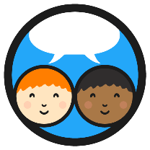
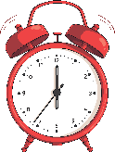
Super Synonyms
A synonym is a word or phrase that means exactly (or very nearly) the same as another word or phrase.
Time for a challenge! With your partner, work together to collect as many synonyms for the following words as possible. You have one minute!
kind
special
important
respectful
Can you say a sentence to your partner using one of the synonyms you came up with?

Slide 8
Exploring

Slide 9

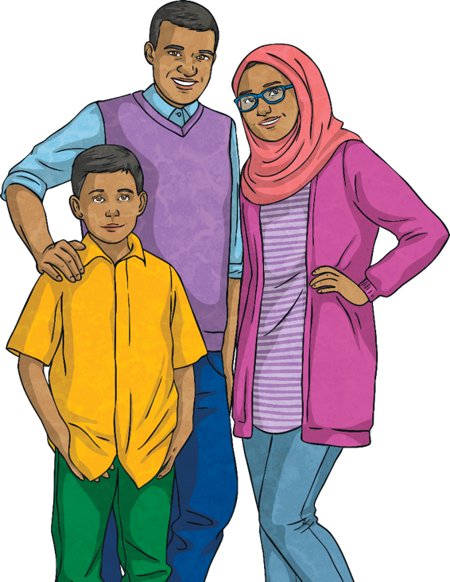

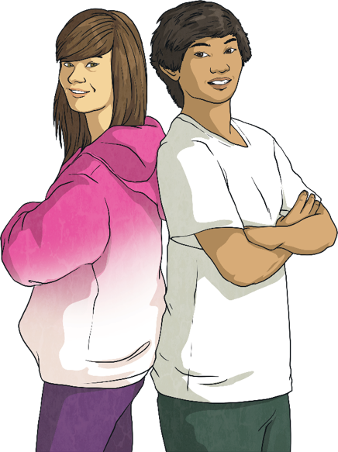
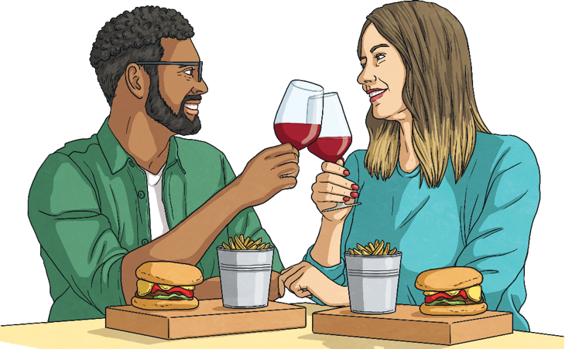
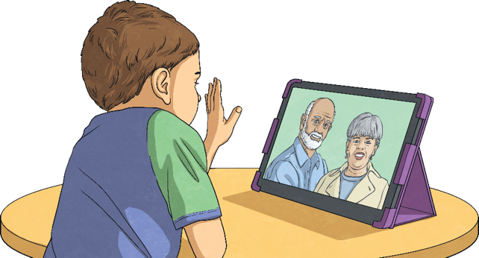
Consideration for Others
What different relationships do people have?
Friendships
Romantic relationships
Family relationships
Online relationships

Slide 10
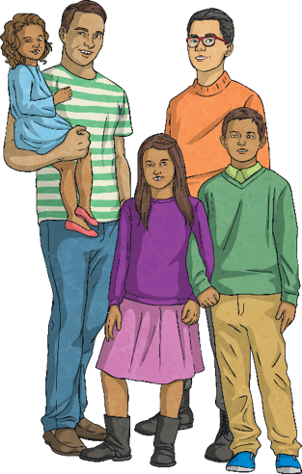
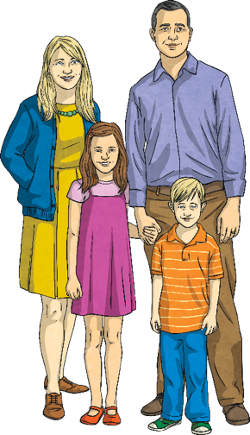
Consideration for Others
Today’s learning will be about who is important to us and why we need to treat those people with kindness and respect.
Take a moment to think about who your very important persons (VIPs) are.
Your family members and close friends will probably be those who are special to you and important people in your life.
This will be personal to you.
How we treat these special people in our lives is very important.

Slide 11
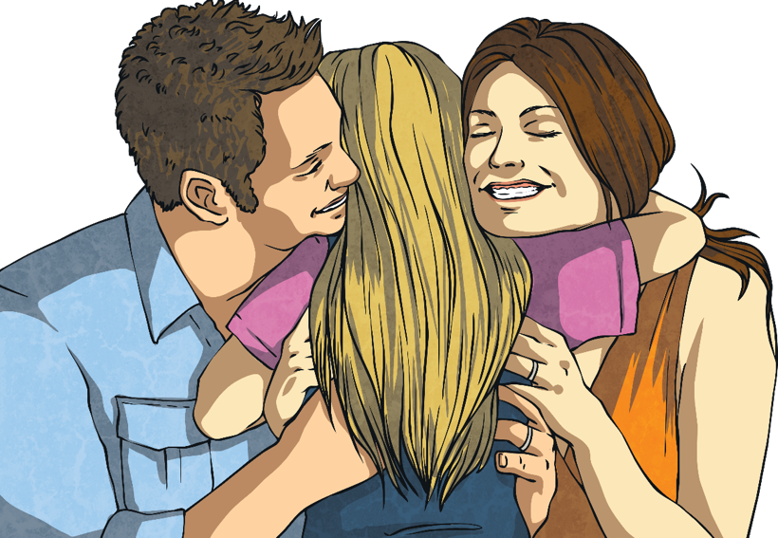
Consideration for Others
Families are very important to us as we grow up.
How does your family make you feel?
Families give us love, security and stability. People in families show love for each other and are there for each other.

Slide 12
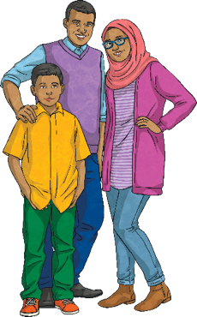
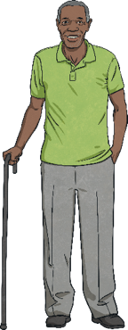
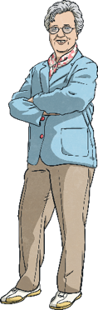
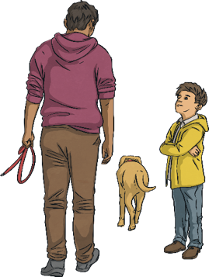
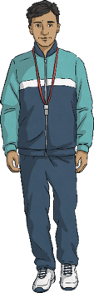
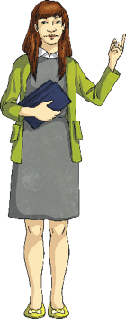
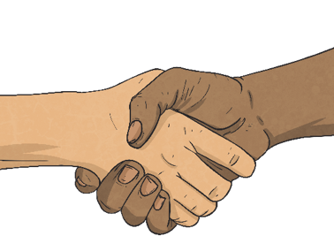
Consideration for Others
It is important to show people we respect them and we can expect people we care about to show us respect too.
How could people show respect to one another?
We should always be treated with care and respect by people we care about, so that those relationships make us feel safe and secure.
If we do not feel this, we can speak to a trusted adult.
Who are our trusted adults?
parents
grandparents
carers
teachers

Slide 13
Consideration for Others
Being kind is when someone has or shows a friendly, generous and considerate nature. It involves thinking of others and doing things that make them happy.
Can you think of some examples of kindness in school?
Can you think of any examples of kindness on a bigger scale, such as in the community?
Kindness does not mean never having what you want or always letting others get their own way.
Some people can take other people’s kindness for granted. This means they see how friendly and generous a kind person is and use this to get what they want. Doing this to a kind person will drive them away as a friend.
How should we treat the kind people in our lives?

Slide 14
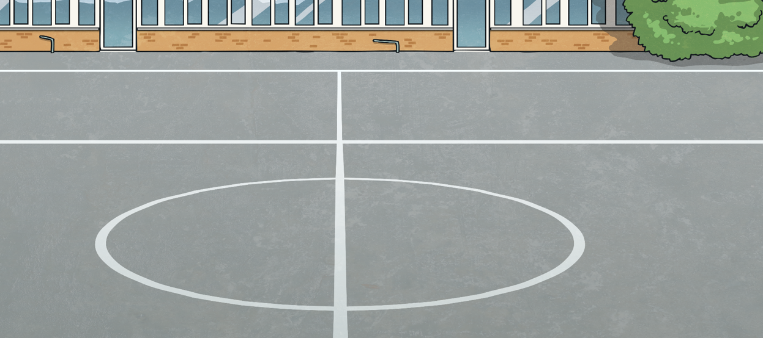
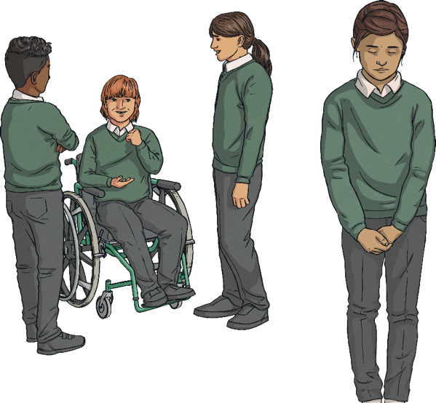
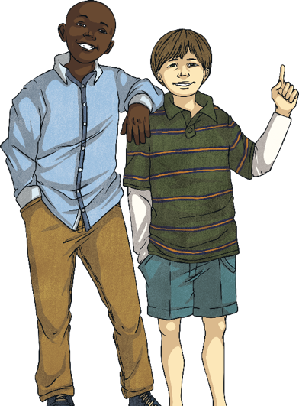
Consideration for Others
Part of being kind is including people we care about.
How does it make you feel when people include you?
How would it feel to not
be included?
Feeling lonely can make people very unhappy. Behaving in a caring way to people that are important to us means that they won't feel
lonely or excluded.

Slide 15
Consideration for Others
Respect is showing regard for the feelings, wishes or rights of others.
It might mean listening to them and taking their views on board.
It means treating them in a way we would like to be treated - with fairness and honesty, accepting them for who they are. Having a happy and healthy relationship means we are treated in this way as well and that we feel safe and happy.
Why should we show our VIPs respect?
How can we show our respect for our VIPs?
What should we do if our VIPs do not make us feel happy or safe?

Slide 16
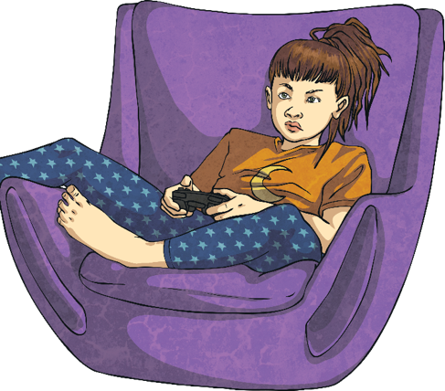
Showing We Care
How does the way we behave affect other people when we are with them in person?
Jude is playing a football game online against his friends. He is speaking to them over his headset but they keep letting goals in and giving the ball away to the other team. Jude is telling his friends that they are rubbish and that it is their fault that they are losing. Jude thinks he is being funny but his friends are really upset. Jude can’t see their reactions, he can only hear them so he doesn’t realise how upset they are.
How could our behaviour online affect other people?
In the example above, Jude might not have carried on saying hurtful things if he realised his friends were upset. Being online means we can’t always see someone else’s reactions so we have to be careful with how we speak and behave. We should make sure we consider how others might feel and be clear with how we communicate.

Slide 17
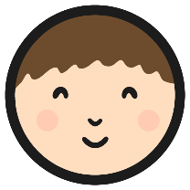
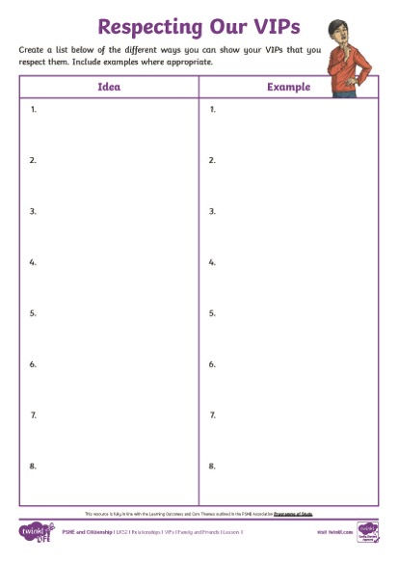
Showing We Care
Thinking of all we have discussed so far, create a list of ways you can show your VIPs respect using the Respecting Our VIPs Activity Sheet.
Consolidating
Reflecting

Slide 18
Consolidating

Slide 19
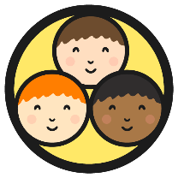
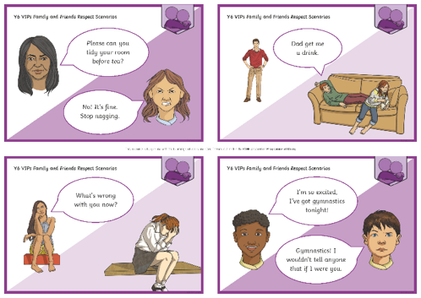
Show Some Respect!
In groups, look at the Respect Scenario Cards, where someone is not showing respect to their family and friends and look at the consequences of these actions.
How does showing our VIPs respect and treating them with kindness affect our VIPs’ lives?
How does it affect our lives when we treat others with kindness and respect?

Slide 20
Reflecting

Slide 21
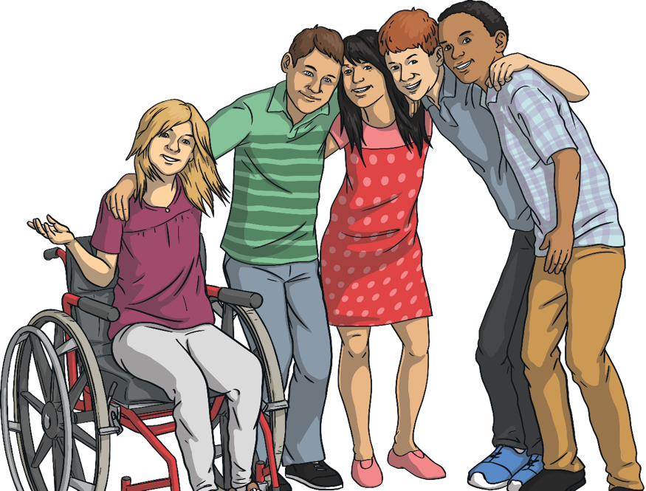
How Does It Feel?
Why do we have friendships in our lives?
How can we make sure our friendships are positive and healthy and support our wellbeing?
Remember, healthy relationships have mutual respect, trust, truthfulness, loyalty, kindness, generosity, shared interests and experiences. Having healthy relationships can also help us with any difficulties we may experience.

Slide 22
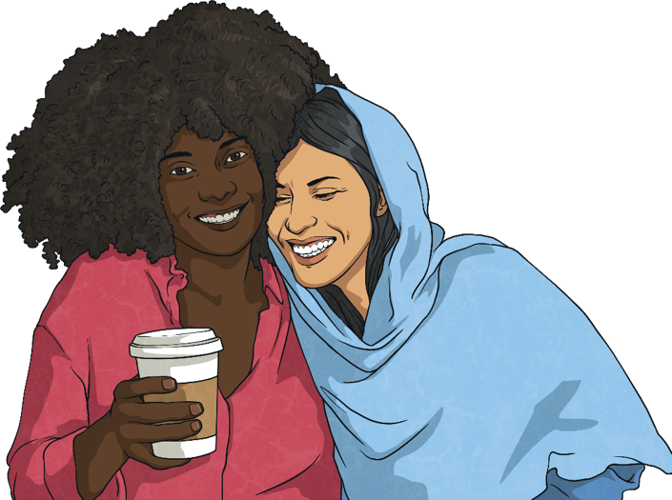
How Does It Feel?
To build positive friendships, we need to start off by having a healthy friendship with someone and this relationship should remain healthy. Part of this includes feeling able to ask for help if your friendship ever feels unhealthy. Lots of friendships can return to being happy, supportive, safe and healthy with a little support from a grown-up.
A positive place to start a good relationship is finding something you have in common with someone else. If you have something that connects you, you are likely to enjoy similar activities.

Slide 23
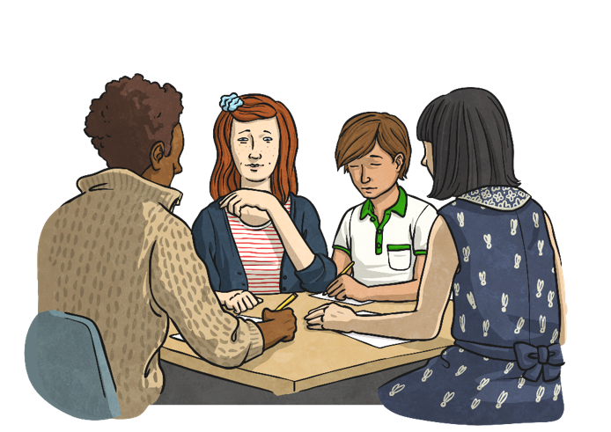
How Does It Feel?
Being kind and showing respect are behaviours that go together.
Both these behaviours enable us to treat our VIPs how they should be treated and ensures they remain our VIPs and we remain theirs.
How does it feel when we are treated with respect and kindness?
Look at the following scenarios and discuss how each character is feeling.

Slide 24


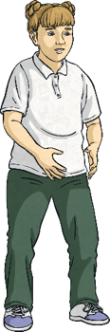

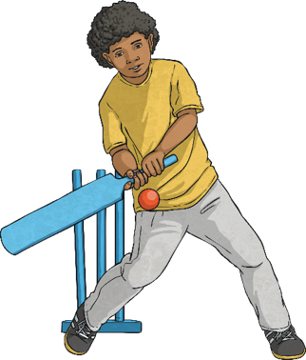
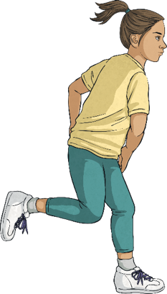
How Does It Feel?
Matt is watching some other children playing cricket. He does not join in as he does not know how to play. His friend, Tafari, comes over and says he will teach Matt how to play if he would like to join in too.

Slide 25
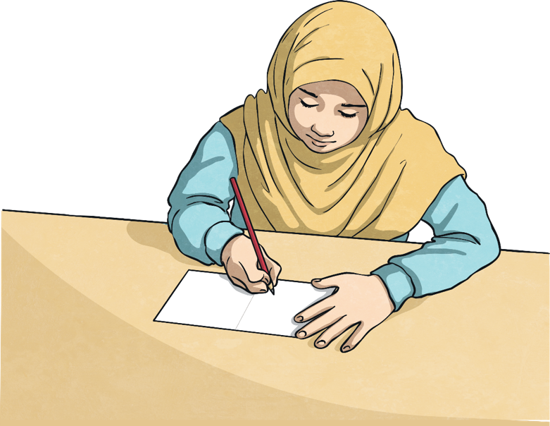
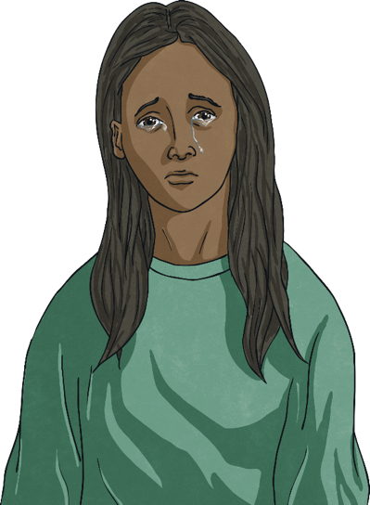
How Does It Feel?
Theresa is sad because she is missing her grandma who recently passed away. Her friend, Trishna, is giving her a card she has made to try and cheer her up.

Slide 26
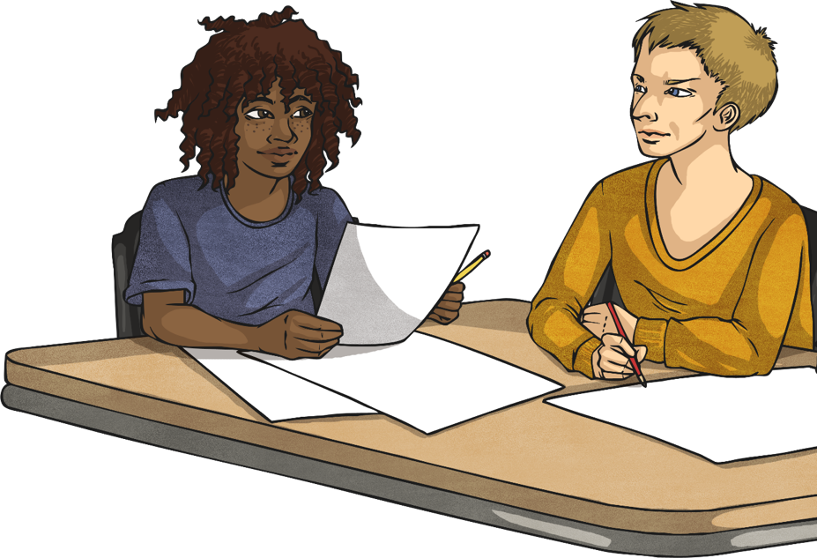


How Does It Feel?
Micah is new to the school and is feeling shy and nervous. Eon gives him a broad smile, asks if he would like to sit with him and lends him a pen and pencil.

Slide 27
The Big Questions

Slide 28
Who are the important people in our lives? Why are they important?
Why is it important to treat them kindly? What can happen if we don't treat our family and friends with respect?
How might you show your VIPs how important they are to you?

Slide 29
Aim
I can explain the importance of respecting my VIPs.
Success Criteria
I can give examples of ways to show my VIPs respect.
I can consider the outcomes of scenarios if I didn’t show my VIPs respect or treat them kindly.

